Slide 1
Halloween Candy Counting!
Ms. Miller’s Class

Slide 2
Let’s count together!
How many pieces of candy corn are there?

Slide 3
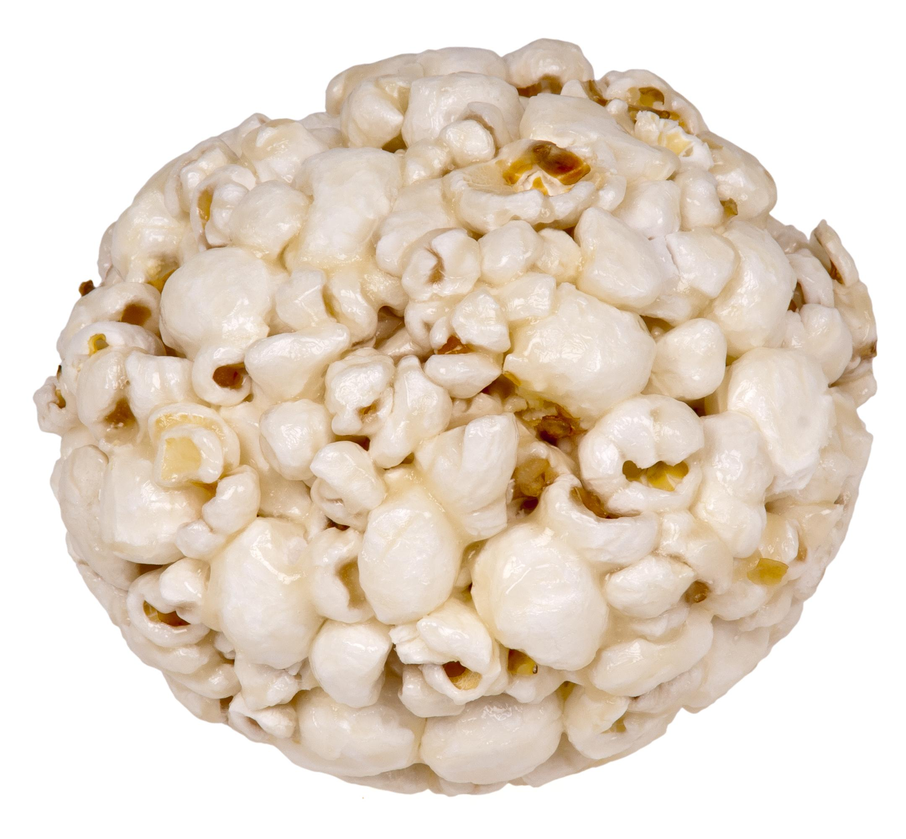
Keep Going!
How many popcorn balls are there?

Slide 4
One More!
How many pieces of Reese’s Peanut Butter cups are there?

Slide 5
Now Let’s Add!

Slide 6
Even More Candy!

