Slide 1
Breast Cancer
Tariane King

Slide 2
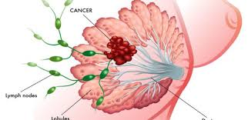
What is breast cancer?
Breast cancer is a disease in which malignant (cancer) cells form in the tissues of the breast.
Second leading cause of cancer death among women
1 in 8 women will be diagnosed with breast cancer in their lifetime.

Slide 3
Stages of Breast Cancer
Stage 0
Abnormal cells in duct lining or sections of the breast. Increased risk of developing cancer in one or both breasts.
Stage I
Cancer in breast tissue. Tumor is less than one inch across in size.
Stage II
Cancer in breast tissue. Tumor is less than two inches across in size. Cancer may spread to the auxiliary lymph nodes.
Stage III
Tumor is larger than two inches across in size and cancer has spread to auxiliary lymph nodes. Possible dimpling, inflammation or skin color change.
Stage IV
Cancer has spread beyond the breast to other nearby areas of the body.

Slide 4
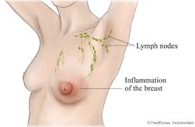
Different types of breast cancer

Slide 5
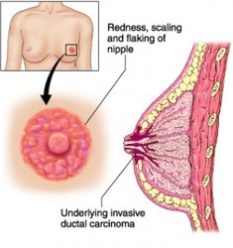
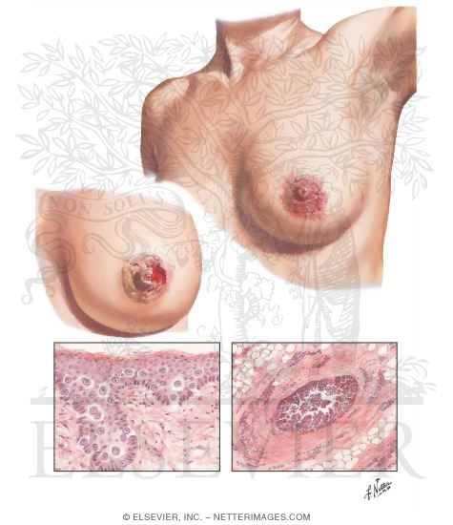
Different types of breast cancer

Slide 6
Who can get breast cancer?
Both men and women can get breast cancer.
Very rare in men, but there is an estimated 2,470 men diagnosed and out of that number about 460 will die each year.
A man’s lifetime risk is about 1 in 1,000.

Slide 7
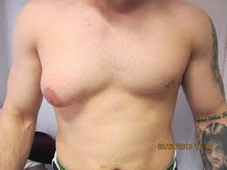
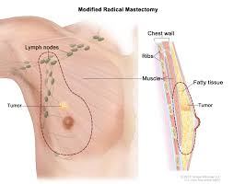
Breast Cancer in Men

Slide 8
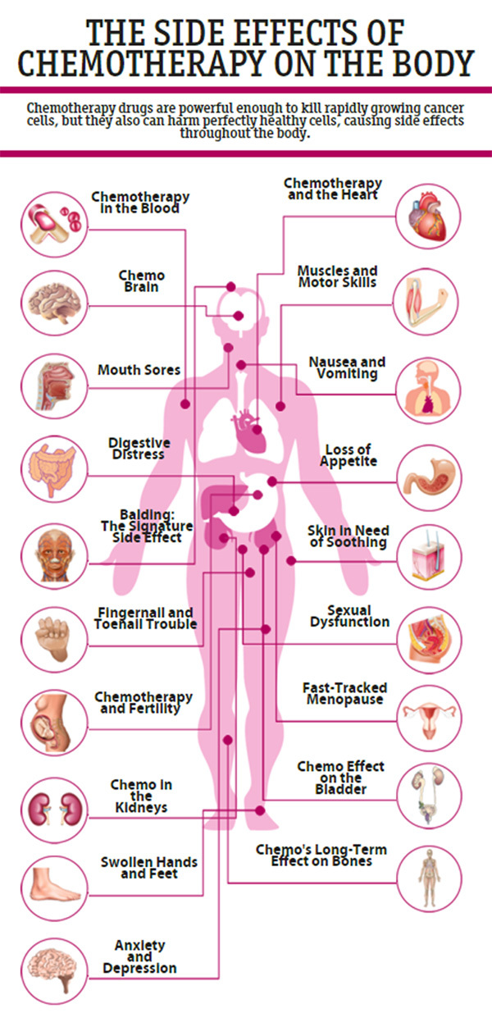
Effects
Breast cancer not only effects the body, but the mind as well.
There are many different side effects that come along with breast cancer.
Sometimes the side effects don’t show until after treatments like weeks, months, or even years later.

Slide 9
Lymphedema
One of the long-term side effect is lymphedema.
Lymphedema is most caused by the removal of or damage to your lymph nodes as a part of cancer treatment.
It results from a blockage in your lymphatic system, which is part of your immune system. The blockage prevents lymph fluid from draining well, and the fluid buildup leads to swelling.

Slide 10
Lymphedema

Slide 11
Lymphedema

Slide 13
Reference Page
https://www.breastcancer.org/symptoms/diagnosis/staging
https://www.breastcancer.org/treatment/lymphedema
https://www.nationalbreastcancer.org/male-breast-cancer

