Slide 1
HOW TO WRITE SENTENCEs
In Miss Annie’s Class

Slide 2
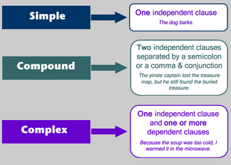
SIMPLE
COMPOUND
COMPLEX
Today we are going to go over three different types of sentences.
These will be on our test this Friday so pay attention!

Slide 3
SIMPLE SENTENCES
A simple sentence consists of one independent clause.
An independent clause contains a subject and verb and expresses a complete thought.
EXAMPLES:
I walked to the store.
I am hungry.
We ate dinner last night.
Sentences can be simple.

Slide 4
Simple Sentences are simple
I am…
  I am going to do my homework.
I thought…
  I thought you were doing your homework?
That is…
  That is absolutely untrue.
    I have never done homework before.
I believe…
She started…
He loved…
Tomorrow we’ll…
Today is…
Our lesson is…
Your homework is…
They Express a COMPLETE thought.
Let’s come up with our own Simple Sentences using this sample sentence starter.

Slide 5
Compound Sentences
A compound sentence is two (or more) independent clauses joined by a conjunction or semi-colon.
Each of these clauses could form a sentence on their own.
EXAMPLES:
I was going to go to the store but Mary thought I should go to the movies.
I like coffee and Mary likes tea.
Mary went to work but Mark went to the store
Our car broke down and caused us to be late.

Slide 6
Coordinating Conjunctions
And
But
Or
Nor
For
Yet
So
This will be on your test!
What ways can you use these to create a compound sentence?
Can you create a compound sentence?

Slide 7
Complex Sentences
A complex sentence consists of an independent clause plus a dependent clause.
A dependent clause starts with a subordinating conjunction or a relative pronoun, and contains a subject and verb, but does not express a complete thought.
EXAMPLES:
We missed our plane because we were late.
Our dog barks when she hears a noise.
He left in a hurry after he got a phone call.
Do you know the man who is talking to Mary?
There was no way to go back to the diner once we were in Texas.

Slide 8
subordinating conjunctions
After
Although
As
Because
Before
How
If
Once
Since
Than
That
Though
Till
Until
When
Where
Whether
While
This will be on your test as well.

Slide 9
Relative Pronouns
That
Which
Who
Whom
Whose
No, they’re not your distant cousins.
They will be on the test!

Slide 10

WRITE A 500 word story that uses simple, compound, and complex sentences.
YOUR PROMPT:
What is friendship?

