Slide 1
The Lifecycle of the Monarch Butterfly

Slide 2
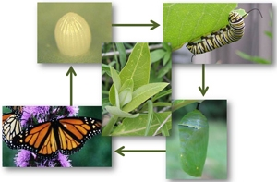
The lifecycle of the monarch butterfly
Monarch butterflies are interesting and beautiful animals in nature that experience a complete metamorphosis as other butterflies and moths. Their metamorphosis stages are:
Egg
Larva
Pupa
Adult

Slide 3
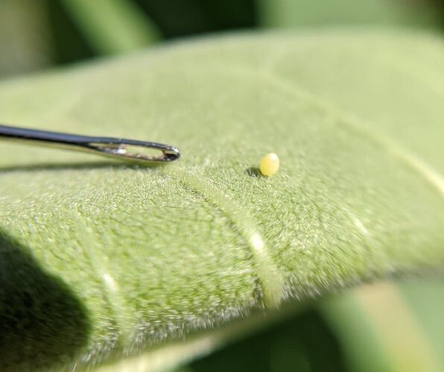
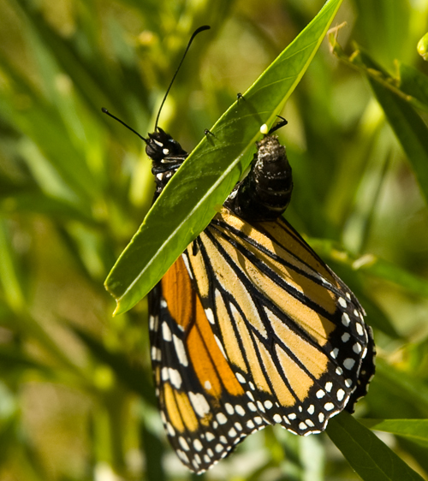
The egg stage
Monarch female butterflies lay their eggs on only on milkweed leaves. Butterflies eat only eat milkweed leaves and lay their eggs on the leaves to help nourish and protect the larva when they hatch. Monarchs can lay around 300-500 eggs in their lifetime.

Slide 4
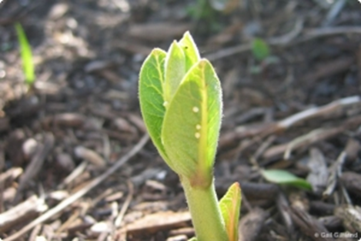
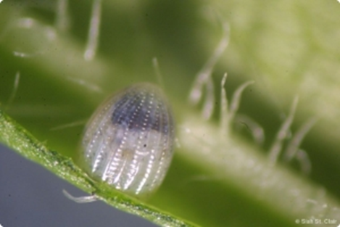
The egg stage
Monarch eggs on attached to the underside of the leaves towards the top of the plants. Butterfly eggs are very small, light white or yellow, and around the size of a pin top. Female monarchs do not stay with their eggs, but the give their eggs the ideal environment to live in when hatched.

Slide 5
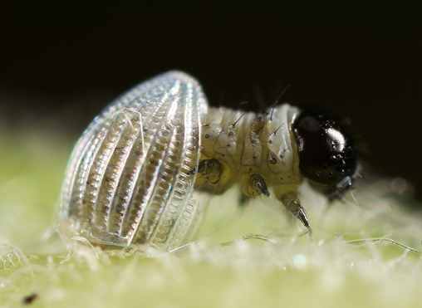
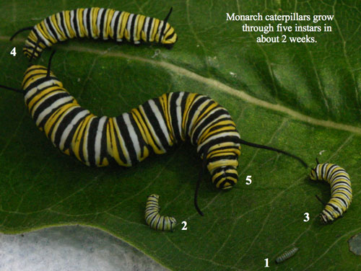
The larva stage
Monarch butterfly eggs hatch and a larva emerges to eat the milkweed leaves for the next two weeks. During this time, the larva has plenty to eat and shelter. The larva is also shedding off their skin up to five times and growing 2,000 times size.

Slide 6
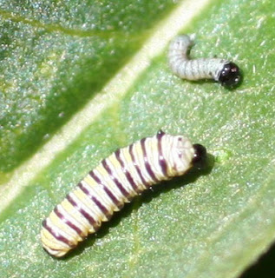
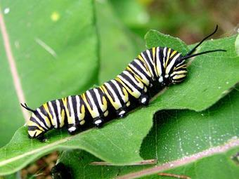
The larva stage
During this phase of metamorphous is the only time a caterpillar is seen. The larva stage can last from nine to 14 days, and in this time the larva are eating machines. Like other insects, larva are in 3 sections: the head, thorax, and abdomen and silk to help them hang on to leaves.

Slide 7
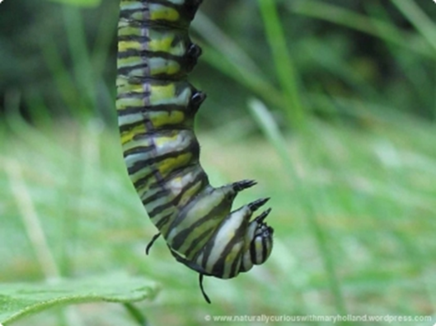
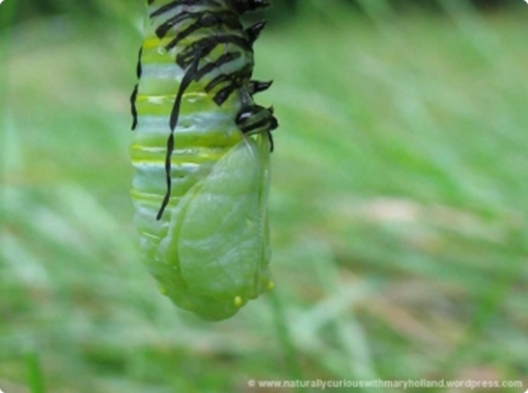
The pupa stage
When the monarch larva have reached their full growth, they begin the final process on their journey, the pupa stage. The larva spins a silk pad, sheds its skin once more and forms a shell called a chrysalis and emerges as an adult monarch butterfly after 8-15 days.

Slide 8
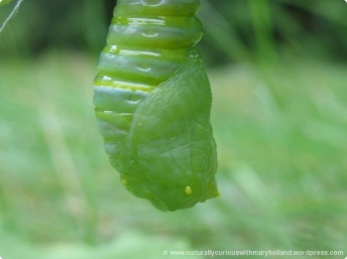
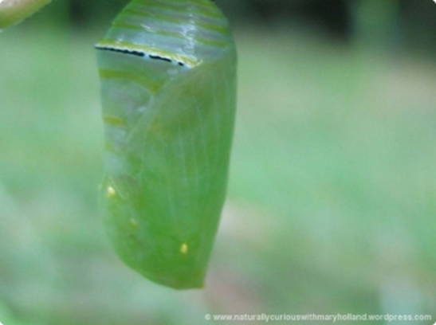
The pupa stage
The larva uses its silk to form a pad to stick itself underneath a plant in a “J” shape. The larva then sheds for the last time, revealing a hard green shell. Inside the chrysalis cells grow wings, and when transformation is nearly complete, the wing colors will be visible through the chrysalis.
Butterflies, unlike most moths, do not spin silk coverings (cocoons) to transform. This is why a butterfly do not have cocoons, instead they form a chrysalis of old skin.

Slide 9
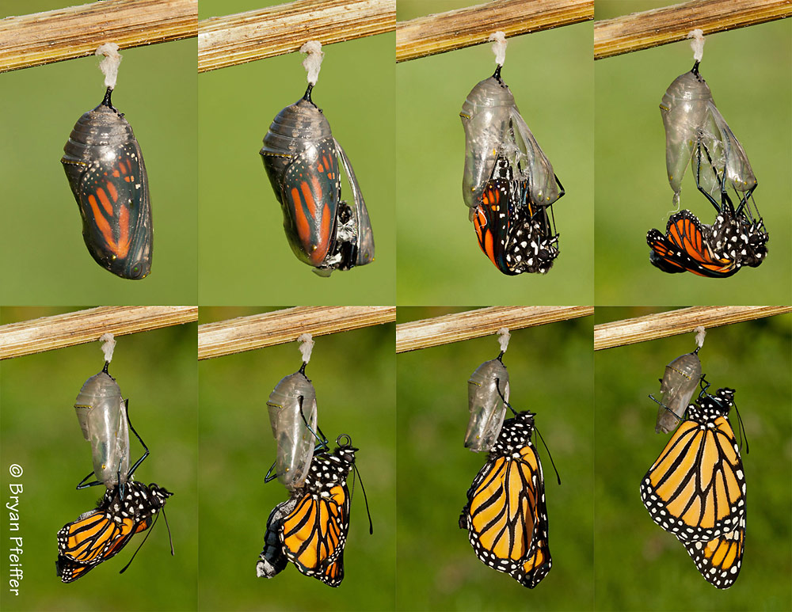
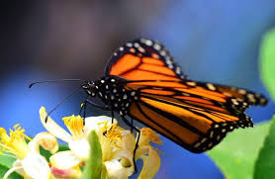
The adult stage
When the adult butterfly emerges from their chrysalis, they spend the rest of their time finding mates, laying eggs, and eating nectar. Butterflies first spend 3-5 days feeding on nectar and will spend the rest of their lives creating many generations of butterflies for 2-5 weeks.

Slide 10
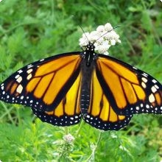
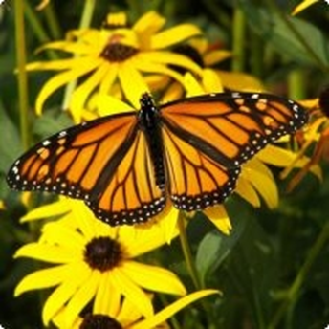
The adult stage
Adult monarchs resemble each other but they are not identical. Male monarchs are identified by lighter coloring, and black spots on their back-wing’s vein that help create chemicals for finding a mate. Both have straw-like tongue to eat and drink they can roll up when not in use.
Male monarch
Female monarch

Slide 11
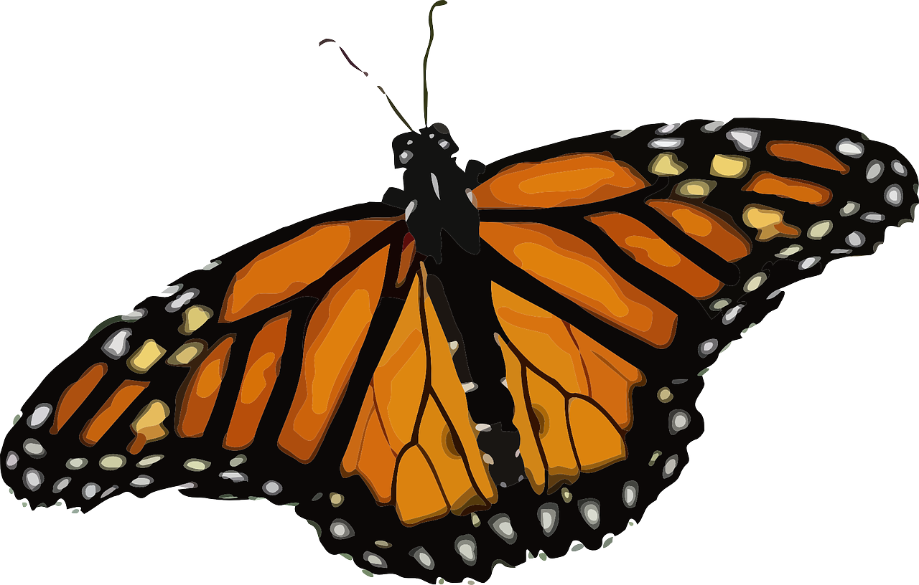
The end

