Slide 1
Pete the cat and the missing cupcakes
By Kimberly & James Dean

Slide 2
What is a character?
Someone who was in the story
Could be a person
Could be an animal
Who the story is about

Slide 3
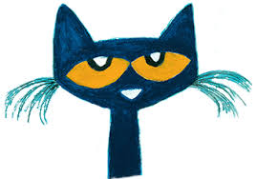
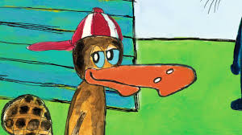
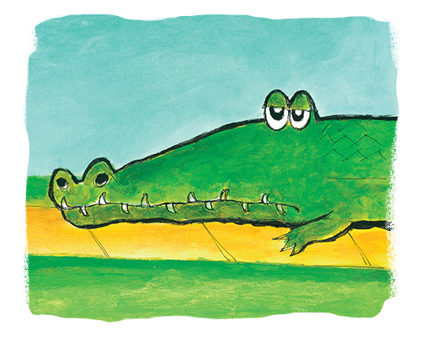
Characters in the story
Pete Gus Alligator

Slide 4
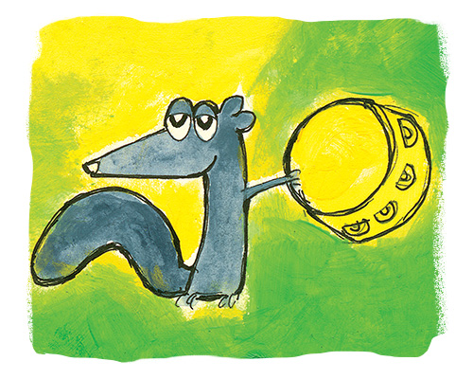
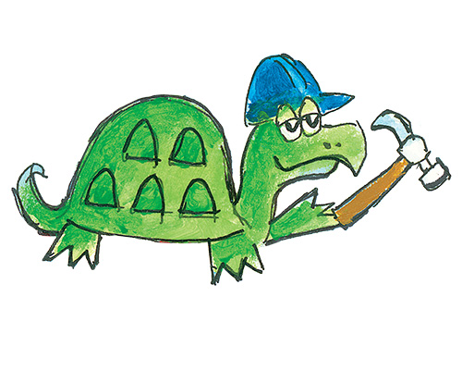
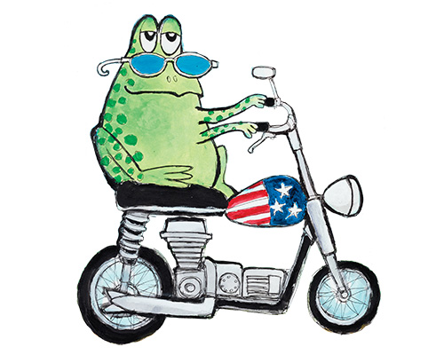
Characters in the story
Squirrel Turtle Toad

Slide 5
What is a setting?
Where the story took place
Where were the characters at during the story?

Slide 6
setting
Kitchen
Outside
Cupcake Party

