Slide 1
Parts of A Plant
Mrs. Worthington’s First Grade Class
The Smartest Kids Ever!

Slide 2
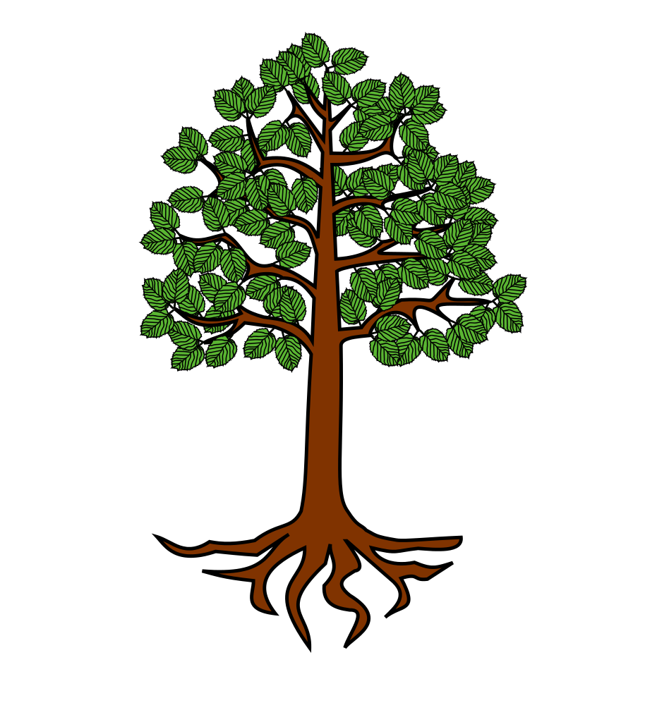
Beginning Of A Plant
Students will answer: Root!
What does it do?
Gives the Flower Food and water
What Is This?

Slide 3
The Bottom Of A Plant
Students Will Answer: Stem!
What does it do?
Carries water from the root to the rest of the plant
What is this?
What is this?

Slide 4
The Middle of a Plant
Students Will Answer: Leaves!
What do they do?
Help soak in air and water to make food
What is this?

Slide 5
Top of A Plant
Students Will Answer: Flower
What does it do?
Attracts animals and insects to help with pollination
Makes seeds
What is this?

