Slide 1
GeoBro Explores:
Geographic Representations

Slide 2
Maps
The most common form of geographic representation is maps. Maps come in many forms. The one you are probably most familiar with is a political map, which represents areas according to their political borders, like the world political map on the other page. Let’s explore the other types of maps!

Slide 3
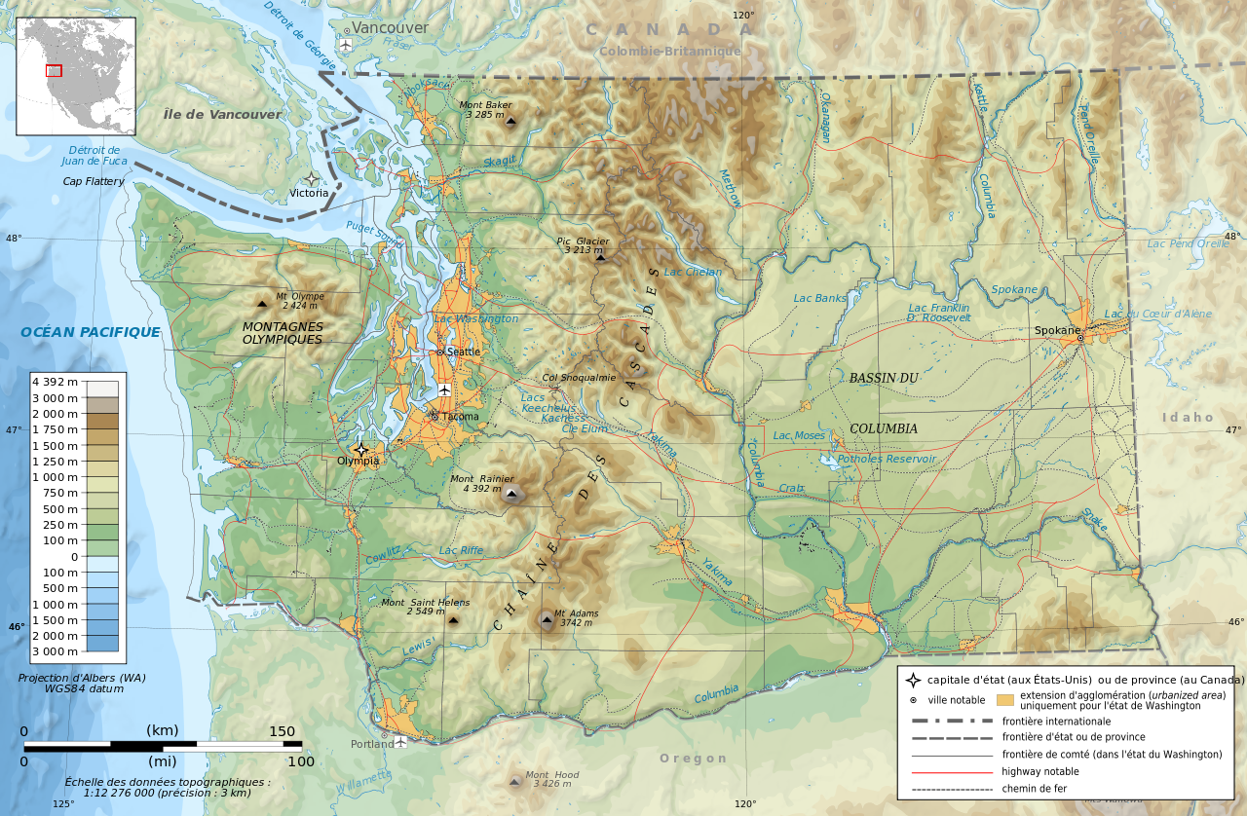
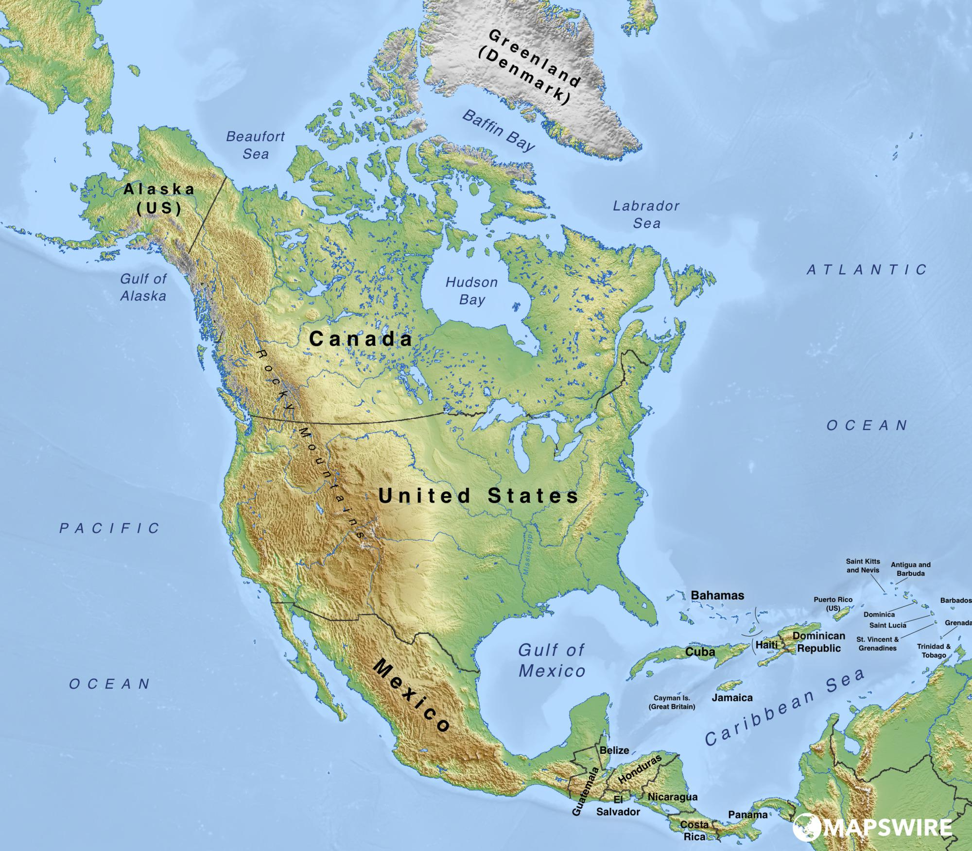
Physical Maps
A physical map shows the different types of physical features of an area, such as mountains or rivers. Water is usually blue, low elevation areas are green, and mountains are brown.
Topographic Maps
Topographic maps are like physical maps in that they show physical features of a land. However, topographic maps show changes in elevation with contour lines.

Slide 4
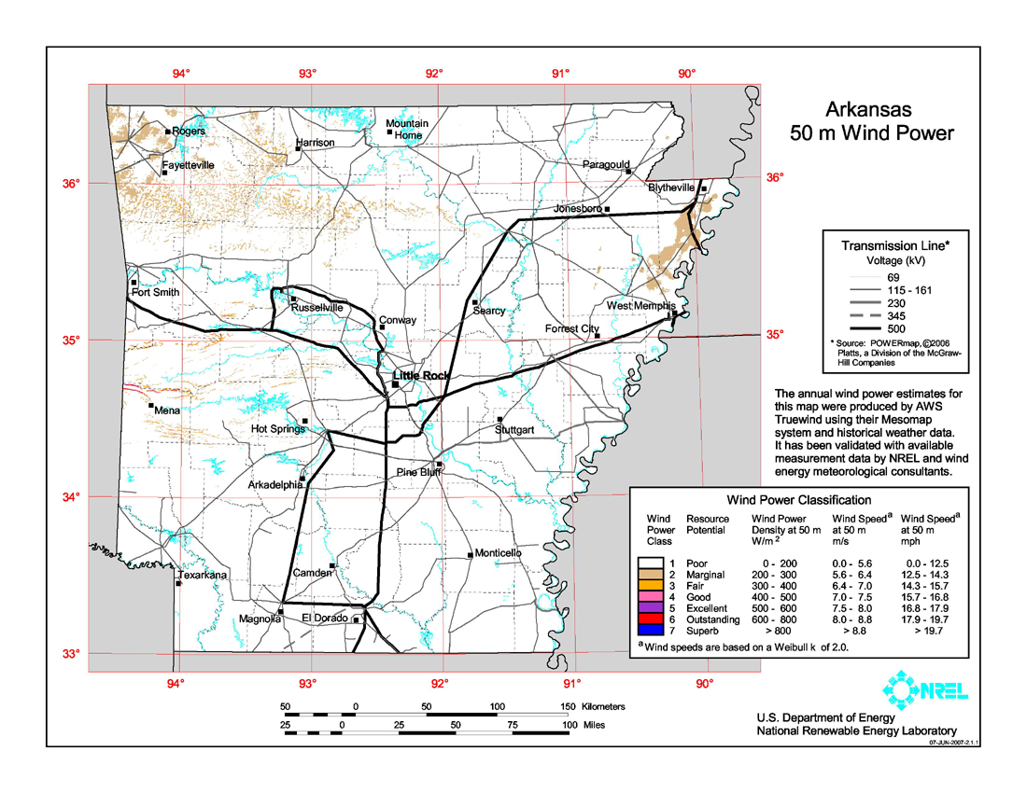
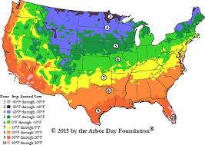
Climatic Maps
Climatic maps show information about the different types of climate in an area.
Economic/Resource Maps
These maps show the economic activity or resources available in an area. This map is specific to wind power in the State of Arkansas.

Slide 5
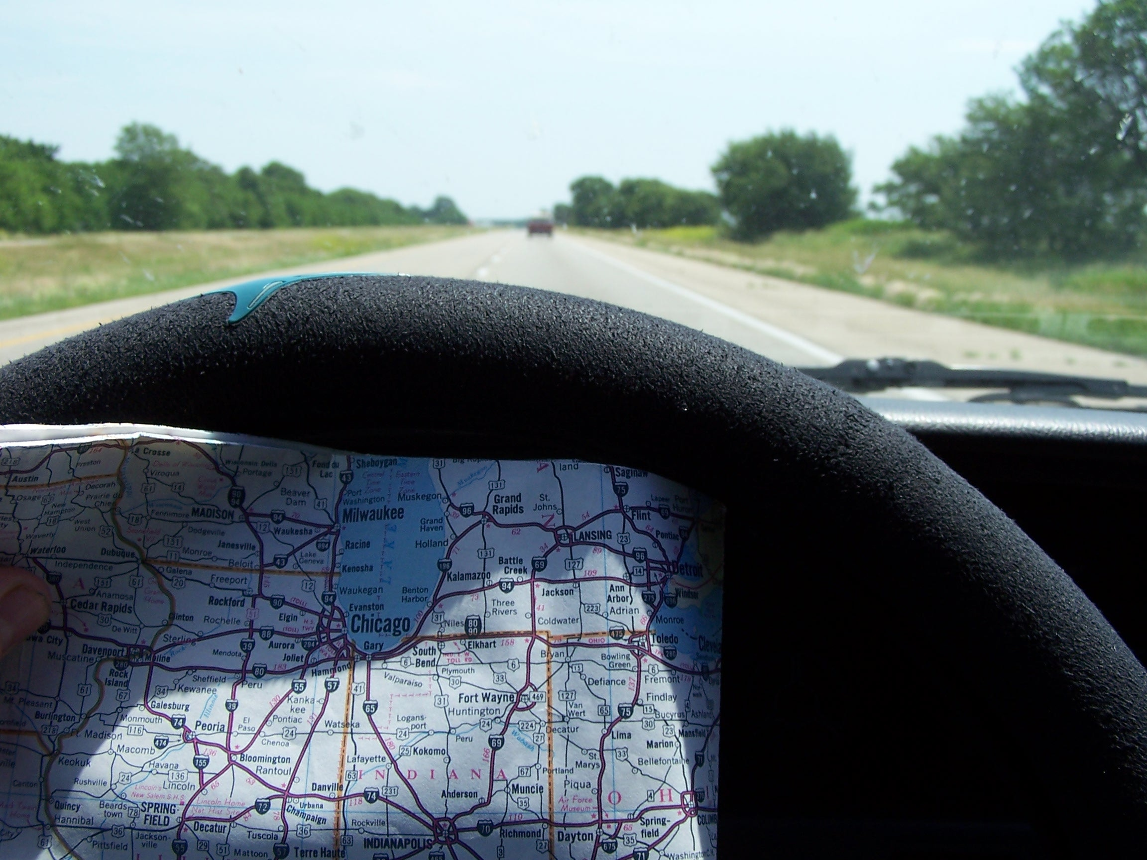
Road Maps
Road maps are the most highly used maps. They show different roads, highways, or railroads in the area. Road maps are highly detailed and are usually used for directions. Below is a way people used road maps before smartphones. To the right is a basic road map of Dallas, TX.

Slide 6
Features of Maps
All maps usually share the following features:
A scale to show you how much space on the map is in real life, for example: one inch equals one mile.
A legend that shows you what symbols on the map mean.
A grid to help accurately locate an area
A map scale

Slide 7
Problems with maps
It is important to know what kind of map to use in a situation, since maps can have issues with them. For example, the more area covered in a map, the less detailed it is. The main issue with maps is that the Earth is a globe, a 3-D object, and maps are 2-D objects. When we stretch the Earth into a flat surface, it distorts the edges making them appear larger than they really are. Maps can also be used for propaganda, such as the map on the right warning people about the threat of the Nazis.

Slide 8
GIS
A Geographic Information System is a computer system for capturing, storing, checking, and displaying data relating to positions on Earth’s surface.

Slide 9
Aerial Photography
One of the easiest ways to make a representation of a geographic area is to simply take a picture of it, thanks to modern technology like the camera and airplanes. With camera equipped drones, it is now easier than ever to take photos from the air.

Slide 10
Graphs
Another way to represent a geographic area is to graph certain data. One good example is a population density graph, like the one on the next page.

