Slide 1
Let’s Learn Sign Language
By Peyton Deason

Slide 2

A

Slide 3

B

Slide 4
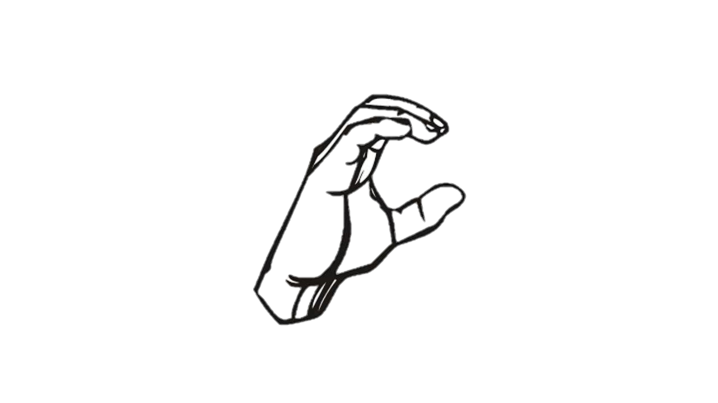
C

Slide 5

D

Slide 6

E

Slide 7
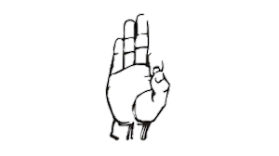
F

Slide 8

G

Slide 9

H

Slide 10

I

Slide 11

J

Slide 12

K

Slide 13

L

Slide 14

M

Slide 15

N

Slide 16

O

Slide 17
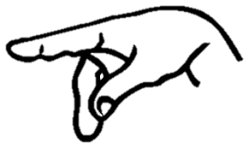
P

Slide 18

Q

Slide 19

R

Slide 20

S

Slide 21

T

Slide 22

U

Slide 23

V

Slide 24
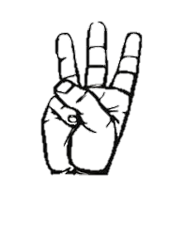
W

Slide 25

X

Slide 26

Y

Slide 27

Z
Z

Slide 28
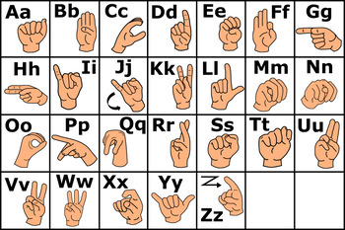
Can You Spell Your Name?
Use what you have learned, along with the picture beside you to spell your name!

