Slide 1
Dinosaurs

Slide 2
Ankylosaurus
This Photo by Unknown Author is licensed under CC BY-SA

Slide 3
Brachiosaurs
This Photo by Unknown Author is licensed under CC BY-SA

Slide 4
Chasmosaurus
This Photo by Unknown Author is licensed under CC BY-SA

Slide 5
Diplodocus
This Photo by Unknown Author is licensed under CC BY-SA

Slide 6
Gallimius
This Photo by Unknown Author is licensed under CC BY-SA-NC

Slide 7
Parasaurolophus
This Photo by Unknown Author is licensed under CC BY-SA-NC

Slide 8
Petrodactyl
This Photo by Unknown Author is licensed under CC BY-SA

Slide 9
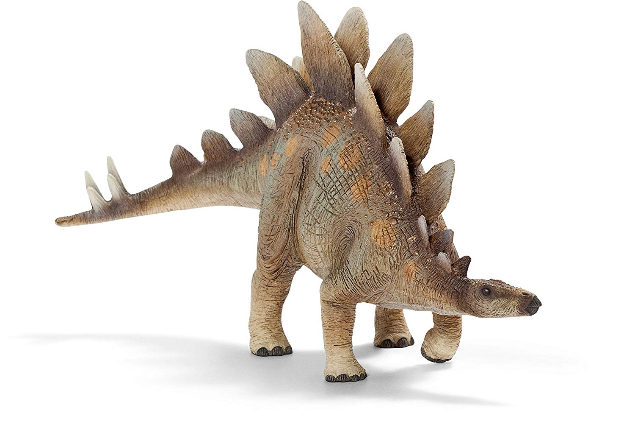
Stegosaurus

Slide 10
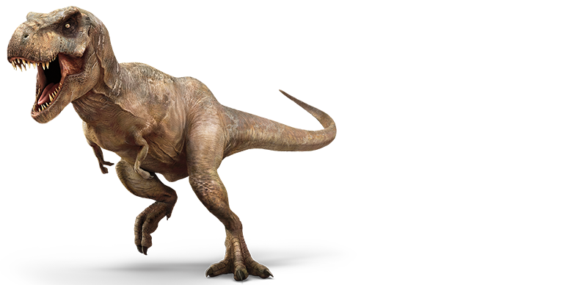
Tyrannosaurus Rex
This Photo by Unknown Author is licensed under CC BY-SA

Slide 11
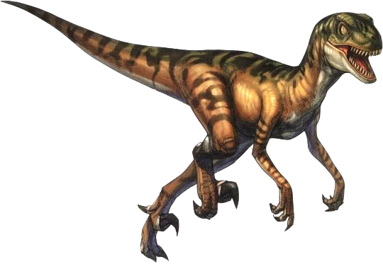
Velociraptor
This Photo by Unknown Author is licensed under CC BY-NC

Slide 12
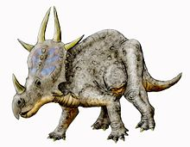
Xenoceratops
This Photo by Unknown Author is licensed under CC BY-SA

