Slide 1
Where in the World is….
Arkansas

Slide 2
Can you locate Arkansas on the Map?

Slide 3
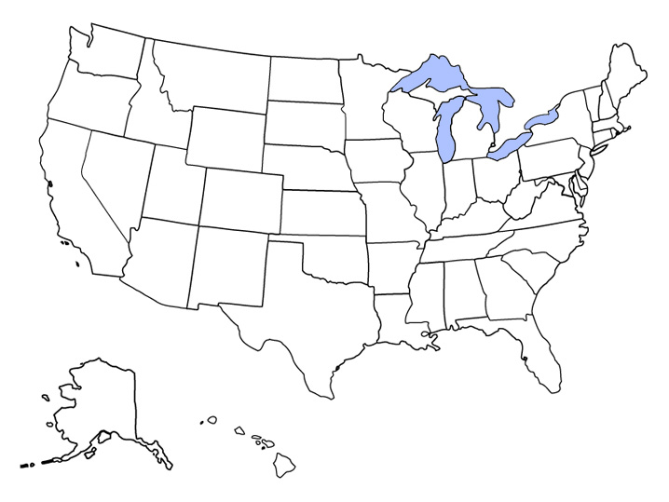
Map of the United States

Slide 4
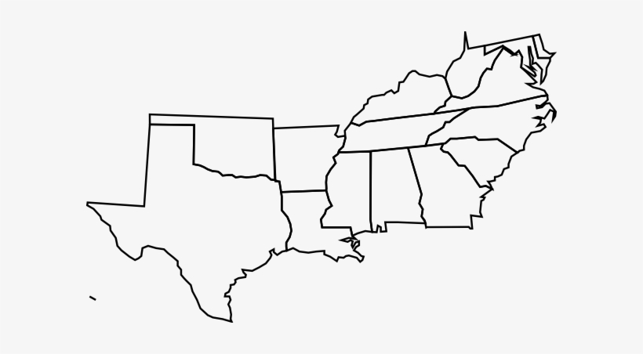
Have you located Arkansas Yet?

Slide 5
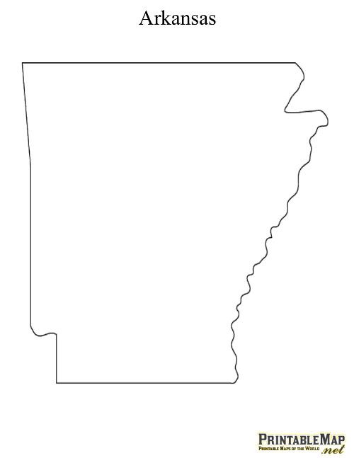
State of Arkansas!!

Slide 6
What States Surround Arkansas?

Slide 7
Kansas Missouri Tennessee Mississippi Louisiana Texas Oklahoma

Slide 8
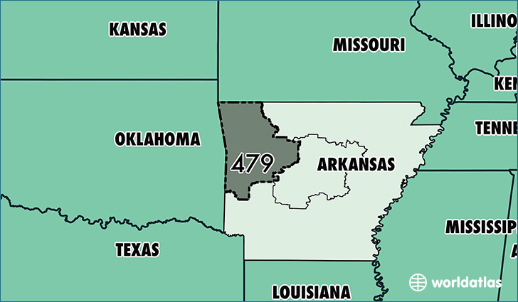
Surrounding States

Slide 9
What is the Capital of Arkansas?

Slide 10
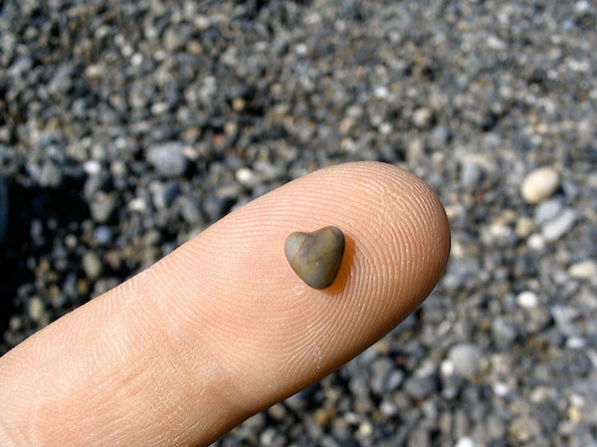
Little Rock

Slide 11
Where is the Capital of Little Rock?

Slide 12
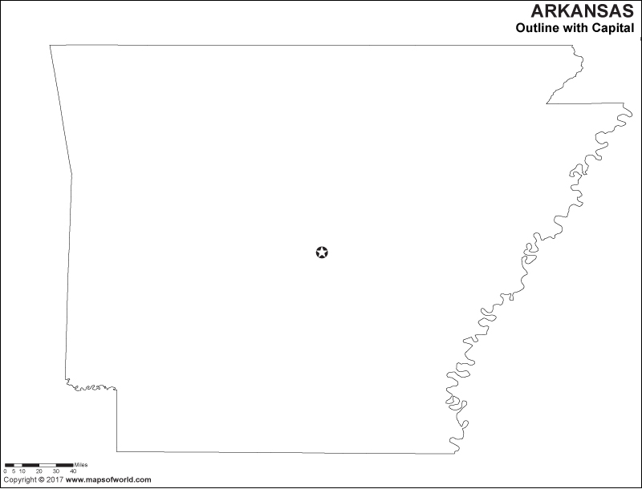
Little Rock

Slide 13
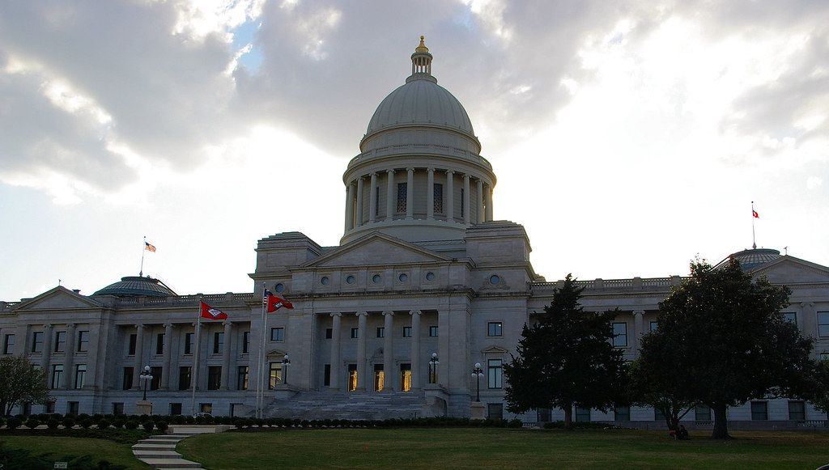
Capital of Little Rock Building
This Photo by Unknown Author is licensed under CC BY

Slide 14
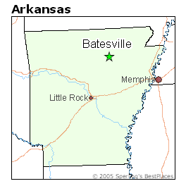
Where do you live in Arkansas?

