Slide 1
Vertebrates and Invertebrates

Slide 2
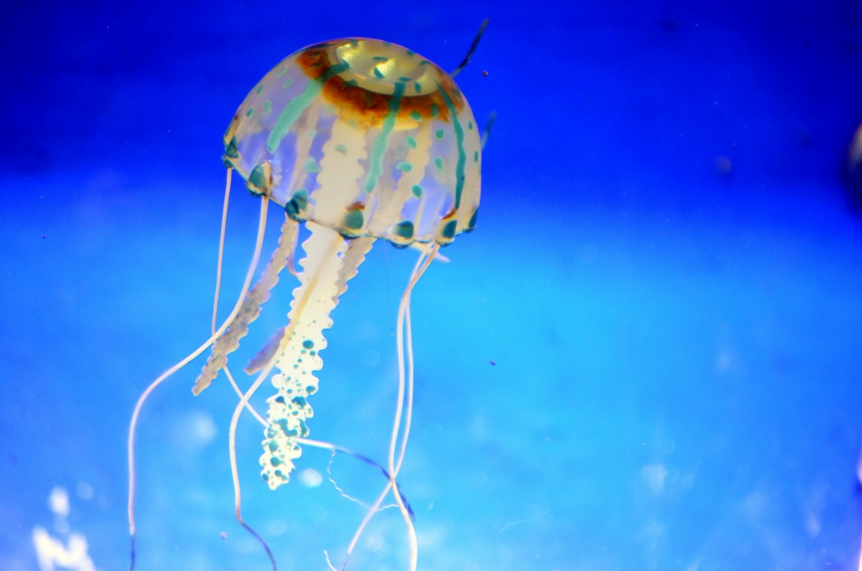
Jellyfish
Vertebrate
Invertebrate
Answer

Slide 3
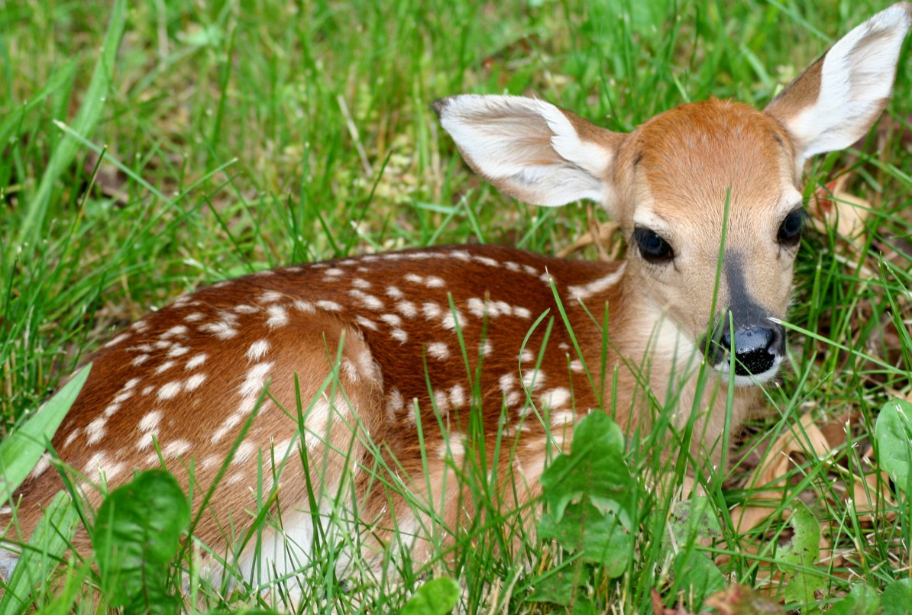
Deer
Vertebrate
Invertebrate
Answer

Slide 4
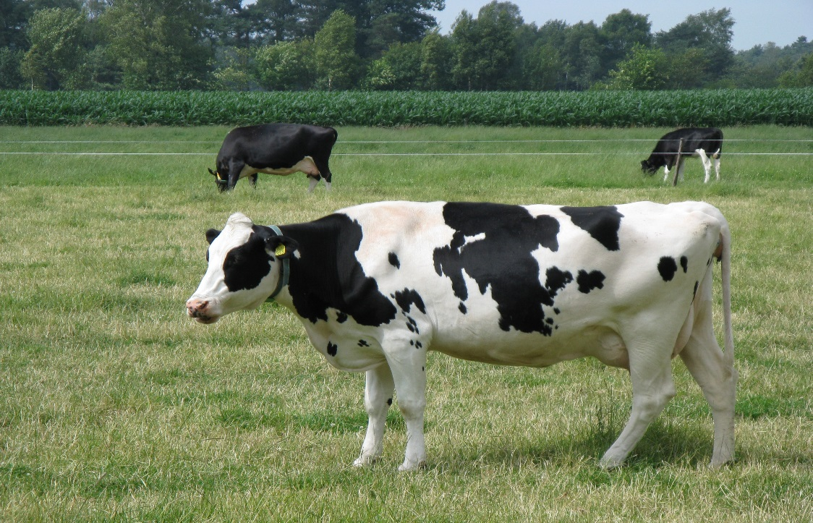
Cow
Vertebrate
Invertebrate
Answer

Slide 5
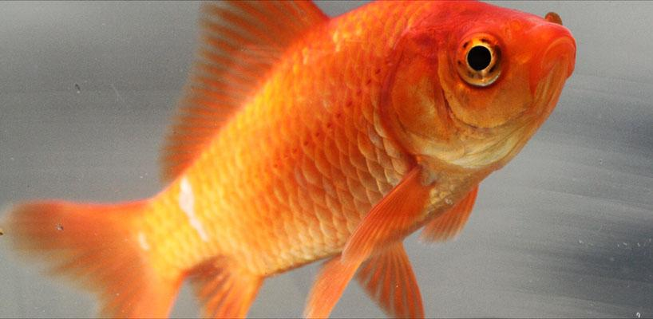
Goldfish
Vertebrate
Invertebrate
Answer

Slide 6
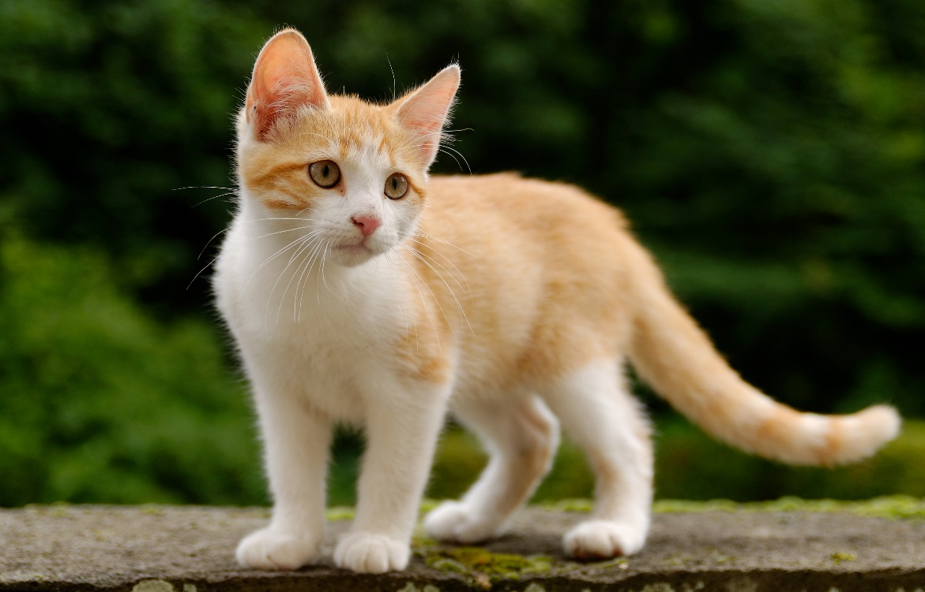
Cat
Vertebrate
Invertebrate
Answer

Slide 7
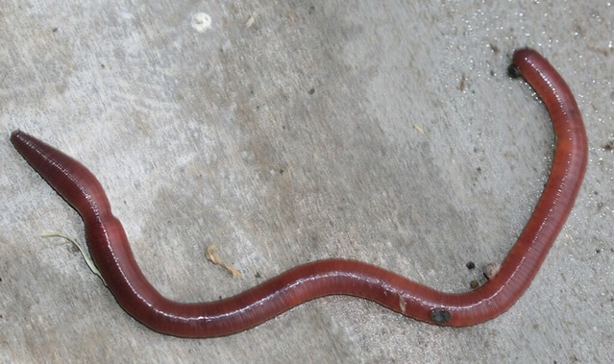
Worm
Vertebrate
Invertebrate
Answer

Slide 8
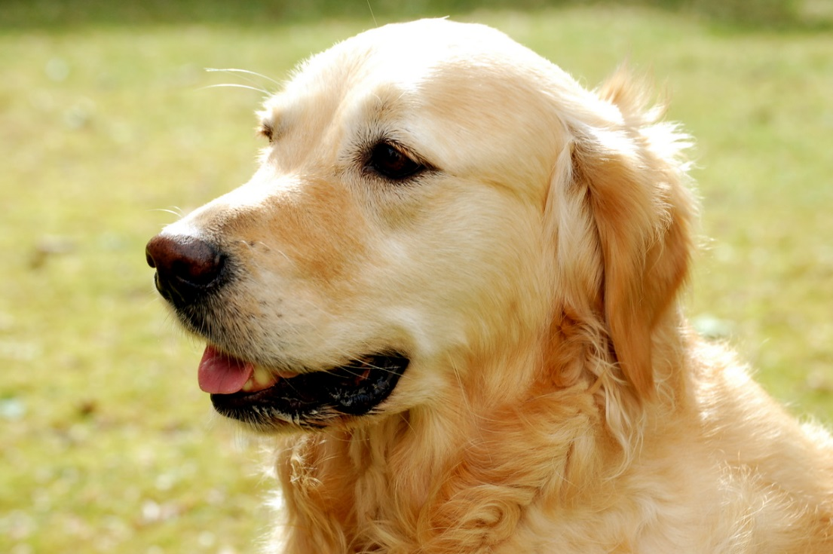
Dog
Vertebrate
Invertebrate
Answer

Slide 9
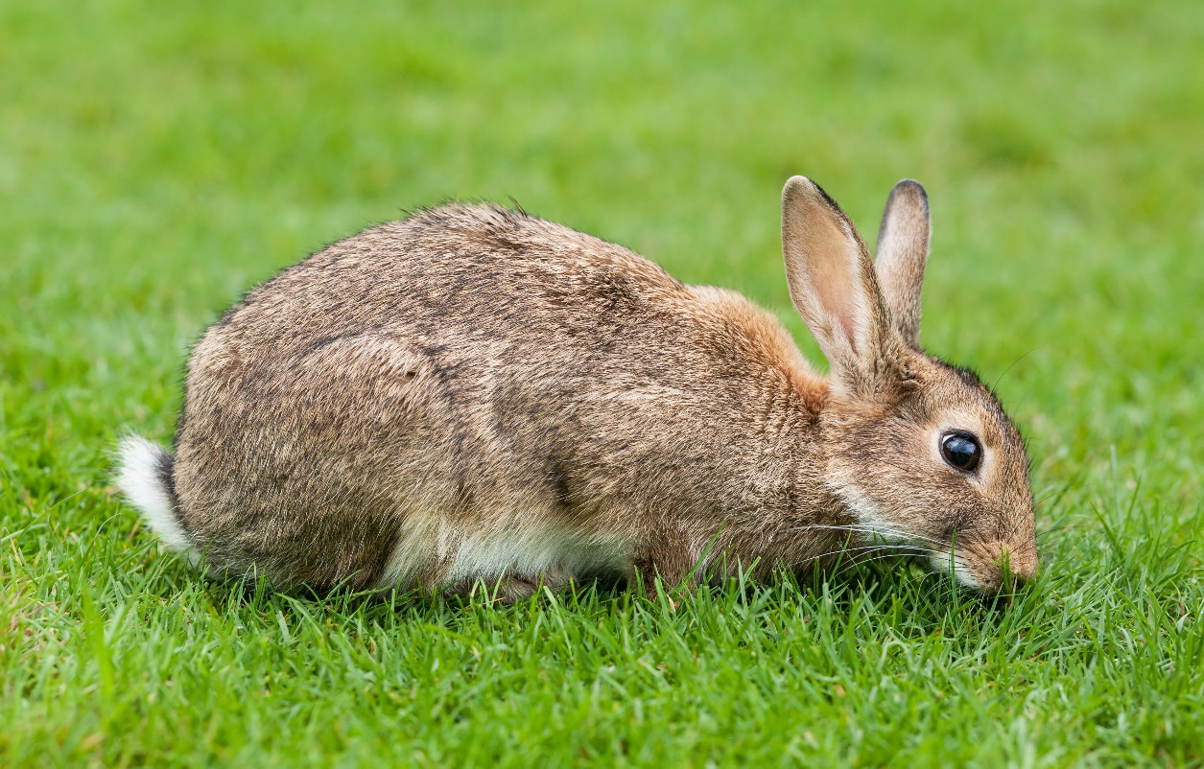
Rabbit
Vertebrate
Invertebrate
Answer

Slide 10
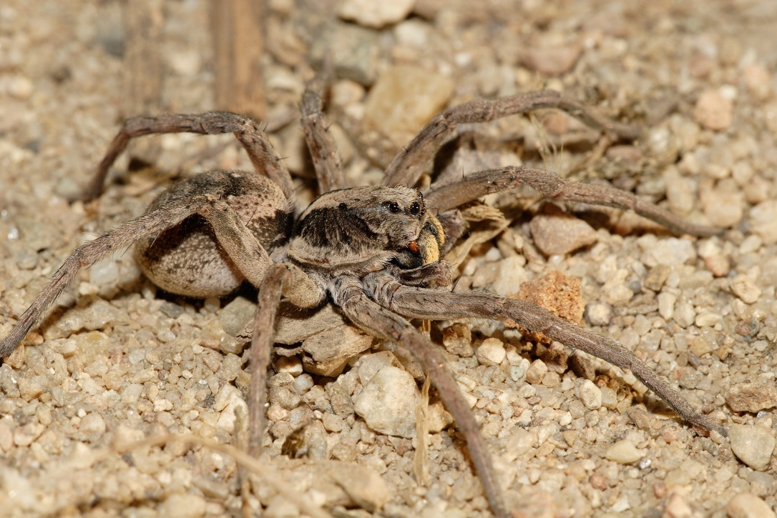
Spider
Vertebrate
Invertebrate
Answer

Slide 11
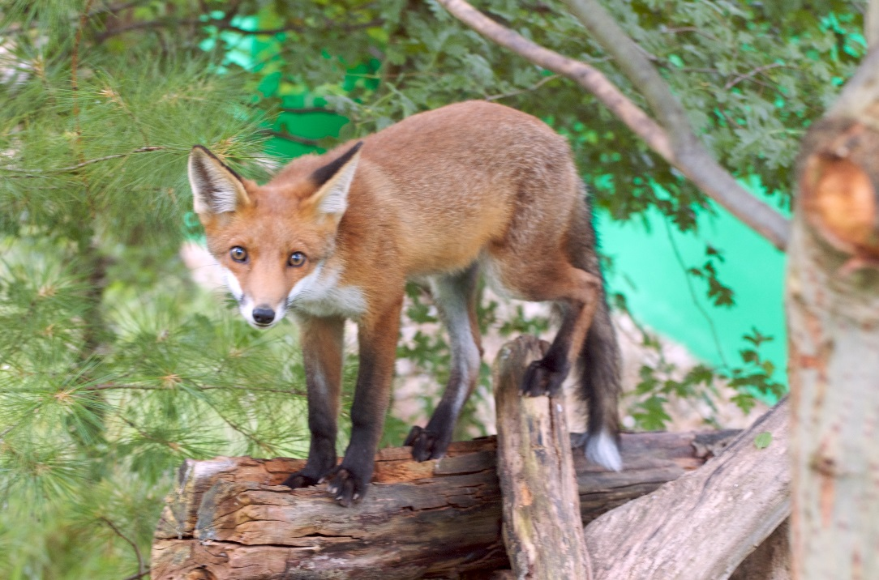
Fox
Vertebrate
Invertebrate
Answer

Slide 12
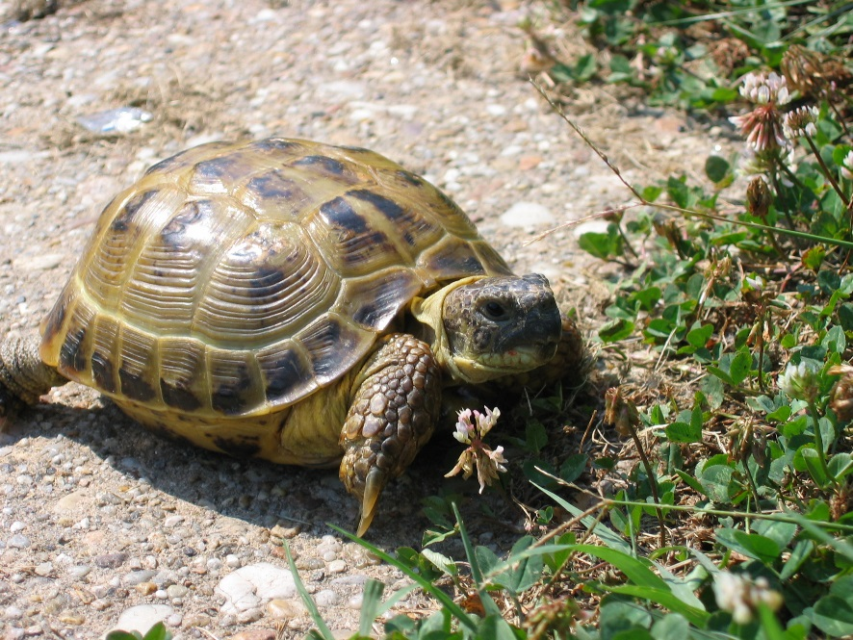
Turtle
Vertebrate
Invertebrate
Answer

Slide 13
Correct

Slide 14
Correct

Slide 15
Correct

Slide 16
Correct

Slide 17
Correct

Slide 18
Correct

Slide 19
Correct

Slide 20
Correct

Slide 21
Correct

Slide 22
Correct

Slide 23
correct

Slide 24
correct

Slide 25
correct

Slide 26
correct

Slide 27
Incorrect

