Slide 1
Money

Slide 2
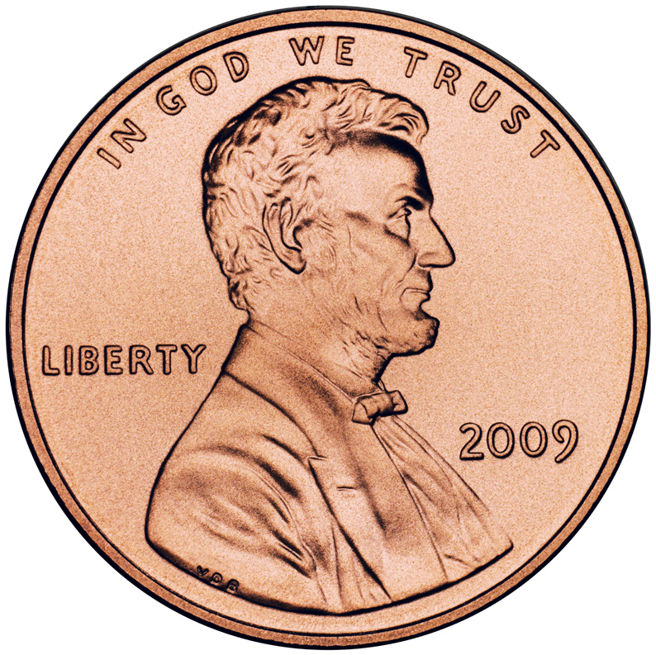
Penny .01

Slide 3
NICKEL .05

Slide 4
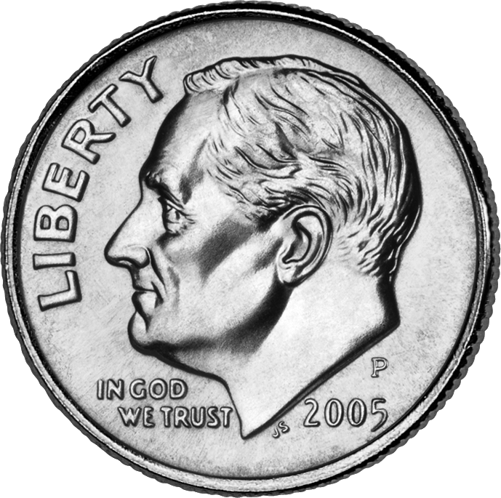
Dime .10

Slide 5
QUARTER .25

Slide 6
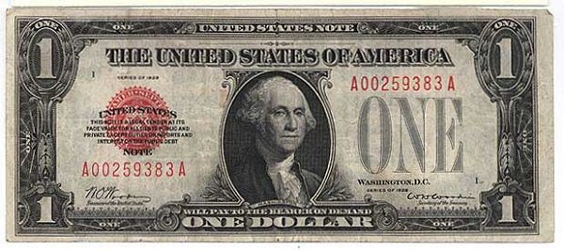
One dollar bill $ 1.00

Slide 7
FIVE DOLLAR BILL $5.00

Slide 8
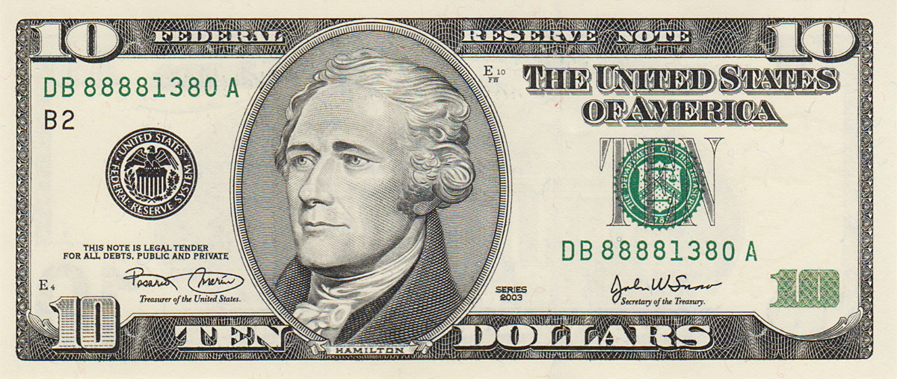
Ten dollar bill $10.00

Slide 9
TWENTY DOLLAR BILL $20.00

Slide 10
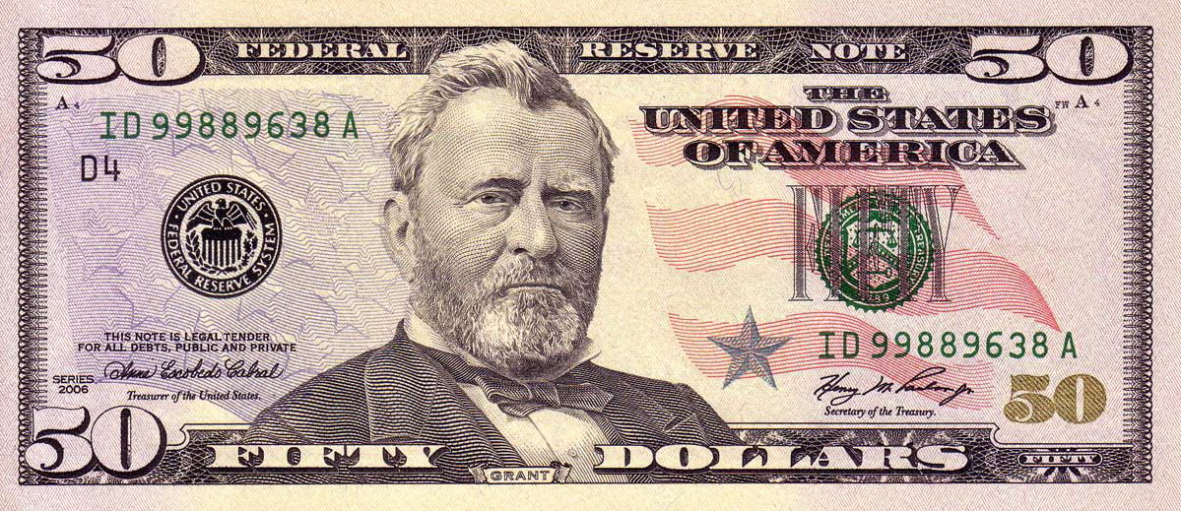
Fifty dollar Bill $50.00

Slide 11
ONE HUNDRED DOLLAR BILL $100.00

