Slide 1
United States of America
States, National Monuments & Patriotic Songs

Slide 2
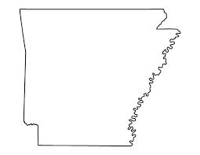
Name the State!
Tennessee
Arkansas

Slide 3
The state is Arkansas!

Slide 4
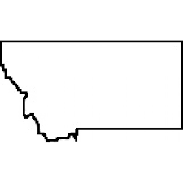
Name the state!
Wyoming
Montana

Slide 5
The state is Montana

Slide 6
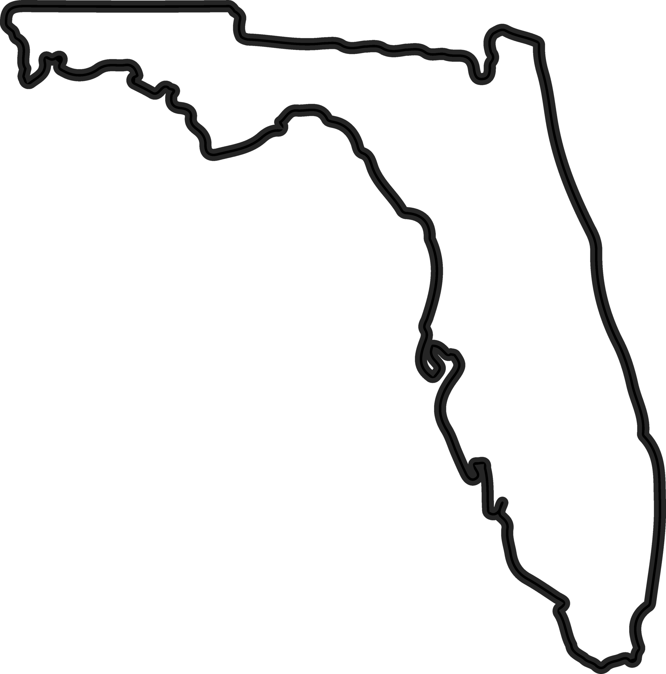
Name the state?
Florida
New Hampshire

Slide 7
The state is Florida.

Slide 8
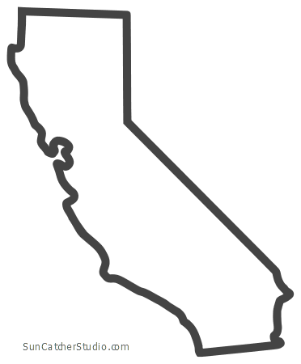
Name the State!
California
New York

Slide 9
The state is California

Slide 10
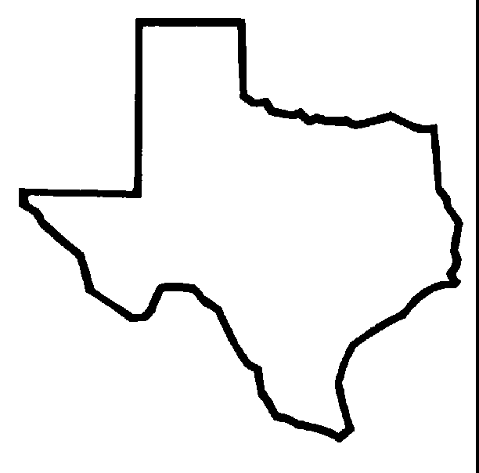
Name the state!
Alaska
Texas

Slide 11
The state is Texas.

Slide 12
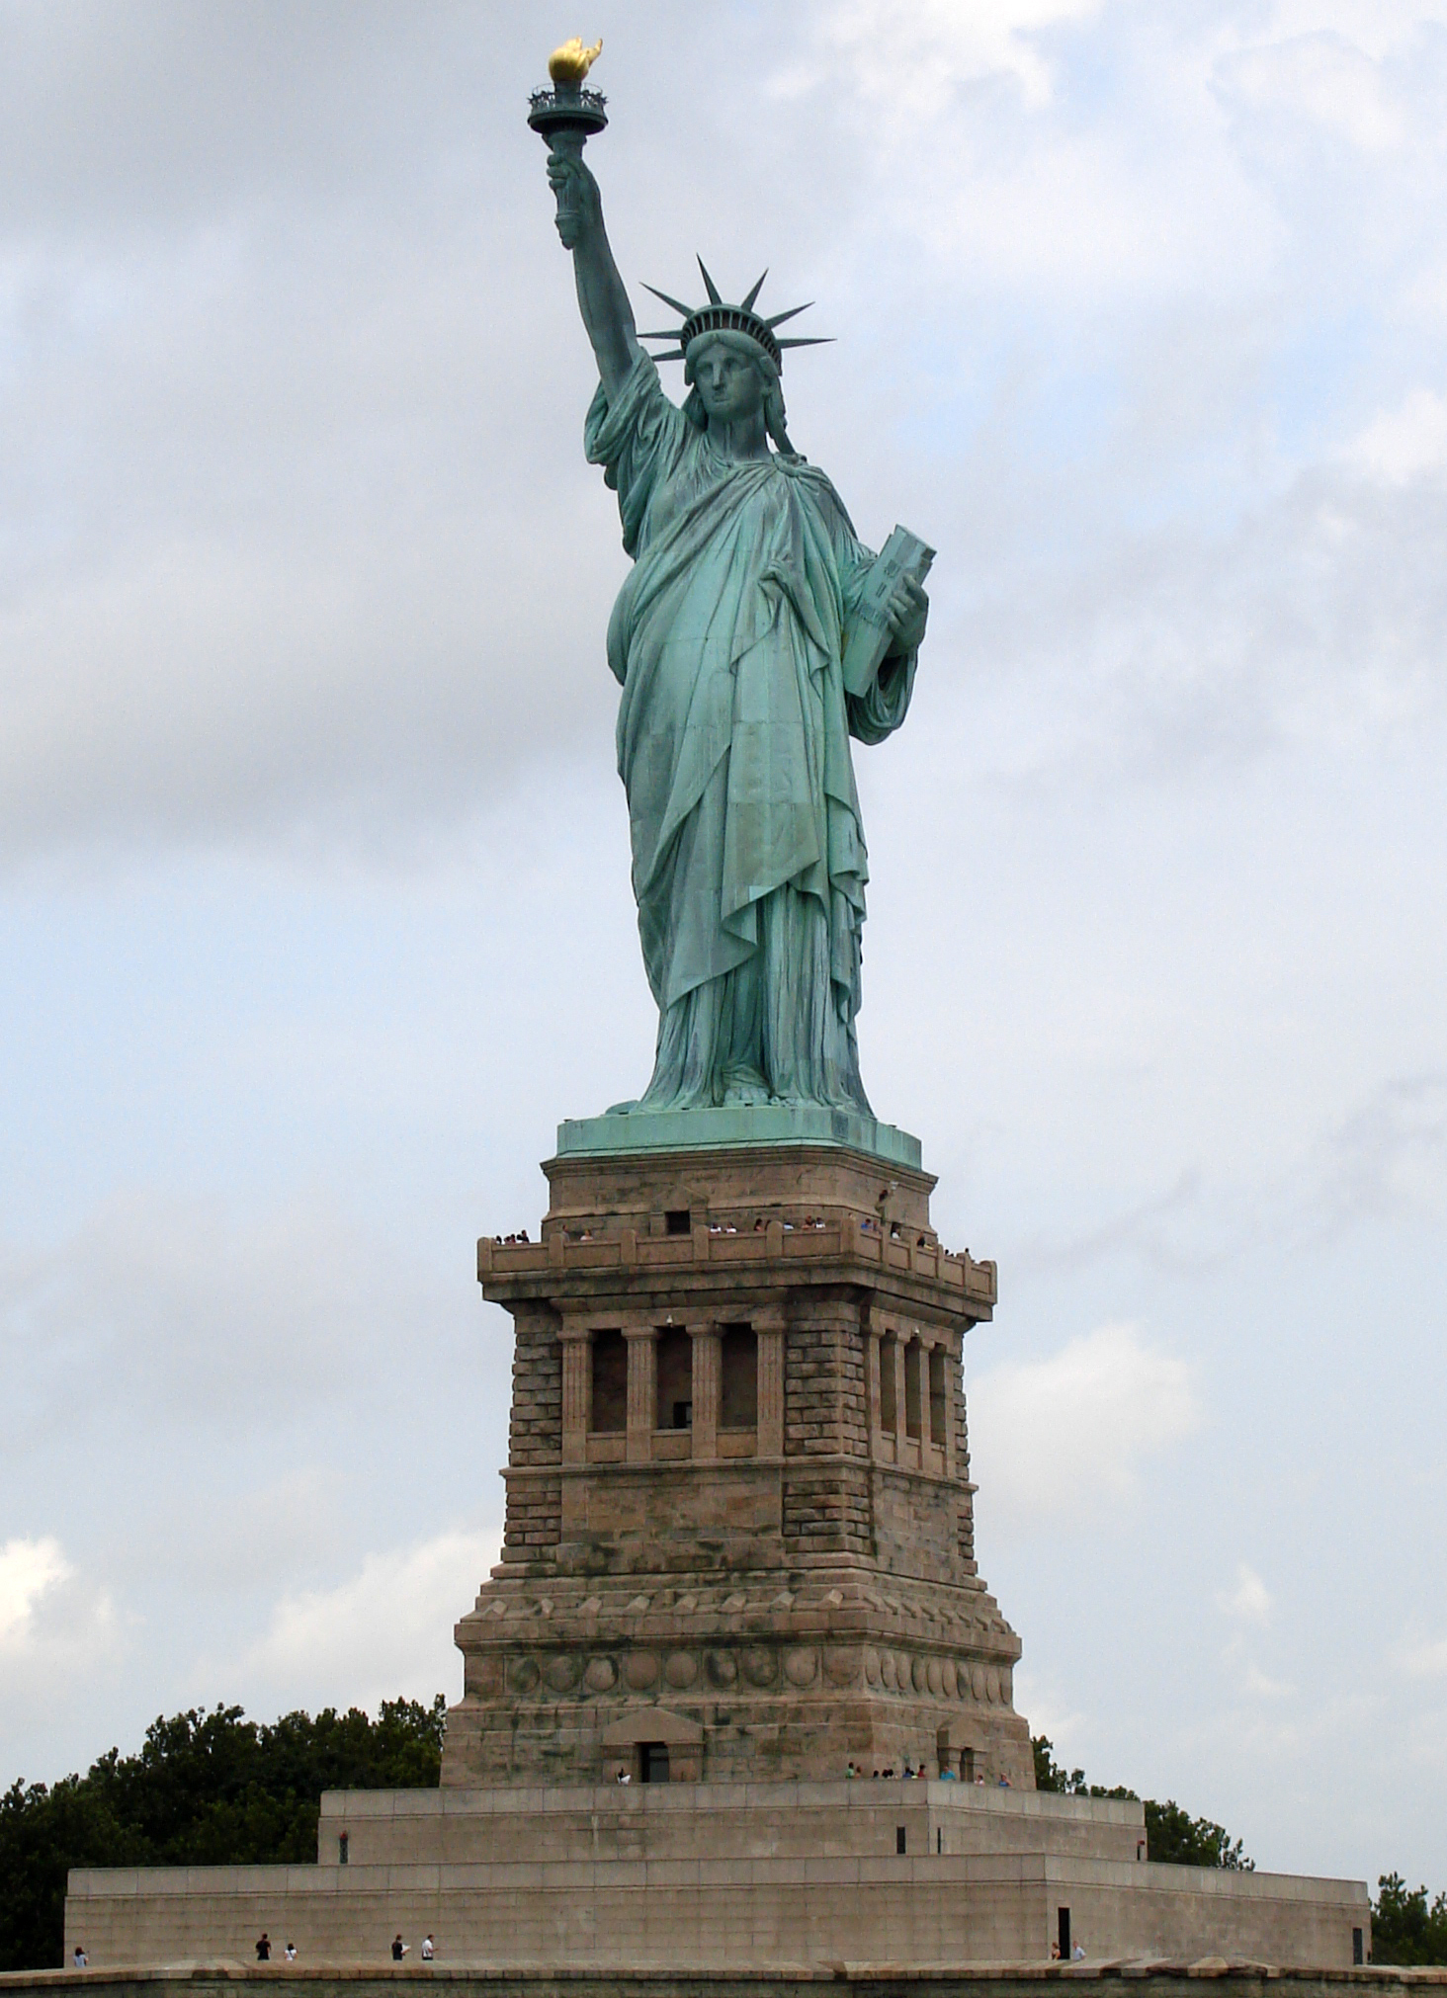
L
Statue of Liberty
Location: New Your Harbor
Date: Oct. 28,1886
A gift from the people of France to the people of America.
Designed by: Frédéric Auguste Bartholdi

Slide 13
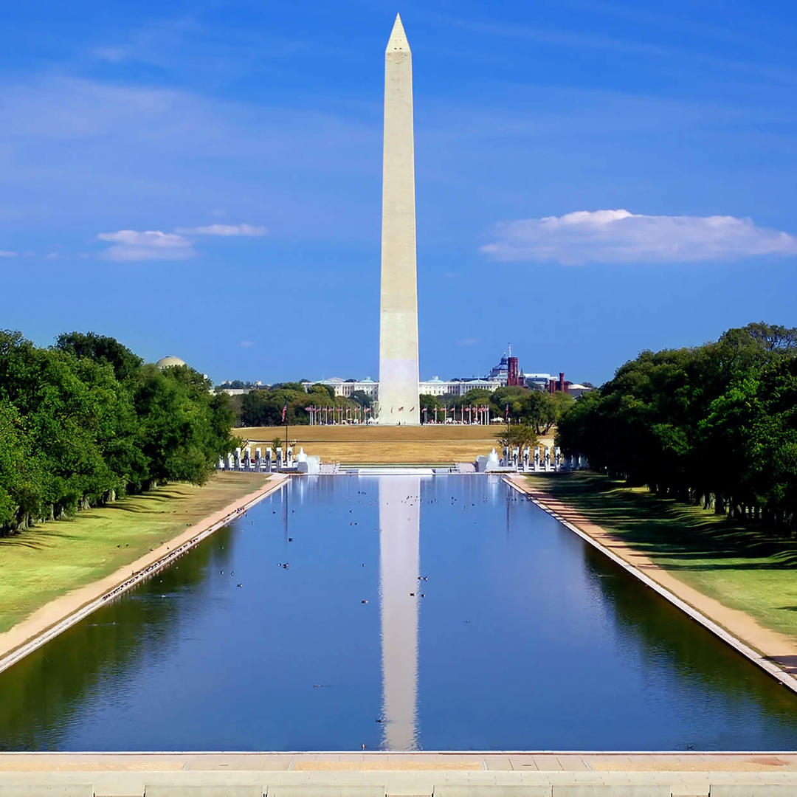
Location: on the National Mall In Washington DC.
Date: Oct. 15, 1966
Height: 555 ft.
Area: 106.01 acres
Washington Monument

Slide 14
Grand Old Flag
You're a grand old flag
You're a high-flying flag
And forever in peace may you wave
You're the emblem of
The land I love
The home of the free and the brave
Ev'ry heart beats true
Under red, white and blue
Where there's never a boast or brag
But should old acquaintance be forgot
Keep your eye on the grand old flag

Slide 15
My Country Tis of Thee
My country, 'tis of thee,
Sweet land of liberty,
Of thee I sing;
Land where my fathers died,
Land of the pilgrims' pride,
From ev'ry mountainside
Let freedom ring!

