Slide 1
Our Solar System
By Madi Goins

Slide 2
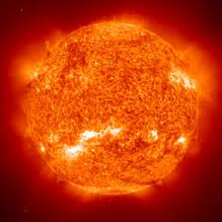
Sun
This is the sun that keeps everything on Earth alive. It gives us sunlight and keeps us warm.
All of the planets in our solar system revolve around the run. Revolve means to spin around.
Our sun is 92.96 million miles away from Earth.

Slide 3
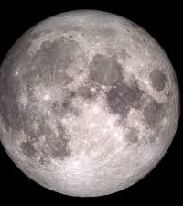
Moon
The moon orbits Earth. We see the moon at night.
The moon is 238,900 miles from Earth.
On July 20, 1969 Neil Armstrong became the first man to step foot on the moon.

Slide 4
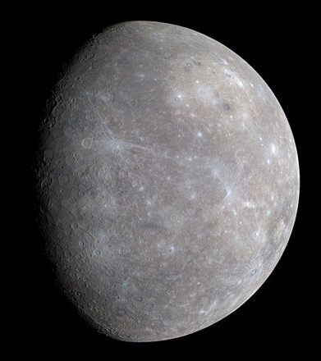
Mercury
Mercury is the smallest planet.
It is also the closet planet to the sun.
Mercury is 48 million miles from Earth.

Slide 5
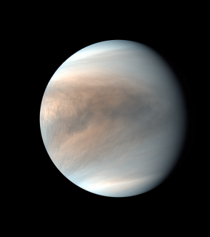
Venus
Venus is the second planet from the sun.
It is Earth’s twin in size.
Venus is 38 kilometers from Earth.

Slide 6
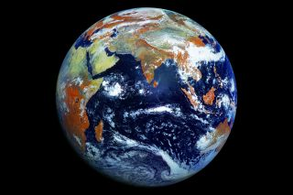
Earth
Earth is the third planet from the sun.
We live on Earth.
It is the only world known to have life.

Slide 7
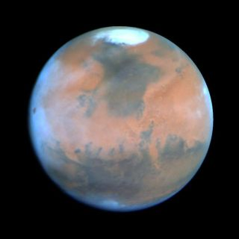
Mars
Mars is the fourth planet from sun.
It is a cold desert like place.
It is made of iron oxides that give it a red color.

Slide 8
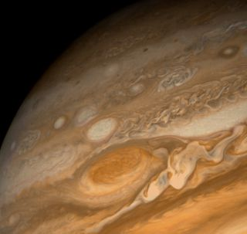
Jupiter
It is the fifth planet from the sun.
It is the largest planet.
It is a giant gas world.

Slide 9
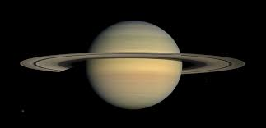
Saturn
Saturn is the sixth planet from the sun.
It is popular for its rings.

Slide 10
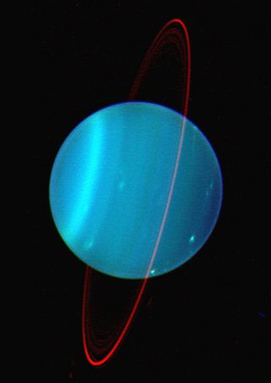
Uranus
It is the seventh planet from the sun.
It smells like rotten eggs.

Slide 11
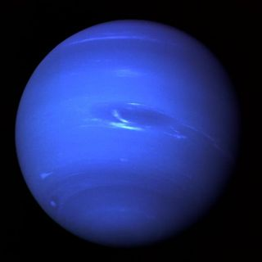
Neptune
It is the eight planet from the sun.
It is far out and very cold.

