Slide 1
Tupac Shacorgi and the Great Adventure
By Mary Gardner

Slide 2
Tupac the corgi wanted to go on a fun adventure.

Slide 3
So, he decided to go to his favorite place, the park.

Slide 4
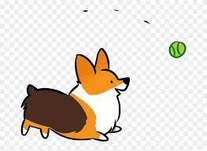
Tupac played with a green ball at the park.

Slide 5
Then Tupac wanted to go to the lake. He put on his cape and ran!

Slide 6
Tupac was at the lake then decided to take a walk up the street.

Slide 7
Tupac came across some mountains. He climbed to the very top.

Slide 8
Tupac watched the sun go down. He knew it was now time to go home.

Slide 9
Tupac arrived at his house and was excited to tell his parents about his great adventure.

Slide 10
The End

