Slide 1
Who? What? Where?
Ms. Awtrey
2nd Grade

Slide 2
Who? What? Where?
Who is in the story?
What is the story about?
Where did the story take place?

Slide 3
Who?
What?
Where?

Slide 4
Who?
What?
Where?

Slide 5
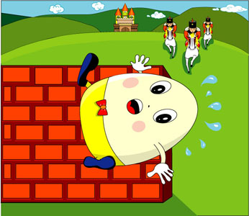
Characters?
Setting?
Plot?

Slide 6
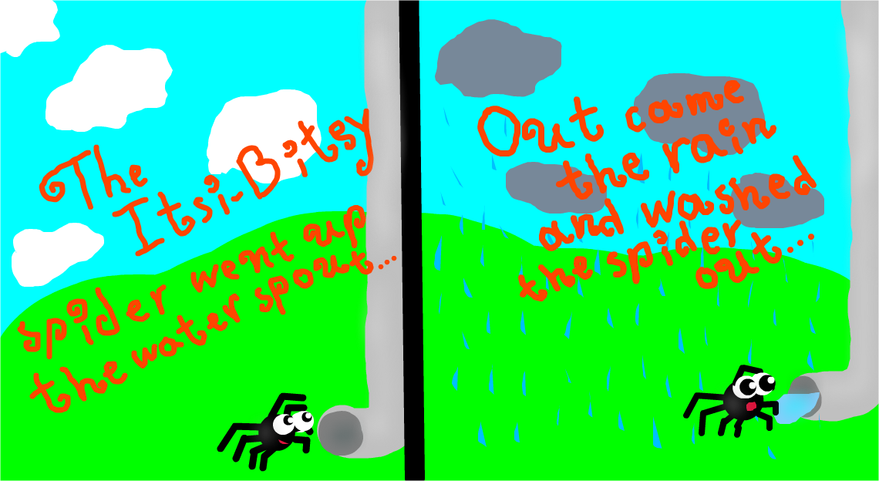
Character?
Setting?
Plot?

Slide 7
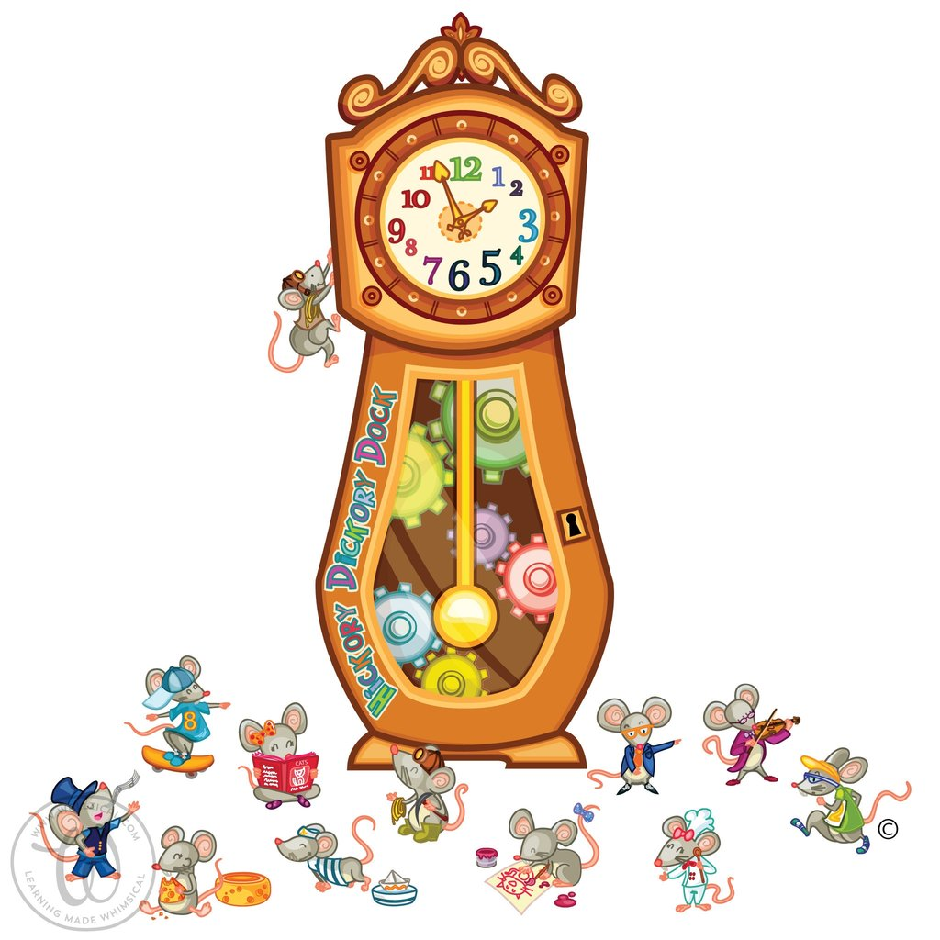
Character?
Setting?
Plot?

Slide 8
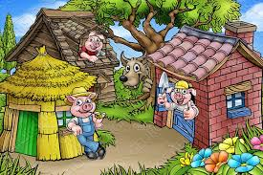
Character?
Setting?
Plot?

Slide 9
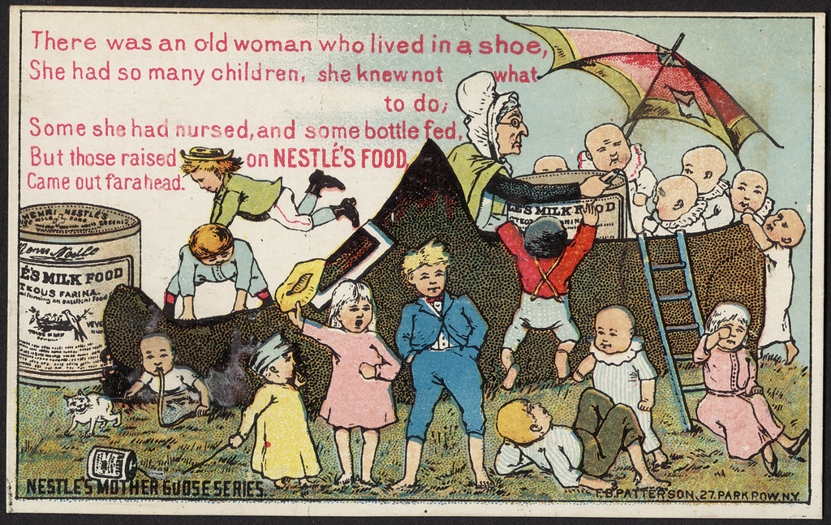
Character?
Setting?
Plot?

