Slide 1
Welcome to Antarctica
Ms. Awtrey

Slide 2
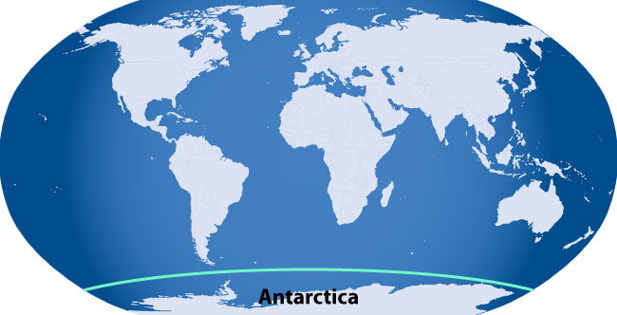
Where is Antarctica?
Sail due south from Chile, South Africa, Australia or New Zealand
At the ‘bottom’ of most globes
Antarctic Circle

Slide 3
Map of Antarctica
East Antarctica
West Antarctica
Transantarctic Mountains
Antarctic Peninsula

Slide 4
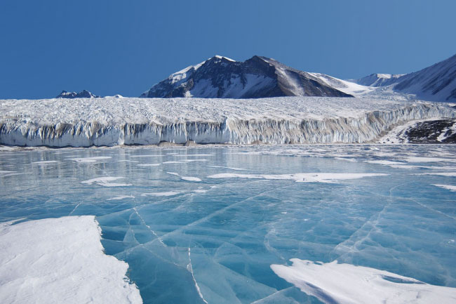
Days In Antarctica
periods of the year during which the sun doesn’t rise for at least 24 hours

Slide 5
Antarctica Ice Sheet

Slide 6
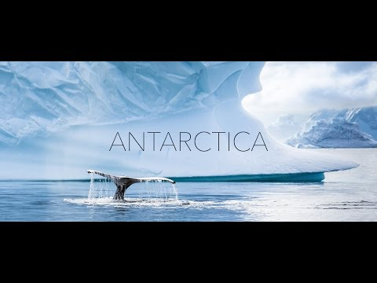

Slide 7
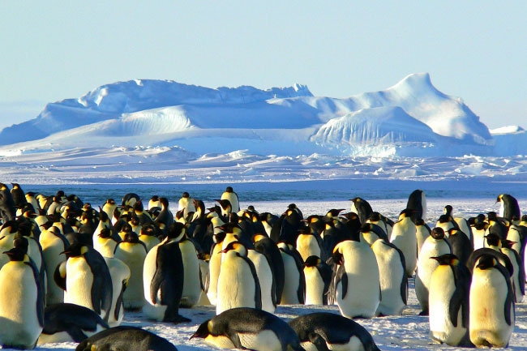

Slide 8
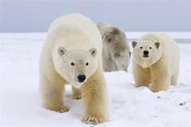

Slide 9
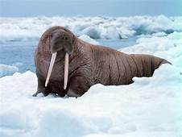

Slide 10
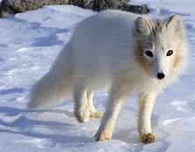

Slide 11
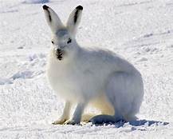

Slide 12
