Slide 1
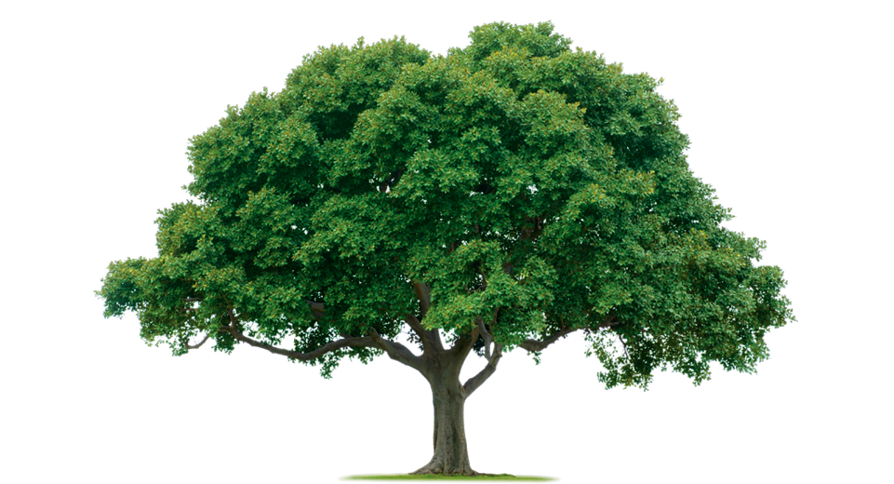
Our Environment
A book of helpful ways to help our environment.
By Lauren Perkey
lauren.perkey@smail.astate.edu
Notes:
(Tree Background) This Photo by Unknown Author is licensed under CC BY-NC-ND

Slide 2
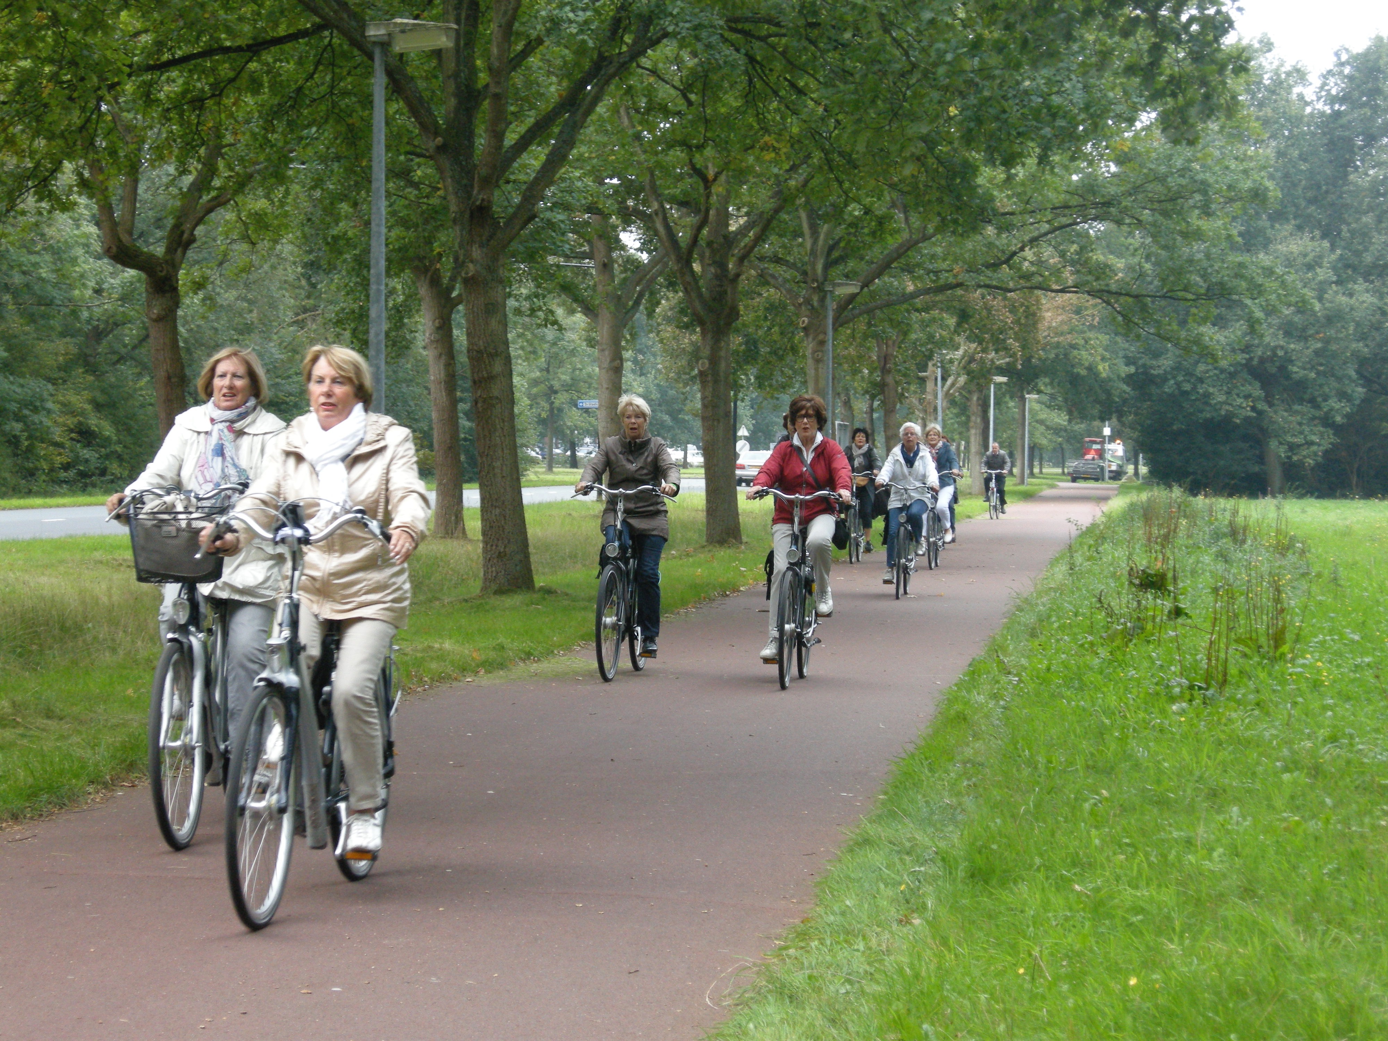
Reduce your carbon footprint by riding a bike.
Notes:
People on bikes This Photo by Unknown Author is licensed under CC BY

Slide 3
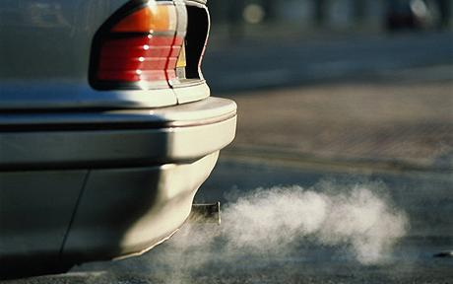
Help keep the air clean from pollution by not using transportation that uses gas or diesel.
Notes:
Car emitting air pollutants This Photo by Unknown Author is licensed under CC BY-NC-ND

Slide 4
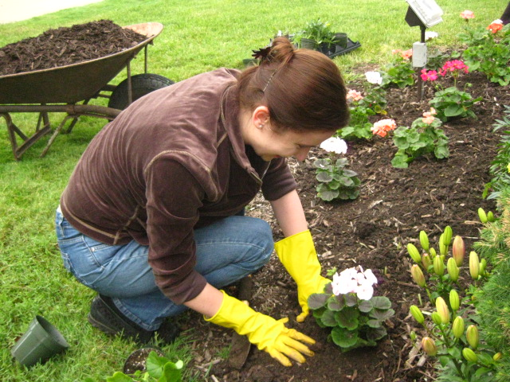
Make more oxygen for mammals to breath by planting plants.
Notes:
Person planting plants This Photo by Unknown Author is licensed under CC BY-NC

Slide 5
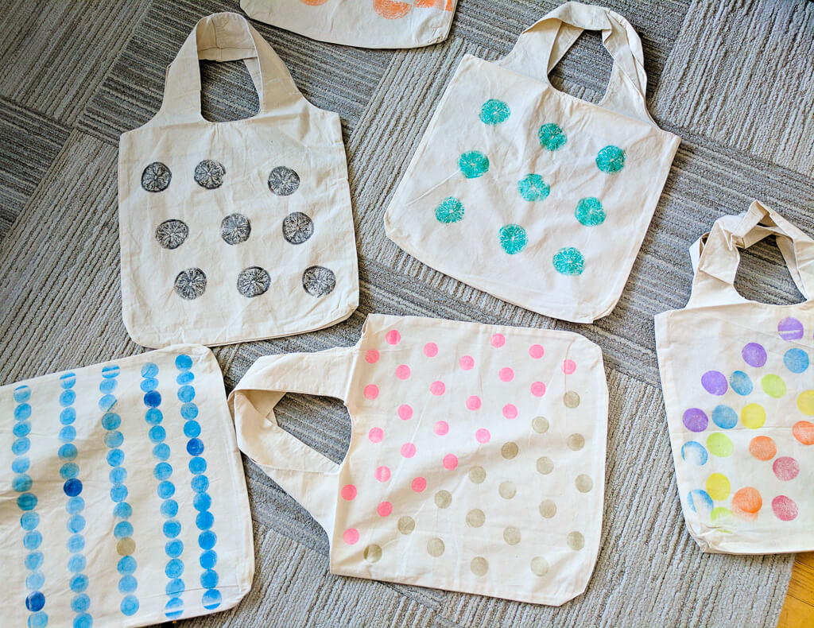
Use reusable fabric grocery bags instead of plastic bags.
Notes:
Reusable grocery bags This Photo by Unknown Author is licensed under CC BY-SA-NC

Slide 6
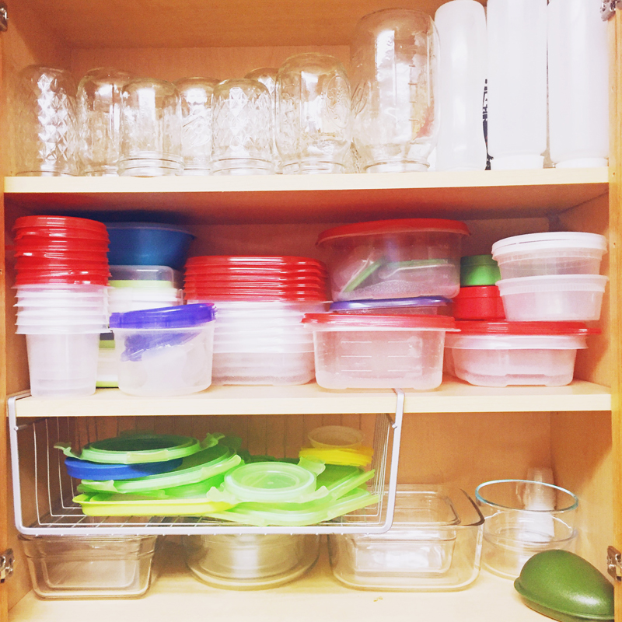
Use washable and reusable eating and drinking utensils to reduce waste.
This Photo by Unknown Author is licensed under CC BY-SA-NC
Notes:
Containers picture by Unknown Author is licensed under CC BY-SA

Slide 7
Turn off lights when you leave the room.
Notes:
Turning off the lights This Photo by Unknown Author is licensed under CC BY-SA

Slide 8
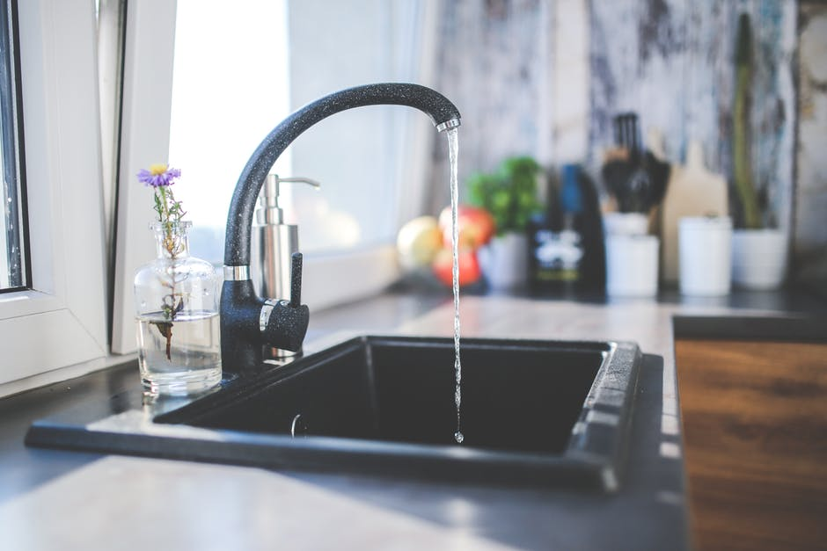
Drink water from the tap instead of drinking bottled water.

Slide 9
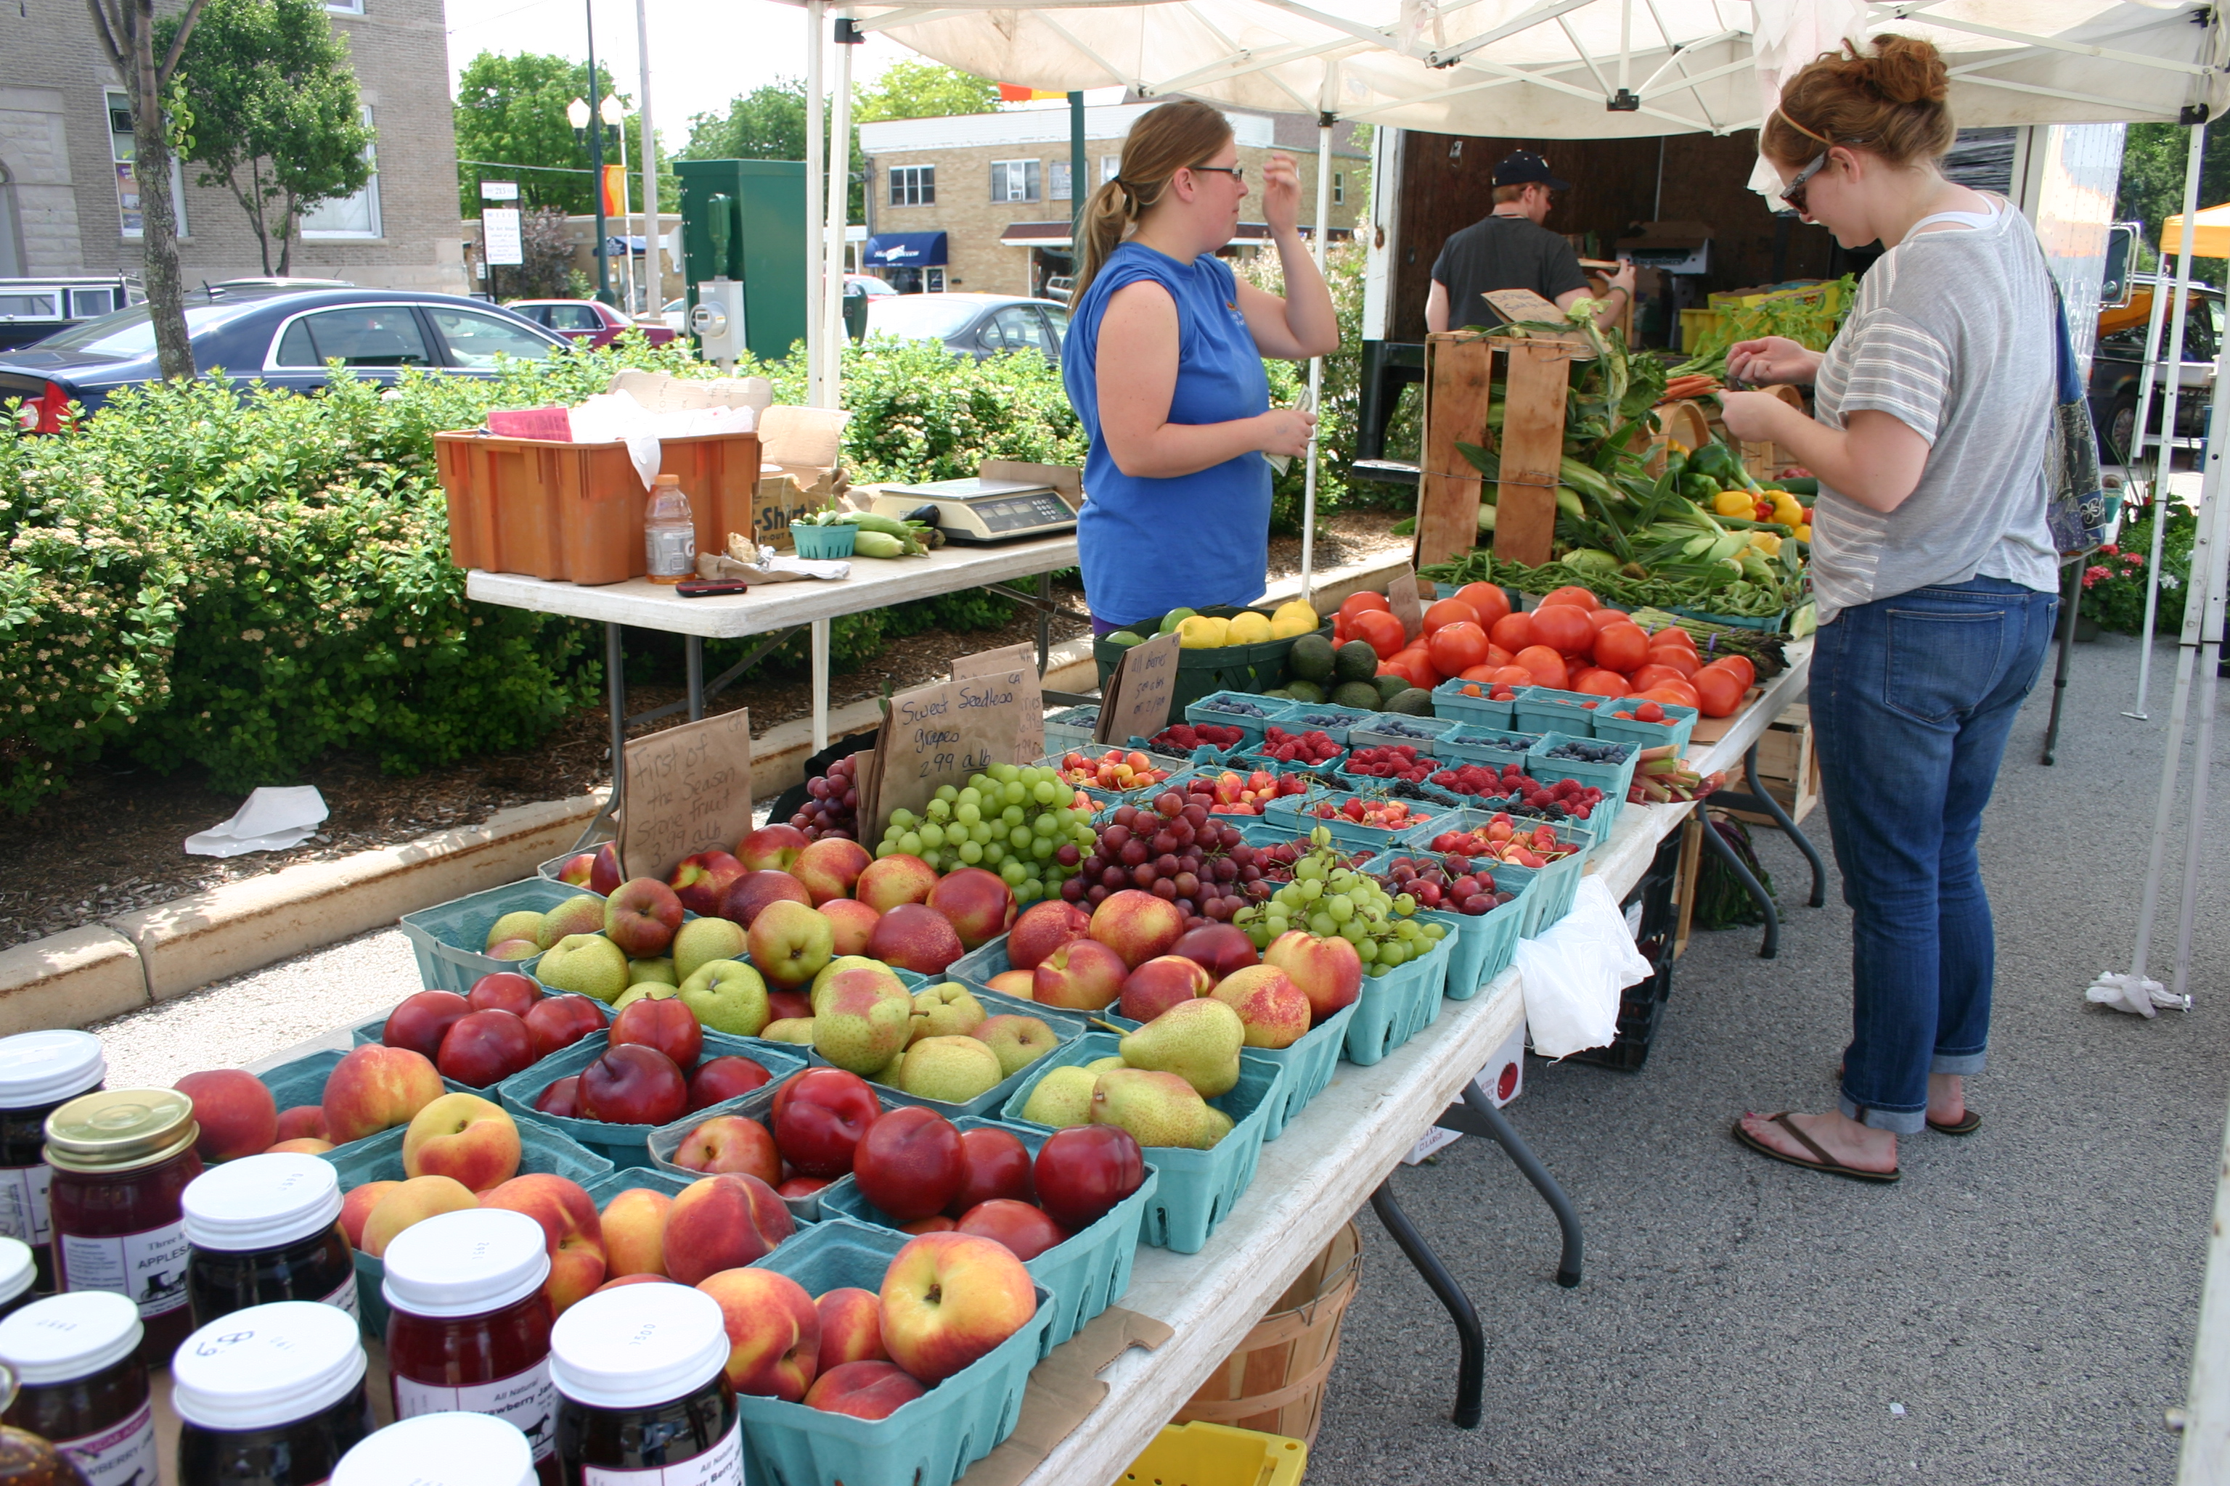
Buy your produce from your local farmer’s market.
Notes:
Farmer’s market This Photo by Unknown Author is licensed under CC BY

Slide 10
Turn the water off while brushing your teeth.
Notes:
Girl brushing teeth This Photo by Unknown Author is licensed under CC BY-SA

Slide 11
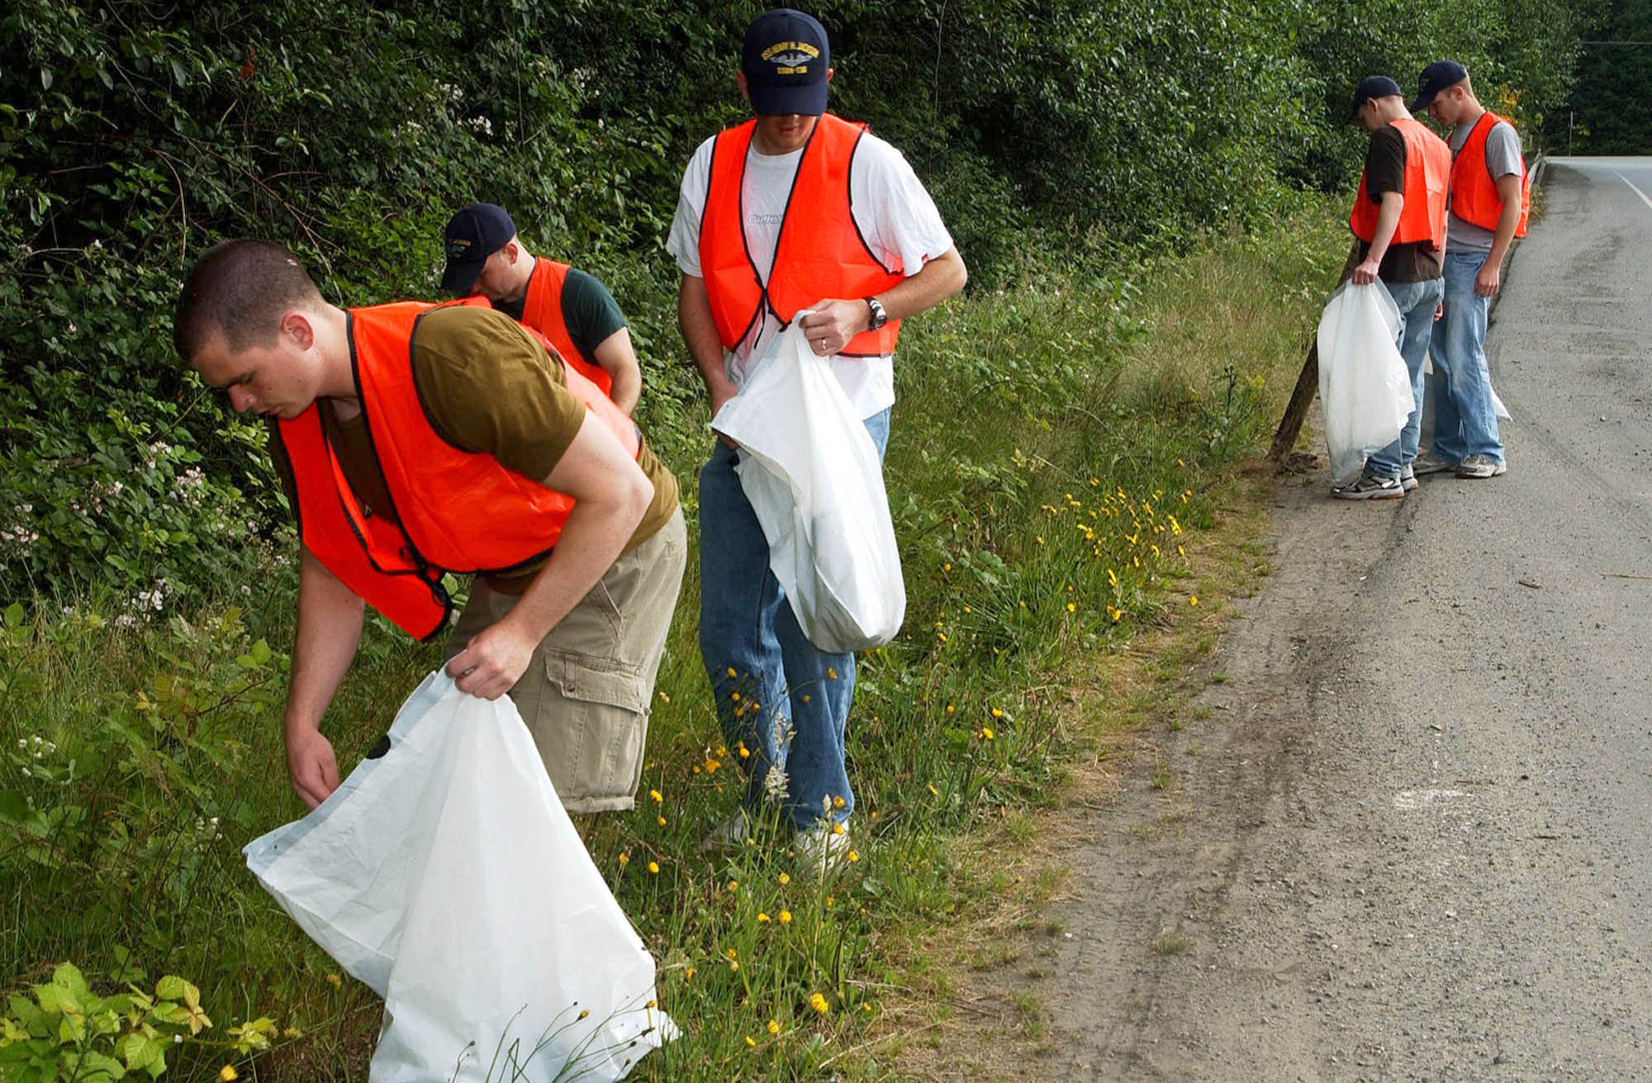
Throw trash away that you see sitting on the ground.
Notes:
People picking up trash This Photo by Unknown Author is licensed under CC BY-SA

