Slide 1
In The Ocean
Book

Slide 2
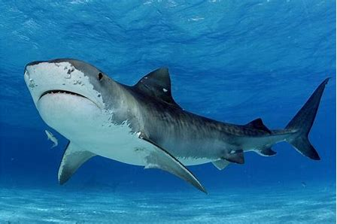
SHARK

Slide 3
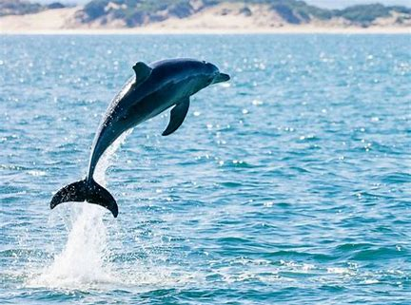
Dolphin

Slide 4
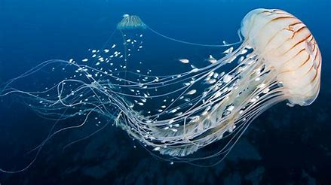
Jelly Fish

Slide 5
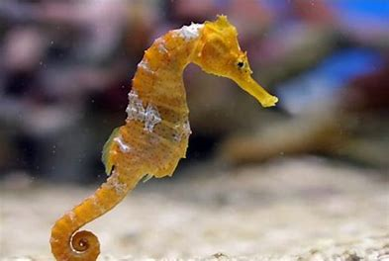
Sea horse

Slide 6
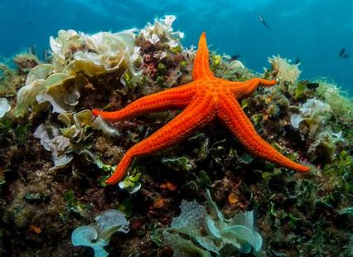
Star Fish

Slide 7
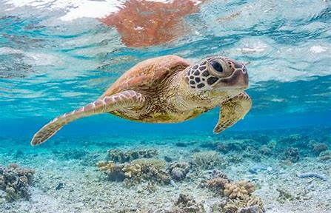
Sea Turtles

Slide 8
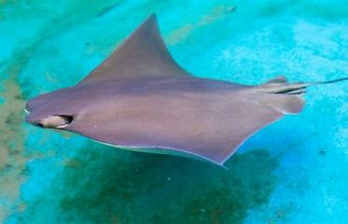
Sting ray

Slide 9
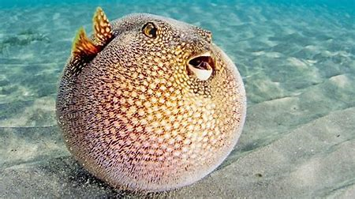
Puffer fish

Slide 10
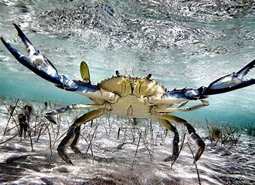
Crabs

Slide 11
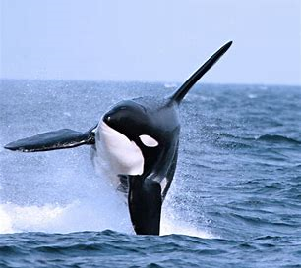
Whale

Slide 12

Come swim with us!

