Slide 1
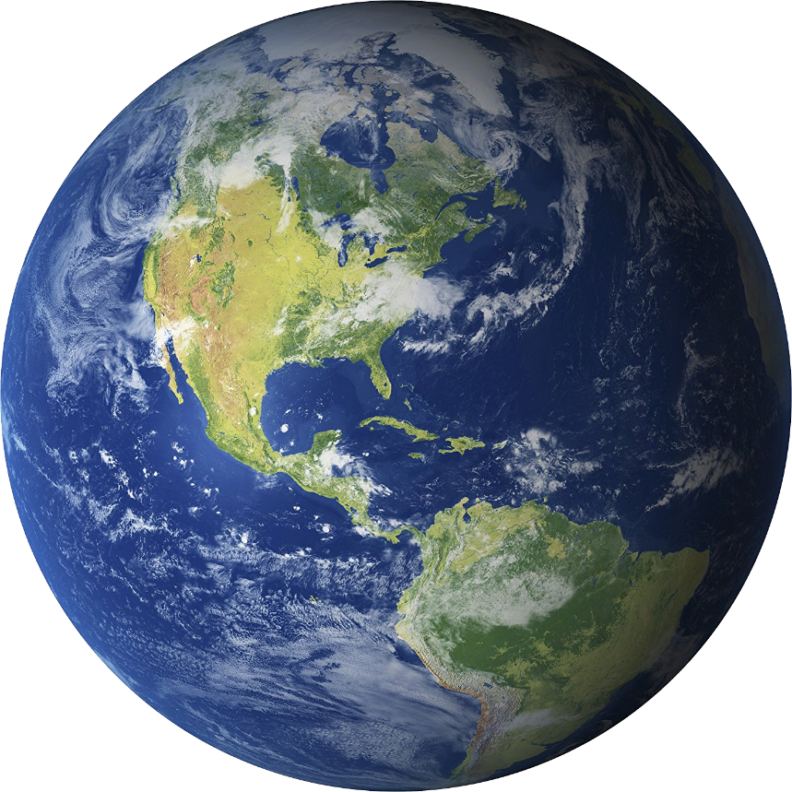
Jack helps the Earth
Made by Ms. Ward

Slide 2
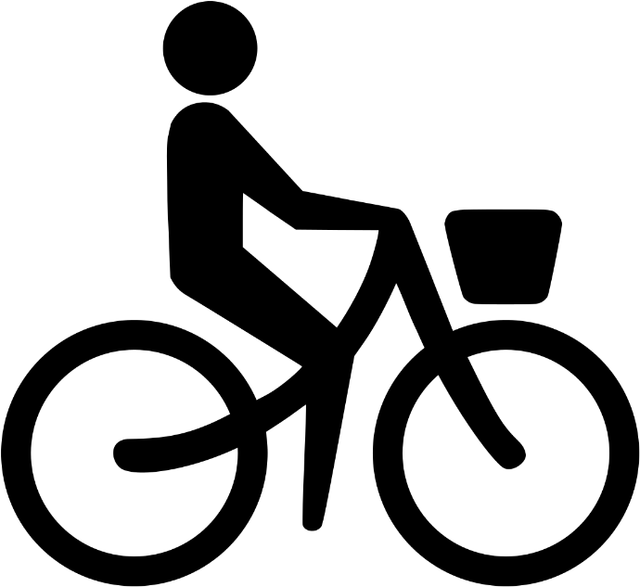
Jack is walking to work. Sometimes he rides his bike too. This not only makes Jack happier and healthier, but it reduces transportation emissions so it makes the Earth happier and healthier too.

Slide 3
For lunch, Jack brought a meat-less meal and food he grew himself. This is because animal agriculture produces huge amounts of greenhouse gas emissions, consumes massive amounts of water volume, and pollution.

Slide 4
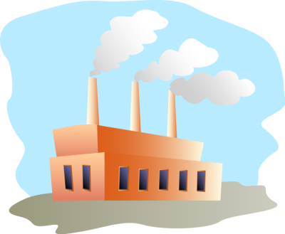
After work, Jack always passes by a factory when walking home. This factory uses fossil fuels, which is a natural fuel such as coal or gas, from the remains of living organisms.

Slide 5
Fossil Fuels cause major pollution because when they are burned carbon dioxide is released. They are definitely not environment friendly.
In replace of fossil fuels, or anything like fossil fuels, Jack uses energy that is renewable such as solar, wind, and hydro power.

Slide 6
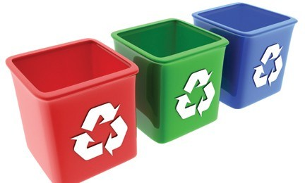
Jack never wastes if it’s paper, plastic, or even food, Jack always finds a way to reuse it. anything. It doesn’t matter
Jack also has four cans at his house: one can for paper, one can for aluminum, one can for plastic, and one for actual trash.

Slide 7
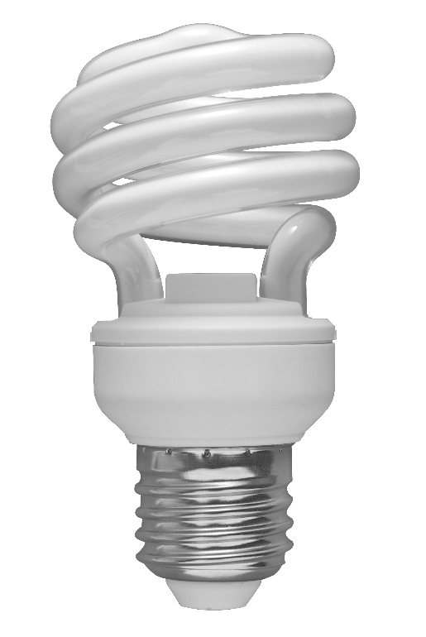
Jack’s house is completely Earth friendly. He replaces his light bulbs with energy-efficient ones, he turns off and unplugs electronics when he’s not using them, and uses energy efficient appliances.

Slide 8
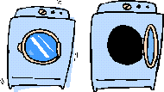
When Jack washes his clothes, he uses cold or warm water instead of hot. He also hangs his clothes up to dry instead of putting them in the dryer, which is a big energy hog.

Slide 9
It’s clear that Jack does a lot of things to help reduce climate change. One last important thing Jack does, though, is…..

Slide 10
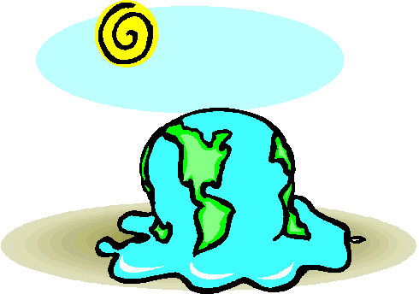
…..he informs people and tells them his story!

