Slide 1
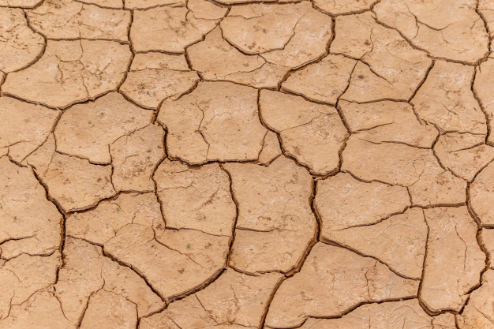
Processes that Change Earth’s Surface
By: Miss. Sheppard

Slide 2
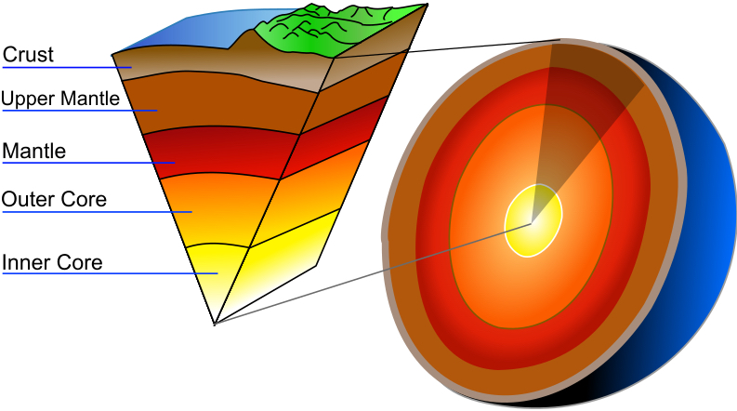
The Layers of Earth
The Earth is made up of 5 main layers. They are Crust, Upper Mantle, Mantle, Outer Core, and Inner Core. There are a few processes that can change not only the surface of the Earth that we see, but also all the way down to the Mantle Layer.

Slide 3
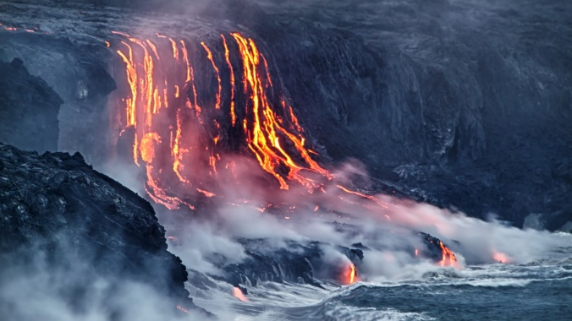
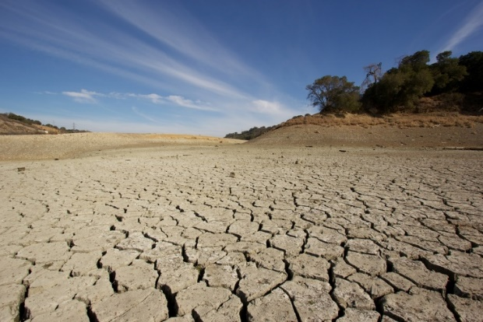
Natural Disasters
In this photo, flooding has caused enough erosion to damage a road.
Magma from volcanoes can create new land after it has cooled.
Natural Disasters can cause major changes to Earth’s surface. Natural disasters include volcanoes, earthquakes, floods, and droughts. Each of these have aspects to them that could cause either erosion or surface weathering.
Droughts cause the surface of Earth to breakdown and become hard to farm.

Slide 4
Erosion
Erosion can easily be confused with weathering but they are not the same. Erosion can be caused when there is heavy rainfall. The water accumulates and washes away minerals in the dirt causing trenches and rivers. Weathering is the breaking down of rock, while erosion washes it away.

Slide 5
Weathering
Weathering is the breaking down or dissolving of rocks and minerals that are on the surface of Earth. Water is the main cause of weathering, along with temperature and animals. All rocks are prone to weathering.

Slide 6
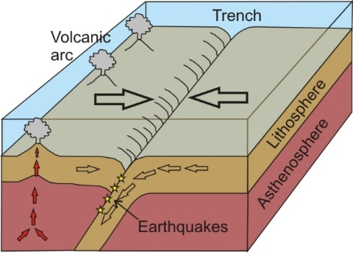
Earthquakes
This is a photo of the San Andreas fault, and the effects that it has had to Earth.
Earthquakes are caused by the movements of plate tectonics below Earth’s surface. They can move in many different ways and at any given time. There are instruments that scientists use to help predict when earthquakes are going to occur.
This demonstrates the movement of plates to create earthquakes.

Slide 7
Mountains
Mountains are formed by the pushing together of plate tectonics. Just as how earthquakes happen due to plate tectonics moving past one another, when the plates collide they create a mountain.
A horst is a risen block of Earth’s crust. A graben is a block of Earth that sets lower than the blocks of Earth next to it.

Slide 8
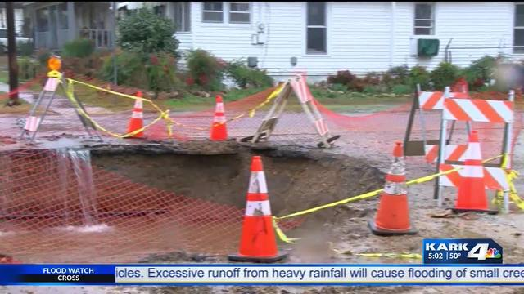
Sinkholes
Sinkholes are formed when rainfall is absorbed by the soil and takes in carbon dioxide as well as decaying vegetation. This causes the water to become acidic and creates many cavities in the Earth. When the land above the holes under the surface collapse, it creates a large, dangerous, hole.
This is an image of a sinkhole that occurred in Jonesboro.

Slide 9
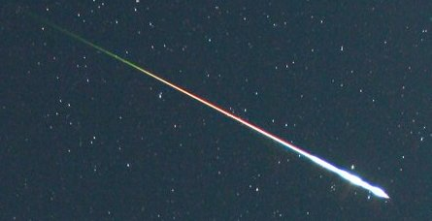
Meteor Impacts
A meteor is a small rocky or metallic body that enters Earth’s atmosphere from space. They range in a variety of sizes. Once they impact the surface, it can leave a large hole.

Slide 10
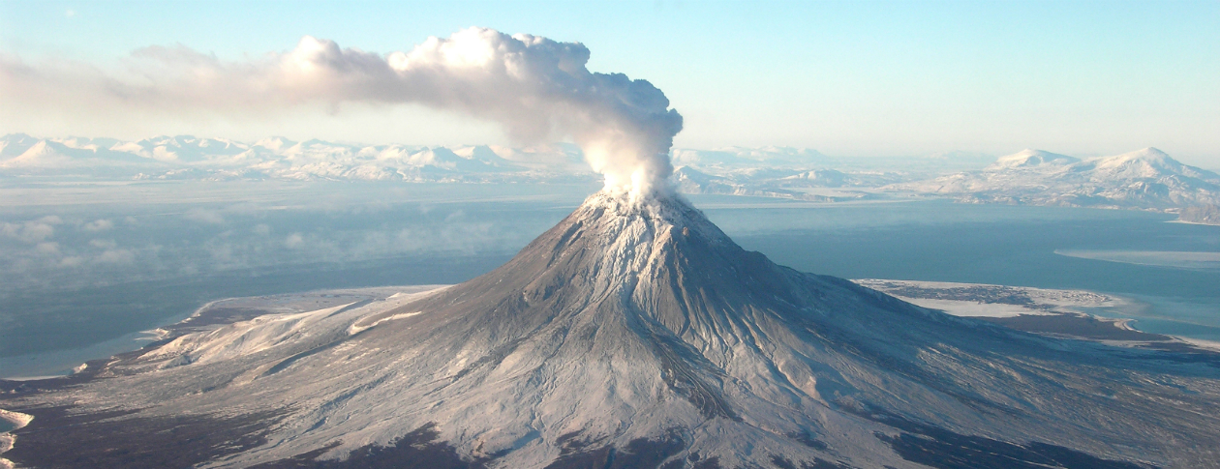
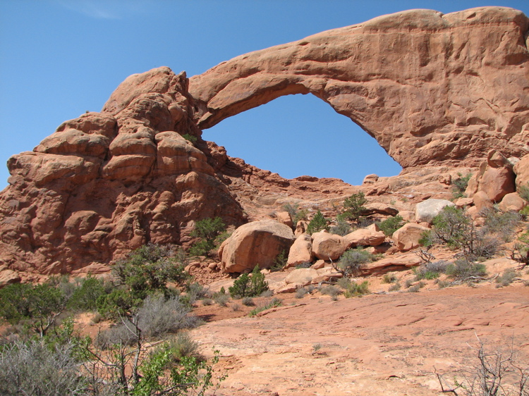
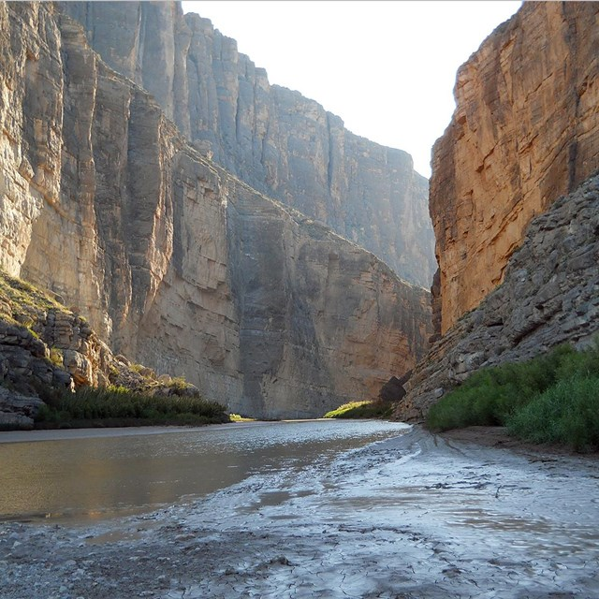
On your way home today, look for unique landforms and changes in the landscape. How did they form? How do these changes to the surface of Earth effect both humans and animals?

