Slide 1
Is this a Sh, Ch, or Th sound?
by : Kaylee Parrish

Slide 2
Is this a Sh, Ch or Th sound?
Th
Ch
Sh

Slide 3
Is this a Sh, Ch or Th sound?
Ch
Th
Sh

Slide 4
Is this a Sh, Ch or Th sound?
Th
Ch
Sh

Slide 5
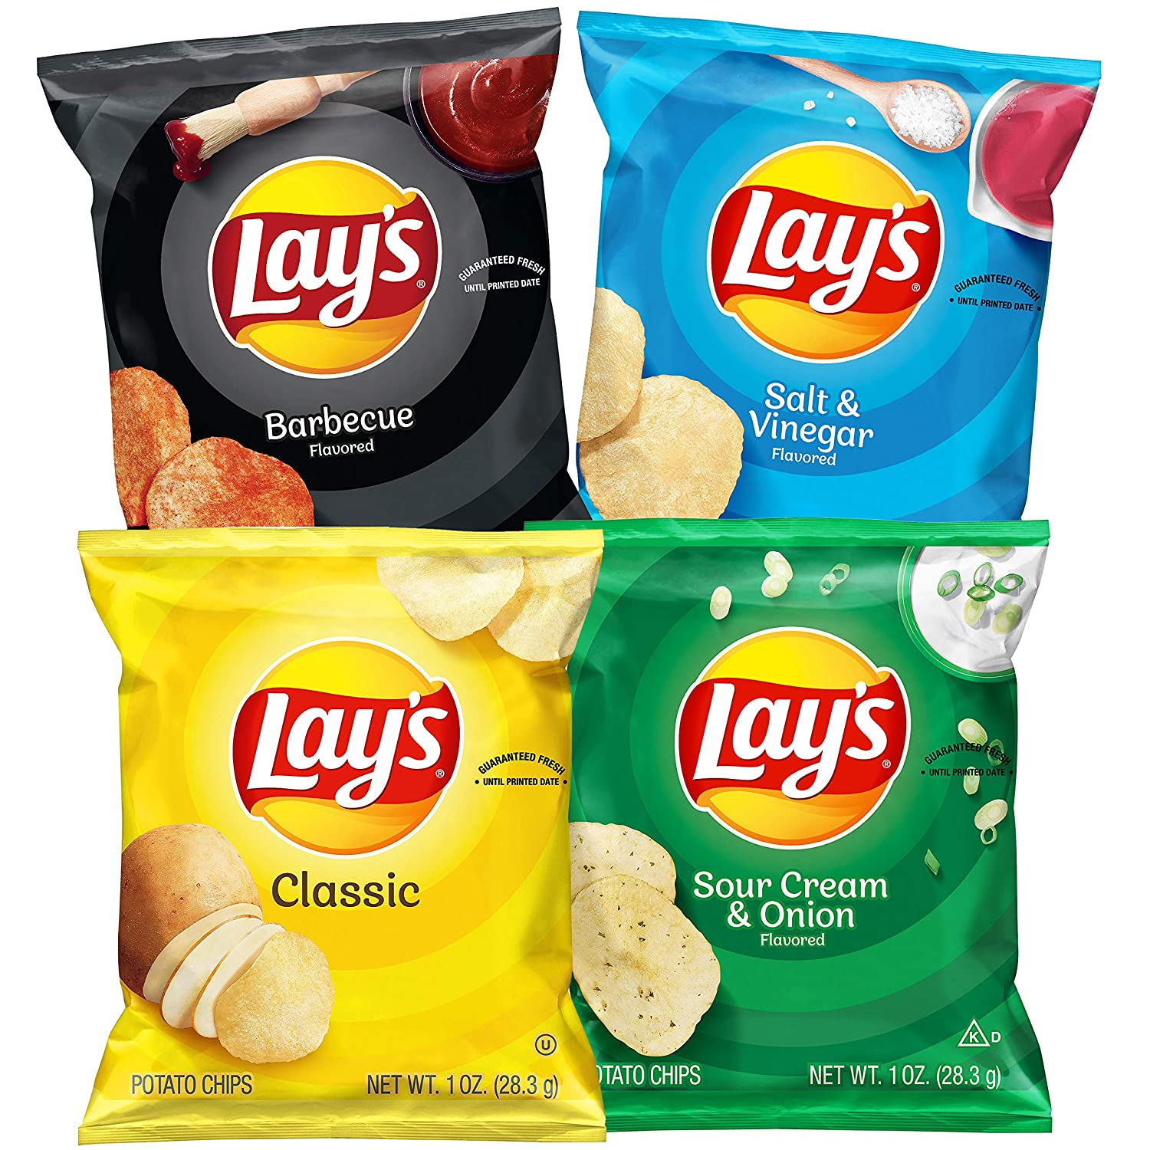
Is this a Sh, Ch, or Th sound?
Sh
Ch
Th

Slide 6
Is this a Sh, Ch, or Th sound?
Th
Ch
Sh

Slide 7
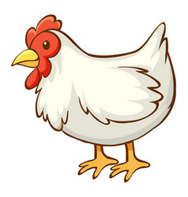
Is this a Sh, Ch, or Th sound?
Sh
Th
Ch

Slide 8
Is this a Sh, Ch, or Th sound?
Sh
Ch
Th

Slide 9
Good Job

Slide 10
Try again

