Slide 1
How to wash your hands
By Kaylee Parrish

Slide 2
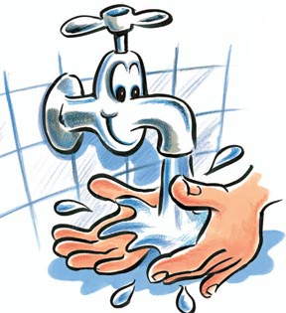
Step one
Wet your hands

Slide 3
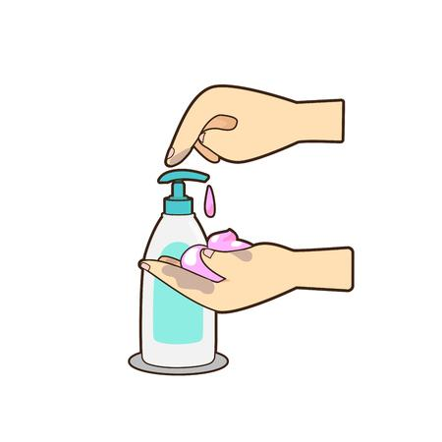
Step two
Apply Soap

Slide 4
Step three
Rub your hands together for 20 seconds. That is the length of the “happy birthday” song!

Slide 5
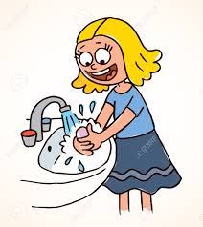
Step four
Rise your hands under water until all soap is gone

Slide 6
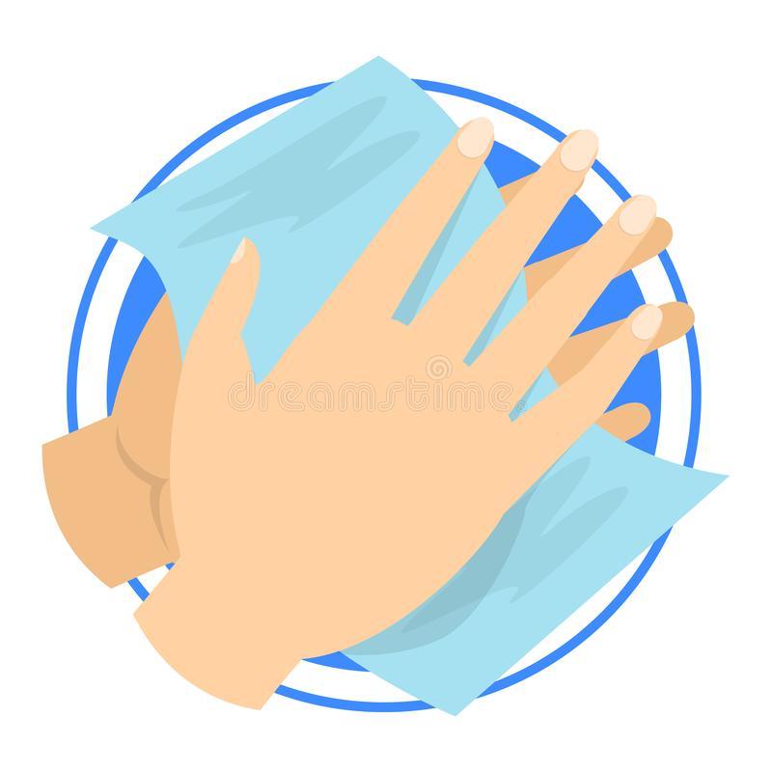
Step five
Dry off your hands until they are no longer wet

Slide 7
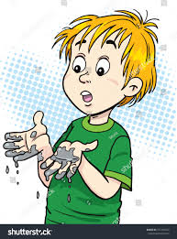
When do i need to wash my hands?
When you come in from recess
Before you go to lunch
After you use the restroom
Before and after you use the ipads or computers
When you get them dirty

Slide 8
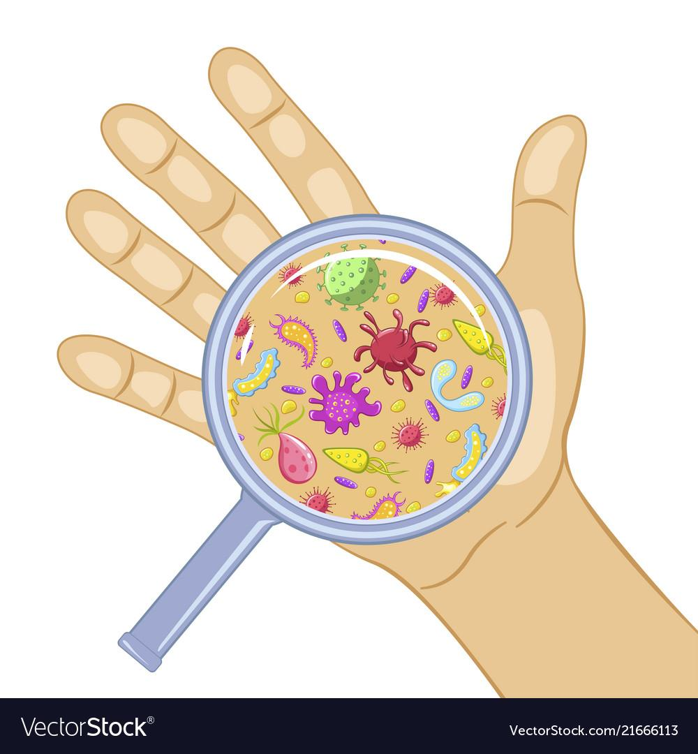
Why do i need to wash my hands?
You should always wash your hands to wash off the germs from objects you touch. Germs will get you sick and washing your hands will help keep you healthy.

Slide 9
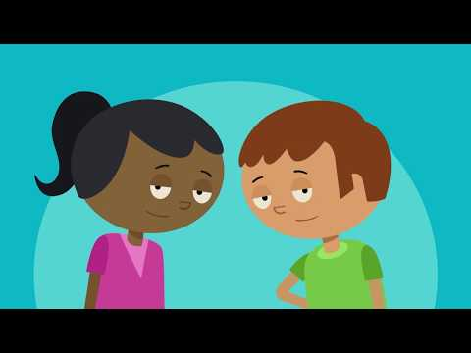
Youtube video

Slide 10
Fun hand washing song by the wiggles

