Slide 1
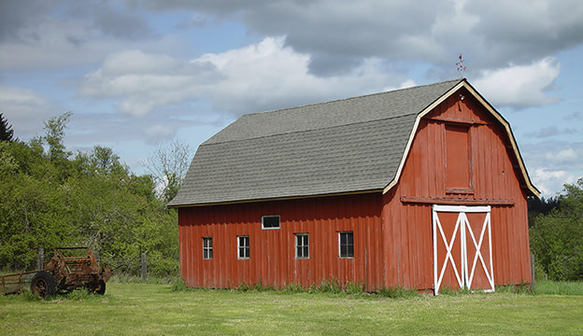
Our Trip to the Farm
Ms. Kayla’s Class
2020

Slide 2
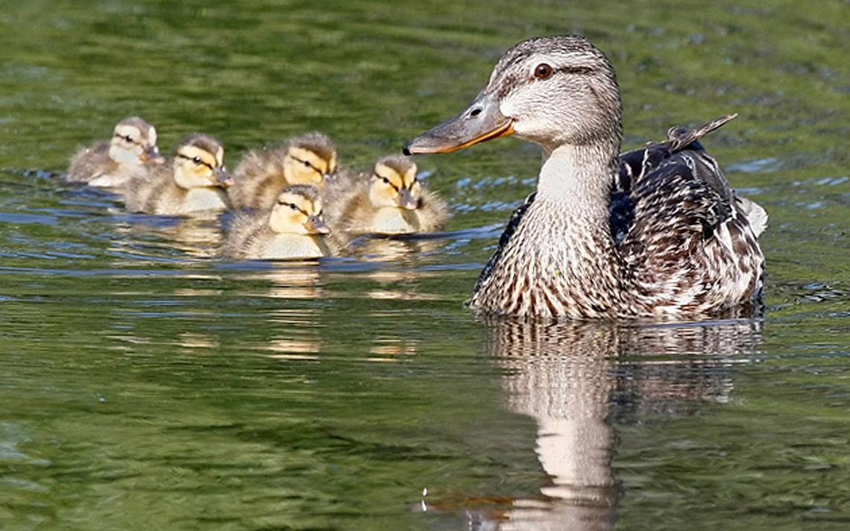
Johnathan B. loved to watch the ducks swim.

Slide 3
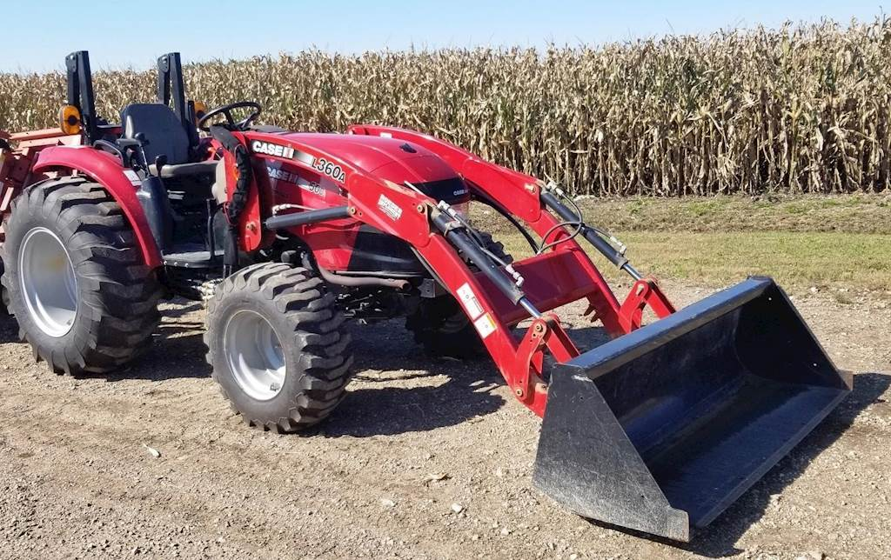
Kate liked the color of the farmer’s tractor.

Slide 4
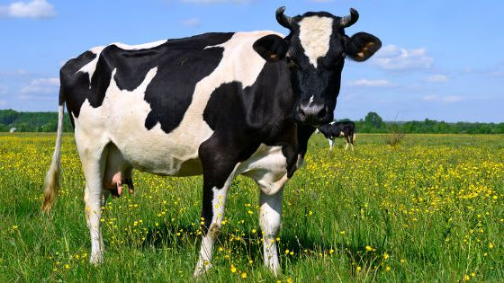
Samantha learned something new about cows.

Slide 5
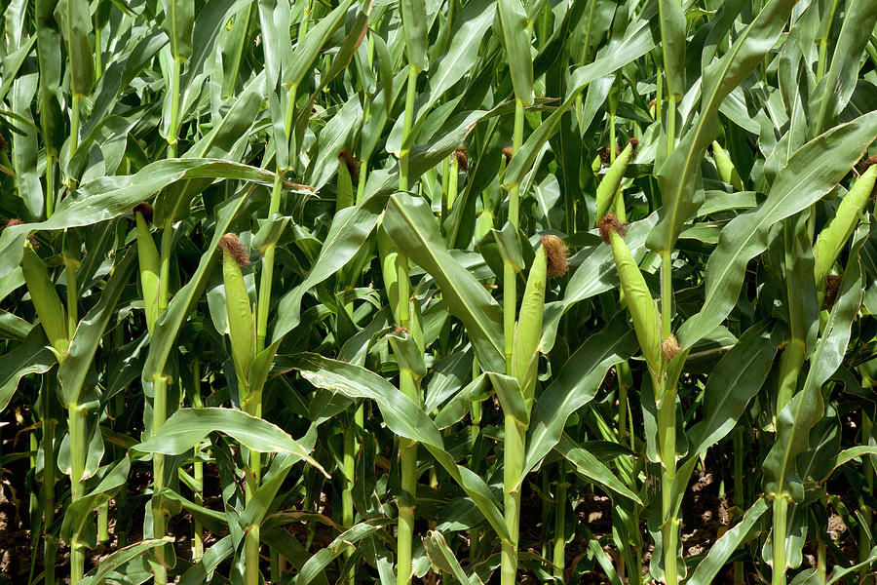
Timmy learned how corn was harvested.

Slide 6
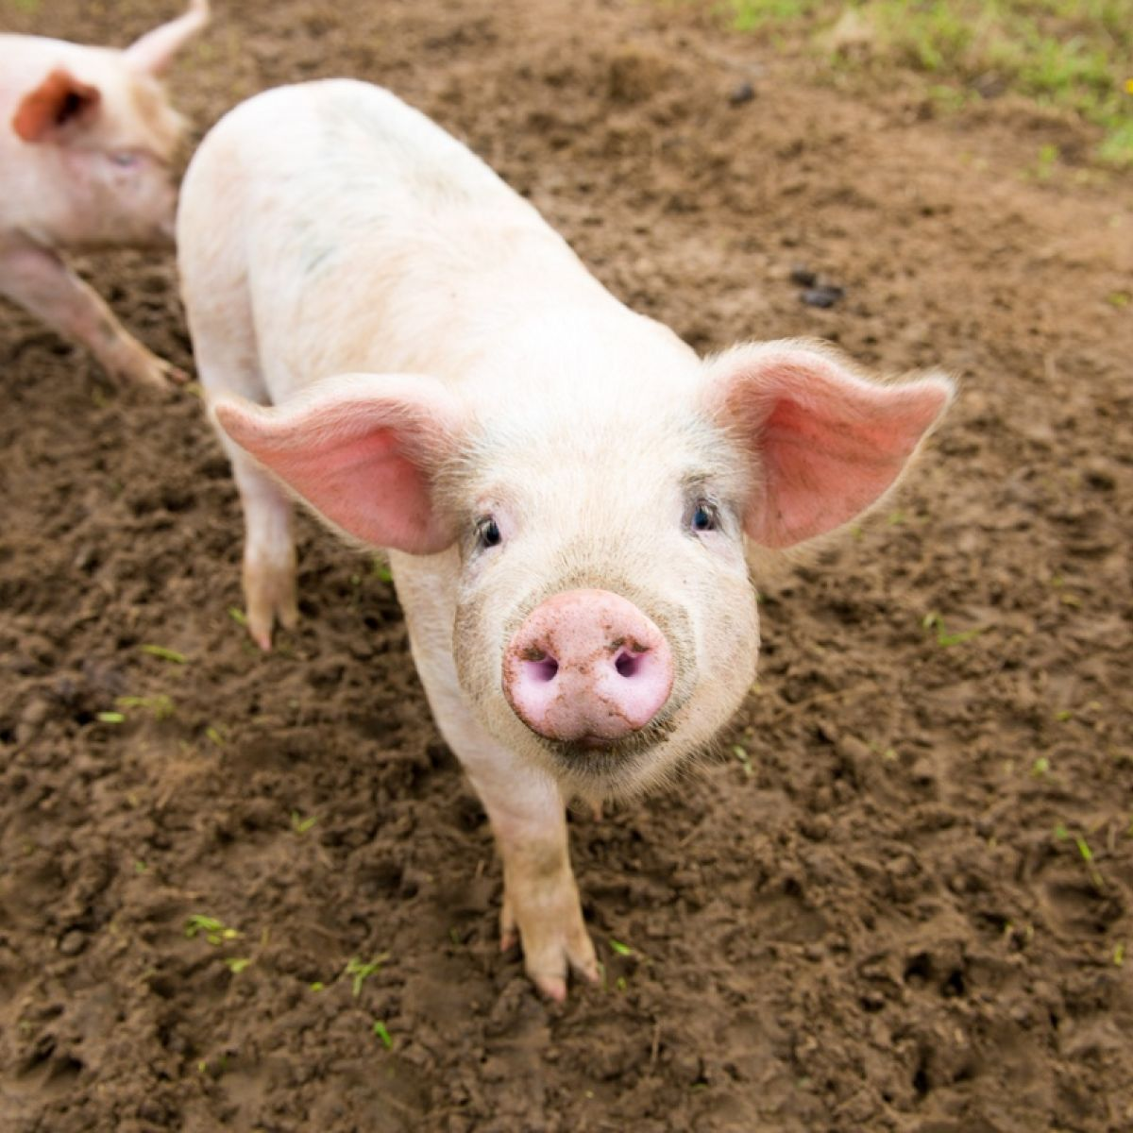
Johnny loved to watch the pigs roll around in the mud.

Slide 7
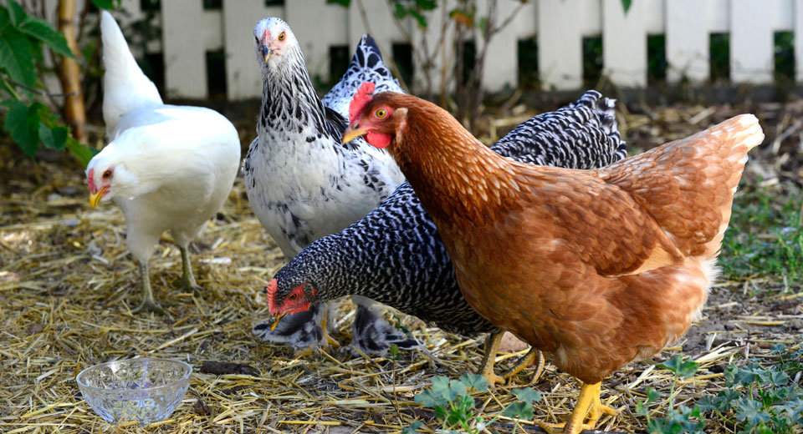
Keely learned that eggs came from chickens.

Slide 8
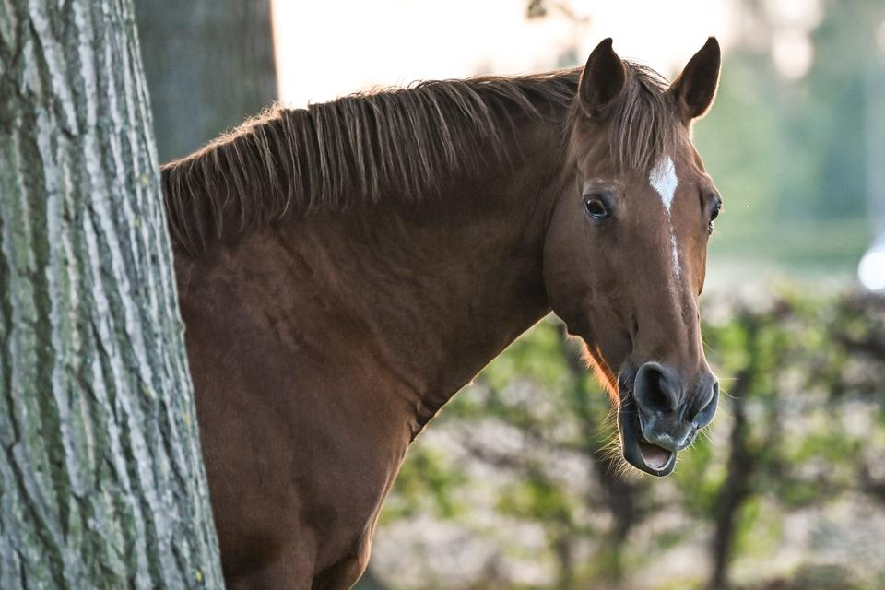
Trevor loved to watch the horses run and play.

Slide 9
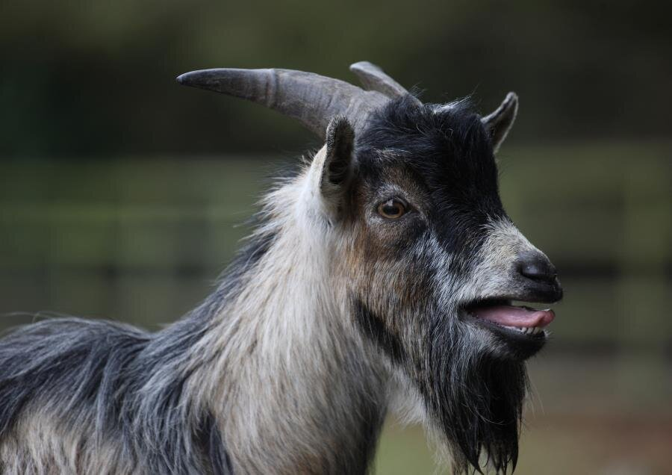
Suzie liked it when the goats would scream.

Slide 10
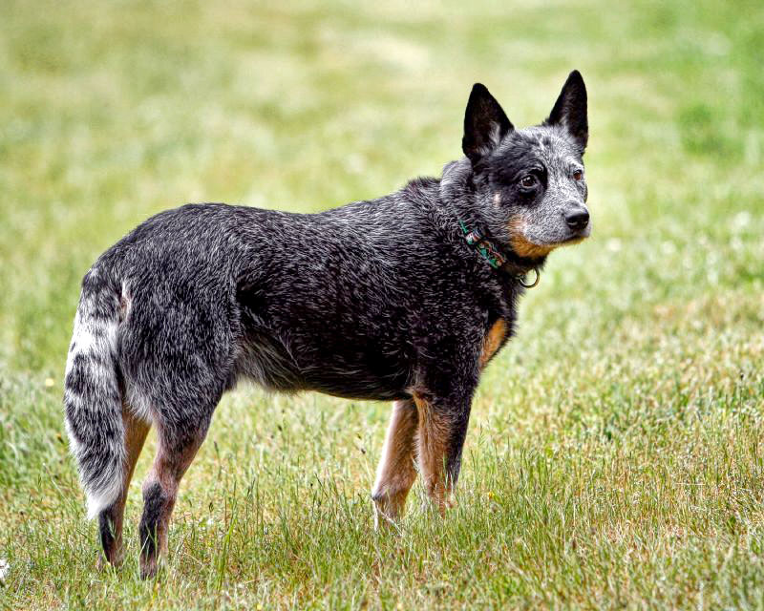
Rylan loved to watch the farmer’s dog chase the cows.

Slide 11
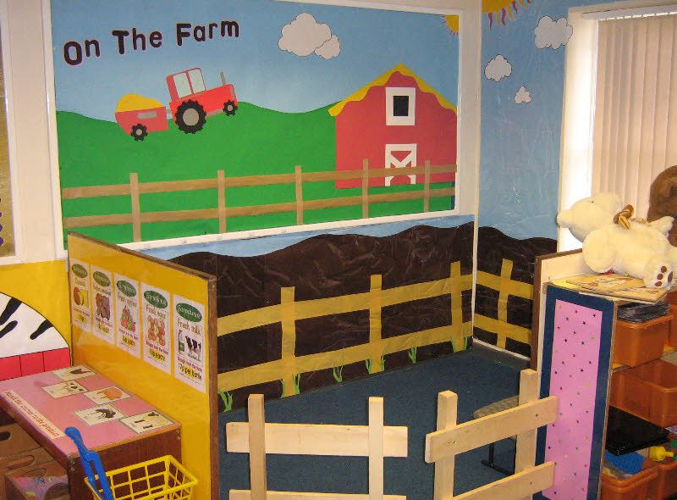
Our class decorated our room to look like a farm.

