Slide 1
STORY ELEMENTS
In Cinderella
Ms. Springhart’s 1st grade classroom

Slide 2
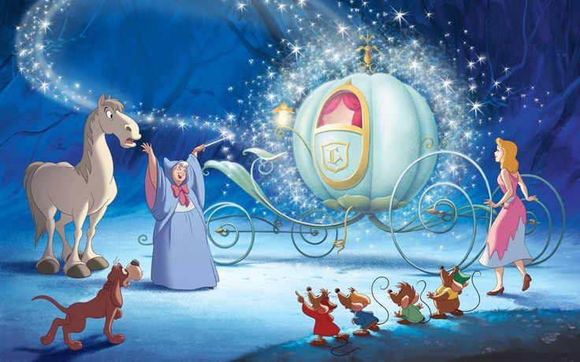
Setting
The setting in a story is where the story takes place. In Cinderella, the setting is the royal kingdom with the castle, the king, and the prince. It is a fictional place, which means it is not real.

Slide 3
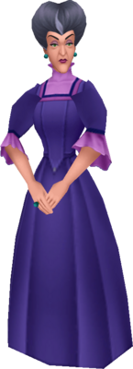
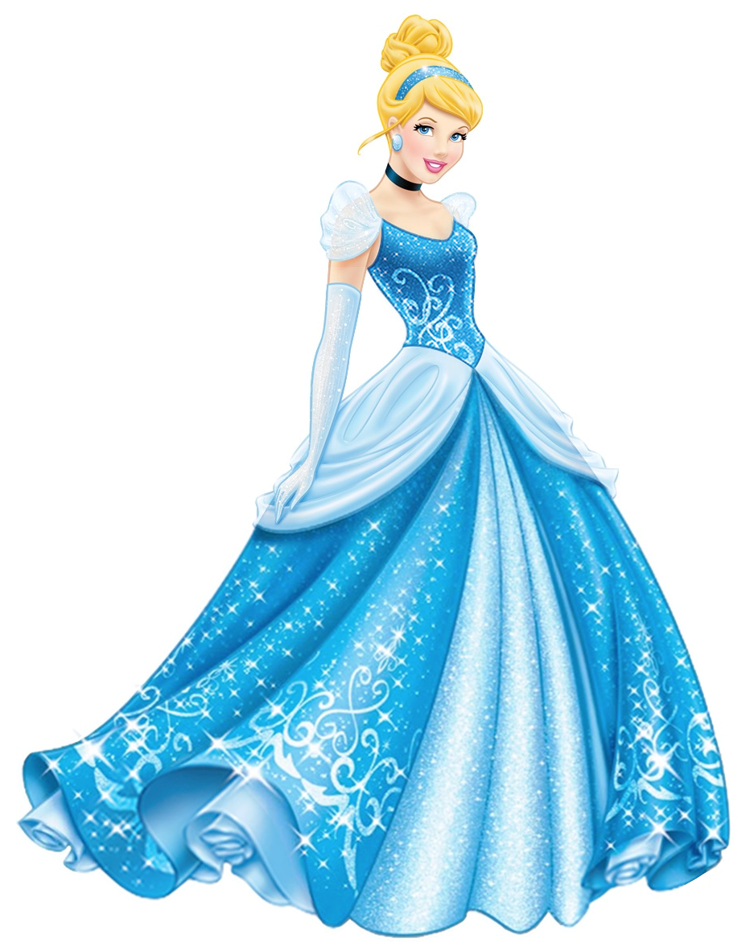
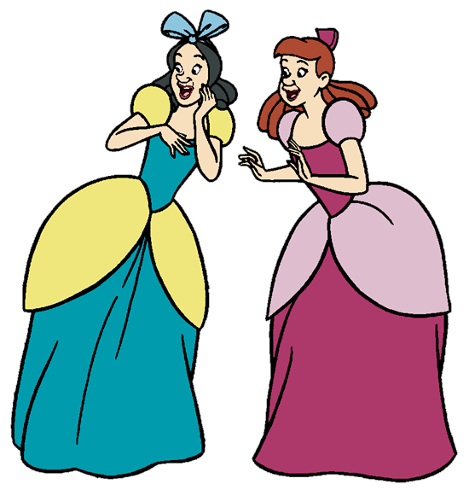
Characters
The characters are the people in the story. In Cinderella, here are some of the characters:

Slide 4
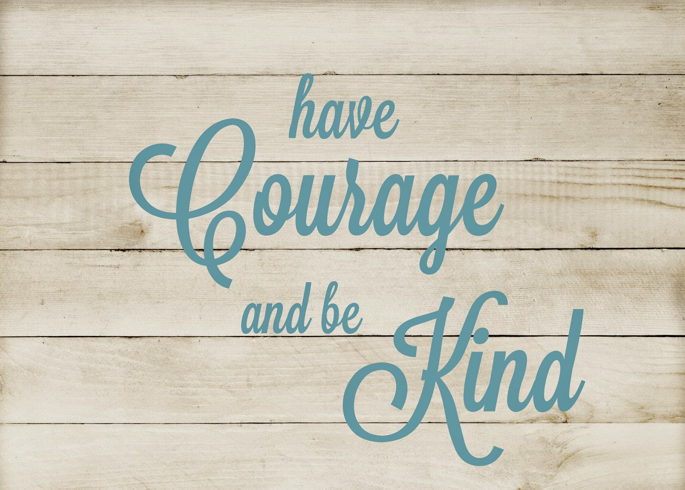
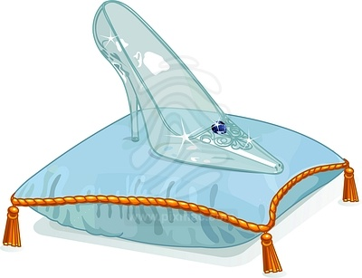
Theme
The theme of a story is the meaning, or the message behind it. What is the author trying to say, to teach you, or to tell you?
The theme of Cinderella could be any of these things:
Real beauty is found within
Being kind will get you further than money and pretty clothes will
Good things come to those who are patient and kind
Life can surprise you!

Slide 5
Exposition
The exposition in a story is simply the beginning part, when we are first introduced to the characters and learning a little bit about them and where they live, and what they want. Can you figure out what the exposition in Cinderella might be? It would include some of these things:
Cinderella’s father passing away
Cinderella’s new stepsisters
Cinderella’s evil new stepmother
Cinderella’s new job as her stepmother’s servant
What else do you think might be in the exposition of Cinderella?

Slide 6
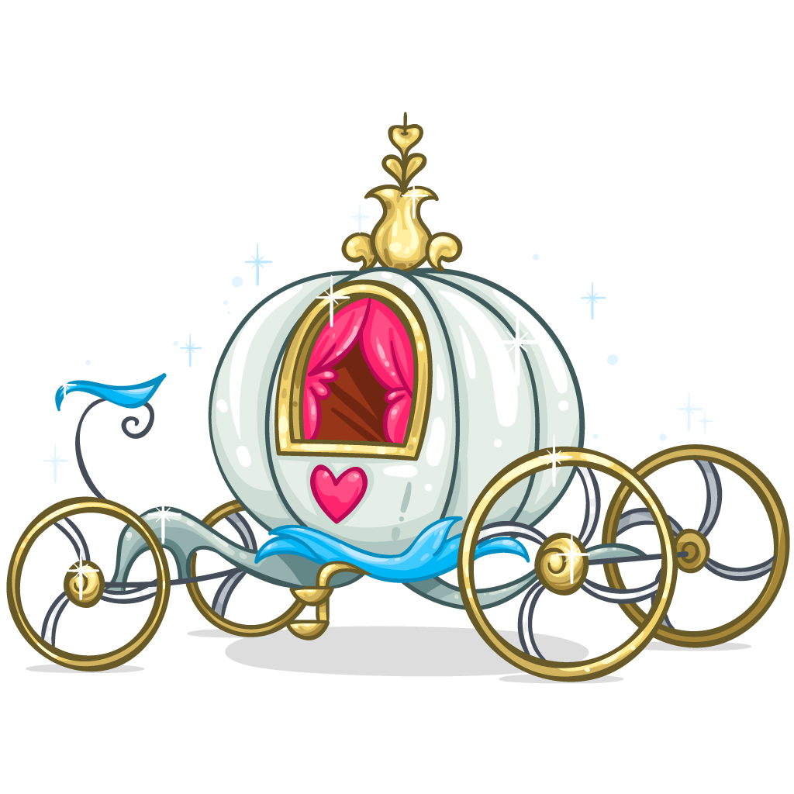
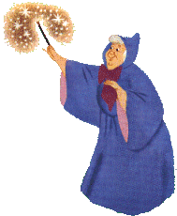
Rising Action
The Rising Action in a story is when things are building up and leading to a problem being faced or solved, and everything is feeling exciting! The rising action in this story would have been when Cinderella’s fairy godmother appeared and made her life a little more magical!

Slide 7
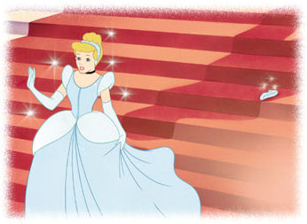
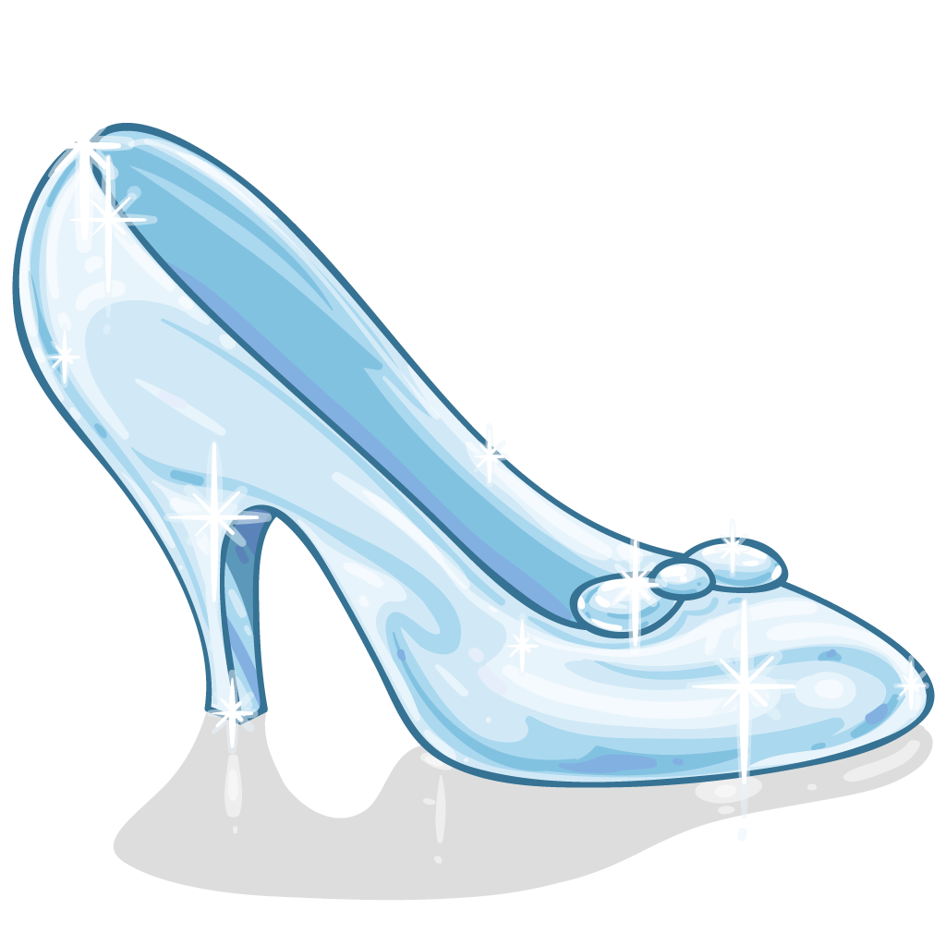
Climax
The climax of the book is when things are getting REALLY EXCITING!! This is the part you’ll remember forever!! Can you guess what the climax of Cinderella is?? I’ll give you a hint…it takes some clumsiness on Cindy’s part!

Slide 8
Falling Action
The Falling Action is the events that take place after the climax. They are winding down the action. In this story, Prince Charming’s search for Cinderella would be some of the falling action. Can you name any more?
(find answers here!)
The sisters being upset, the stepmother being upset, the prince’s father wanting him to find a wife

Slide 9
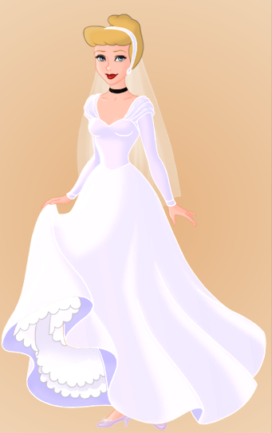
Resolution
The resolution of a story is when everything is falling into place and the story is coming to a close. This is when we tie everything up nice and pretty with a bow and say, “And they lived happily ever after,” just like our book ends.
Which story element is your favorite?

Slide 10
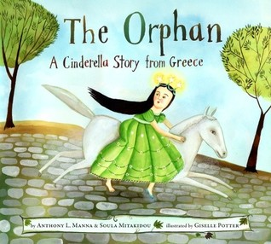
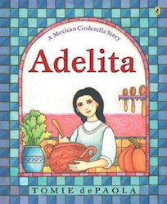
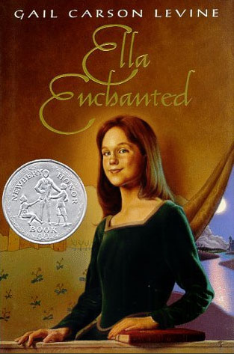
Other Cinderella Stories….

Slide 11
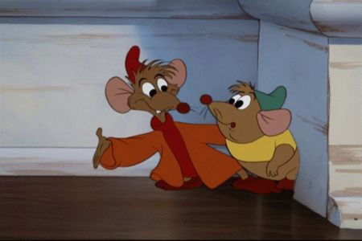
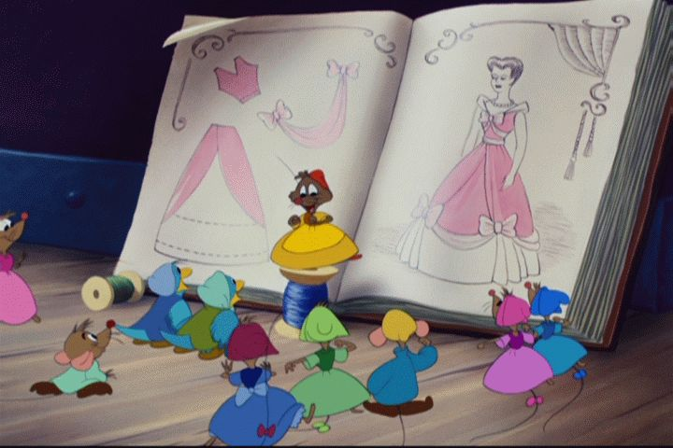
More loveable Cinderella characters

