Slide 1
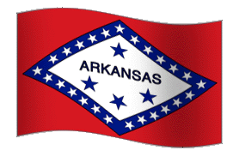
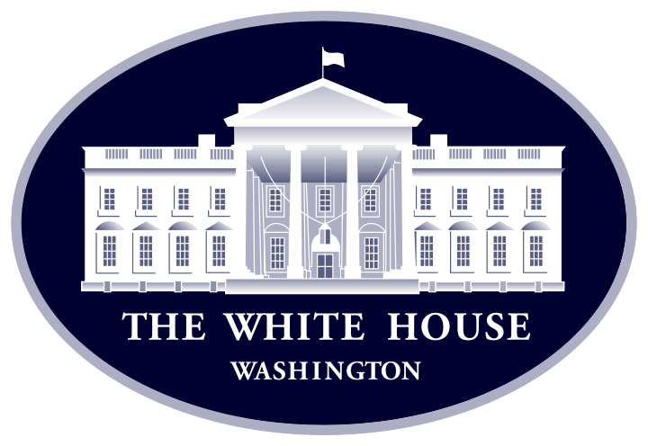
Social Studies Jeopardy Ms. Springhart’s Class
Walt Disney Elementary School
This Photo by Unknown Author is licensed under CC BY-SA

Slide 2
Presidents | American Flag Facts | State Capitols | Arkansas Facts | National Holidays
$200 | $200 | $200 | $200 | $200
$400 | $400 | $400 | $400 | $400
$600 | $600 | $600 | $600 | $600
$800 | $800 | $800 | $800 | $800

Slide 3
George Washington

Slide 4
Who was the first President of the United States?

Slide 5
Donald Trump

Slide 6
Who is the current President of the United States?

Slide 7
Martha Washington

Slide 8
Who was the first First Lady of the United States?

Slide 9
William Taft

Slide 10
Which president got stuck in his bathtub?

Slide 11
50 and 13

Slide 12
How many stars and how many stripes are on the American flag?

Slide 13
Betsy Ross

Slide 14
Who designed the original American flag?

Slide 15
The 50 states.

Slide 16
What do the 50 stars represent?

Slide 17
1777

Slide 18
When was the flag adopted?

Slide 19
Little Rock

Slide 20
Arkansas

Slide 21
Jackson

Slide 22
Mississippi

Slide 23
Montgomery

Slide 24
Alabama

Slide 25
Nashville

Slide 26
Tennessee

Slide 27
Apple Blossom

Slide 28
What is Arkansas’ state flower?

Slide 29
Northern Mockingbird

Slide 30
What is Arkansas’ state bird?

Slide 31
AR

Slide 32
What is Arkansas’ abbreviation?

Slide 33
The Natural State

Slide 34
What is Arkansas’ nickname?

Slide 35
July 4th

Slide 36
On what day do we celebrate our independence from England?

Slide 37
Martin Luther King Jr. Day

Slide 38
On what day do we celebrate the man who fought for equal rights for all colors of people in America?

Slide 39
To honor soldiers who have died serving our country.

Slide 40
Why do we celebrate Memorial Day?

Slide 41
The last Thursday in November.

Slide 42
When do we celebrate Thanksgiving?

