Slide 1
Frida Kahlo and Her Animalitos
Monica Brown
Made by Anna Kate

Slide 2
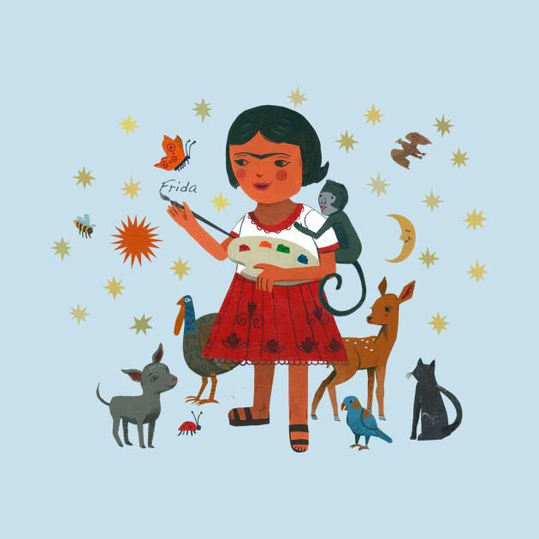
Frida is a little girl.

Slide 3
Frida’s dad is a photographer.
He lets her help with his pictures, and she starts to paint.

Slide 4
Frida gets hurt as a little girl. She has lots of pets.
Like a monkey, a turkey, a parrot, and dogs and cats!

Slide 5
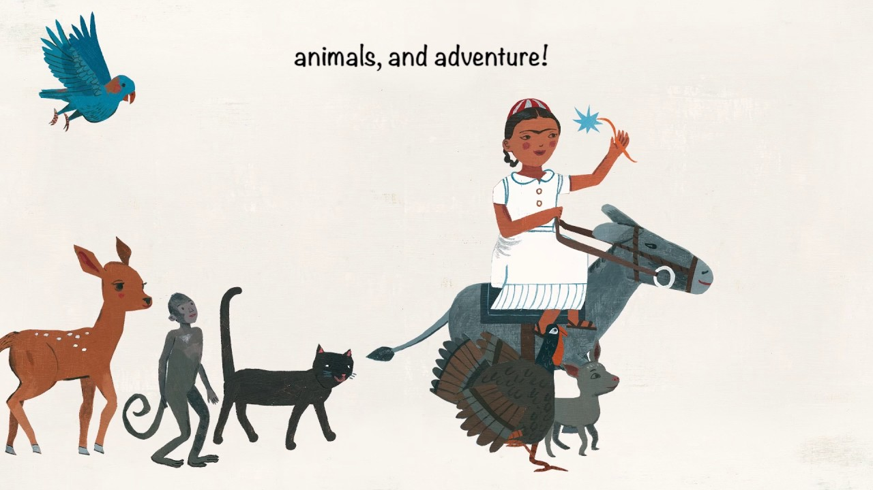
Frida loves her pets and they make her happy even when she is sick.

Slide 6
Frida grew up to marry a man named Diego.
He loved her and her paintings and her love for her pets.

Slide 7
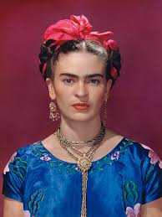
Frida was from Mexico. She loved the bright colors there.

Slide 8
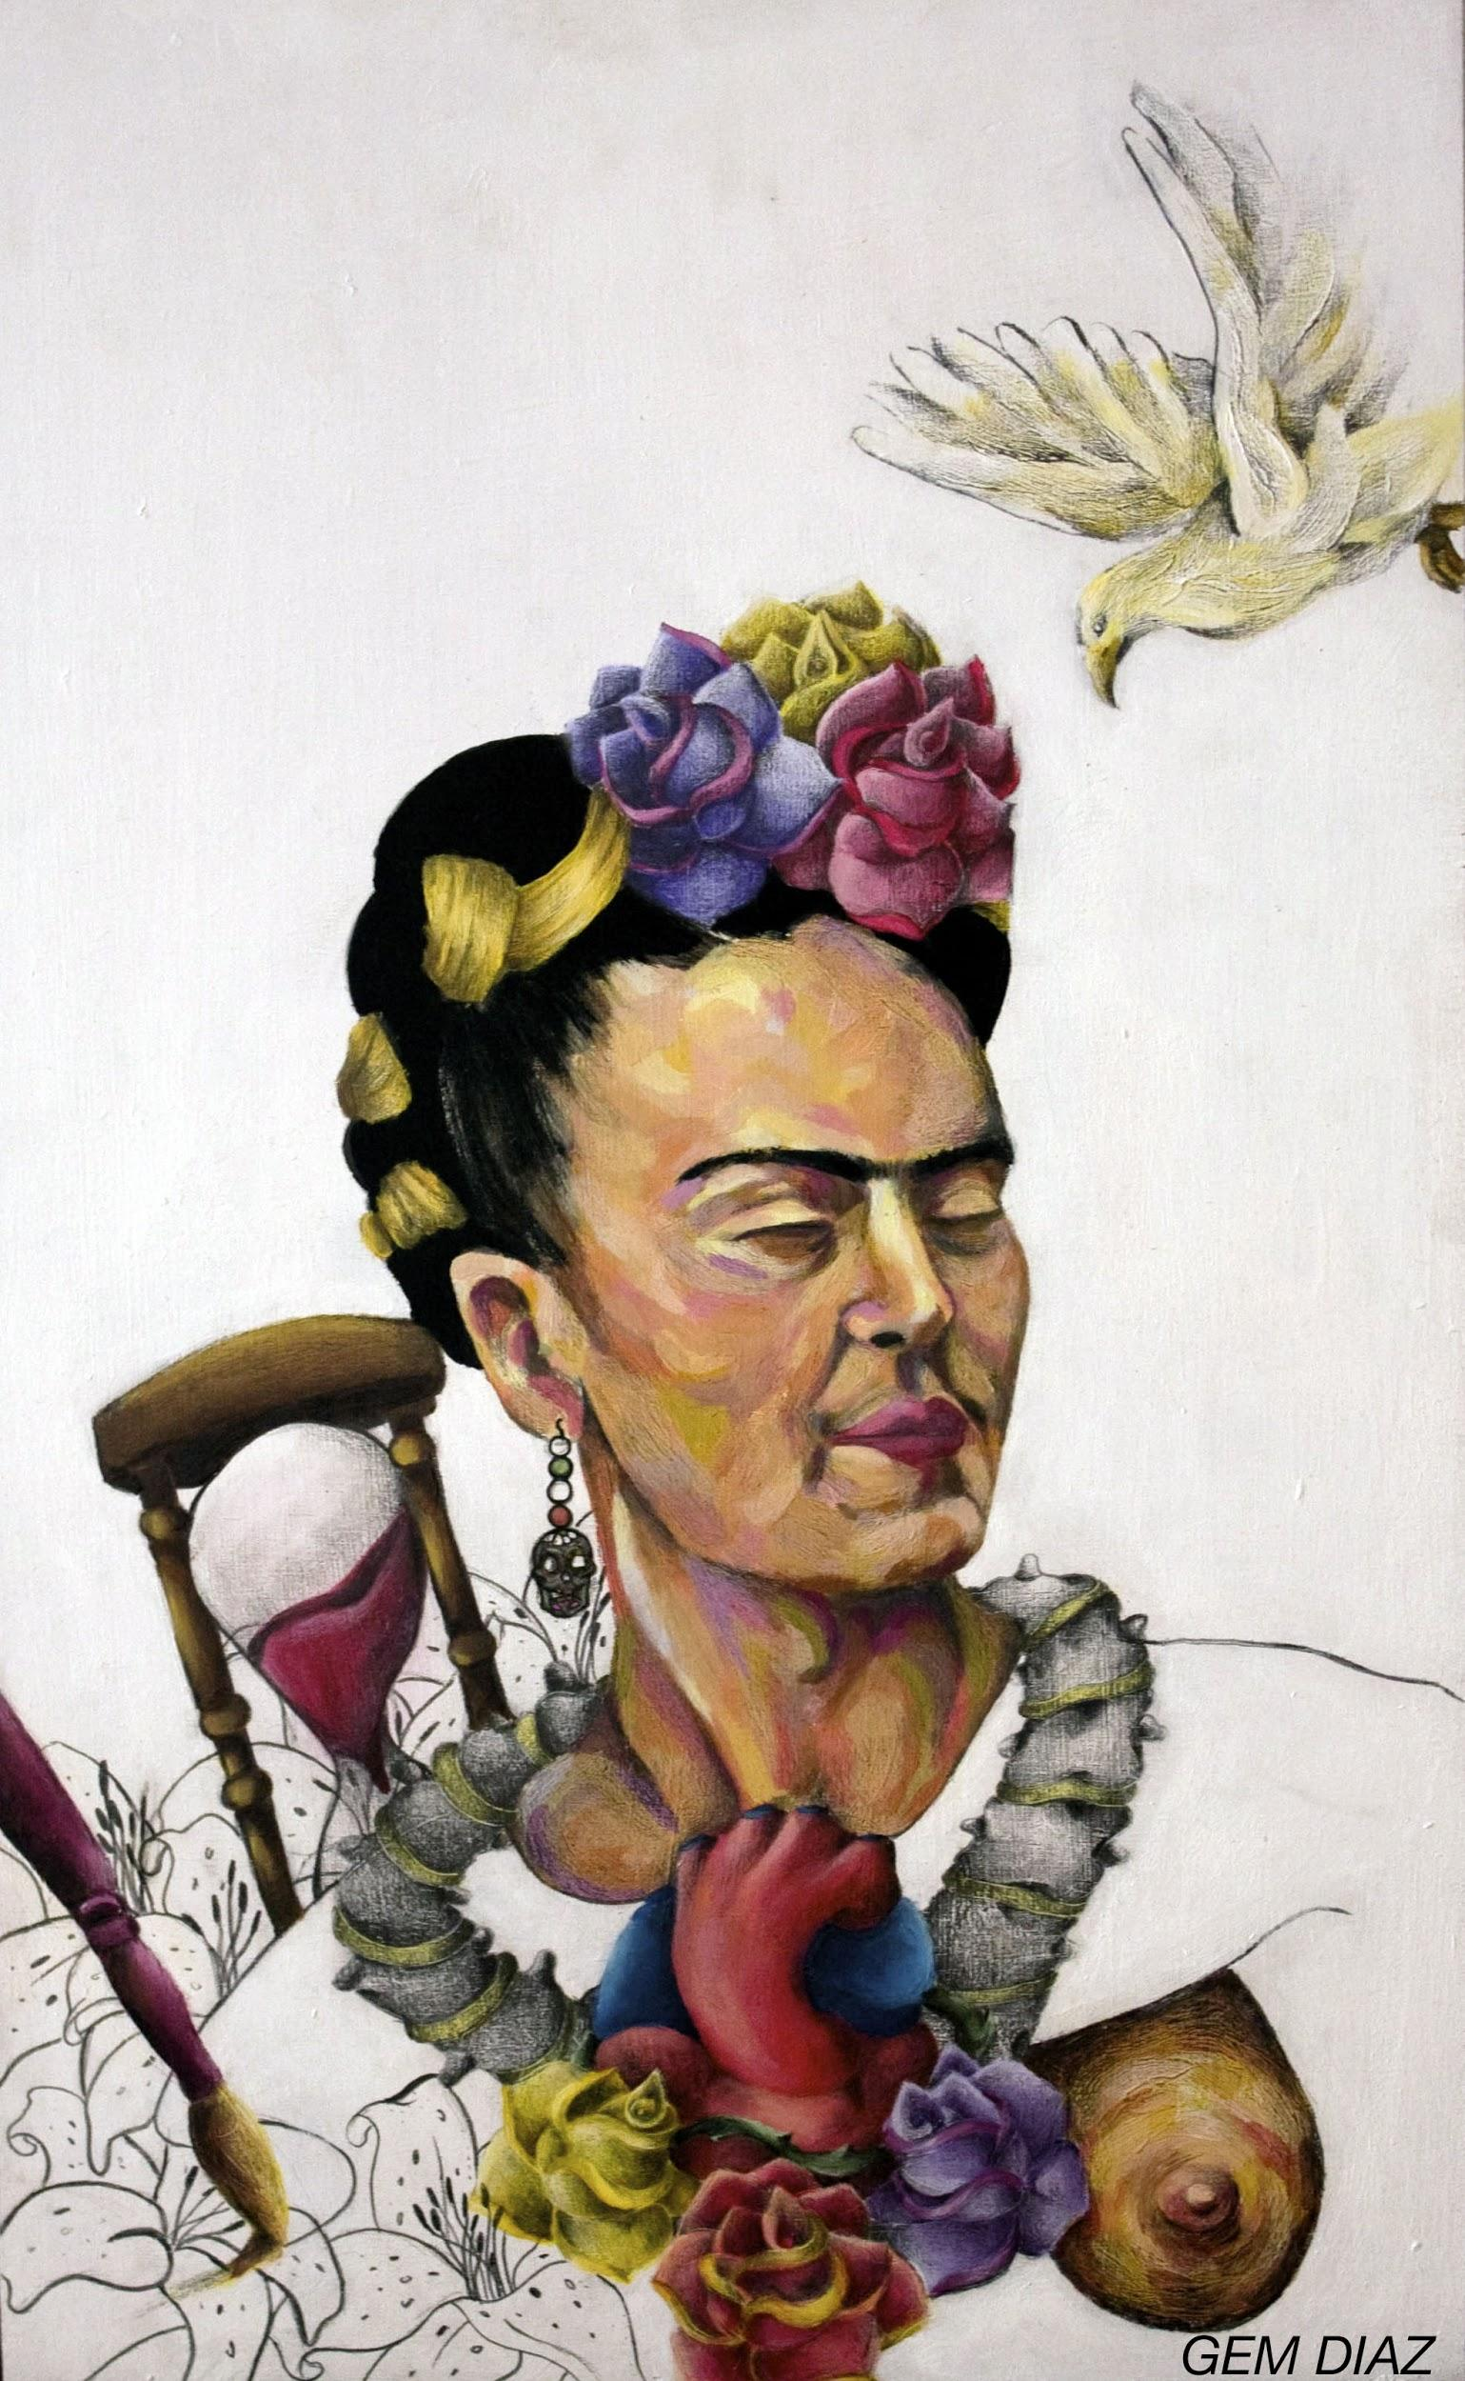
Frida painted even when she was sick and stuck in bed, and her paintings became very famous.

