Slide 1
All About Goats
By : Ms. Baker’s 3rd grade class

Slide 2
Types of Goats
There are three types of goats : Domestic Goats (Capra Hircus), Wild Goats (Capra genus), and Mountain Goats (Oreamnos Americanus). In those are different breeds.

Slide 3
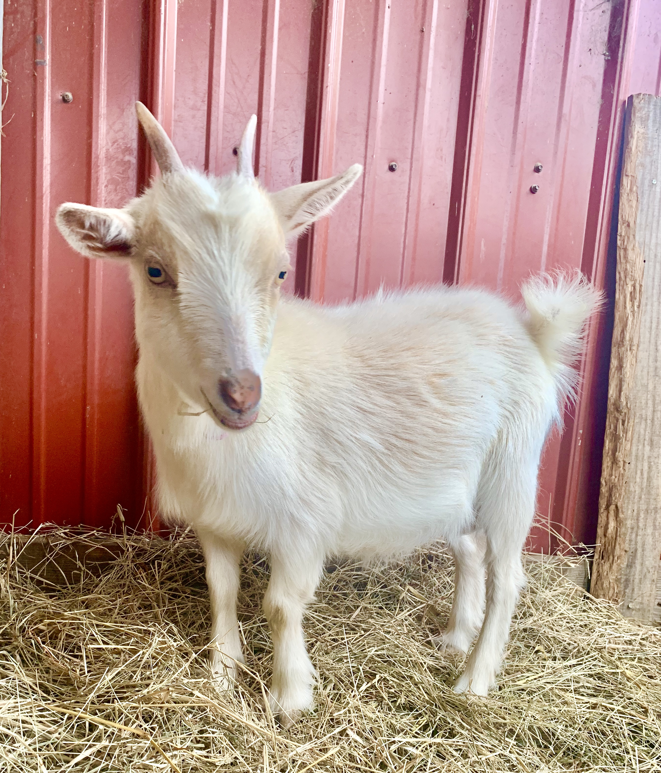
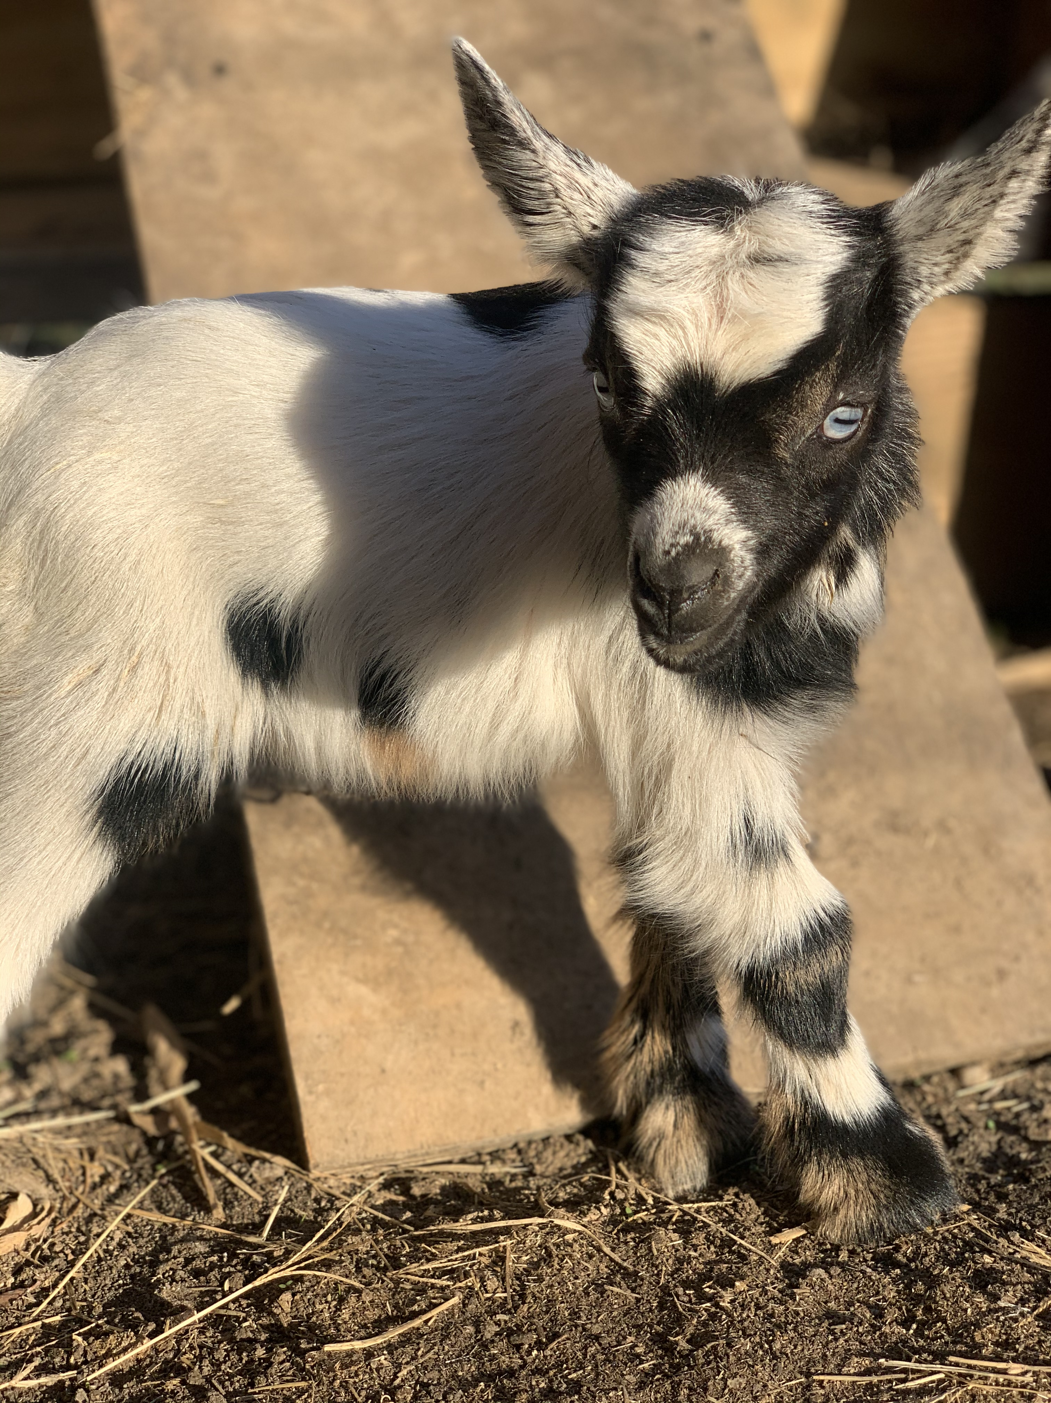
Domestic Goats
Nigerian Dwarf
American Pygmy
Fainting
Lamancha
Boar
Nubian

Slide 4
Wild Goats
Ibexes
Turs
Markhor

Slide 5
Mountain Goats
Irish
Altai Mountain
Alpine
Booted

Slide 6
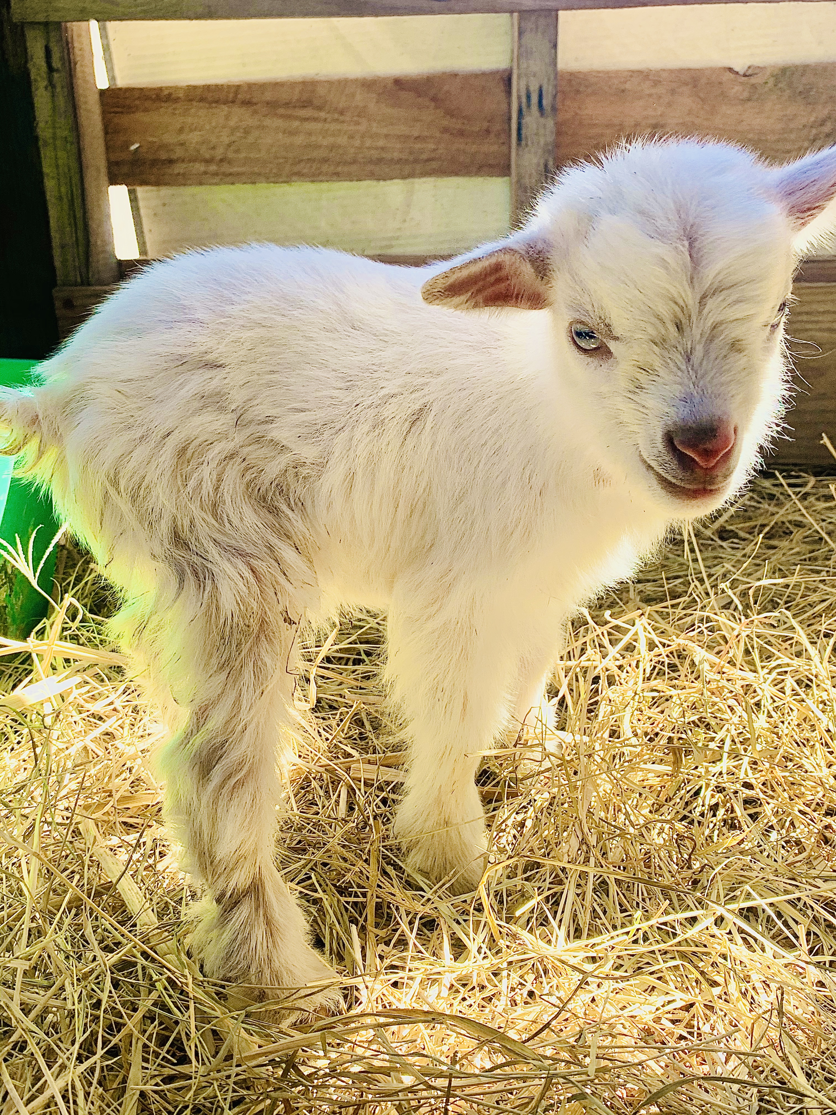
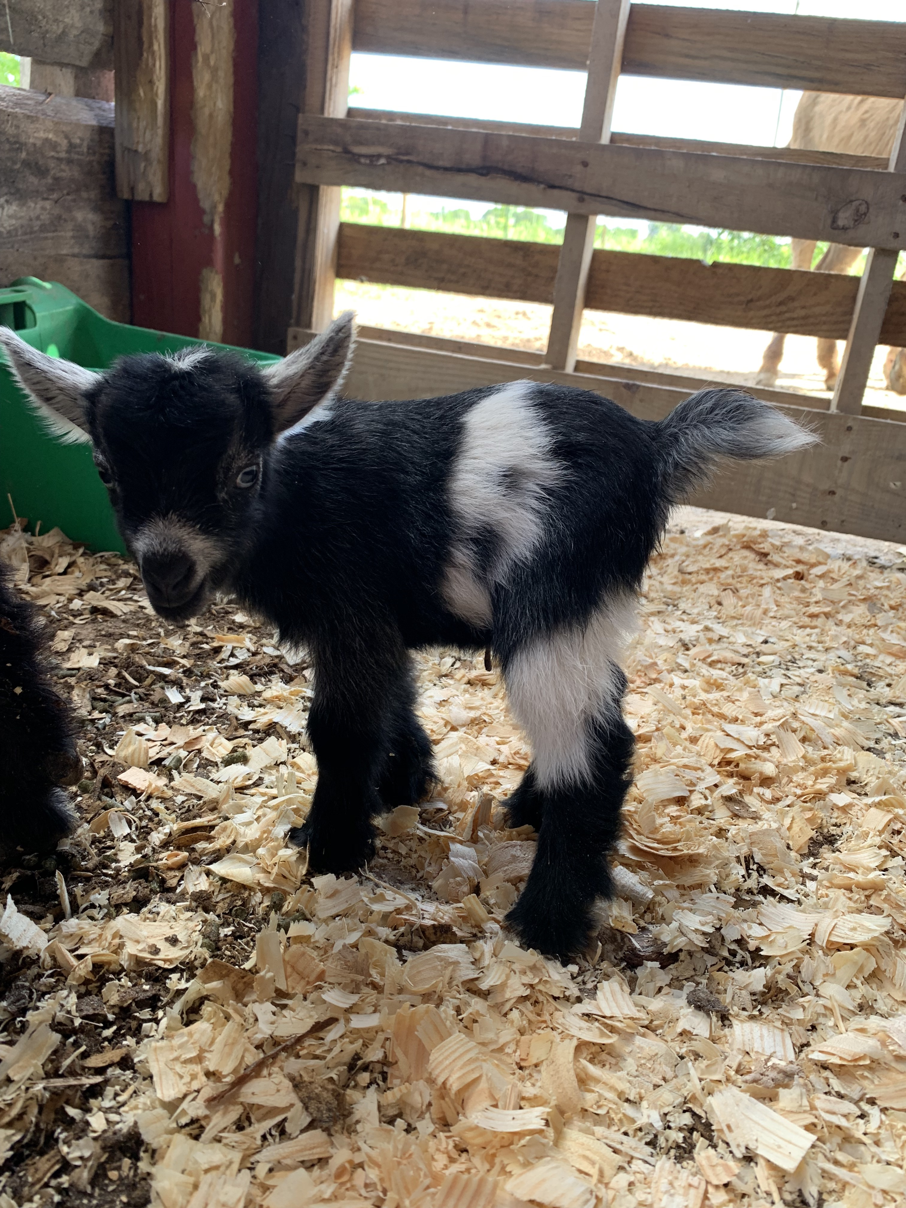
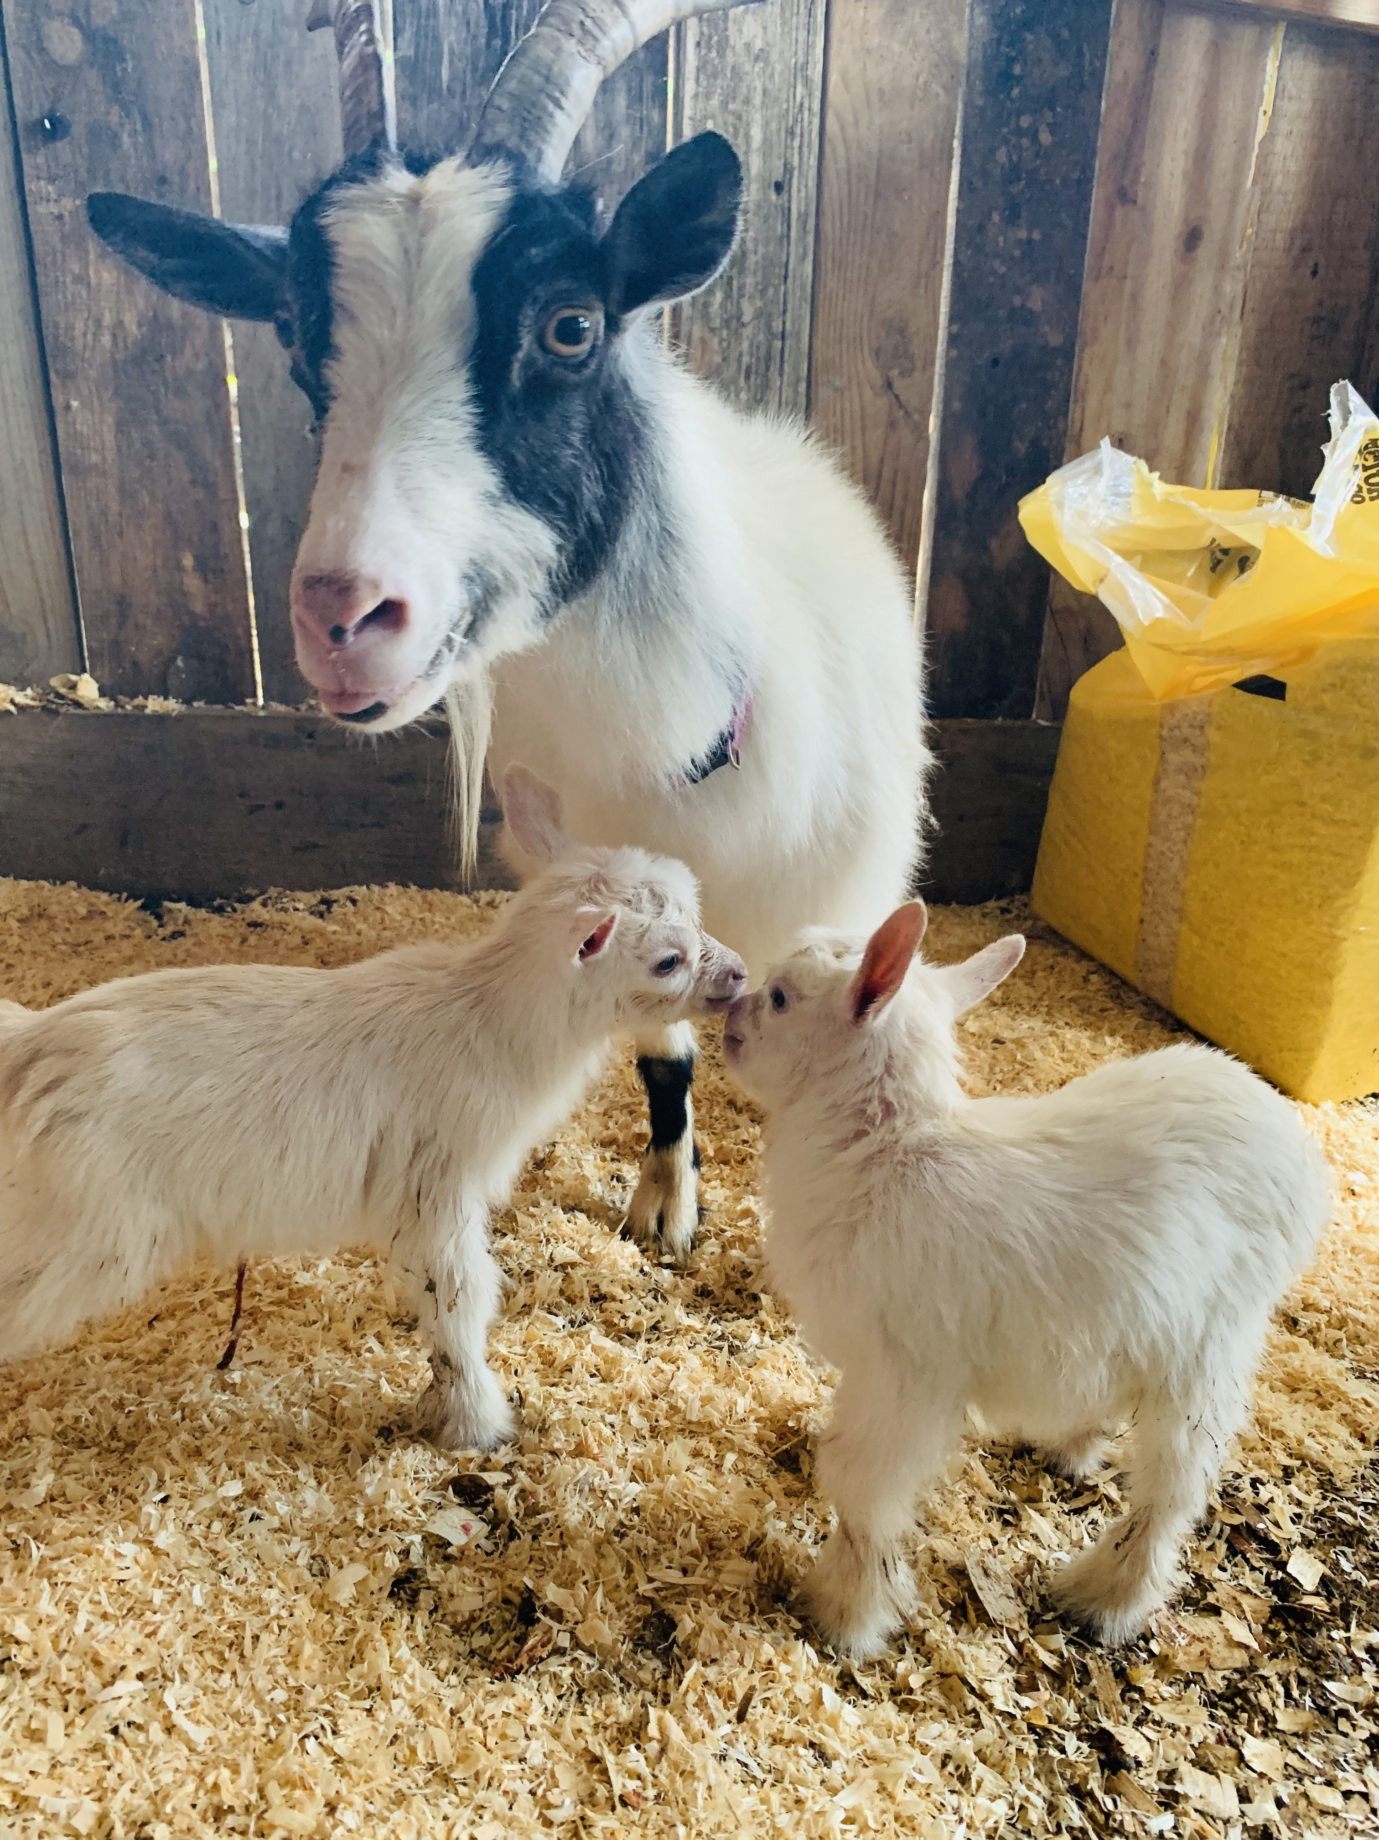
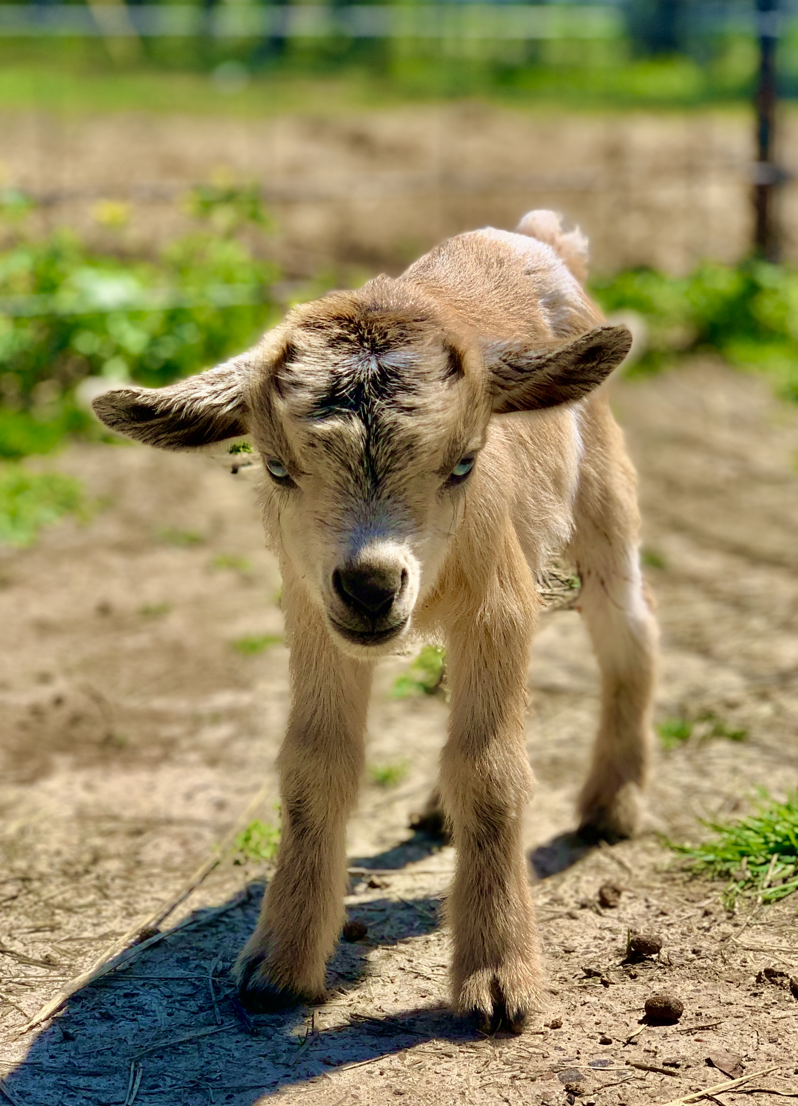
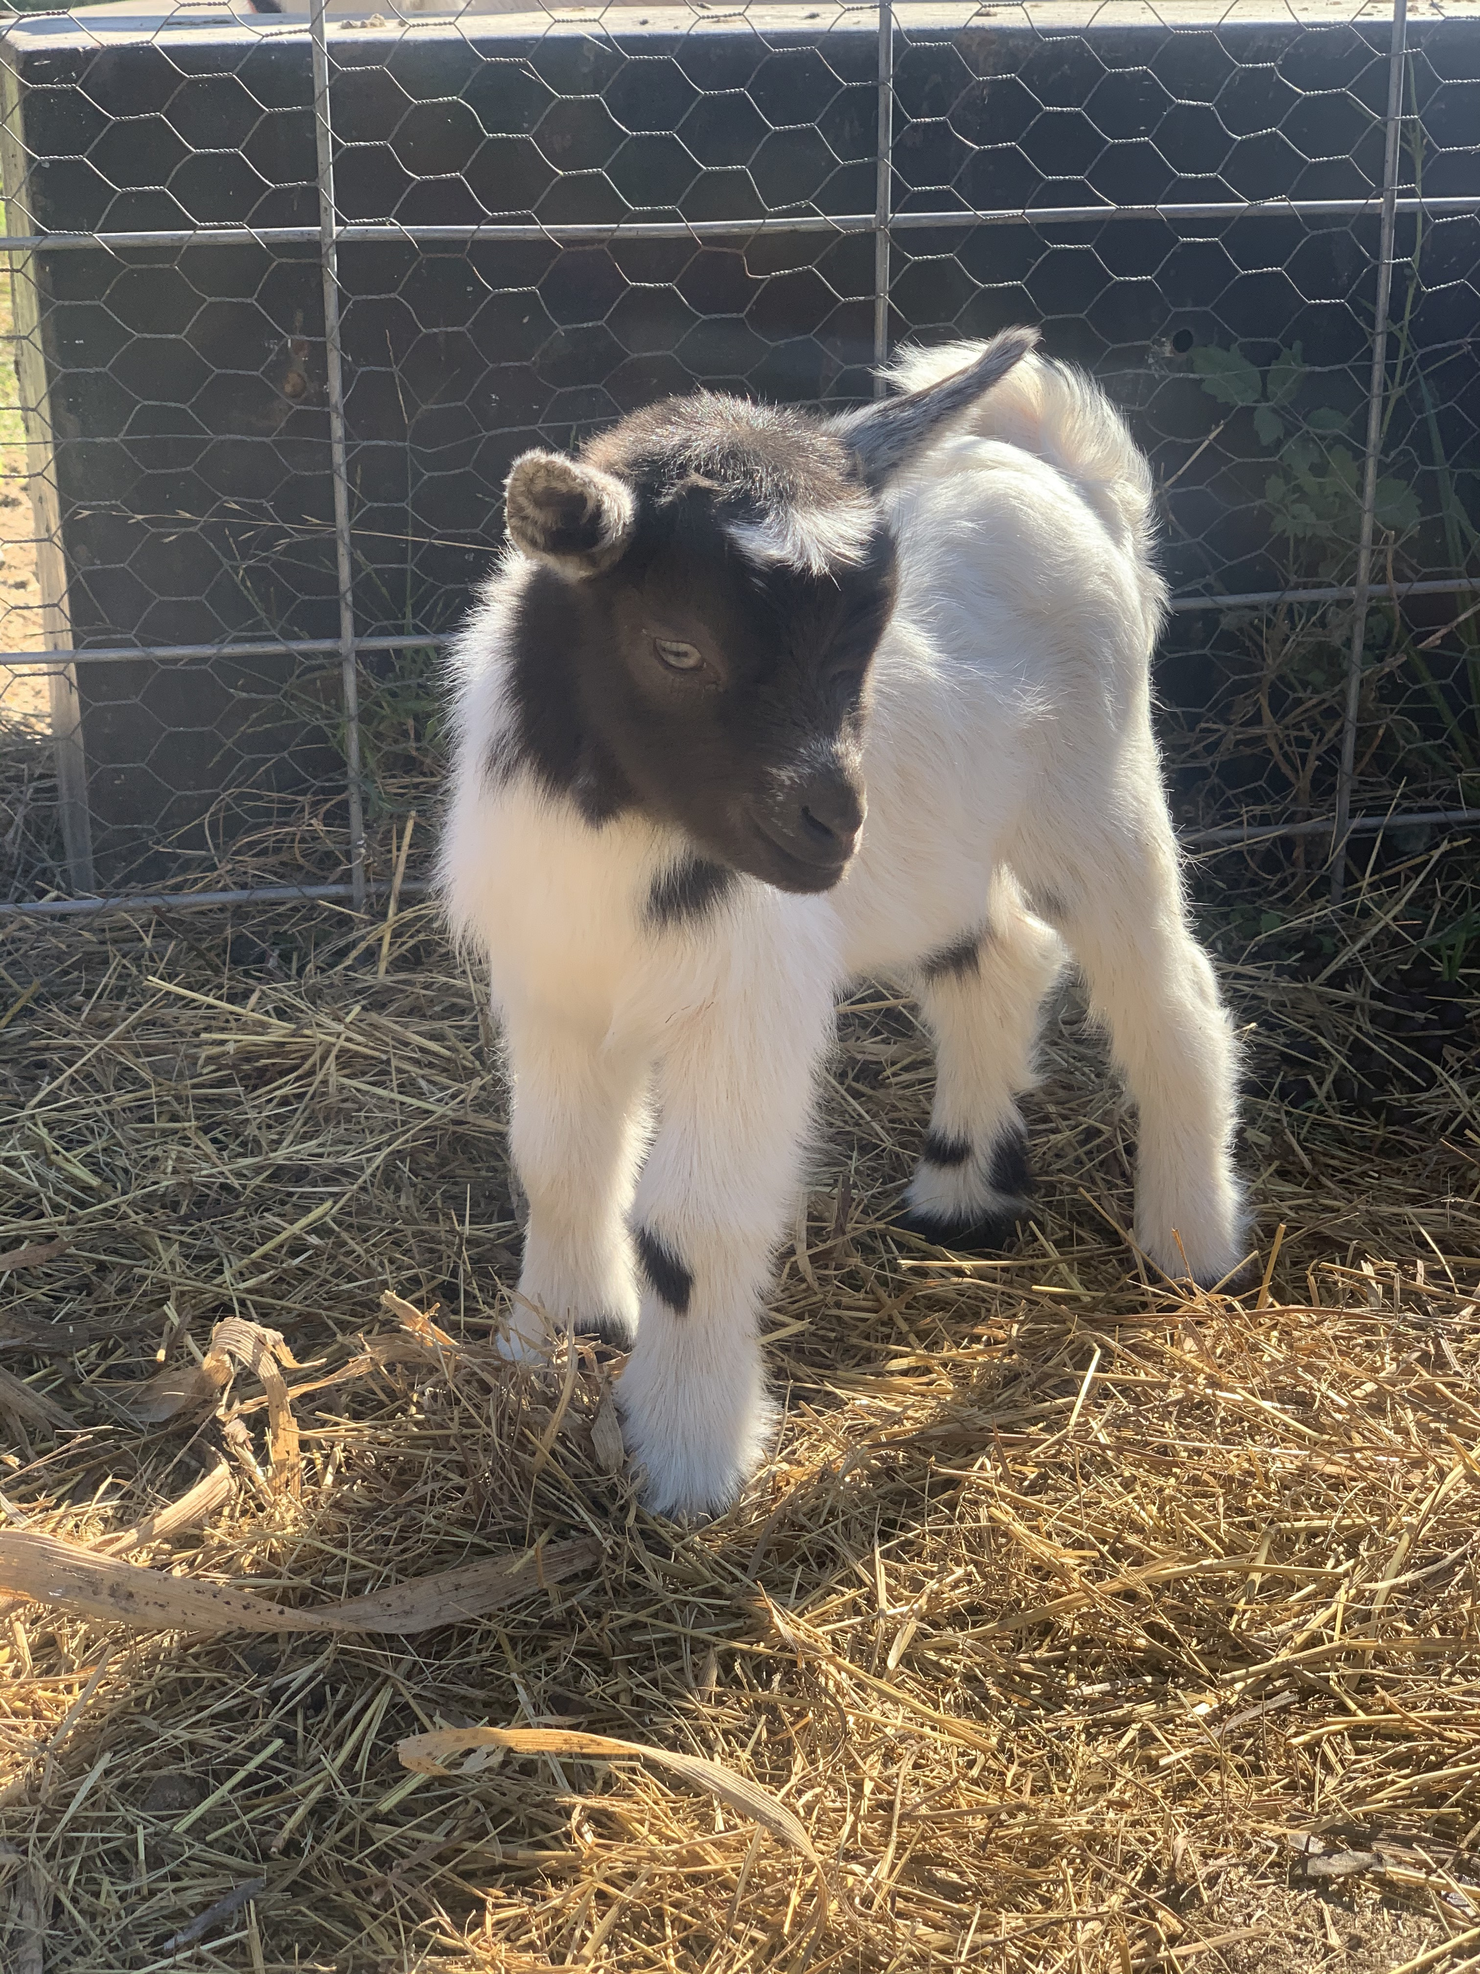
Baby Goats
Baby goats are called Kids. They can get up and walk around minutes after being born and love to jump around. Single, twins, triplets, and quadruplets are common when being born.

Slide 7
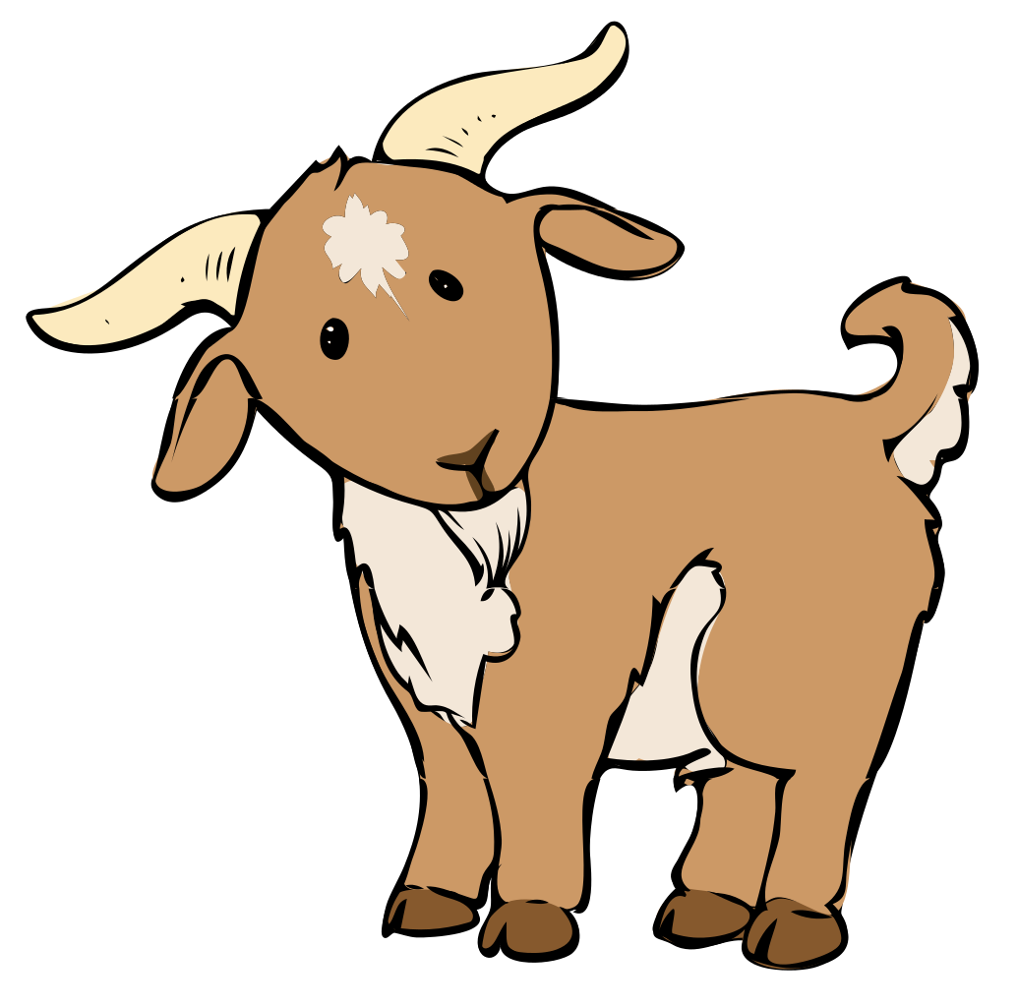
Fun Facts about Goats
Goats were one of the first animals to be tamed by humans over 9,000 years ago.
Goats can be taught their name and to come when called just like dogs.
Goats do not have teeth on their upper jaw.
Goats have four stomachs.
Goats need a herd to live in.

Slide 8
Why have goats ?
Goats are great animals for farms or petting zoos.
Their milk is very beneficial and can be used for many different things like cheese, ice cream, butter , and even soap, skin care, and lotion.
Many people raise goats for meat.

Slide 9
Goat Activities
Goats love to climb ! They are known to take shelter in trees in many other countries. Many domestic goats have been taken into the new trend of goat yoga, where goats climb on you while doing yoga. Goats are very active and tend to be curious animals but can be lazy too.

Slide 10
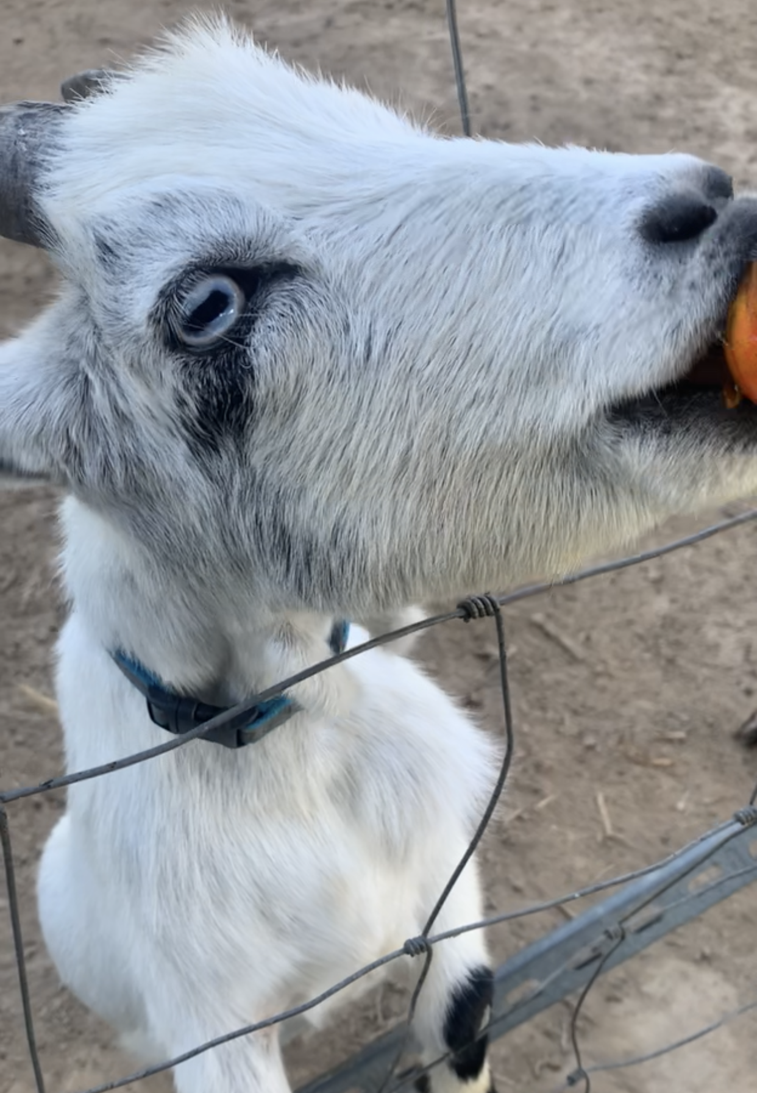
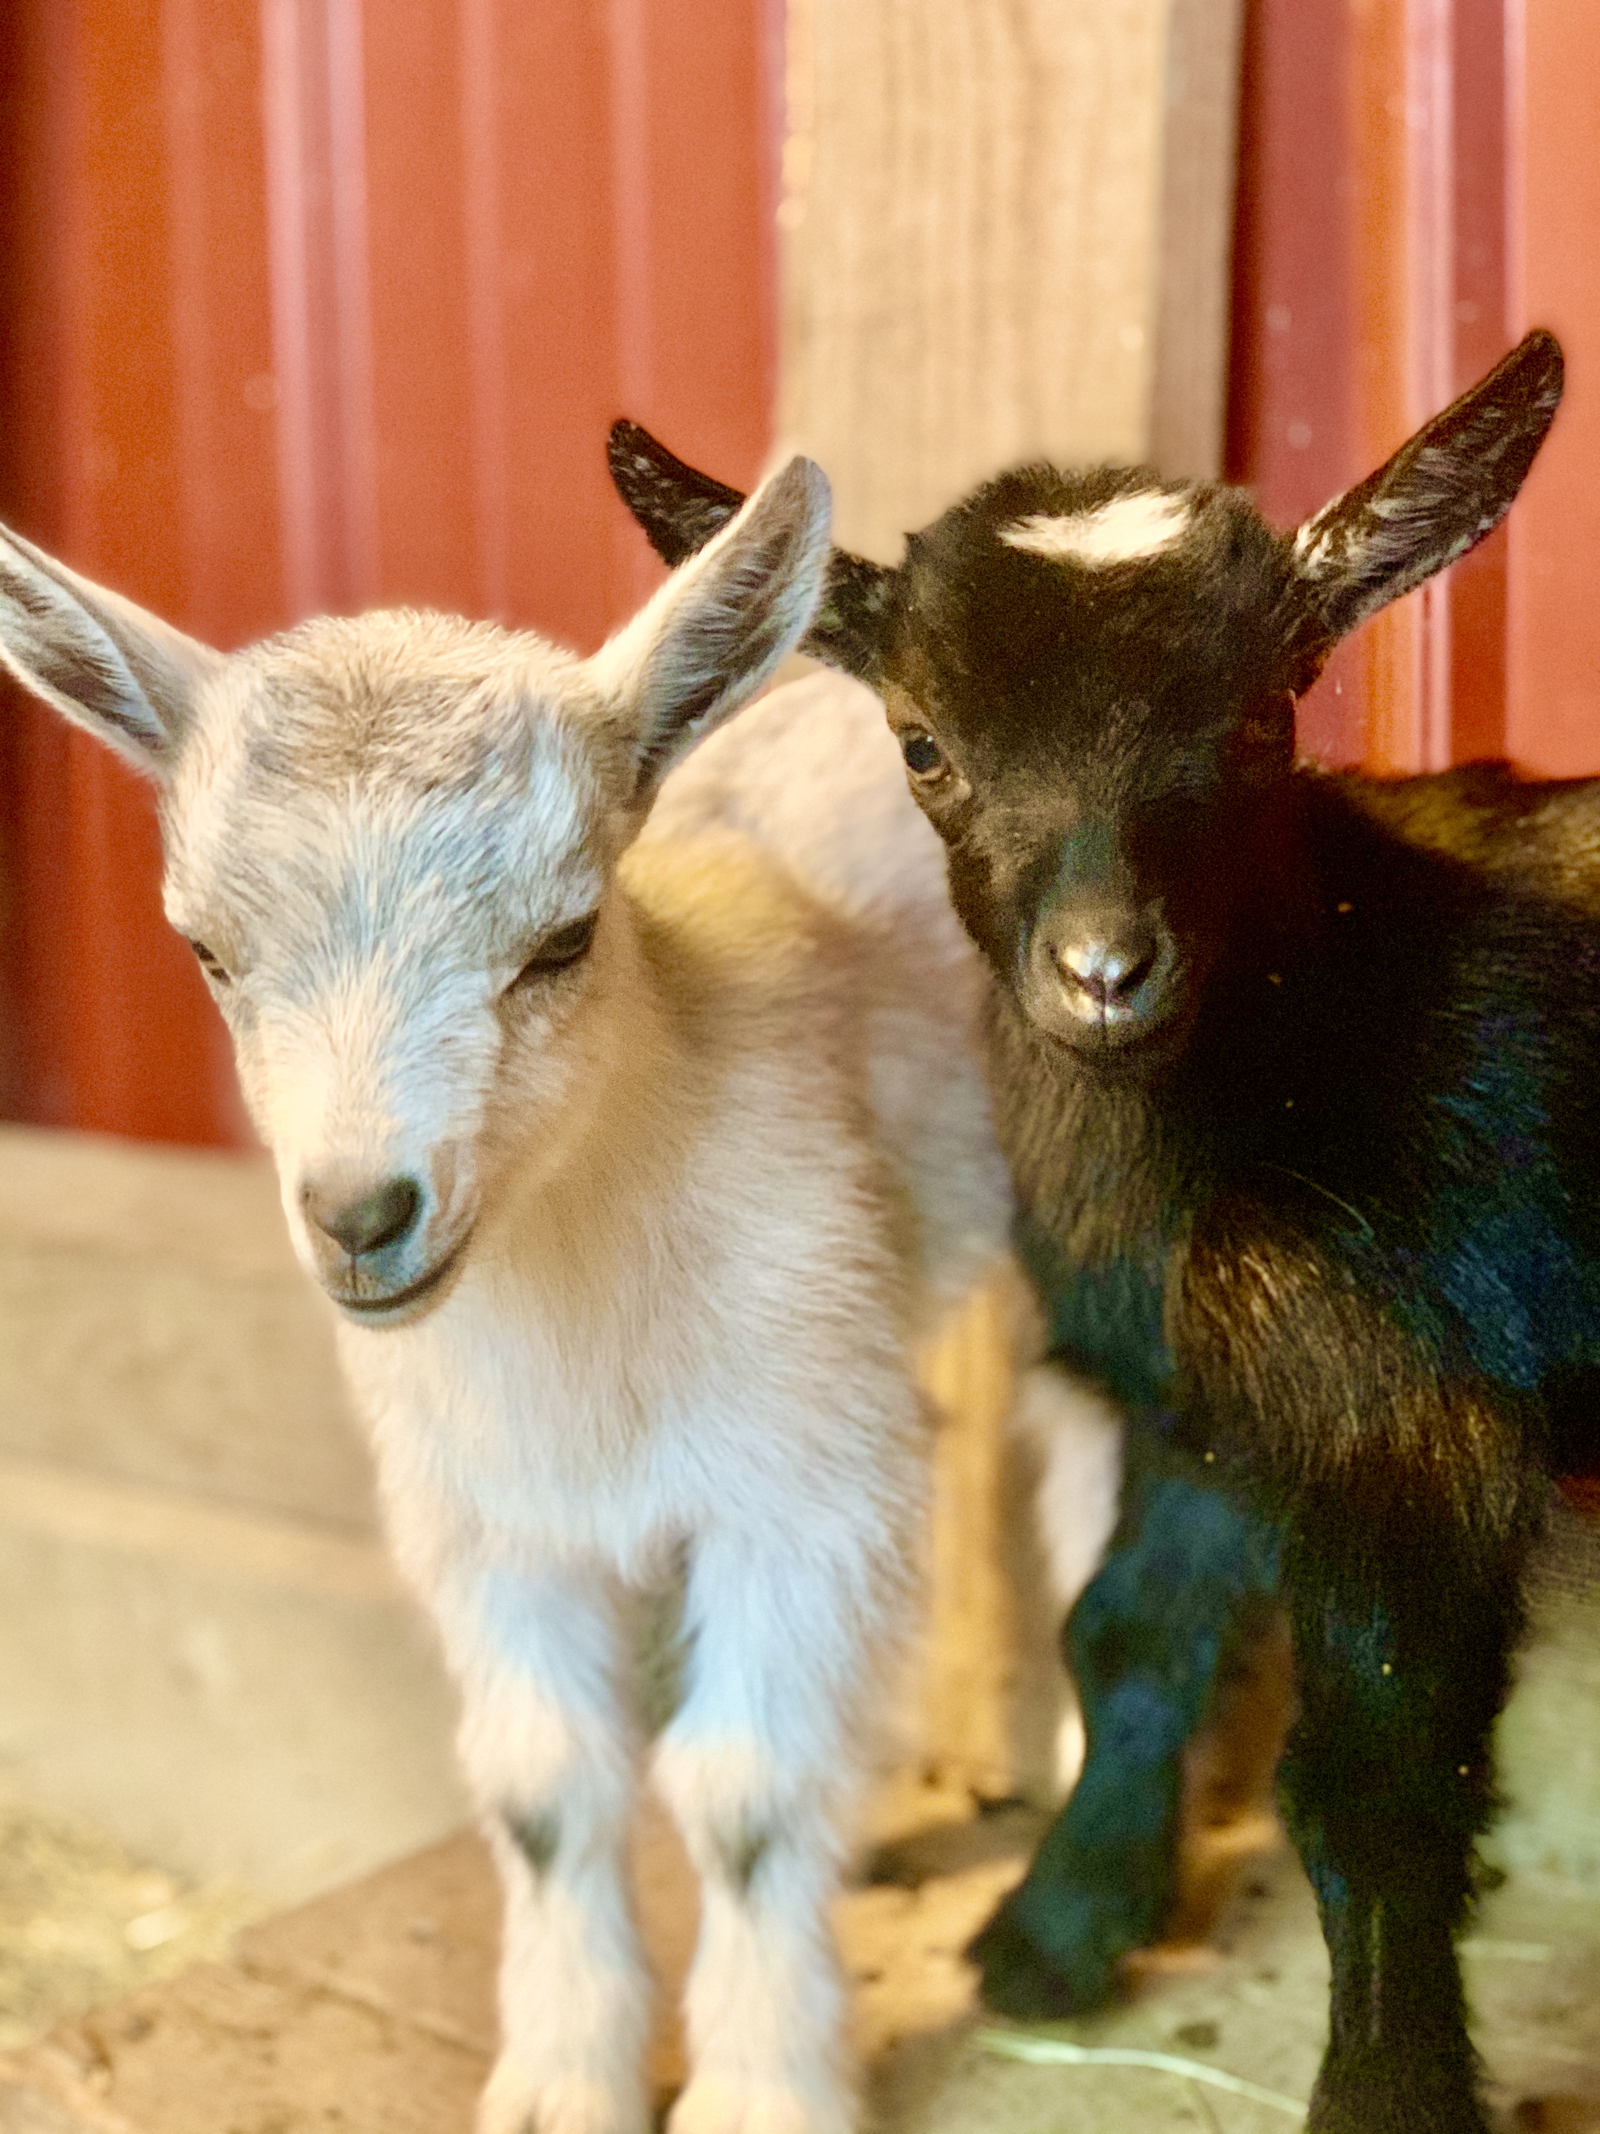
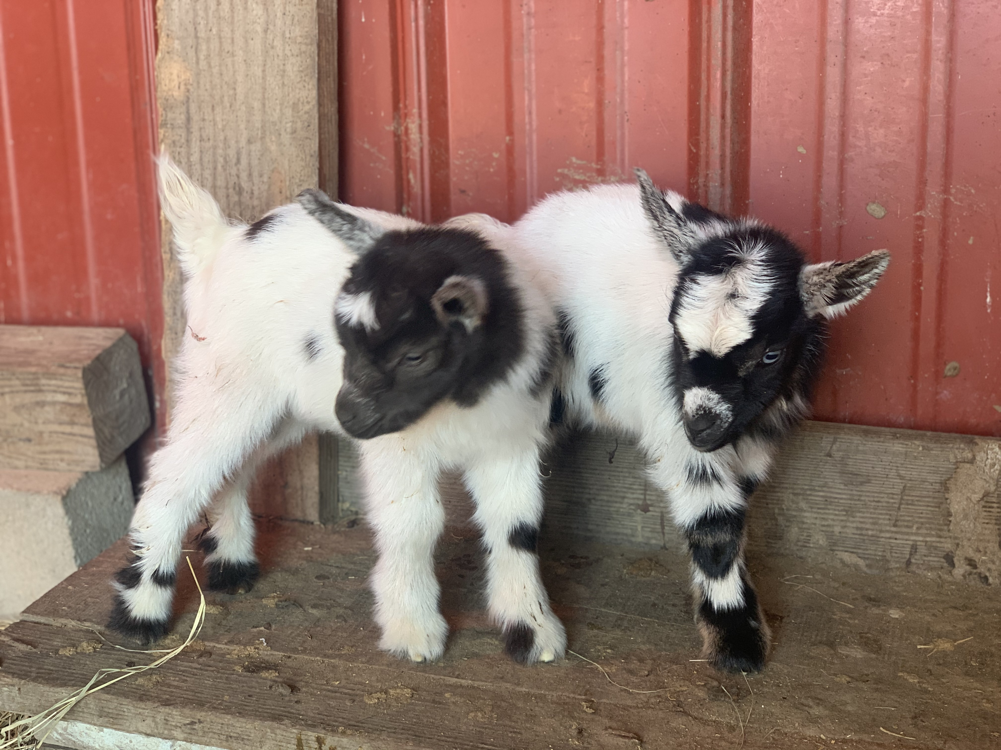
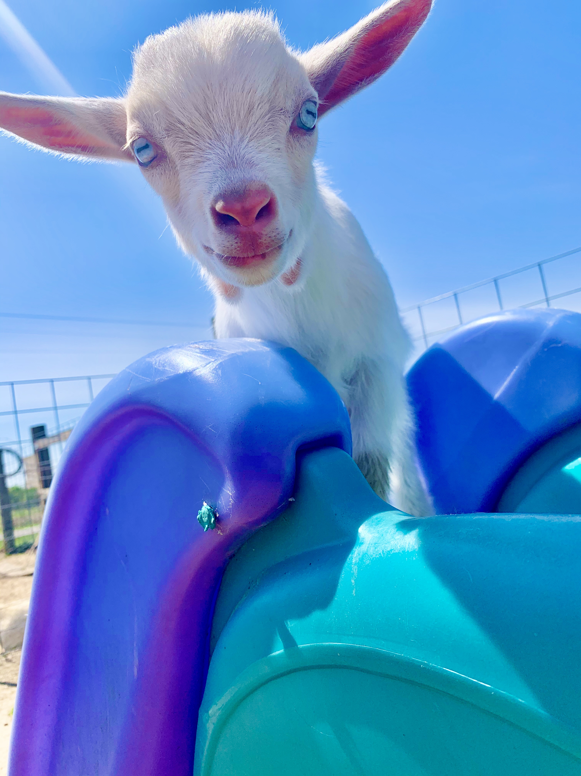
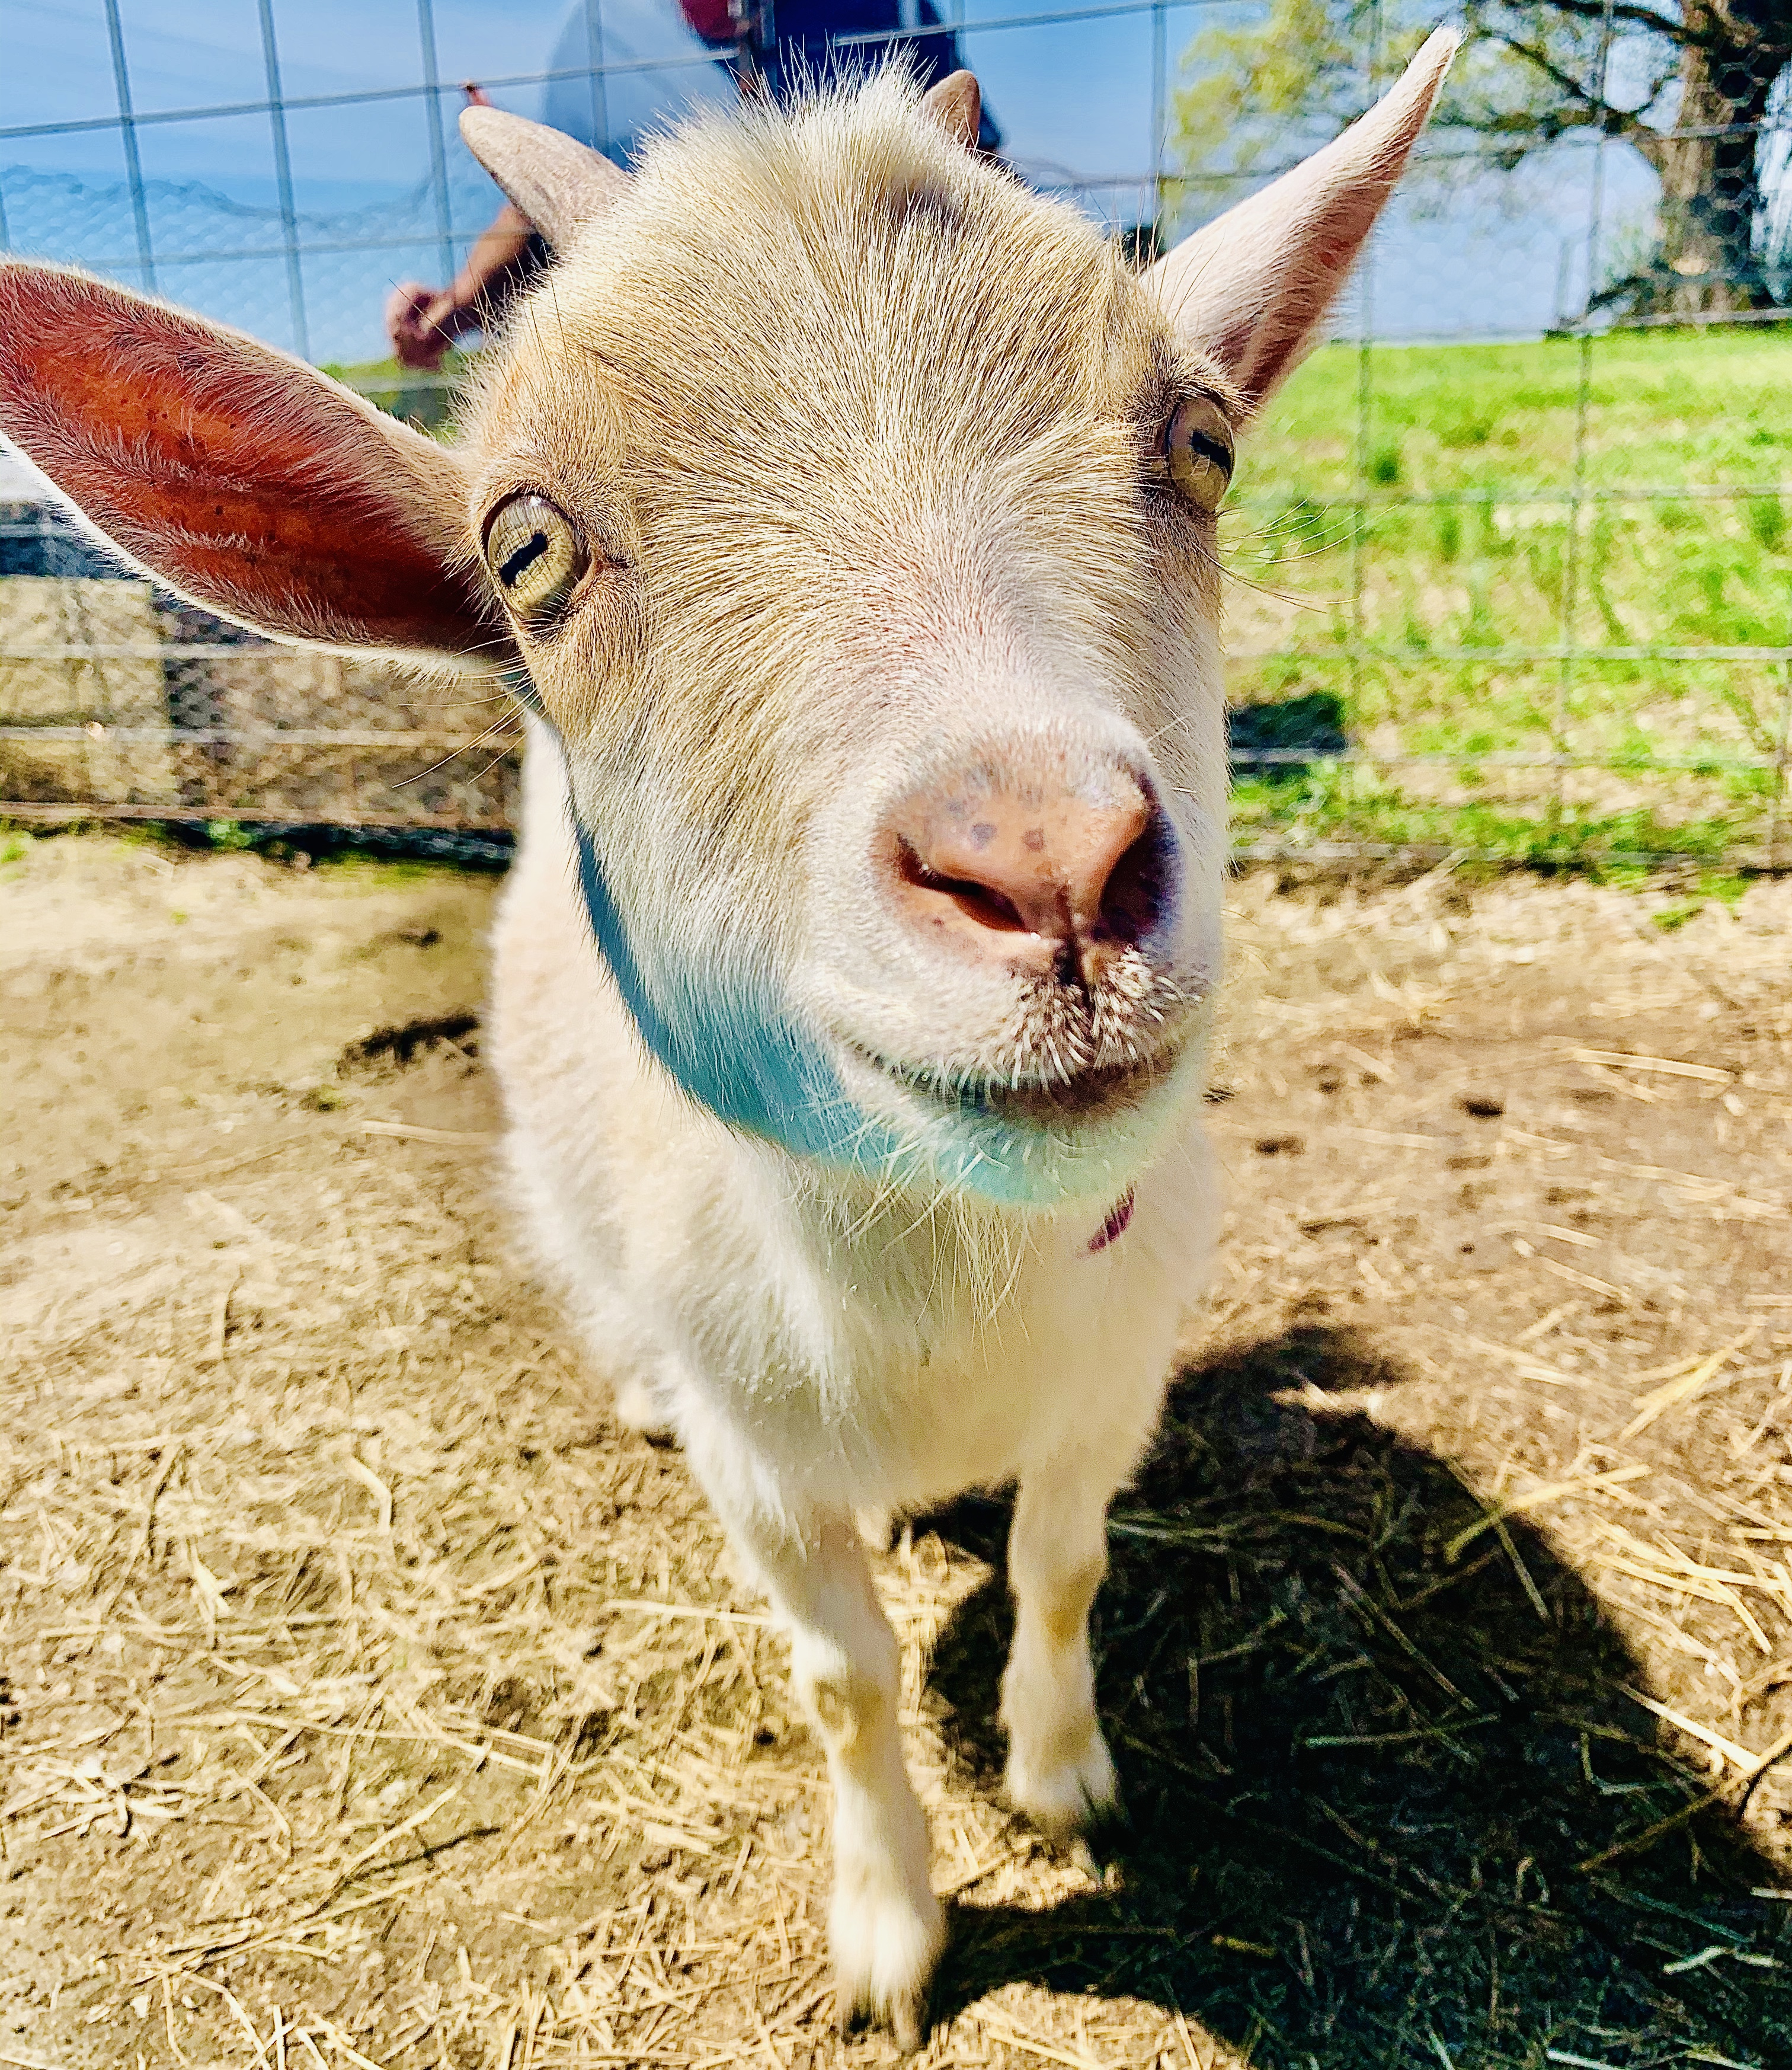
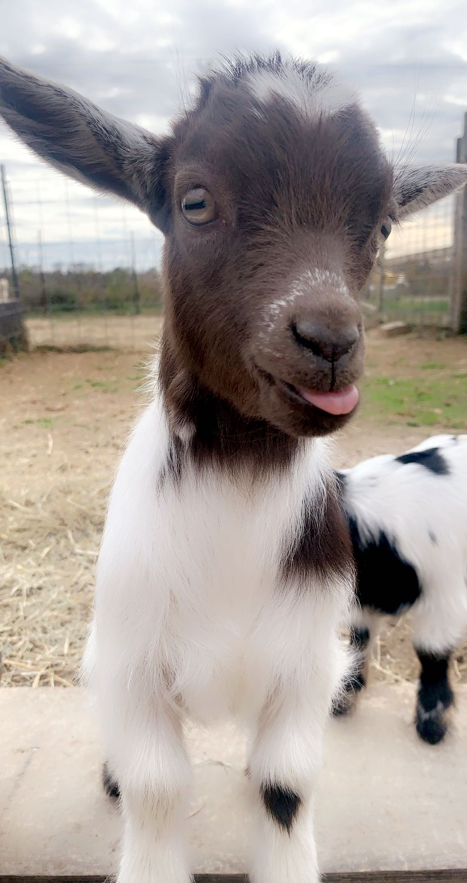
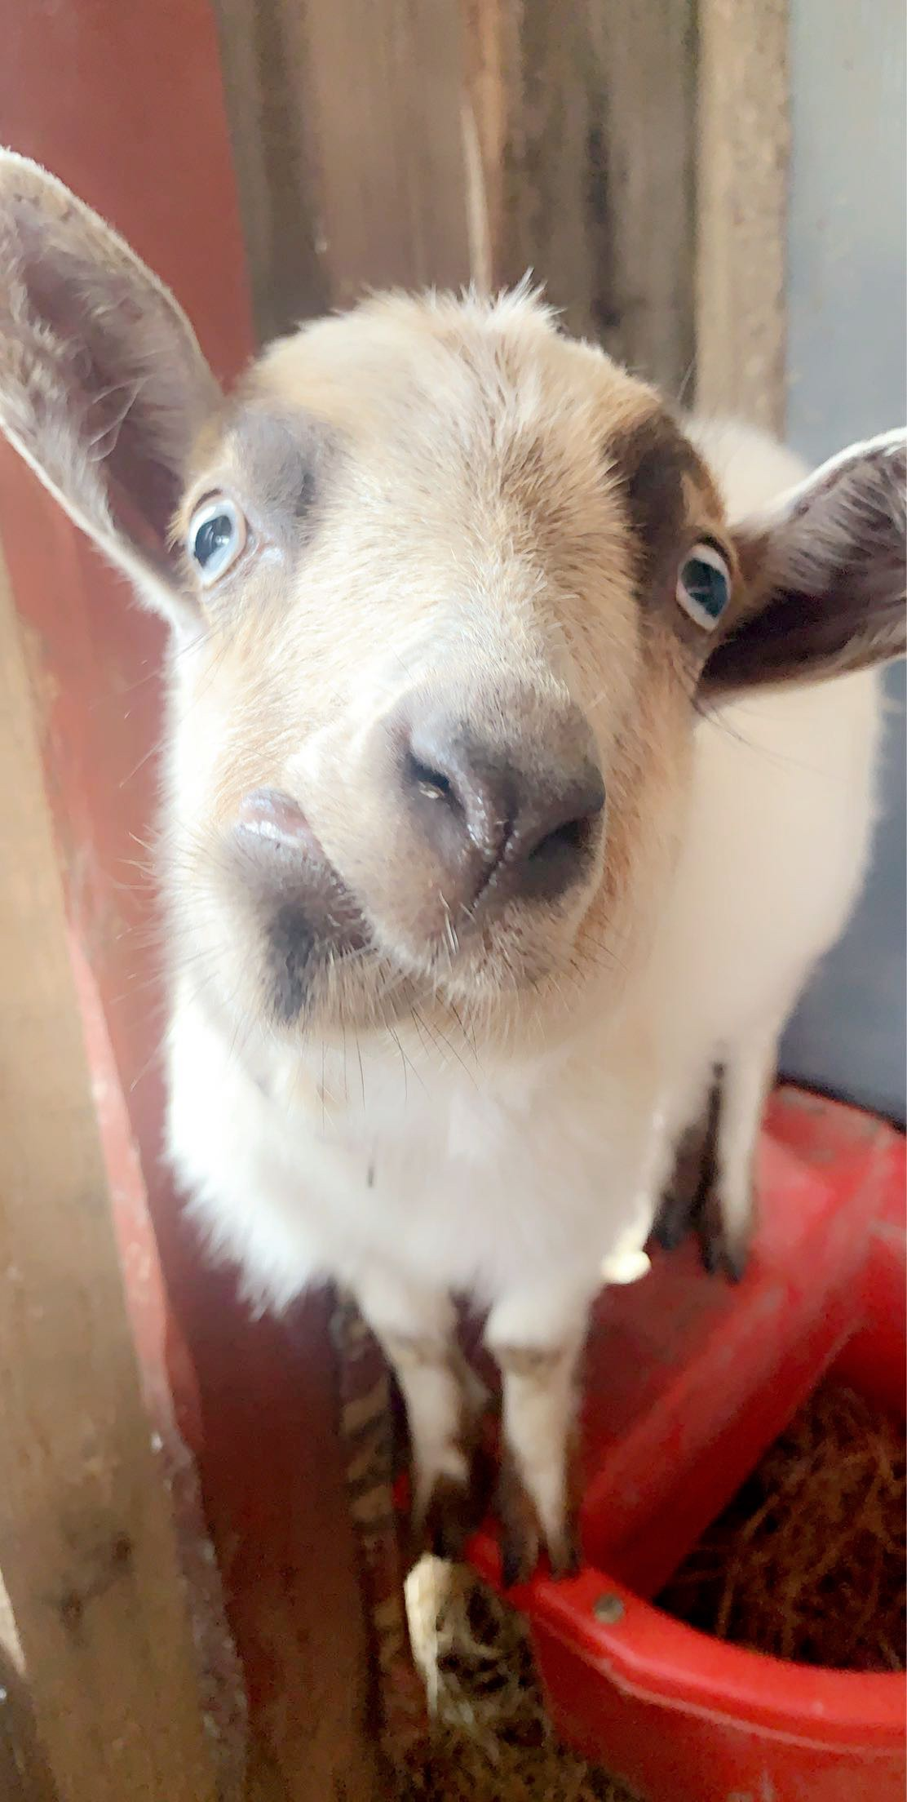
The End

