Slide 1
All About Me
By Ms. Hannah Welsh
Hannah.welsh@smail.astate.edu

Slide 2
Background Information
My name is Hannah Welsh
I am from Tuckerman, AR
I graduated from Arkansas State University in 2022 with my bachelors in mid-level education, specialties in math and science
I am currently engaged; my fiancé is Andrew Montgomery. We own one cat named Cream

Slide 3

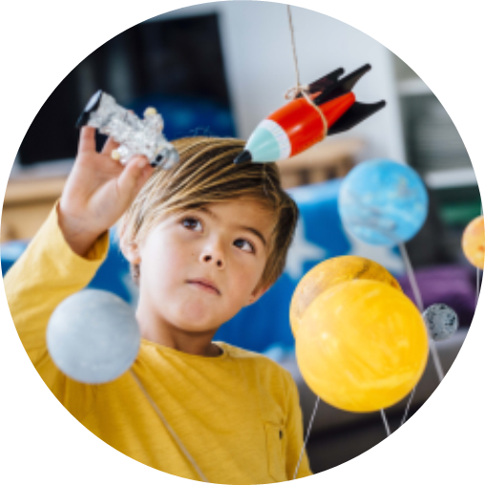
Classroom
One thing that I believe is important in my classroom is the knowledge and acceptance of diversity in our students. I want to create a diverse and accepting community between my students. My goal is to have students to learn and appreciate different perspectives around the. I want them to be prepared to interact with those who are different than themselves in a professional way, giving them the skills to benefit them not only in the future but outside of a school environment as well. This is one of the topics that I have listed on my advocacy page as well if you’re interested in learning more about promoting diversity in the classroom.

Slide 4
Student Learning
I am a big advocate for student-centered learning. I think that students should be active in their learning process. Student-Centered learning allows for students to take control of their learning. I think that students need the opportunities to investigate problems and try to find solutions on their own. One quote that I love is by educator Marva Collins who states…

Slide 5
If you can’t make a mistake, you can’t make anything
Marva Collins

Slide 6
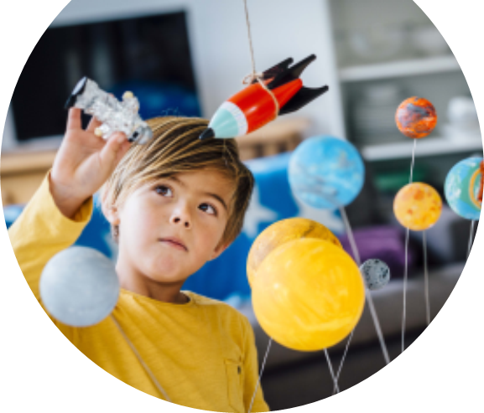
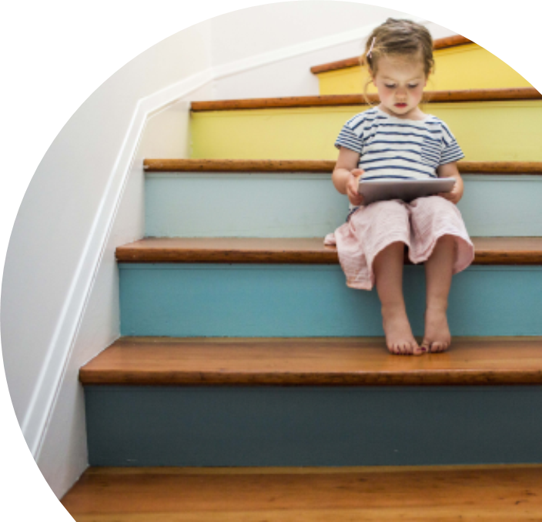
Student – Centered Learning
By allowing students to be in control of their learning, they are able to bring in all the past experiences. Each individual student brings something different to contribute to the learning process and those around them and I think that it is very important in a student's education

Slide 7
Integrateing Technology
I am very big on integrating technology within my classroom

Slide 8
Integrating Tech
Another important aspect of my classroom is students will be engaging with technology in many of my lessons. These days, technology is becoming more and more common to students. I believe that when students are exposed to technology in the correct way, it can be very beneficial to their learning experiences and allow students to learn in more ways than before. Therefore, I will be exposing students to numerous learning technologies throughout the school year to enhance their learning opportunities.
As an educator, I also work to educate myself on new types of technologies that become available and ways to implement them in my classroom. I am constantly researching and learning these new technologies in order to learn and provide our students with the best possible technologies for their learning

