Slide 1
Where Is Water?
By: Ms. Hailey Schue

Slide 2
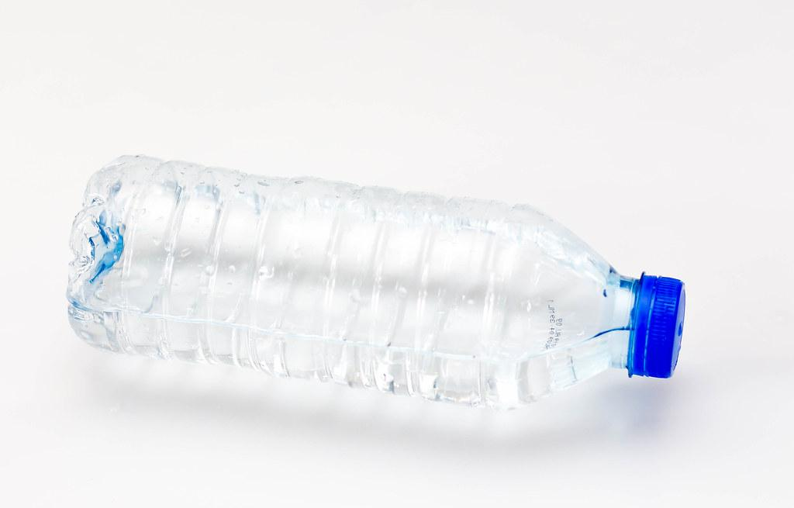
We can find it in a bottle

Slide 3
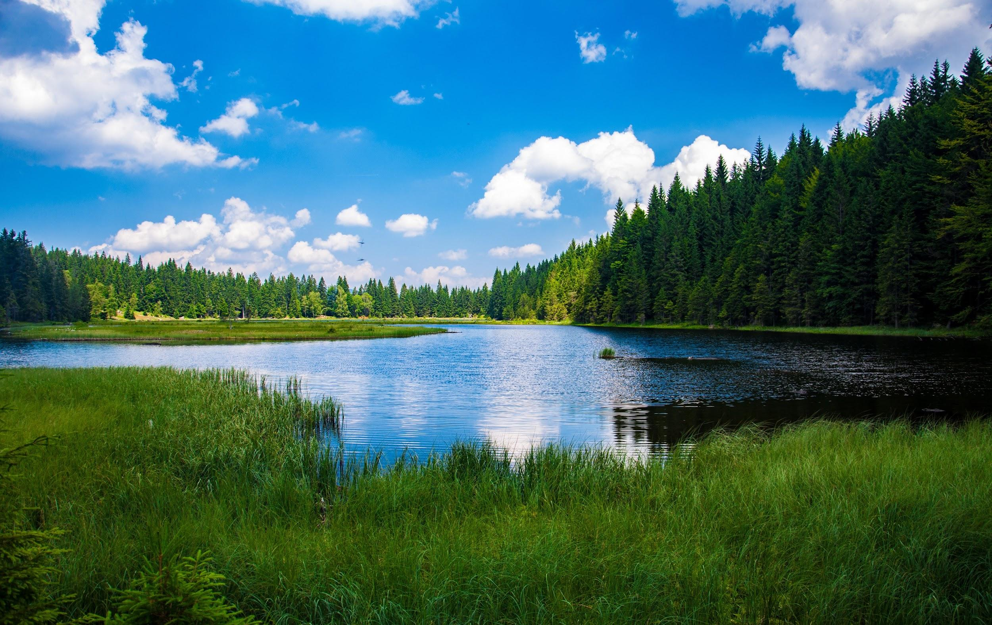
We can find it in a lake

Slide 4
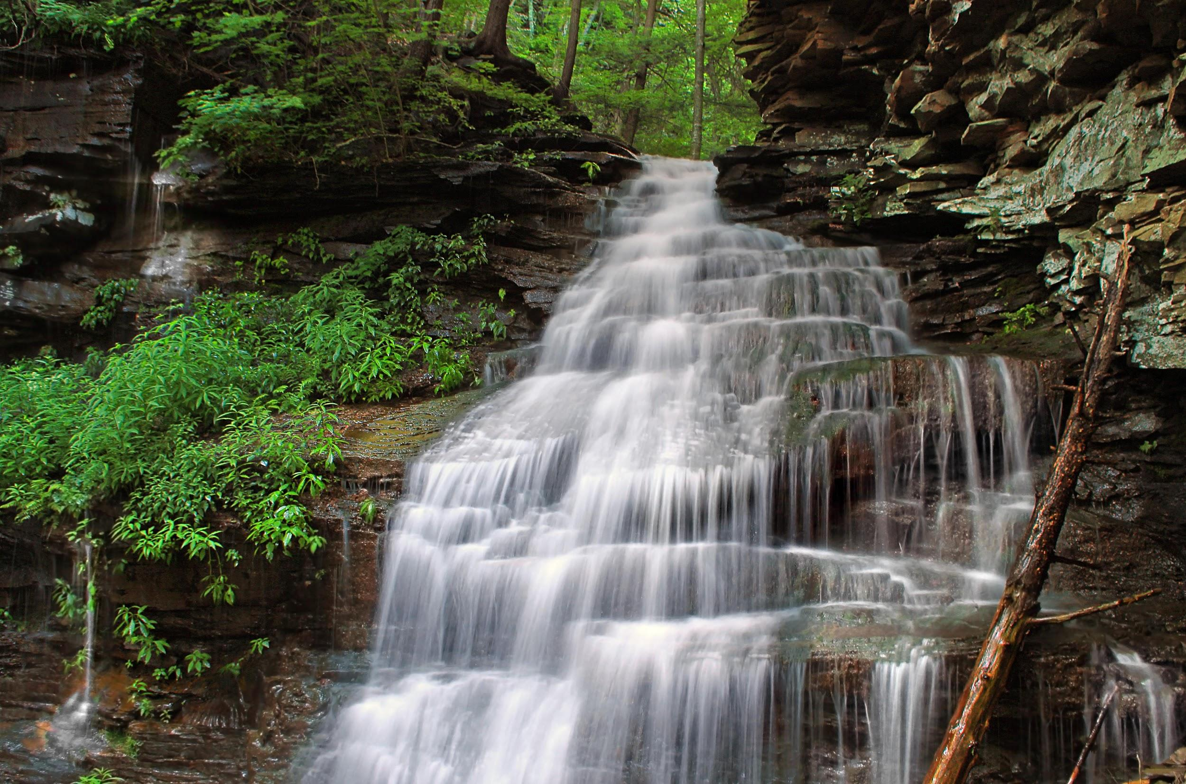
We can find it in a stream

Slide 5
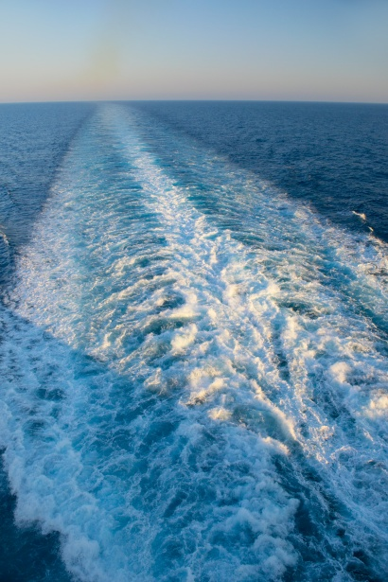
We can find it in a wake

Slide 6
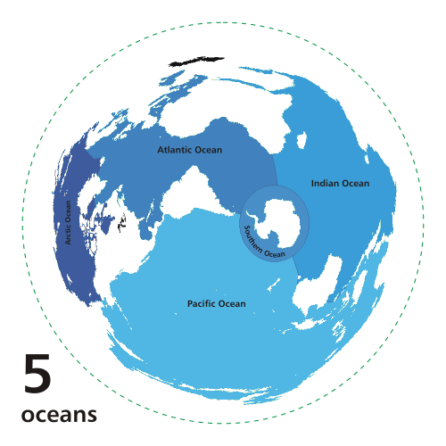
We can find it in the ocean

Slide 7
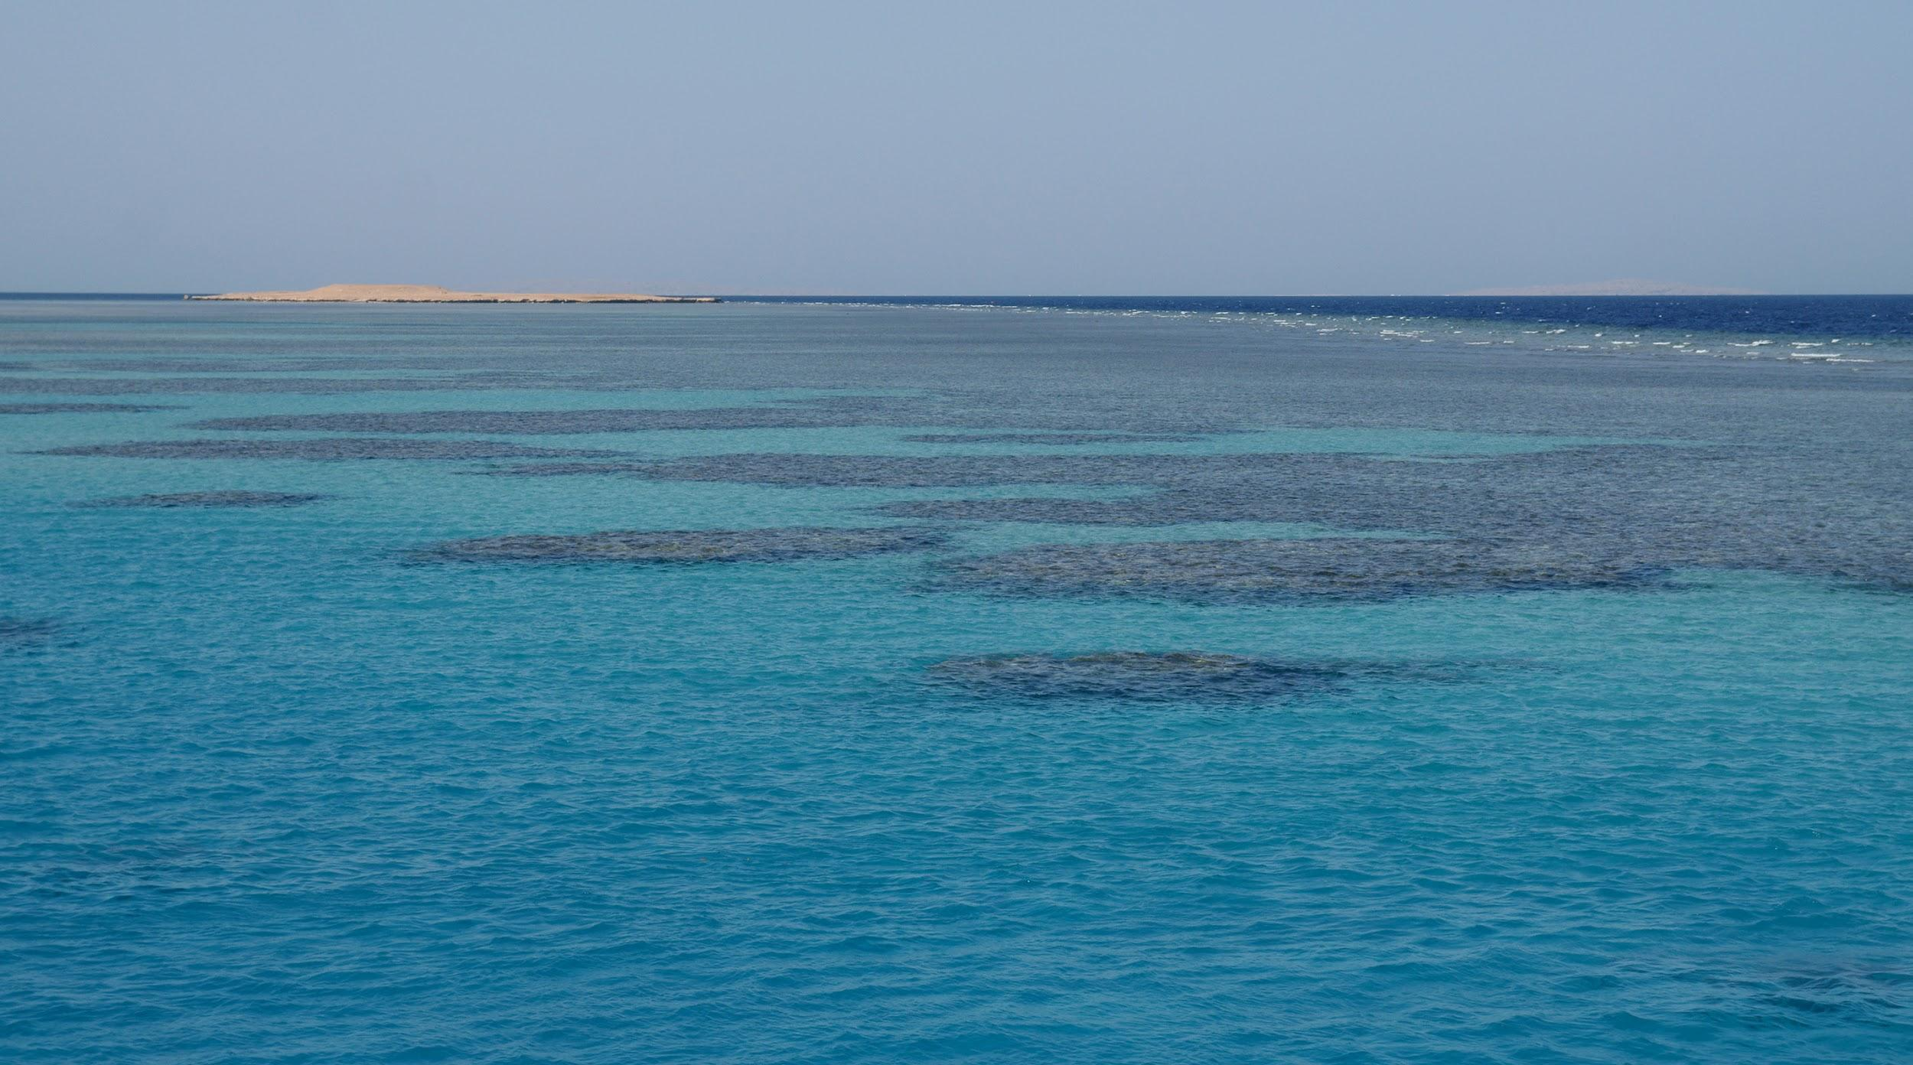
We can find it in a sea

Slide 8
With water it is an endless possibility

Slide 9
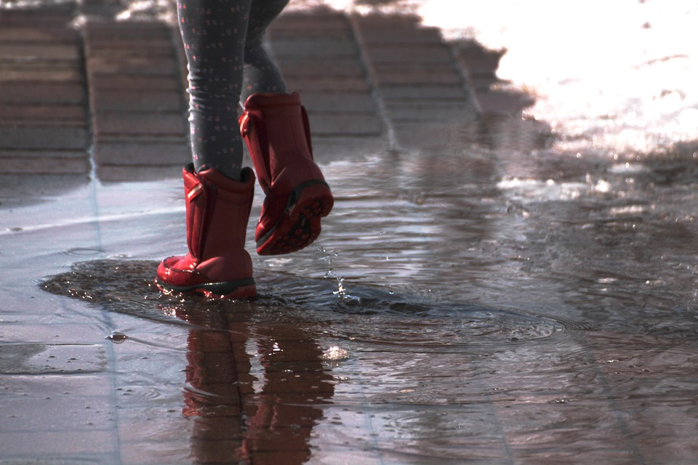
We can find it in a puddle

Slide 10
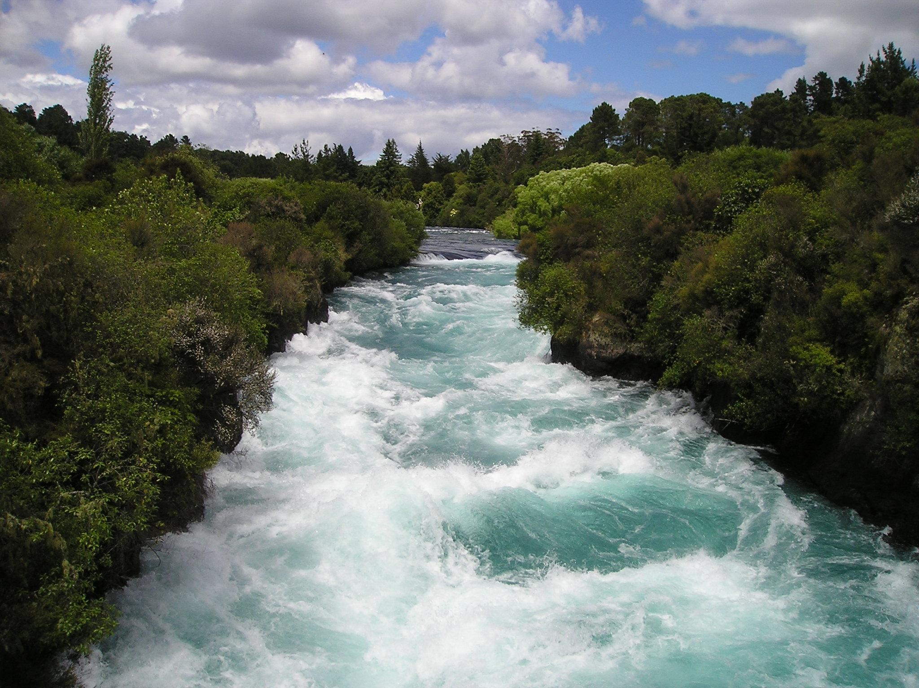
We can find it a river

Slide 11
But did you know...

Slide 12
Water can even make you shiver?

