Slide 1
Roxy goes to the beach
by Ms. Hannah Bridger ah Bridger

Slide 2
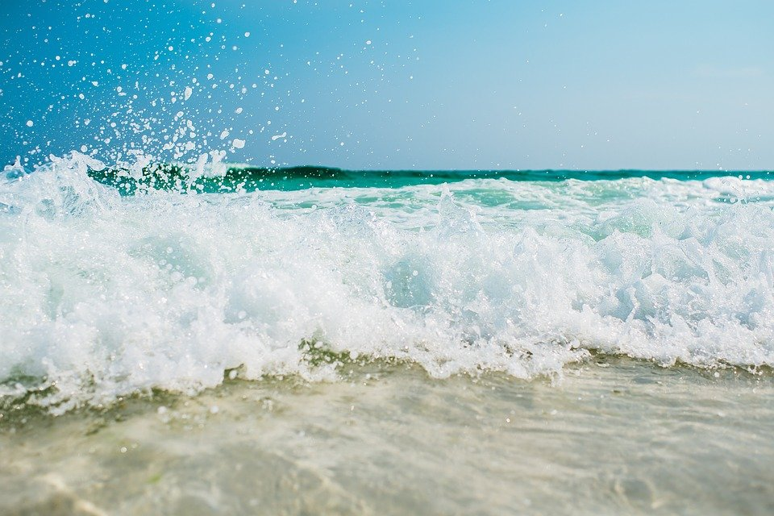
Roxy and her parents travelled to the beach for a family vacation.
Since she loves the sound of the beach, Roxy decides to walk through the sand towards the water.
She can smell the salt in the water and the wind blowing her hair all over her head.

Slide 3
Roxy decides to only get knee deep in the water.
She notices something floating in the water that’s white and round.
All of a sudden, Roxy SCREAMS.
The white, round thing is a Jelly Fish that has stung her on her leg.

Slide 4
Roxy’s parents suddenly rush to her where she’s about to fall into the water.
Her father picks her up and takes her away from the crashing waves.
He evaluates her sting and realizes that she will be okay.
Her mother suggests that they take her back to the beach house.

Slide 5
Roxy then researches jelly fish and what they consist of.
She finds out that jelly fish have 15 tentacles that grow from each corner of the bell and can reach 10 feet in length. Each tentacle has about 5,000 stinging cells, which are triggered not by touch but by the presence of a chemical on the outer layer of its prey.
When a person is stung, it usually burns, prickles, and stings in pain. The jellyfish will leave tracks on the skin as their “print” from the tentacles. Sometimes the print can itch afterwards.

Slide 6
Roxy’s parents assess her leg and decide to put ointment on her sting.
As Roxy is still in pain, she thanks her dad for running out to her as soon as she screamed.
A few minutes later, her leg did not sting as much as it had before.

Slide 7
Before the family does anything else, Roxy’s mother suggests that Roxy put a bag of ice on her sting so that the welp would go down and it would also cause the stinging to go away.
Roxy done just that.
Twenty minutes later and Roxy is ready for the next thing on the trip’s agenda.

Slide 8
Later on, Roxy requests ice cream from ’Ice Cream – You Scream Parlor’.
So that is exactly what she got.
Roxy got strawberry ice cream.
Her mom got chocolate ice cream.
And Roxy’s dad got French vanilla ice cream.

Slide 9
After the ice cream, Roxy’s parents asked if she felt like going on a bicycle ride.
Of course, even if her leg was hurting, she would not have turned down a bike ride by the beach.
Roxy and her parents rode bikes to the beach and watched as the sun set.

Slide 10
For the rest of the trip, Roxy watched the water very closely when she got in, but she built more sand-castles than she thought she would because she was a little too scared to stay in the water for a long period of time.

