Slide 1
Earth’s Systems
Ms. Darnell’s Class

Slide 2
Geosphere
This is the sphere that includes the core and crust
It includes all things that are natural and lifeless that make up the earth’s surface
Examples of this are the rocks and sand particles that are on dry land and even in the ocean

Slide 3
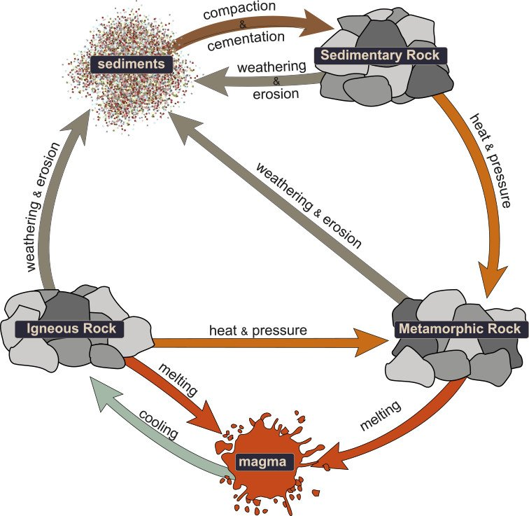
Geosphere continued
The geosphere undergoes infinite processes that can change other spheres. One example is the rock cycle

Slide 4
biosphere
This is all the living components on earth
Humans, plants, bacteria, animals, fungi
This sphere also includes organic matter that has yet to decompose

Slide 5
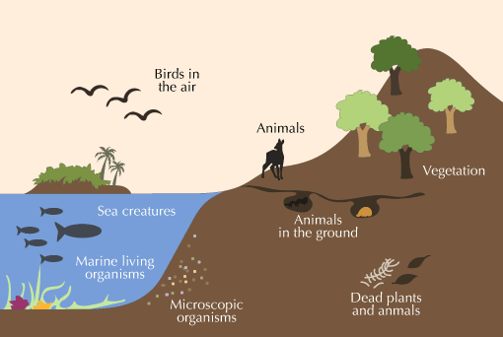
Biosphere continued
Its said that the biosphere is very dependent on the other spheres
It relies on the atmosphere for gasses
Nitrogen, oxygen, carbon dioxide
It depends on the hydrosphere for things like water and moisture

Slide 6
hydrosphere
This includes all Water parts on the planet
This means everything on the surface, subsurface, and even water vapor in the atmosphere
This sphere is also known as one of the fluid spheres because it contains the liquid components of earth

Slide 7
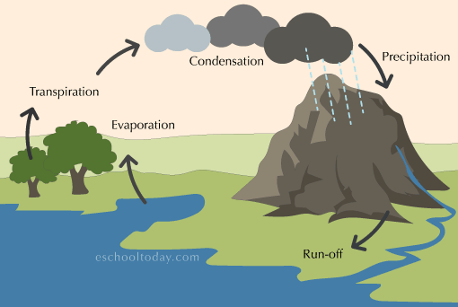
Hydrosphere continued
Think Of all the water on this planet in the oceans, seas, lakes, rivers, etc. this is all included in the hydrosphere and it covers 70% of the earth
The hydrosphere also has infinite processes everyday that help the other spheres, the water cycle is an example

Slide 8
atmosphere
This sphere is the gaseous component that is above earth’s surface and is also known as a fluid sphere
There is a mix of gases in this sphere
78% Nitrogen
21% oxygen
The remaining is carbon dioxide, aerosols and argon

Slide 9
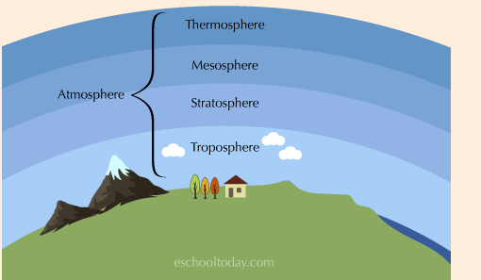
Atmosphere continued
The atmosphere has multiple layers in it
The troposphere is the closest to the earth, next is the stratosphere, then the mesosphere, and finally the layer furthest from the earth is the thermosphere

Slide 10
Reference Page
https://eschooltoday.com/earth-system/the-geosphere.html

