Slide 1
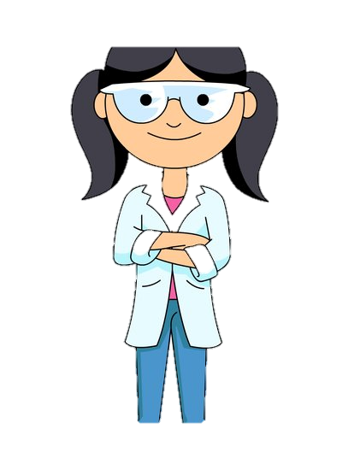
Jenny Jacobs and The Leaky Water Fountain
By: Georgia Brewer

Slide 2
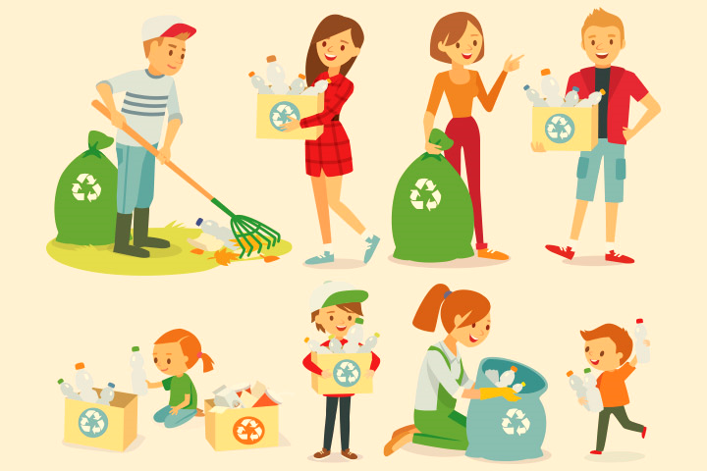
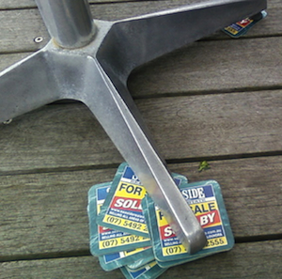
Jenny Jacobs is an aspiring young scientist who is always looking for new and inventive solutions to everyday problems. She corrected the weight distribution of her wobbly desk by wedging an old science book under the short leg. She even helped control waste at her school by starting a recycling club. What will she do next?

Slide 3
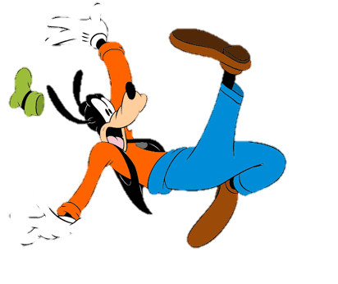
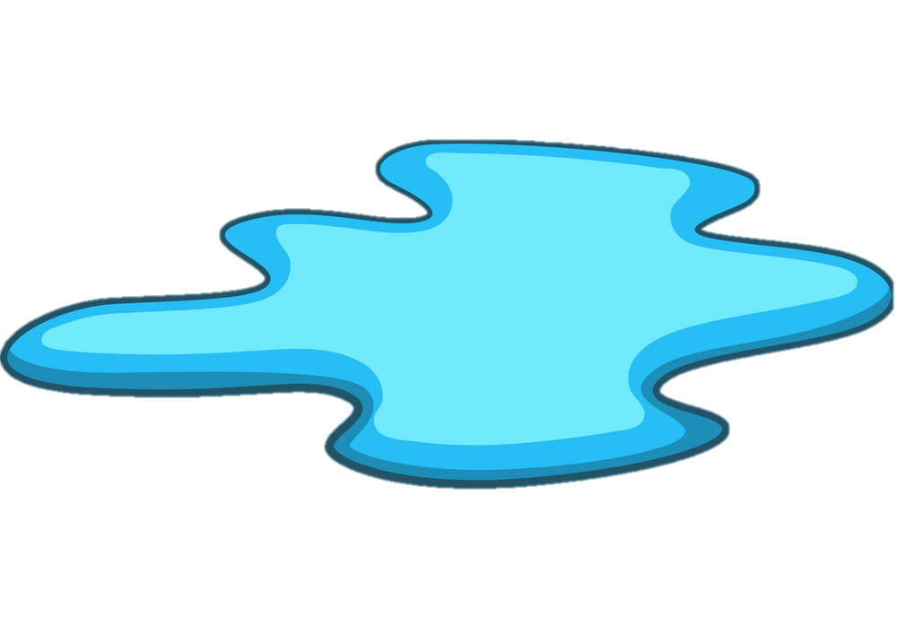
Jenny was on her way to Mr. Wilburs math class thinking about her next big solution. Then the unthinkable happened. Mrs. Wilbur slips in the middle of the hallway on a puddle from the leaky water fountain. Jenny rushes to her rescue and offers her scientific expertise to find a solution to the problem.

Slide 4
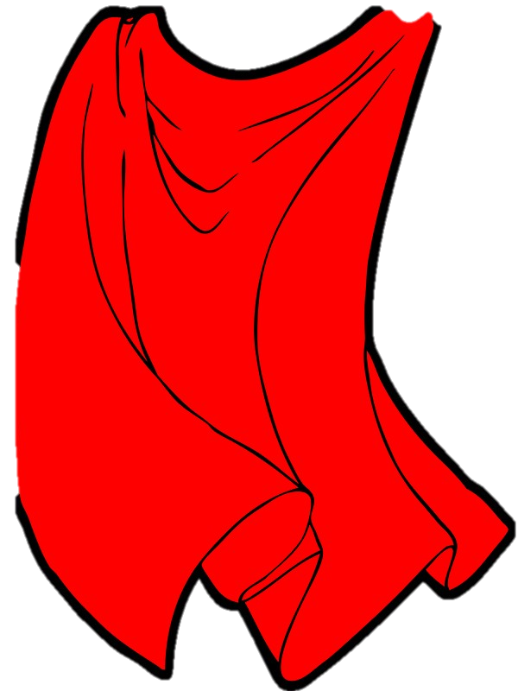
She rushed home straight after school to brainstorm and sure fire way to fix the leaky water fountain and save the hallways from the slippery threat. She doodled , and scribbled , and tore out page after page and finally she had her solution. Jenny Jacobs kid scientist to the rescue!!

Slide 5
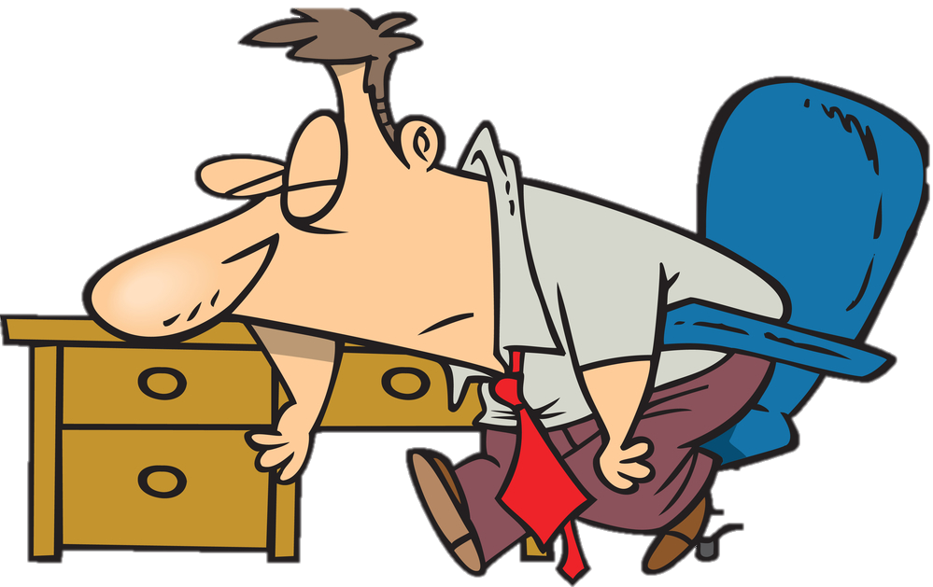
She got to school bright and early to set her plan in action. She caught Mr. Wilburs taking his morning nap before school and didn’t mind interrupting.“Mr. Wilburs,” she screamed , “I know how to fix the water fountain ,” she exclaimed! “All we have to do is tighten the pipes with our super hero grip.”Mr. Wilburs would do anything to get Jenny out of his hair so he followed along

Slide 6
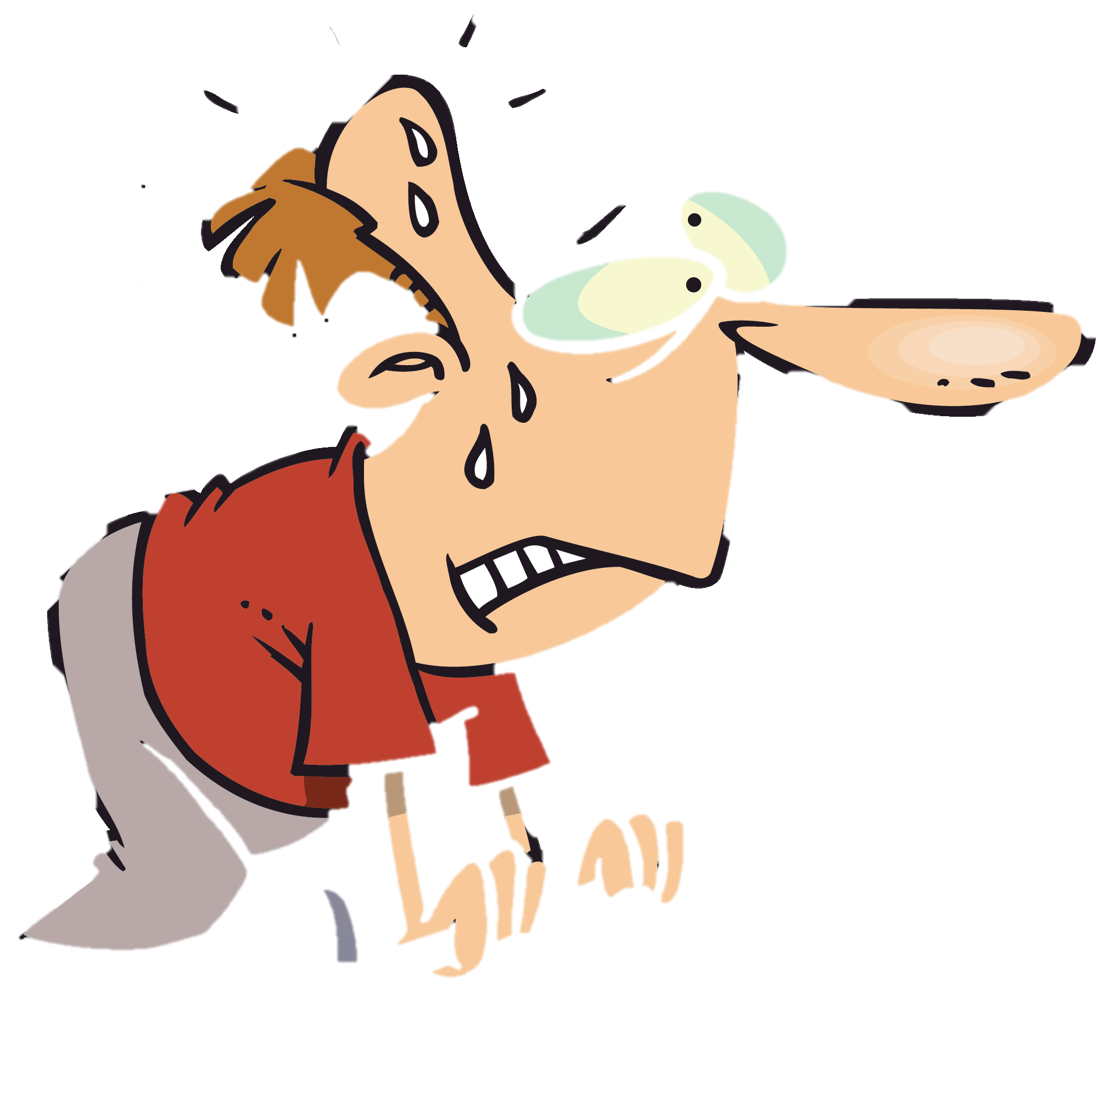
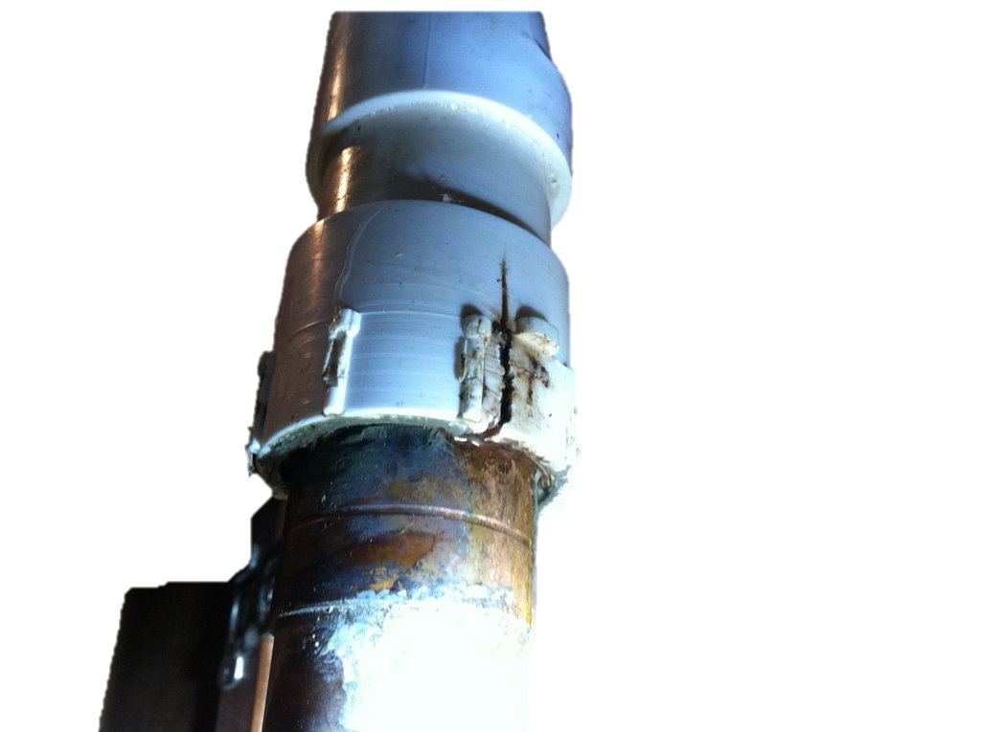
Mr. Wilburs struggled and strained for about 20 minutes. Needless to say the water fountain was still leaky. She quickly realized that superhero grip only works in the movies and that she was going to need to rethink her solution.

Slide 7
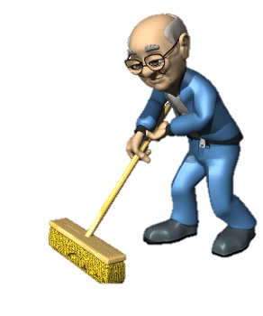
She spent all morning wondering how she could modify her solution and get it right before anyone else takes a tumble. Then it hits her , “ I’ll borrow one of those big grippy things that my Dad uses at home when his bolts are too loose, ” she says with certainty. She knew just where to get one …… Janitor Bill

Slide 8
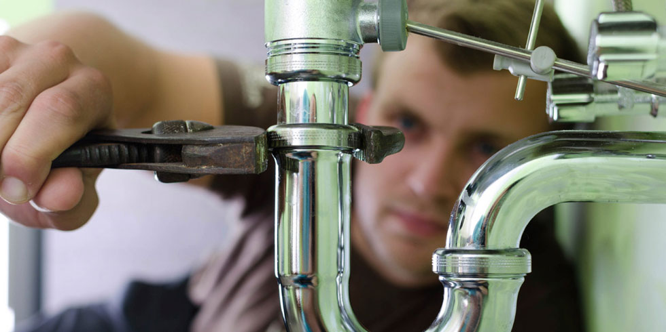
She rushed to Janitor Bill’s office during recess to propose her new solution. And after begging and pleading for about 3 minutes he agreed to grab his wrench , or “grippy thingy,” and take a look with her. He was just about to have her test it out when the bell rang ending recess and sending her back to class.

Slide 9
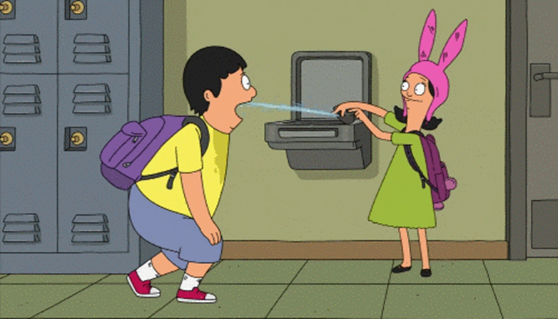
She waited with ants in her pants during social studies. She couldn’t wait to test out her solution with her best pal Patrick. The leak was no more , but they now have to use the water fountain in pairs.

Slide 10
Questions
What was the problem?
What was her first solution?
Why didn’t her first solution work?
What was her new solution?
What solution should she try next ?

