Slide 1
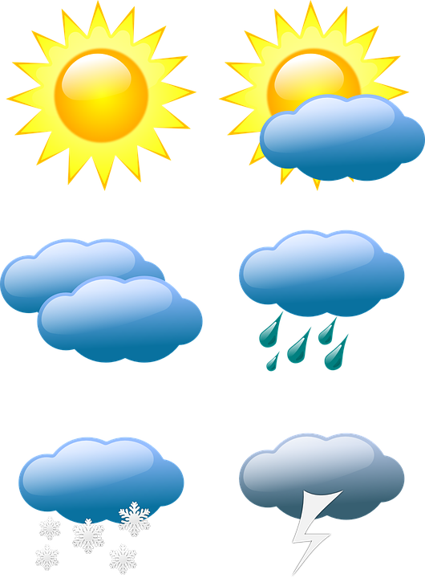
The Weather
by Ms. Reid’s 2nd grade class

Slide 2
The Sun
A large star
Center of our Solar System
Provides energy for the Earth
Changes the seasons as it moves around the Earth
Light from the sun reaches the Earth in 8 minutes

Slide 3
Clouds
A large group of tiny droplets we can see in the air
Rain, snow, sleet, and hail fall from clouds
They are white because they reflect light from the sun
When they are filled with water, they are gray because they can no longer reflect light

Slide 4
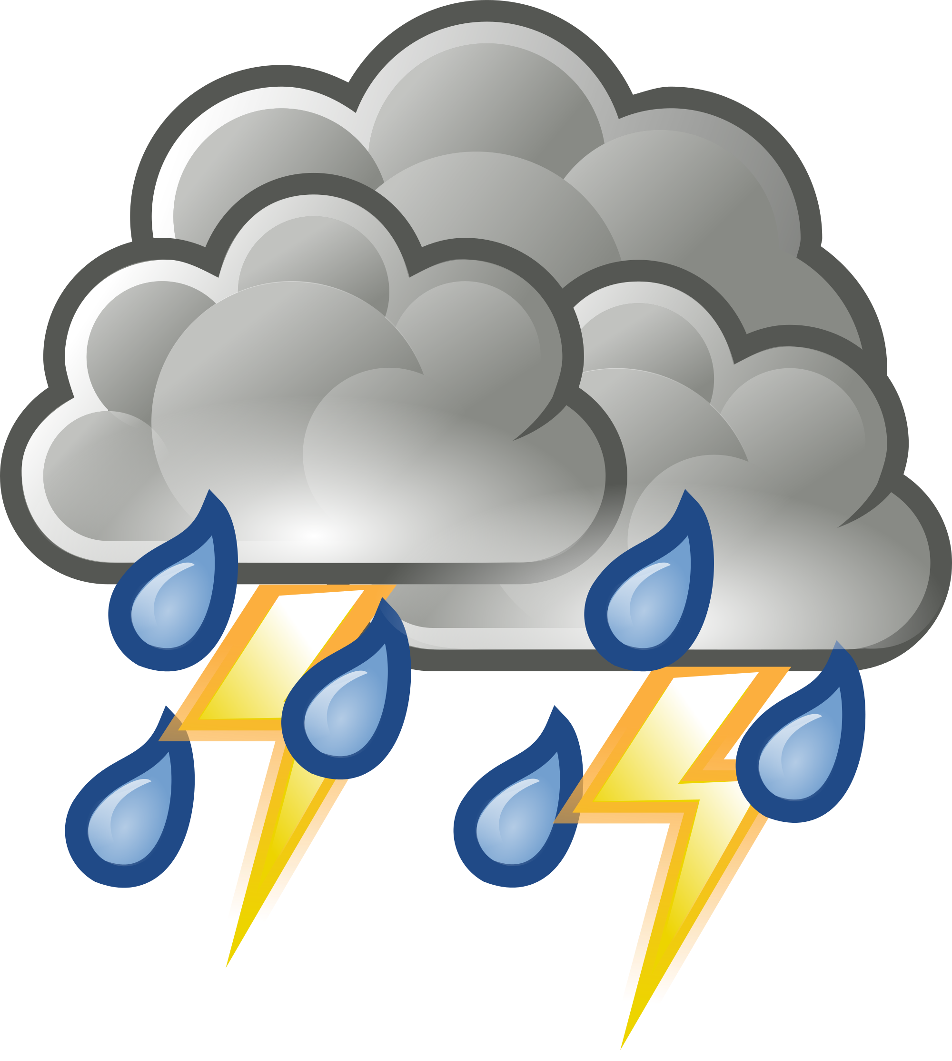
Rain and Thunderstorms
Rain falls from the sky in the form of water droplets, we call this precipitation
Precipitation can be rain, snow, sleet, or hail
Thunderstorms need moisture, unstable air, and lift to form
Lightning is an electric charge caused by frozen droplets hitting each other

Slide 5
Rainbows
Are formed when light bends and reflects through water
They can be seen in rain, mist, dew, and fog
Made up several colors:
Red, Orange, Yellow, Green, Blue, Indigo, and Violet
They are actually circles, but look like arches on the ground

Slide 6
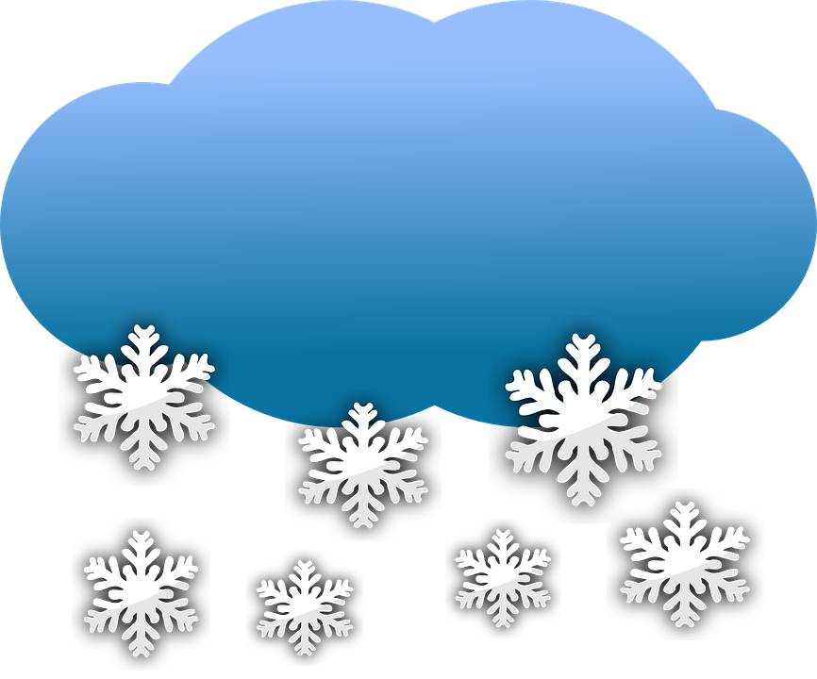
Snow
Snow forms when water vapor in the atmosphere freezes into ice crystals.
Snowflakes form in a variety of different shapes.
Snow is a form of precipitation, other forms of precipitation are rain, hail and sleet

Slide 7
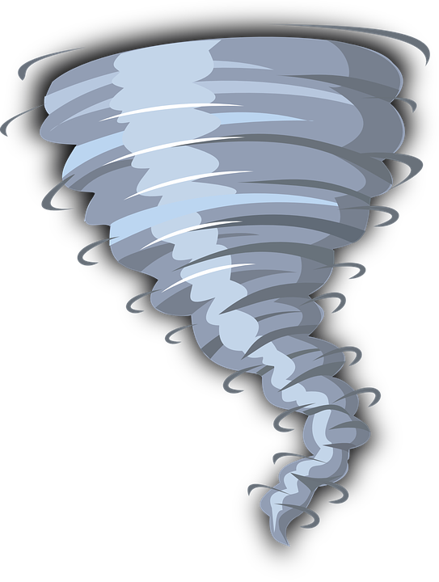
Tornados
A tornado is a rapidly spinning tube of air that touches both the ground and a cloudabove.
Tornadoes are sometimes called twisters.
Not all tornadoes are visible but their high wind speeds and rapid rotation often form a visible funnel of condensed water.

Slide 8
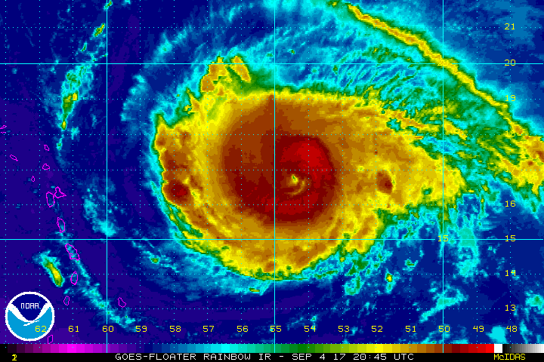
Hurricanes
A hurricane is an intense tropical storm with powerful winds and heavy rain.
Other names for a hurricane include cyclone, typhoon and tropical storm.
Hurricanes usually form in tropical areas of the world.
Hurricanes develop over warm water and use it as an energy source.
Hurricanes lose strength as they move over land.
Weather in the eye of a hurricane is usually calm.

