Slide 1
Kindergarten Letter, Number, and Color Jeopardy!
By: Chloe Johnson

Slide 2
Letters | Numbers | Colors
$100 | $100 | $100
$200 | $200 | $200
$300 | $300 | $300
$400 | $400 | $400
$500 | $500 | $500
$600 | $600 | $600

Slide 3
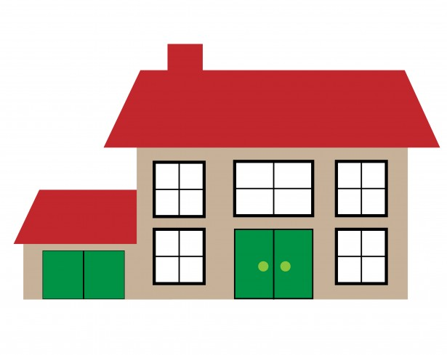
What is the first letter in the alphabet?
A
Z
F
D

Slide 4
What Letter comes after C?
W
M
X
D

Slide 5
What Letter comes after M?
N
P
H
V

Slide 6
What Letter comes after P?
E
O
Q
R

Slide 7
What Letter comes after w?
B
T
X
P

Slide 8
What is the last letter in the alphabet?
A
Z
R
F

Slide 9
A is correct!

Slide 10
D is correct!

Slide 11
n is correct!

Slide 12
q is correct!

Slide 13
x is correct!

Slide 14
Z is correct!

Slide 15
Incorrect, Try again!

Slide 16
What is 1+1?
2
0
100
77

Slide 17
What number is zero?
17
0
500
50

Slide 18
What number is two?
44
7
19
2

Slide 19
What is 2+2?
1
77
4
100

Slide 20
What number is seven?
200
0
7
54

Slide 21
What is 3+2?
589
0
100
5

Slide 22
2 is correct!

Slide 23
0 is correct!

Slide 24
2 is correct!

Slide 25
4 is correct!

Slide 26
7 is correct!

Slide 27
5 is correct!

Slide 28
What Color is this?
Brown
Pink
Yellow
Red

Slide 29
What Color is this?
Green
Orange
Blue
Blue
This Photo by Unknown Author is licensed under CC BY-SA

Slide 30
What Color is this?
Yellow
White
Pink
Black

Slide 31
What Color is this?
Yellow
Pink
Green
Red

Slide 32
What Color is this?
White
Red
Brown
Blue

Slide 33
What Color is this?
Pink
Black
Yellow
Blue

Slide 34
Red is correct!

Slide 35
Orange is correct!

Slide 36
Yellow is correct!

Slide 37
Green is correct!

Slide 38
Blue is correct!

Slide 39
Pink is correct!

