Slide 1
How many lady bugs do you see?
= 4
= 5

Slide 3
= 4

Slide 4
How many grasshoppers do you see?
= 6
= 7

Slide 6
= 7

Slide 7
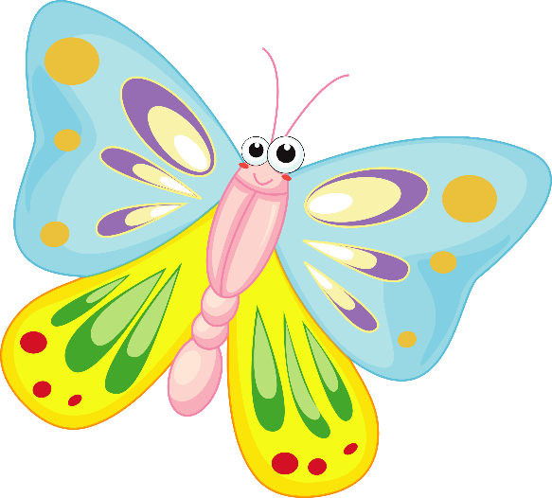
How many butterflies do you see?
= 9
= 10

Slide 9
= 9

Slide 10
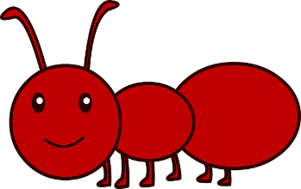
How many ants do you see?
= 19
= 20

Slide 12
= 20

Slide 13
How many insects do you see?
= 4
= 5

Slide 15
= 5

Slide 16
The End!

