Slide 1
Bobby and Grandpa Talk About the Bank
Written By Cassidy Brewer-Snyder & Leah Brewer
Illustrated By Cassidy Brewer-Snyder

Slide 2
Bobby woke up at 7:00 AM because he was too excited to sleep any longer.
He was staying the weekend with Grandpa and Grandma and he couldn’t wait to go finishing!
He rolled out of bed and made his way to the kitchen.

Slide 3
Grandpa was at the table with a cup of coffee and a laptop! Bobby was curious as to what Grandpa was doing. He had never seen him with a laptop!

Slide 4
“Morning, young man.” Grandpa leaned over and ruffled Bobby’s hair. “I am figuring out how much money Grandma and I have.”
“What are you doing, Grandpa?”

Slide 5
Bobby crinkled up his nose. “I don’t see any money on the table, Grandpa.”
“That’s because its in the bank, Bobby.”

Slide 6
“Why is it in the bank and not on the table?” Bobby leaned over and looked at the computer screen.”

Slide 7
“There are lots of reasons, but for one, I keep my money in the bank because it’s safer than keeping it somewhere in my house.
If I kept it here, it could get stolen or something else could happen, like a fire!”

Slide 8
“Oh! It can’t catch fire or get stolen at the bank?” Bobby asked.
“Well, I guess it could, but it’s protected by insurance. So, I wouldn’t lose it if something did happen. The bank would make sure I still had my money.”

Slide 9
“Ok. Why else do you keep your money in a bank?” Bobby scratched his head trying to figure out why the bank would do that. “Who pays you more money? The owner of the bank?”
“I make more money by keeping it in a bank. It’s called interest, Bobby.”

Slide 10
“The bank loans money out and when people pay that money back, they pay extra. The bank then uses a part of that extra money to pay interest or extra money to customers who keep their money in savings. It helps the bank have more customers and access to more money.”

Slide 11
“Wow. I guess that sorta makes sense.” Bobby leaned over and hugged his Grandpa. “Grandpa, will you help me with my money when I get some?”

Slide 12
“Of course, I will, Bobby.” Grandpa said as he hugged Bobby back.
“I’ll let you in on a little secret, though. You already have some money in a bank.” Grandpa said with a wink.

Slide 13
Bobby’s eyes lit up, “But I don’t have a job! How do I have money in a bank? Did you give me some of yours?”

Slide 14
“Grandma and I set you up your own account when you were just a baby. We want to make sure you have security when you’re older by having a savings account waiting on you.”

Slide 15
“Whoa. Thanks, Grandpa!” Bobby said. “Can we please go fishing now?”
“Sure thing, Bobby. Let’s go!”

Slide 16
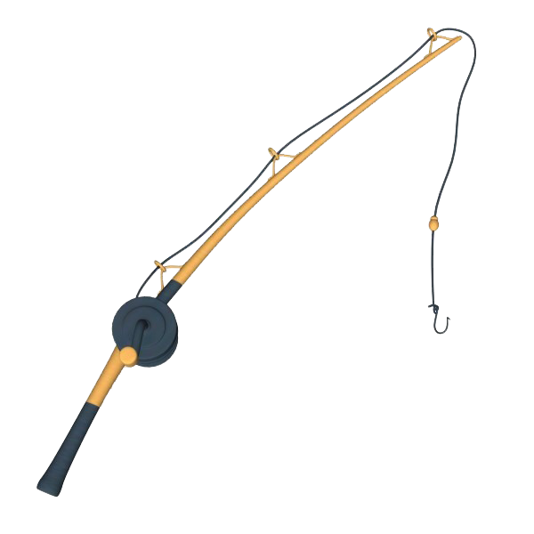
The End

