Slide 1
Fiction Writing

Slide 2
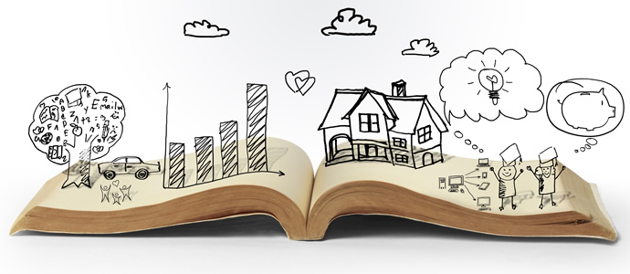
Fiction Writing
“literature in the form of prose, especially novels, that describes imaginary events and people.”

Slide 3
Importance of Fiction Writing Skills for Young Children
Develops their creativity and language skills
Encourages self discipline
Reviewing
Editing
Rewriting
Allows them to think critically
Broadens their understanding

Slide 4
Characteristics of Fiction
Uses imagery to describe objects, things, places, experiences, people, and situations
Sensory Information
Sight
Sound
Taste
Touch
Smell

Slide 5
Characteristics of Fiction
Tells a story
Point of view
First Person
Second Person
Third Person
Ordered sequentially
Beginning
Middle
End

Slide 6
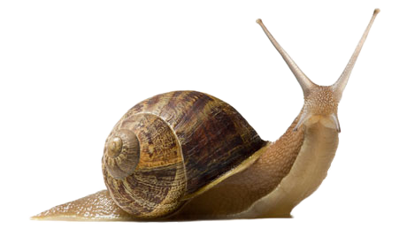
Characteristics of Fiction
Pacing
Action
Exposition
Cliffhanger
Dialogue

Slide 7
Characteristics of Fiction
Figurative Language
Purpose
More effective, persuasive, or impactful
Figures of Speech
Analogies
Similes
Metaphors

Slide 8
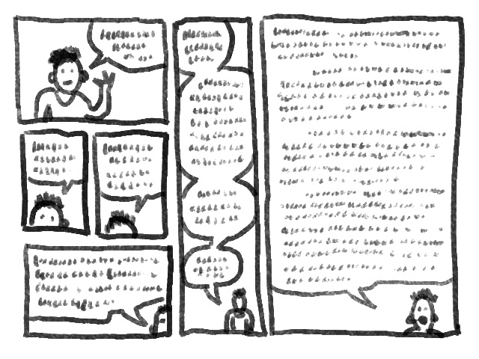
Elements of Plot in Fiction
Introduction/Exposition
Hook your audience
Establish characters
Set the scene
Background information
Introduce main conflict

Slide 9
Elements of Plot in Fiction
Rising Action
Series of events that build up to the conflict
Suspense
Interest
Tension
Characters
Flaws
Decisions

Slide 10
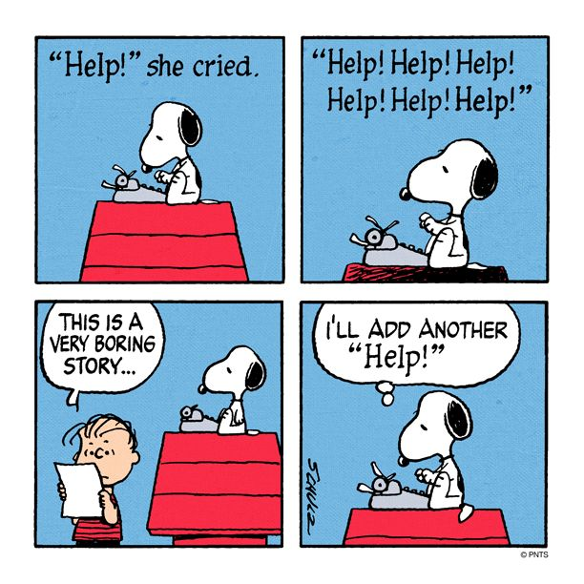
Elements of Plot in Fiction
Climax
Turning point of the story
Highest peak of suspense,
interest and emotion

Slide 11
Elements of Plot in Fiction
Falling Action
Resolves the main conflict
Wraps up the narrative
Ties up loose ends
Leads towards Resolution

Slide 12
Elements of Plot in Fiction
Resolution
“Denouement”
Solution of main conflict

Slide 13
References
Fiction Writing
Plot
Introduction
Rising Action
Climax
Falling Action
Resolution
Narrative Writing
Pacing
Figurative Language

