Slide 1
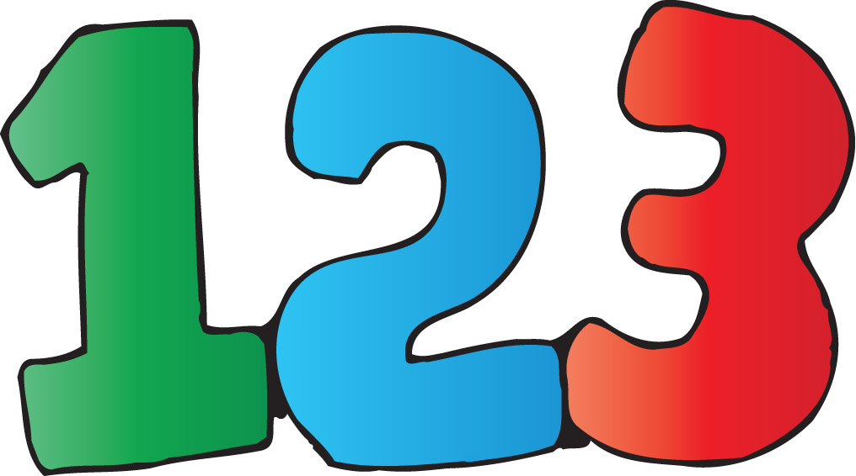
Kindergarten

Slide 2
Shapes | Colors | Numbers
$0.25 | $0.25 | $0.25
$0.50 | $0.50 | $0.50
$1.00 | $1.00 | $1.00
$5.00 | $5.00 | $5.00
$10.00 | $10.00 | $10.00
$20.00 | $20.00 | $20.00

Slide 3
What shape is this?

Slide 4
Triangle

Slide 5
What shape is this?

Slide 6
Square

Slide 7
What shape is this?

Slide 8
Circle

Slide 9
What shape is this?

Slide 10
Rectangle

Slide 11
What shape is this?

Slide 12
Cube

Slide 13
What shape is this?

Slide 14
Sphere

Slide 15
What color is this?

Slide 16
Red

Slide 17
What color is this?

Slide 18
Yellow

Slide 19
What color is this?

Slide 20
Green

Slide 21
What color is this?

Slide 22
Orange

Slide 23
What color is this?

Slide 24
Blue

Slide 25
What color is this?

Slide 26
Purple

Slide 27
What number is this?

Slide 28
Three

Slide 29
What number is this?

Slide 30
Five

Slide 31
Solve!
1 + 4 =

Slide 32
5

Slide 33
Solve!
2 + 4 =

Slide 34
6

Slide 35
Solve!
9 - 6 =

Slide 36
3

Slide 37
Solve!
5 - = 3

Slide 38
2

