Slide 1
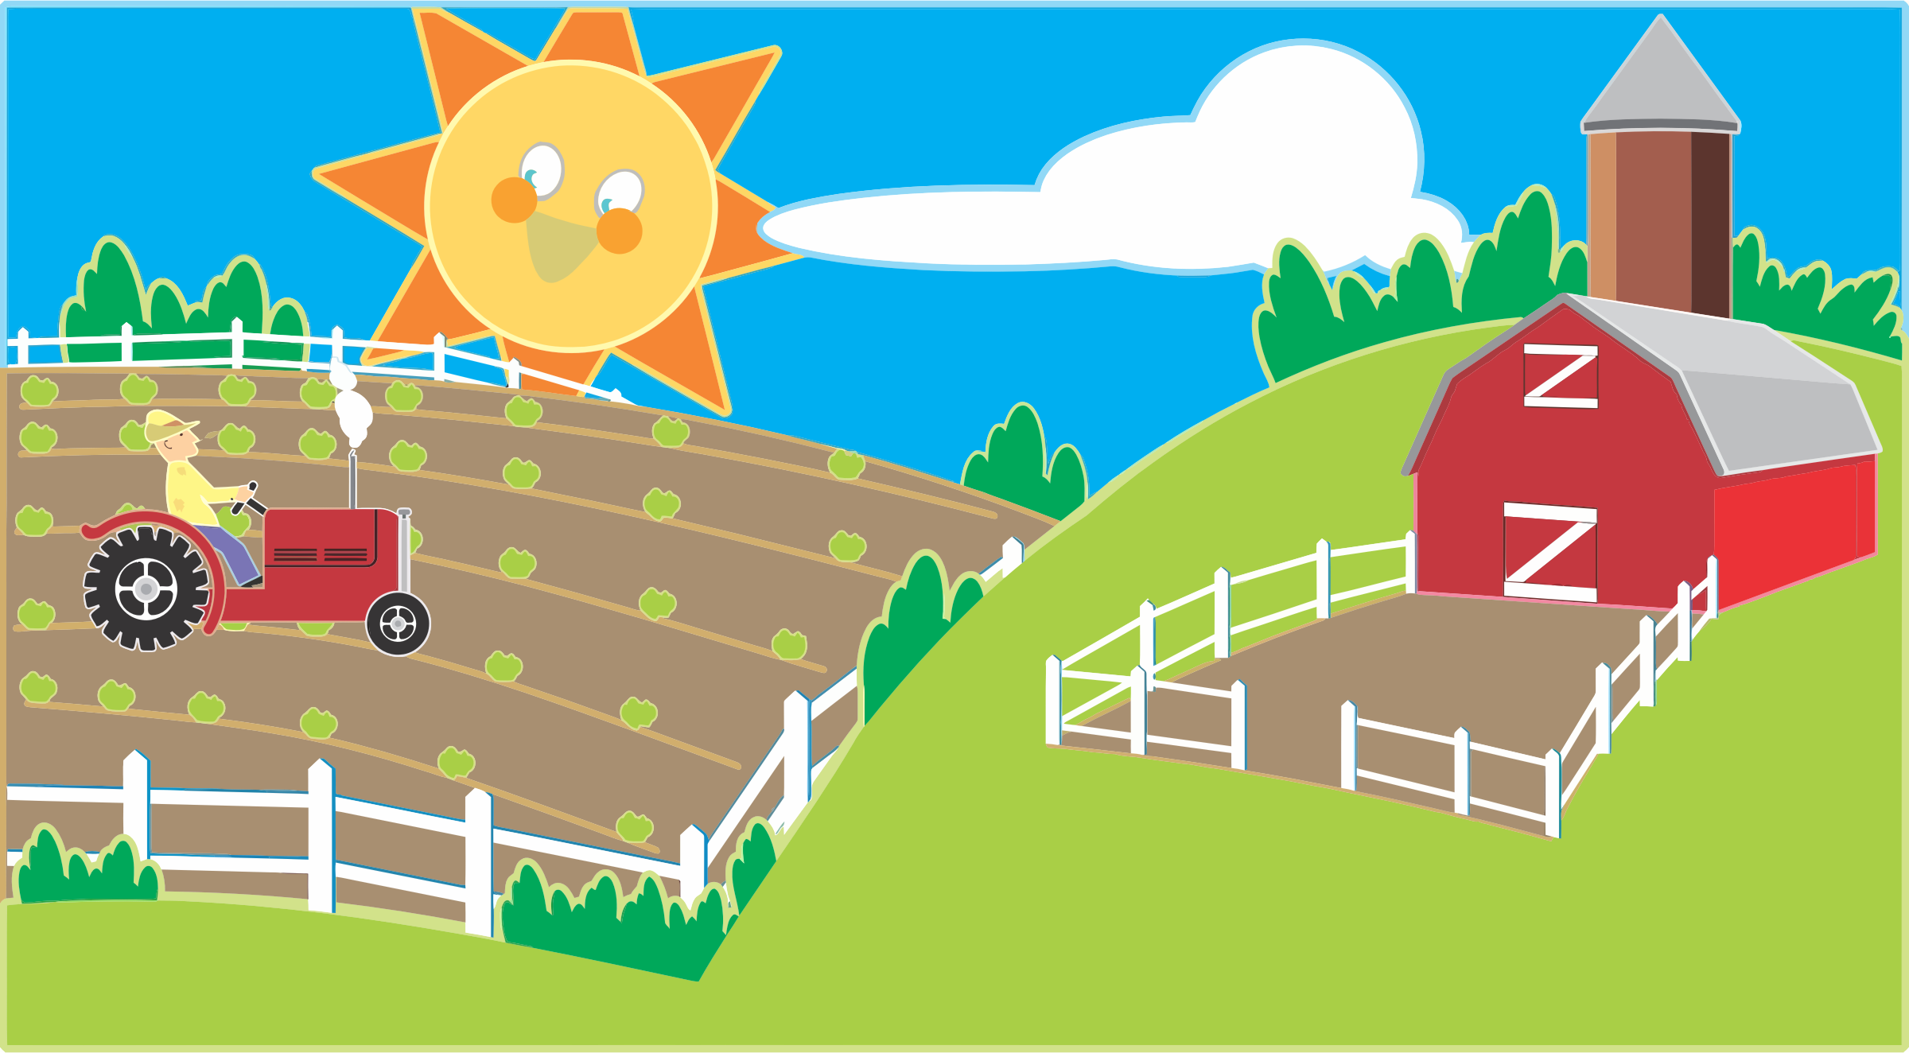
Baby Farm Animals
By: Amber Whitaker

Slide 2
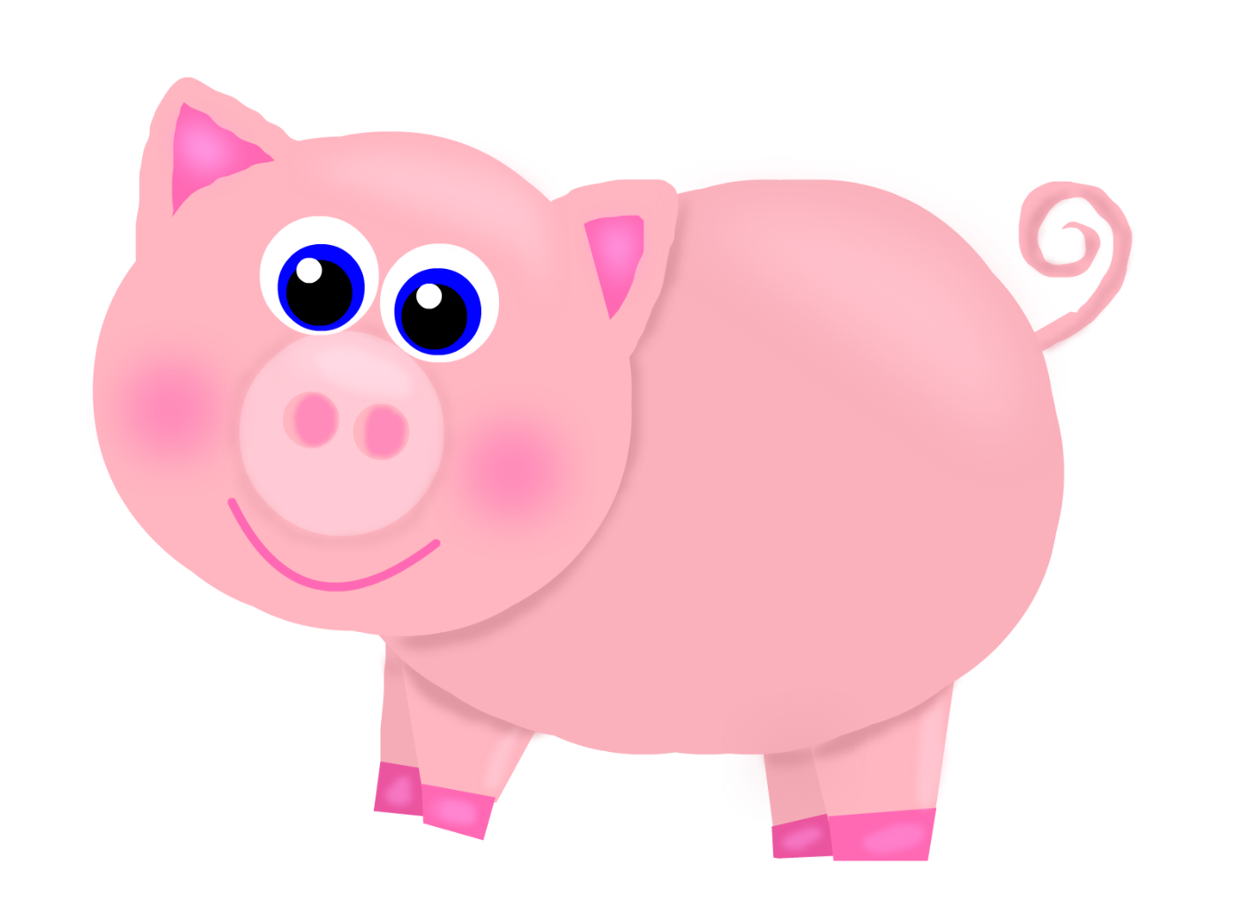
A baby pig is called a piglet. The piglet says “Oink Oink!”

Slide 3
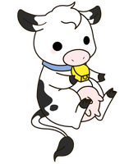
A baby cow is called a calf. The calf says “Moo!”

Slide 4
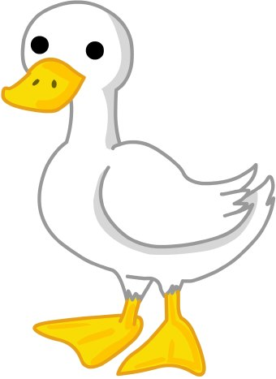
The baby goose is called a gosling. The gosling says “Honk Honk!”

Slide 5
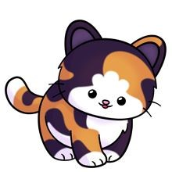
The baby cat is called a kitten. The kitten says “Meow!”

Slide 6
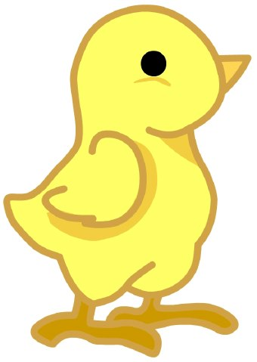
The baby chicken is called a chick. The chick says “Chirp Chirp!”

Slide 7
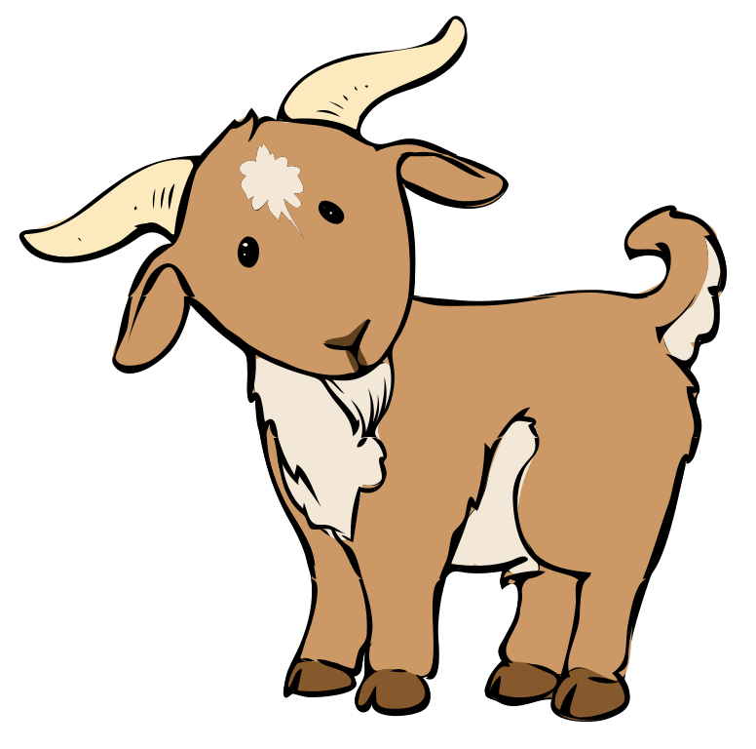
The baby goat is called a kid. The kid says “Maa Maa!”

Slide 8
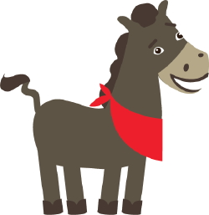
The baby horse is called a foal. The foal says “Neigh!”

Slide 9
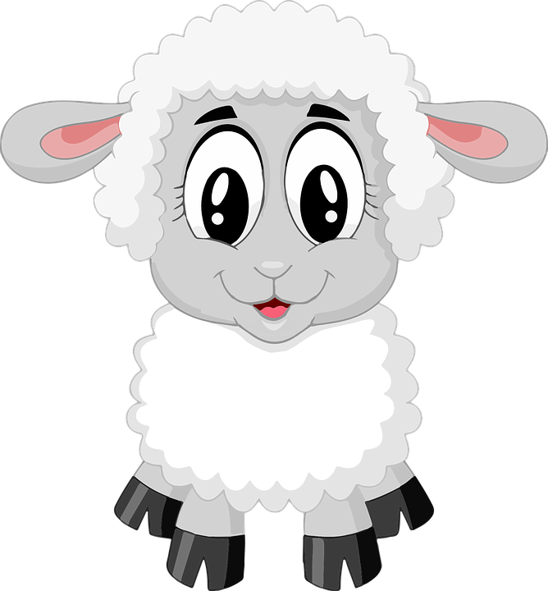
The baby sheep is called a lamb. The lamb says “Baa!”

Slide 10
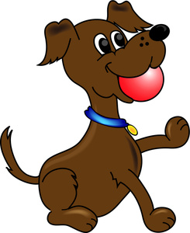
The baby dog is called a puppy. The puppy says “Woof Woof!”

Slide 11
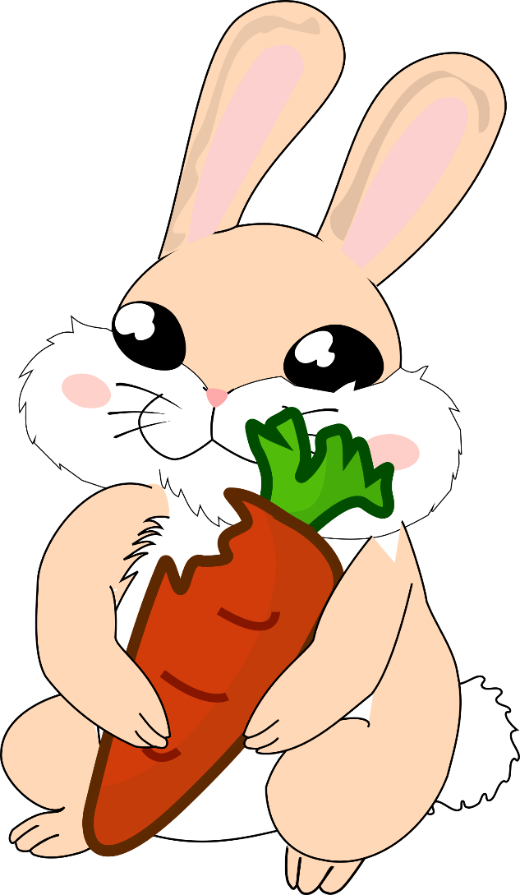
The baby rabbit is called a kit. Kits love to eat carrots.

Slide 12
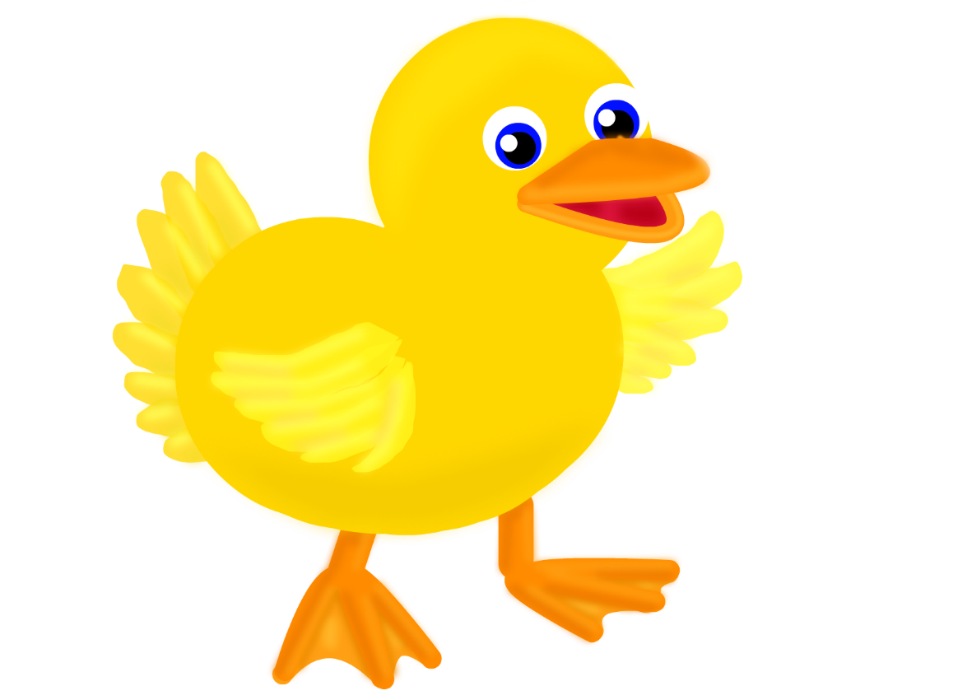
The baby duck is called a ducking. The duckling says “Quak Quak!”

Slide 13
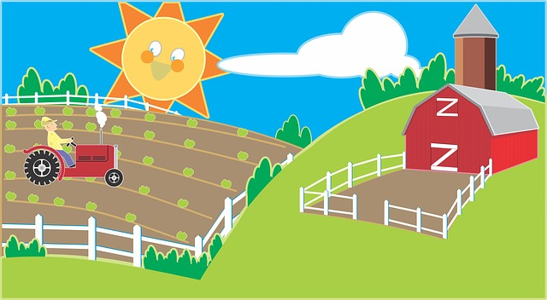
The piglet, calf, gosling, kitten, chick, kid, foal, lamb, puppy, rabbit and the ducking all live happily on the farm.

Slide 14
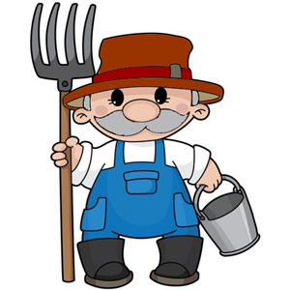
Farmer Joe cares for the baby farm animals.

Slide 15
The End

