Slide 2
Battles of the Civil War | Important People | Documents
100 | 100 | 100
200 | 200 | 200
300 | 300 | 300

Slide 3
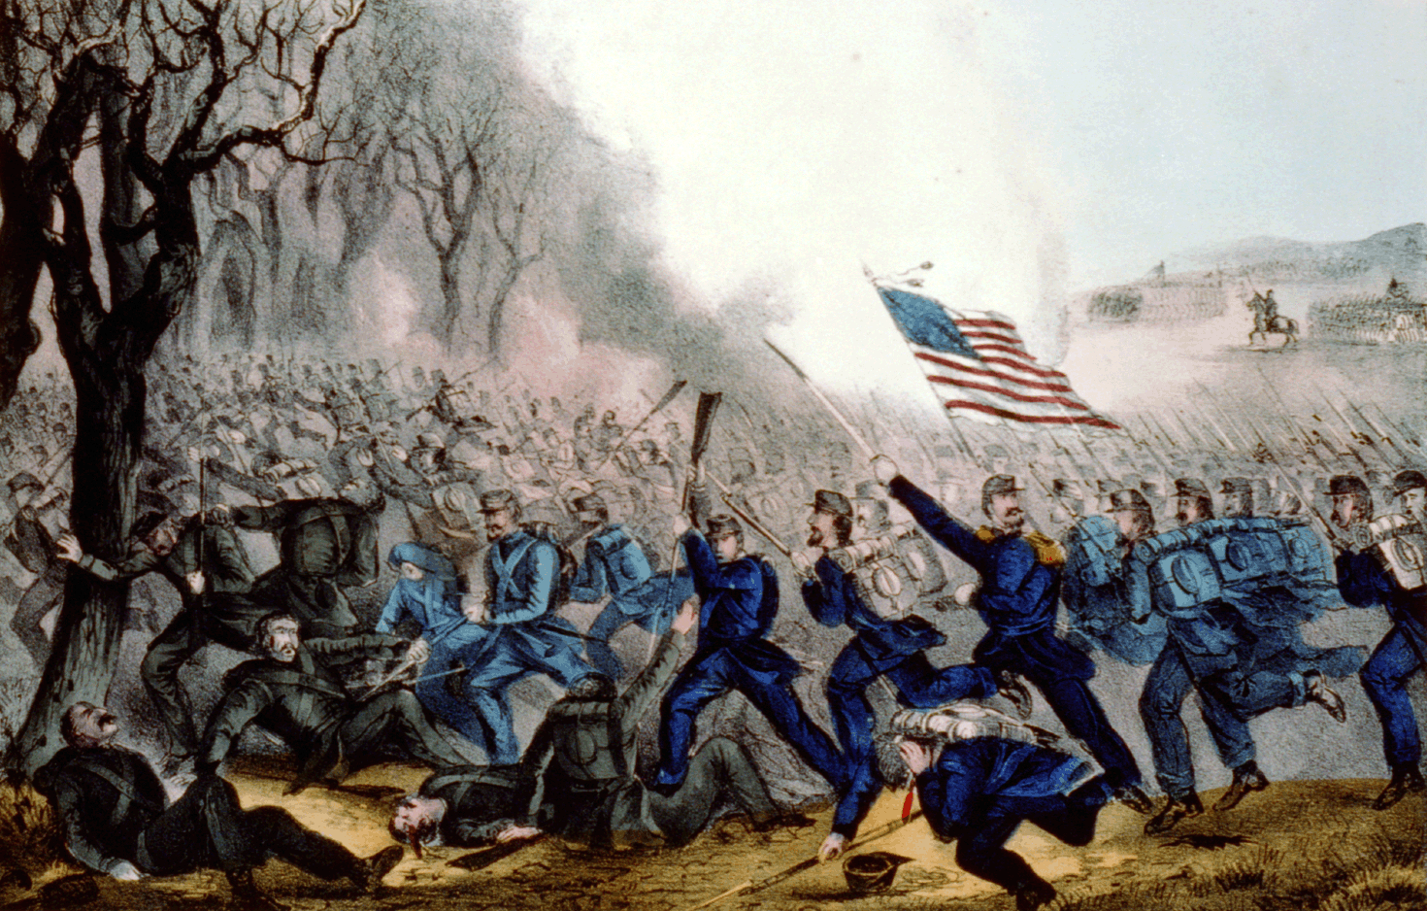
What was the first battle of the Civil War?
This Photo by Unknown Author is licensed under CC BY-SA

Slide 4
The Battle of Bull Run
Back

Slide 5
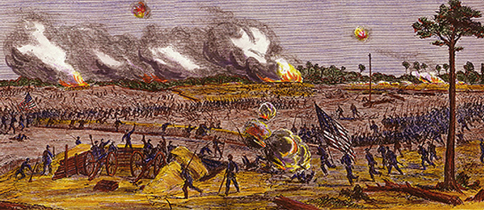
What was the last battle of the Civil War?

Slide 6
The Battle of Palmito Ranch
Back

Slide 7
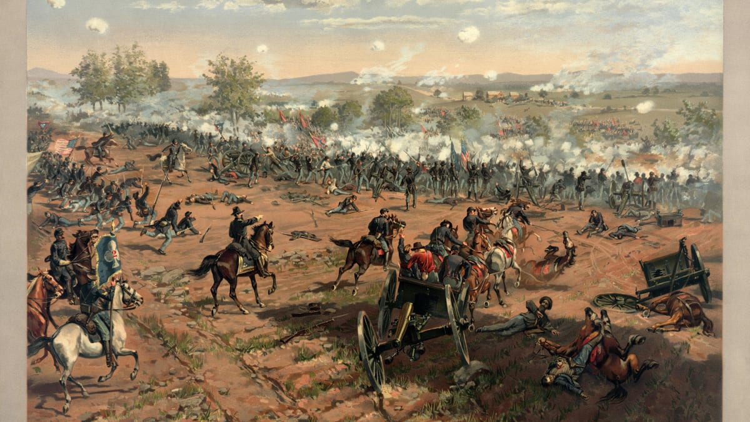
What was the most significant and famous battle of the Civil War?

Slide 8
The Battle of Gettysburg
Back

Slide 9
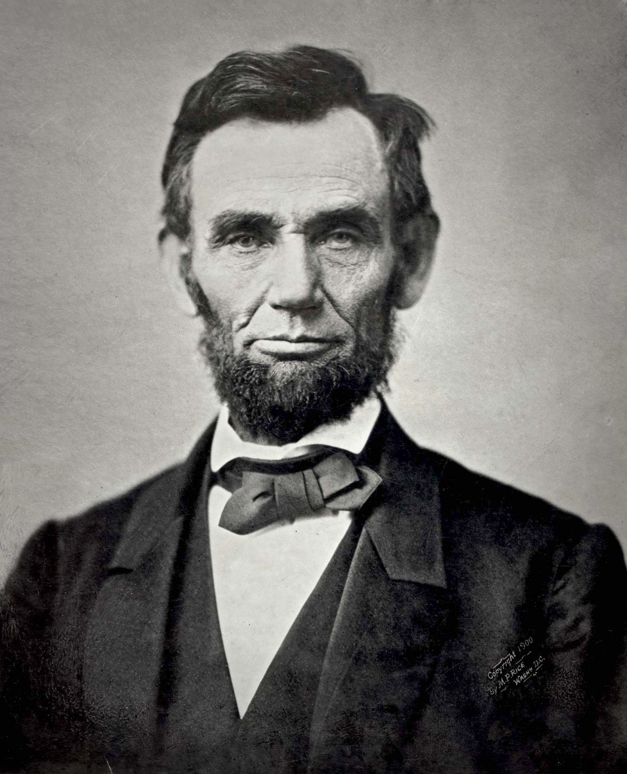
Who is this?

Slide 10
This is Abraham Lincoln!
Back

Slide 11
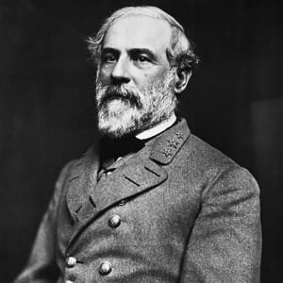
Who is this?

Slide 12
This is Robert E. Lee
Back

Slide 13
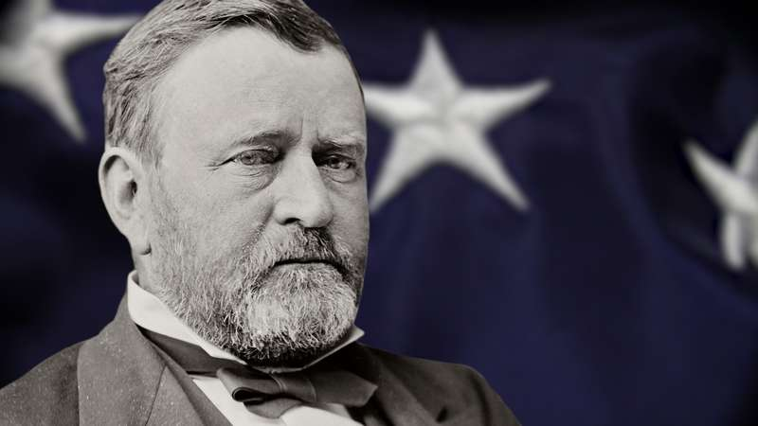
Who was the commanding general of the Union Army?

Slide 14
Ulysses S. Grant
Back

Slide 15
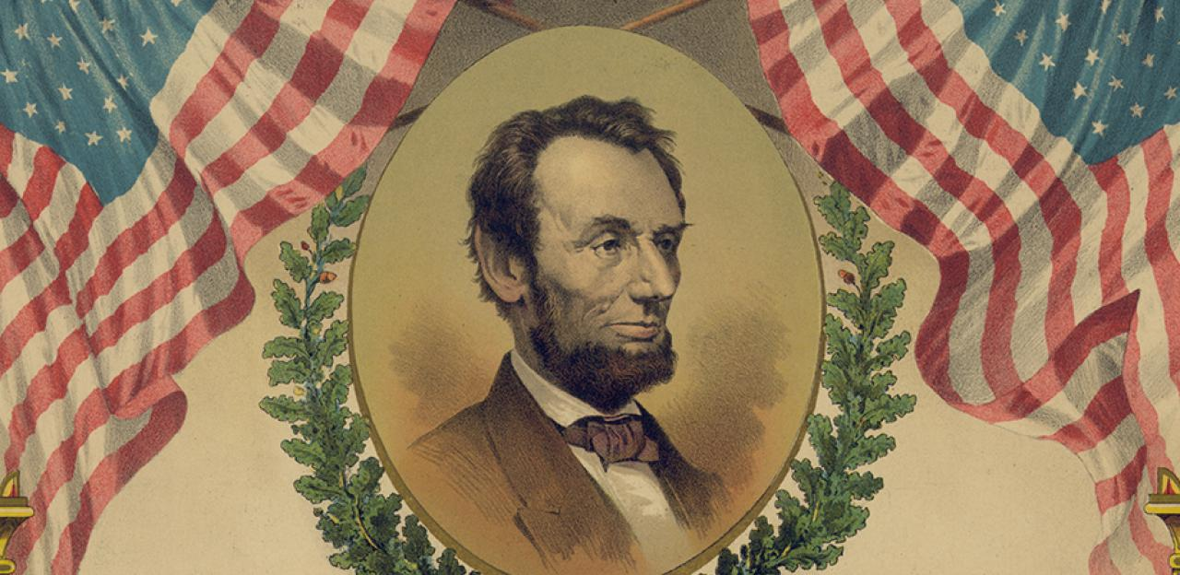
What document declared "that all persons held as slaves" within the rebellious states "are, and henceforward shall be free."

Slide 16
The Emancipation Proclamation
Back

Slide 17
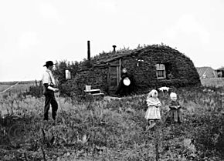
What Act stated that “provided that any adult citizen, or intended citizen, who had never borne arms against the U.S. government could claim 160 acres of surveyed government land.” ??

Slide 18
The Homestead Act of 1862
Back

Slide 19
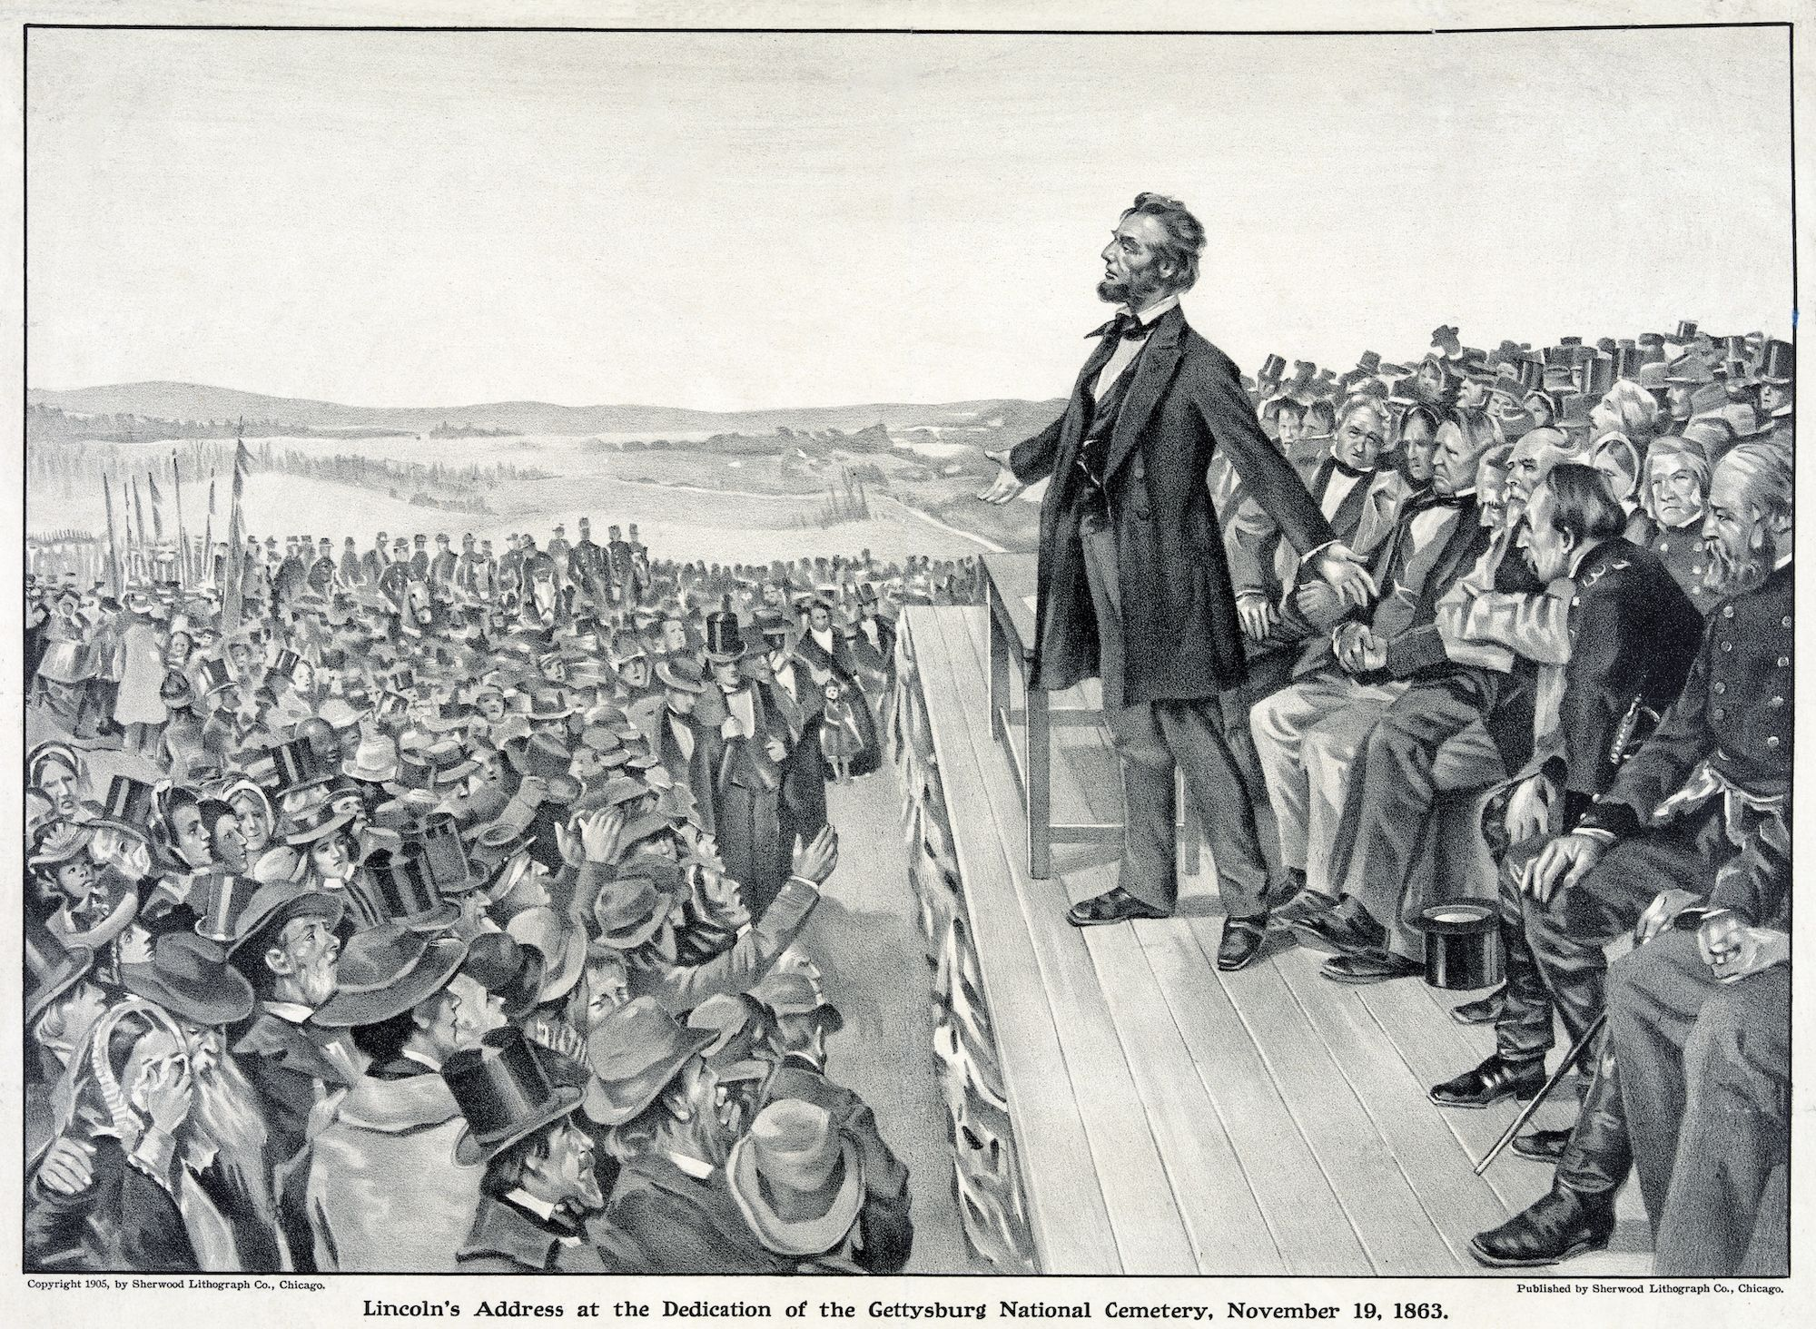
What was a speech that U.S. President Abraham Lincoln delivered during the American Civil War at the dedication of the Soldiers' National Cemetery in Pennsylvania?

Slide 20
The Gettysburg Address
Back

