Slide 1
Genres
By Anna Tomlinson

Slide 2
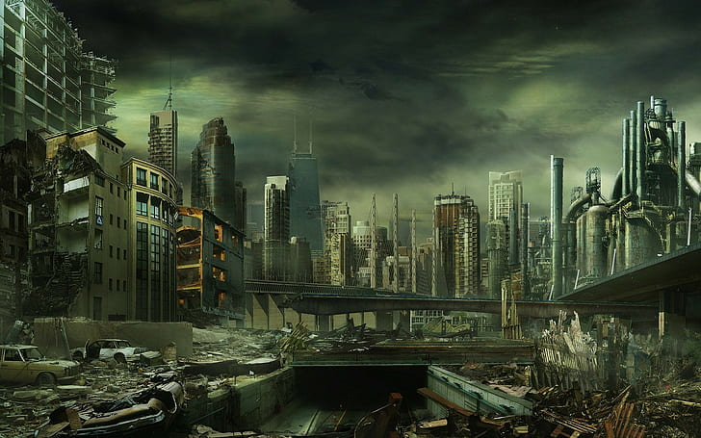
Dystopian: relating to or denoting an imagined state or society where there is great suffering or injustice.

Slide 3
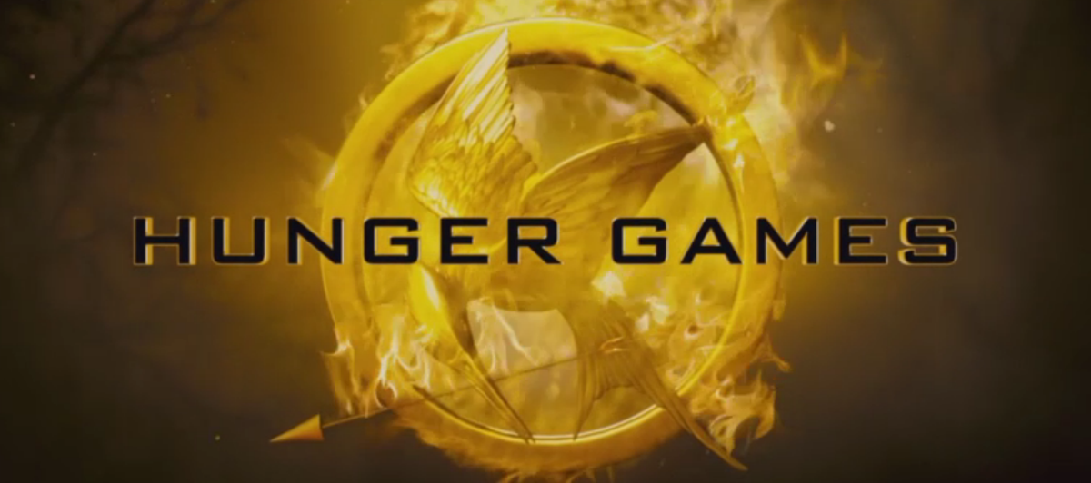
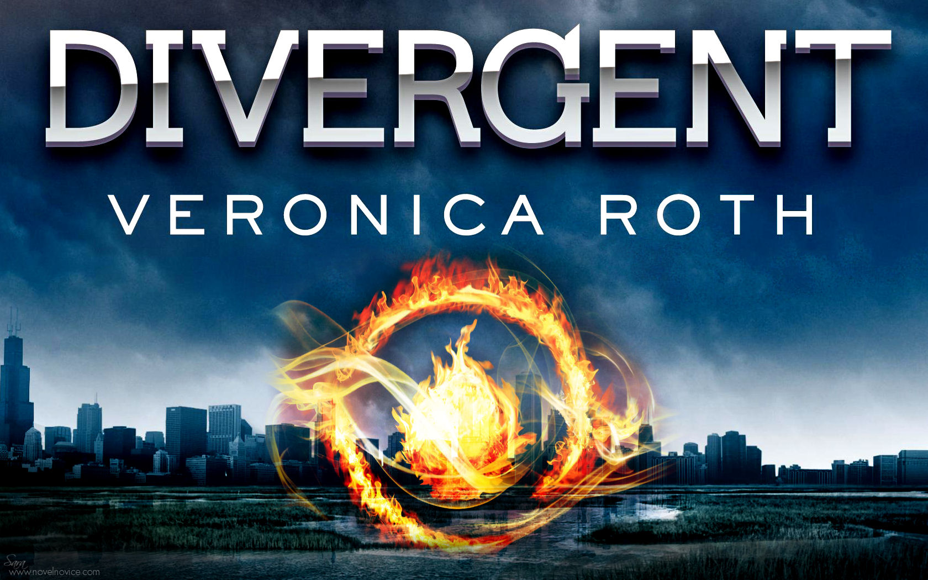
Dystopian Books: Maze Runner, The Hunger Games, and Divergent.

Slide 4
Action and Adventure: featuring characters involved in exciting and usually dangerous activities and adventures

Slide 5
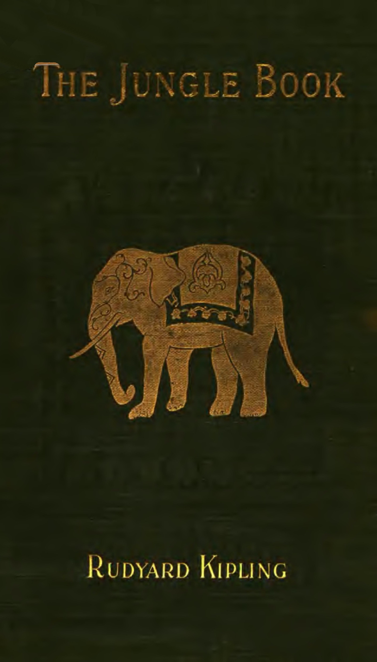
Action and Adventure books: Journey to the Center of the Earth, Hatchet, and The Jungle Book.

Slide 6
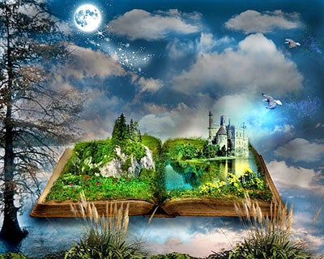
Fantasy: he faculty or activity of imagining things, especially things that are impossible or improbable.

Slide 7
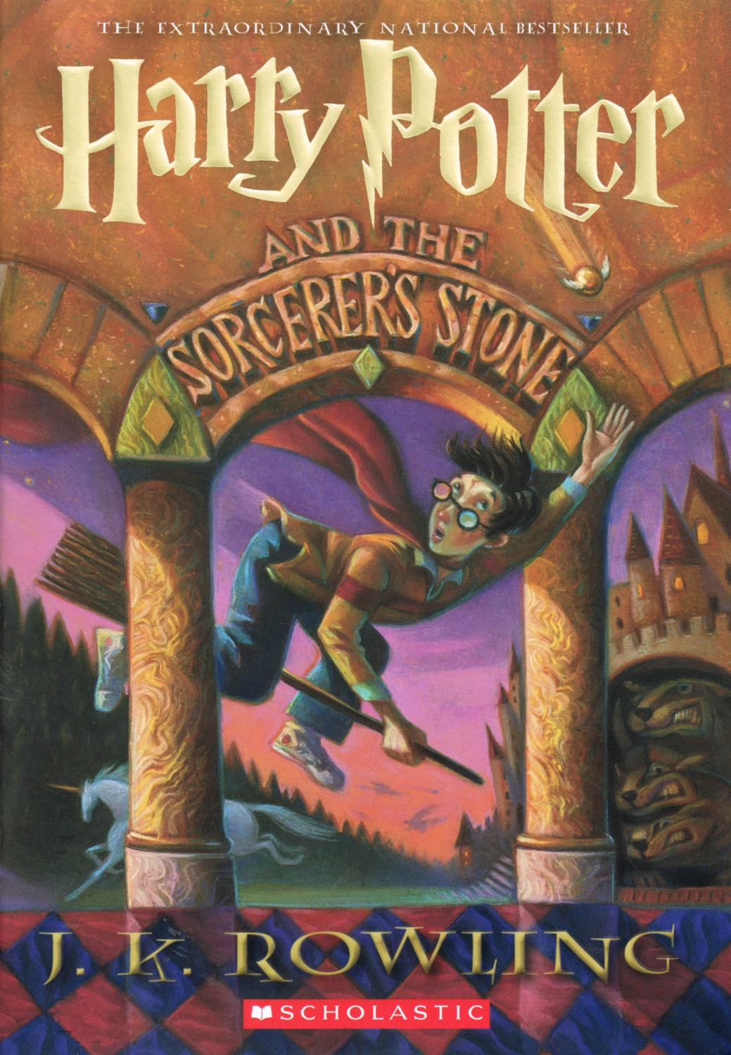
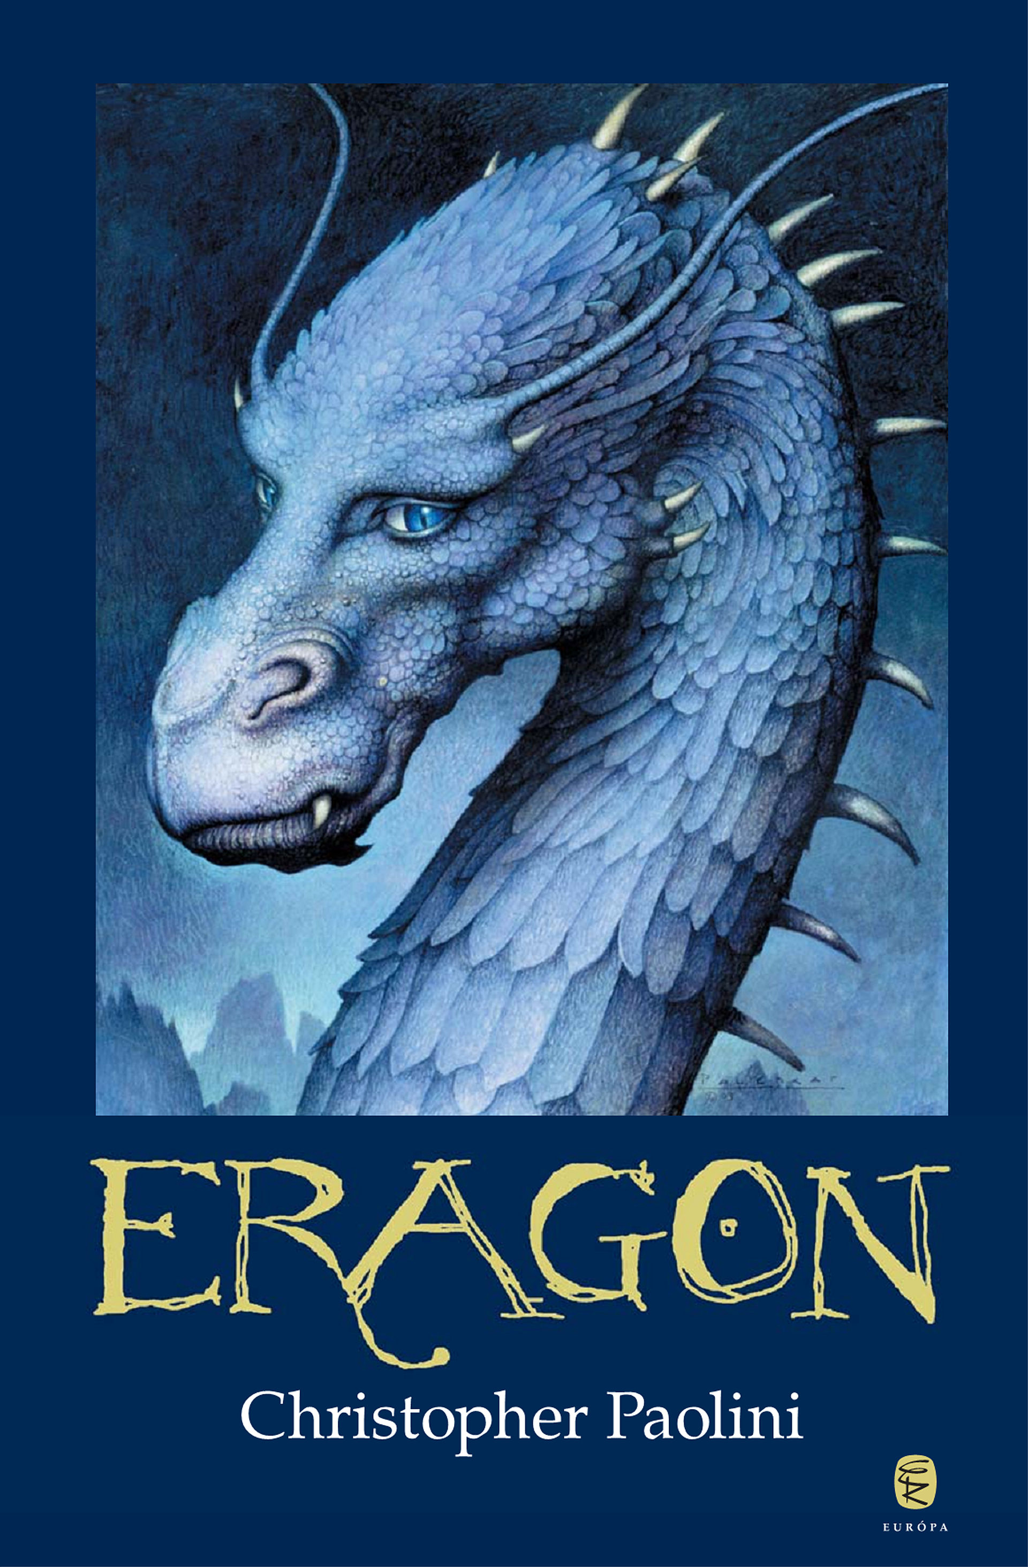
Fantasy Books: Harry Potter, Lord of the Rings, and Eragon.

Slide 8
Historical Fiction: genre in which the plot takes place in a setting located in the past.

Slide 9
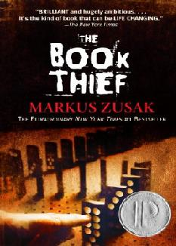
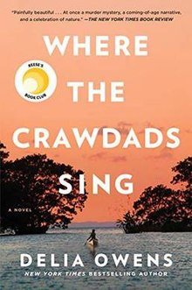
Historical Fiction books: My Lady Jane, Where the Crawdads Sing, and The Book Thief.
This Photo by Unknown Author is licensed under CC BY-SA

Slide 10
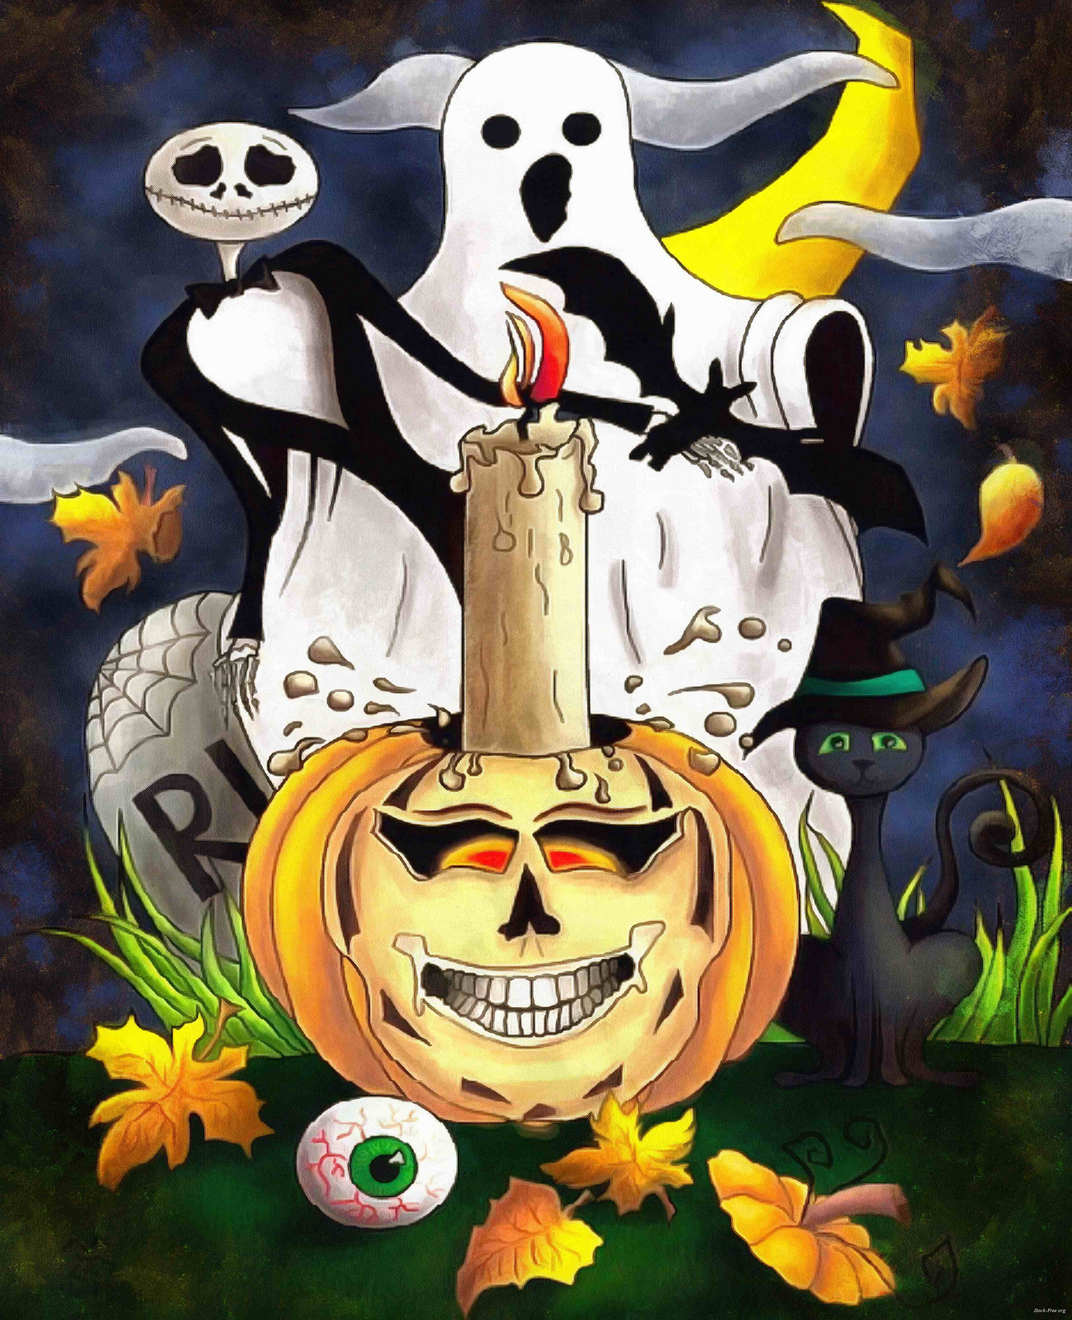
Horror: an intense feeling of fear, shock, or disgust.

Slide 11
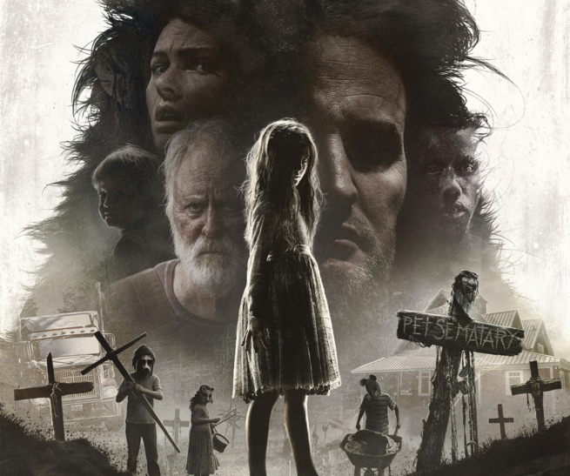
Horror books: Pet Cemetery, It, and The Haunting of Hill House.

Slide 12
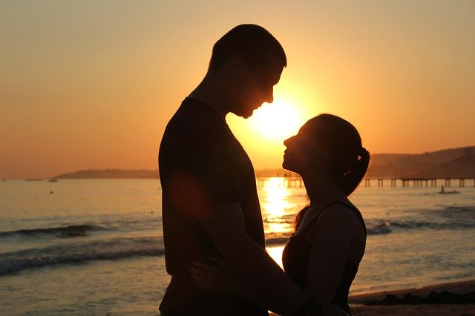
Romance: a feeling of excitement and mystery associated with love.

Slide 13
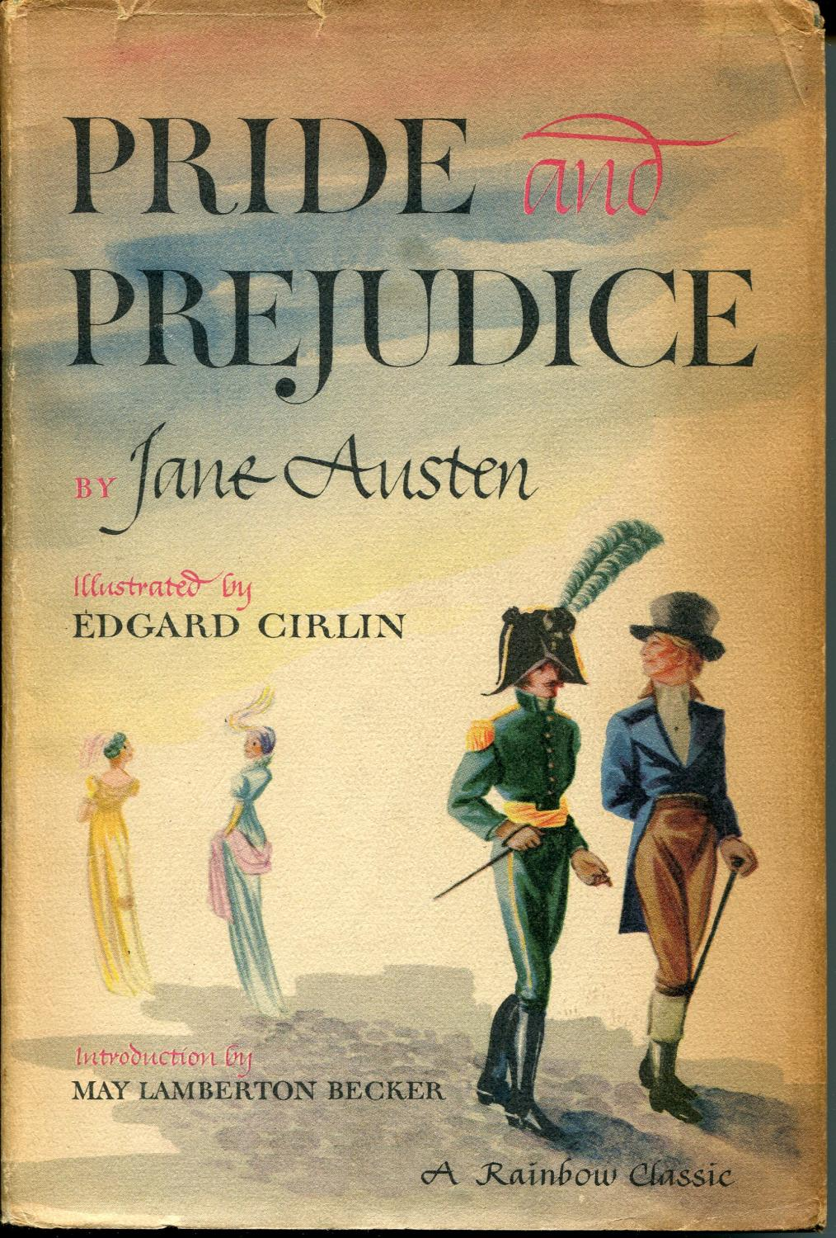
Romance Books: The Wedding Date, Pride and Prejudice, and The Notebook.

Slide 14
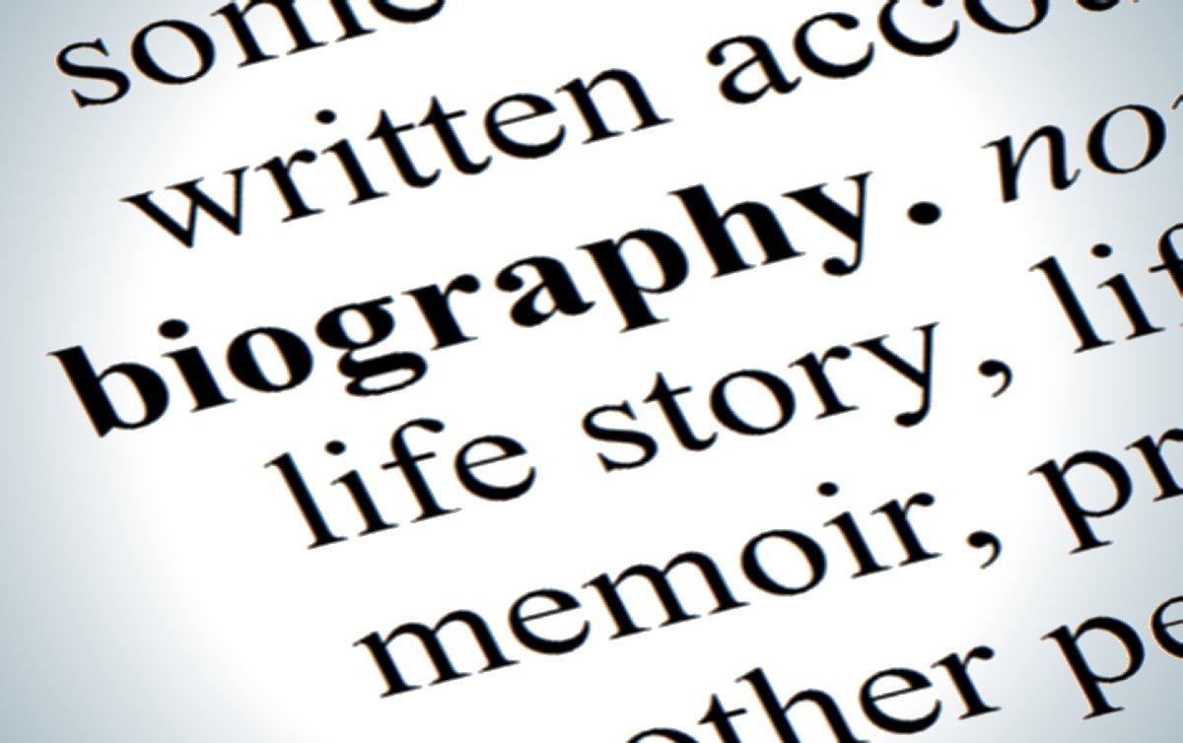
Biographies: an account of someone's life written by someone else.
Autobiographies: an account of a person's life written by that person.

Slide 15
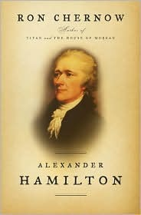
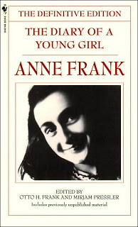
Biographies books: Alexander Hamilton by Rob Chernow and Churchhill: A Life by Martin Gilbert
Autobiographies books: The Diary of Anne Frank and Malcolm X.

