Slide 1
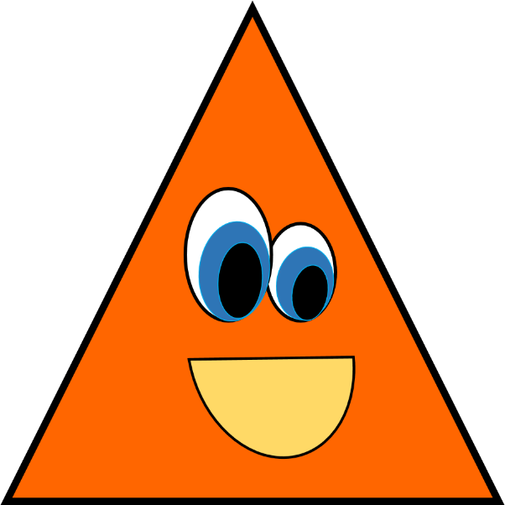
The shape Game!

Slide 2
What shape is this?
Square 2) Circle
3) Triangle 4) Rhombus s

Slide 3
What shape is this?
11) Sphere 2)Square
3) Triangle 4) Rectangle

Slide 4
What shape is this?
Square 2) Rectangle
3) Circle 4) Rhombus

Slide 5
What shape is this?
1) Sphere 2) Circle
3) Square 4) Rectangle

Slide 6
What shape is this?
Square 2) Rectangle
3) Rhombus 4) Circle

Slide 7
What shape is this?
Square 2) Rectangle
3) Rhombus 4) Triangle

