Slide 1
How to be a good citizen!
Victoria Haley
Amy.haley@smail.astate.edu

Slide 2
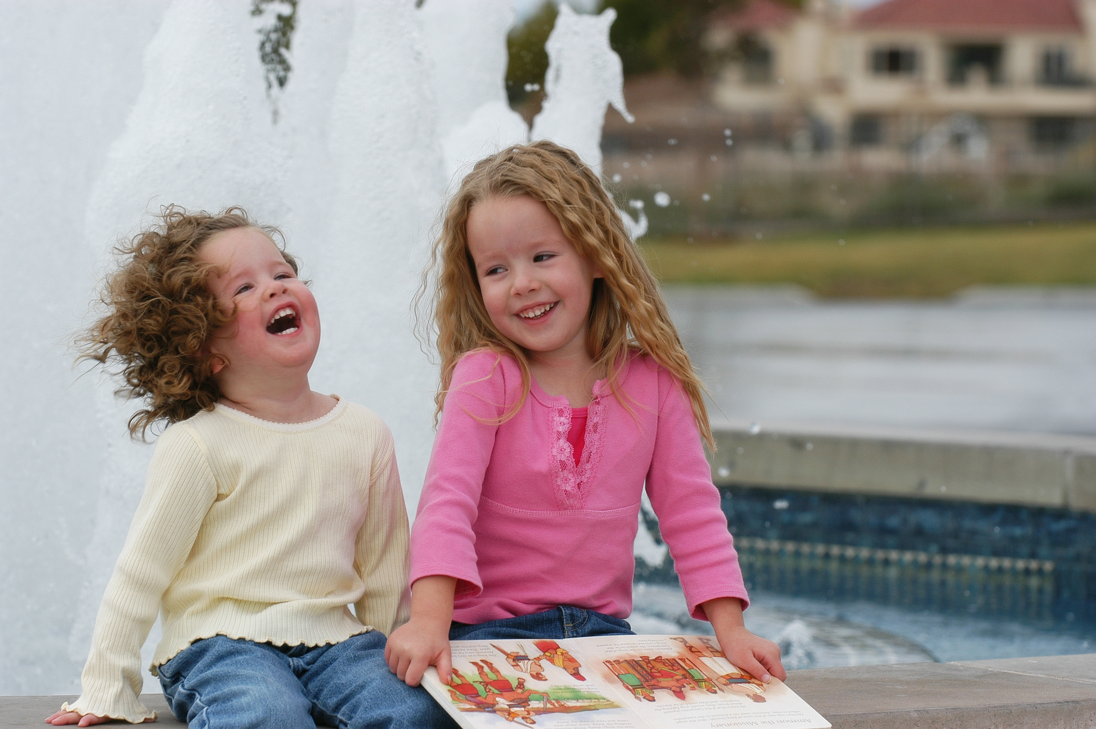
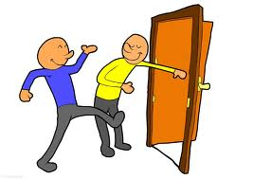
Lets talk about some ways we can be better citizens!

Slide 3
Pick Up trash when you see it on the ground!

Slide 4
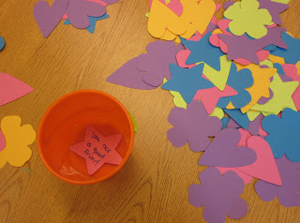
Giving someone a compliment!
This Photo by Unknown Author is licensed under CC BY-NC-ND

Slide 5
Helping a classmate out with their work!

Slide 6
Recycling!

Slide 7
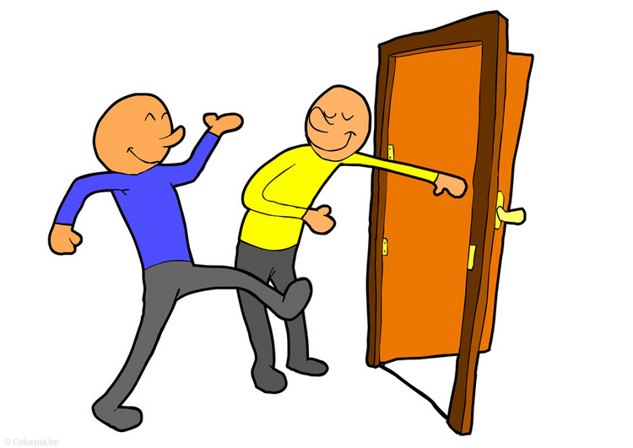
Holding the door for someone!

Slide 8
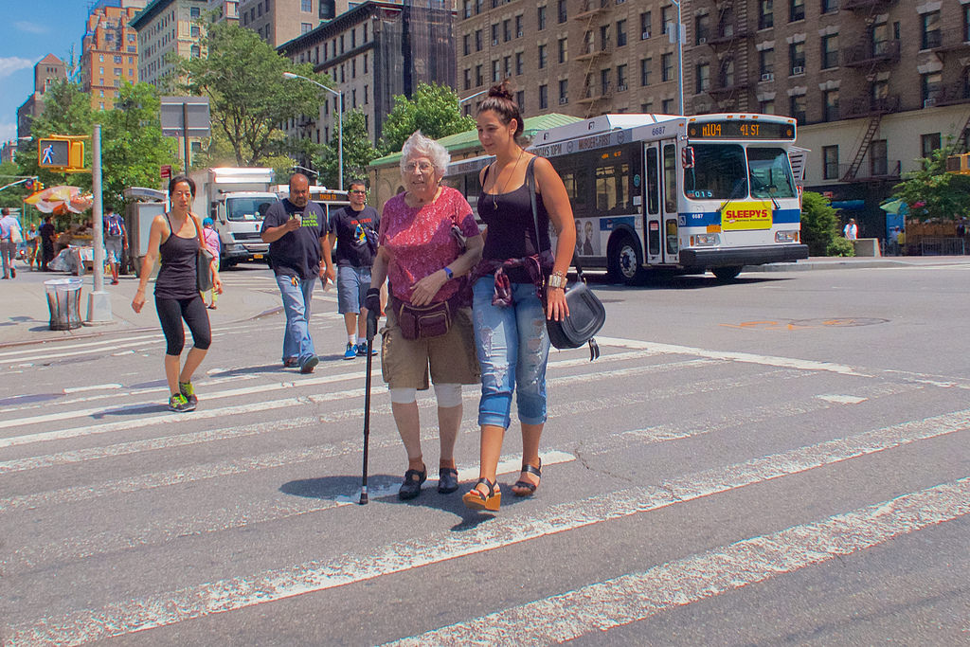
Helping elders across a sidewalk!

Slide 9
Sharing your umbrella!

Slide 10
You made it to the end!
Now you can go out and be a better citizen!

