Slide 1
Climates Around Our world
By: Anya Dickey

Slide 2
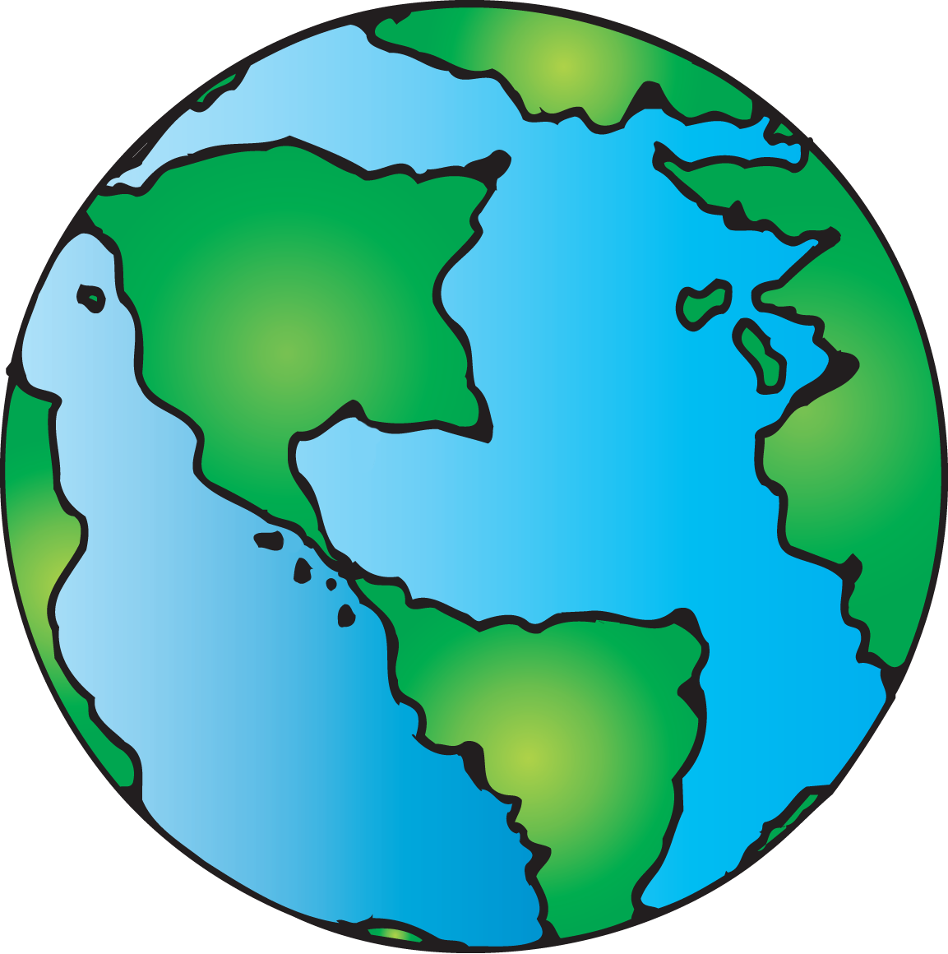
There are many different environments around the world. Let’s TAKE A LOOK AT THEM.

Slide 3
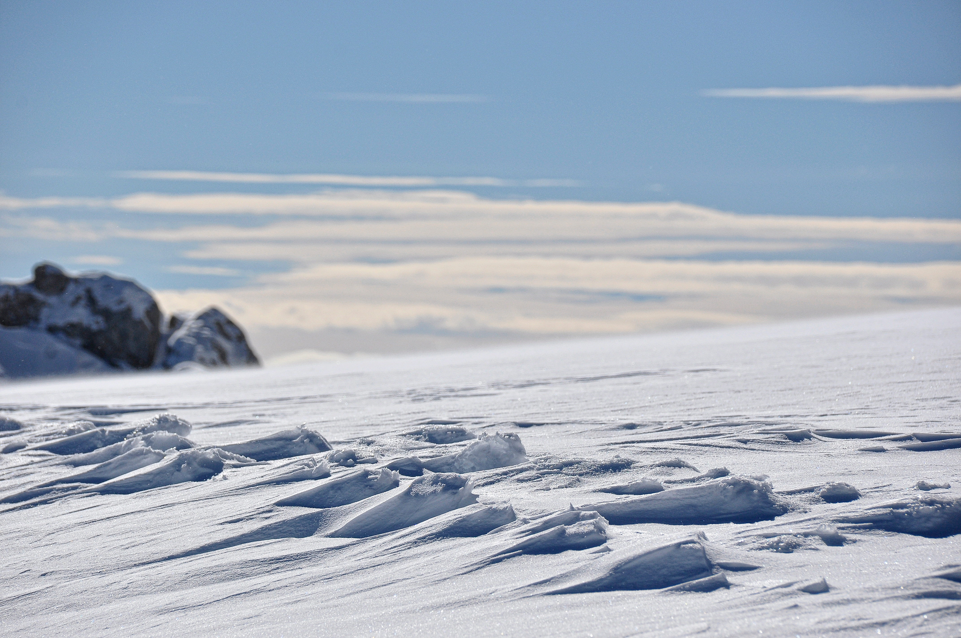
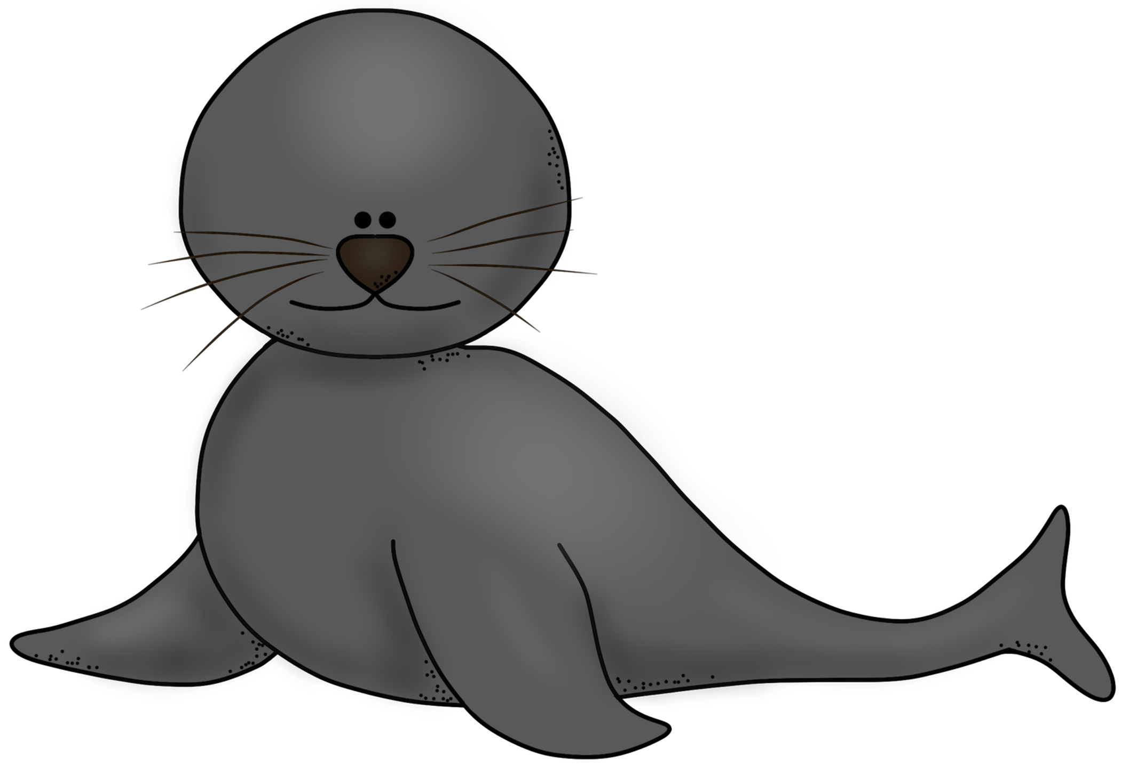
Polar Tundra
There is no actual land in the polar tundra, just continually shifting ice sheets which makes plants almost impossible to grow. The sun shines 24/7 during the summer, and it is dark 24/7 in the winter.

Slide 4
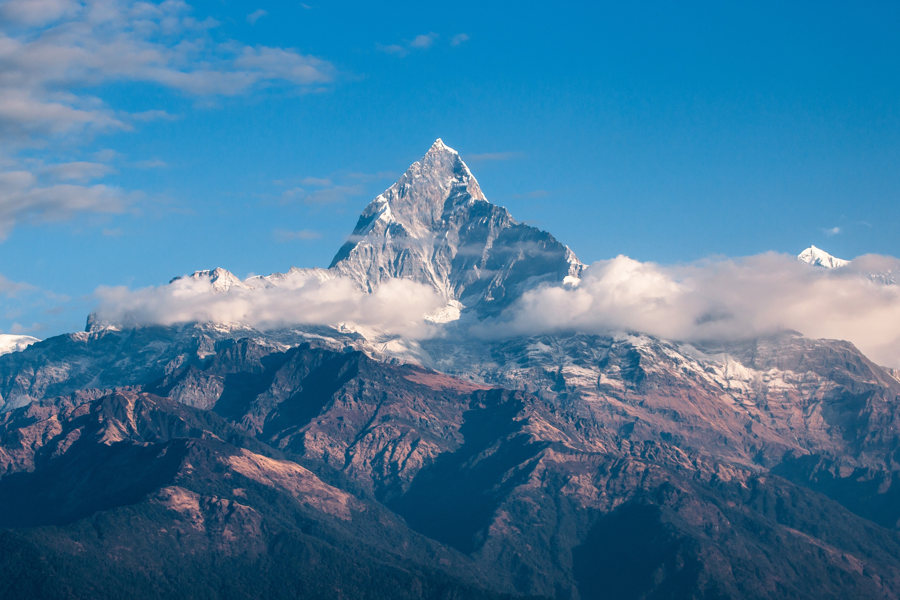
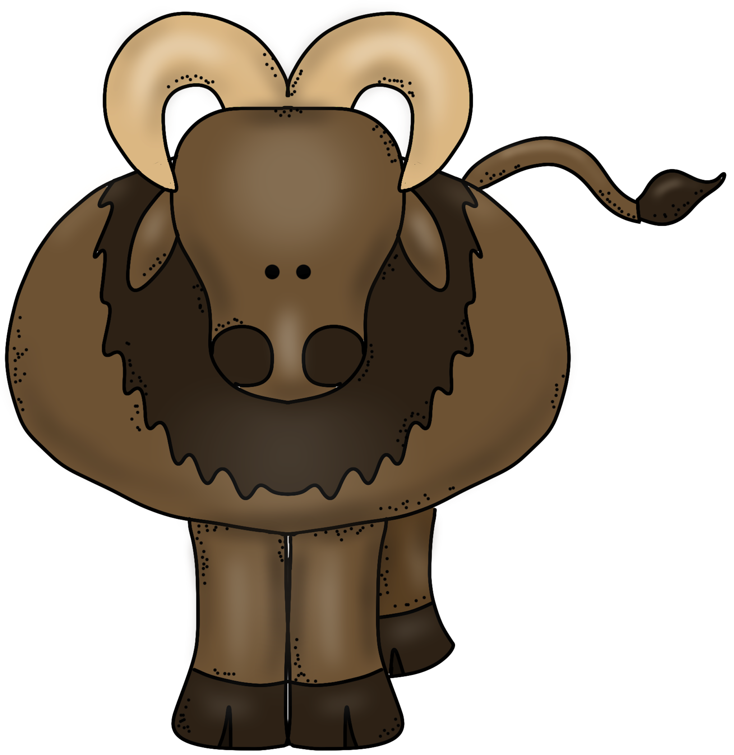
Mountain
Mountains are only ever continent. The longest range is 40,000 miles long! Cold air rises therefore the higher the altitude, the colder the temperature so the top of the mountains are very cold.

Slide 5
Grasslands
The grasslands can be found on more than 40% of the earth. They receive more rain than deserts, but less precipitation than forests. Most of the plants here are grasses so they do not need as much water as forest vegetation.

Slide 6
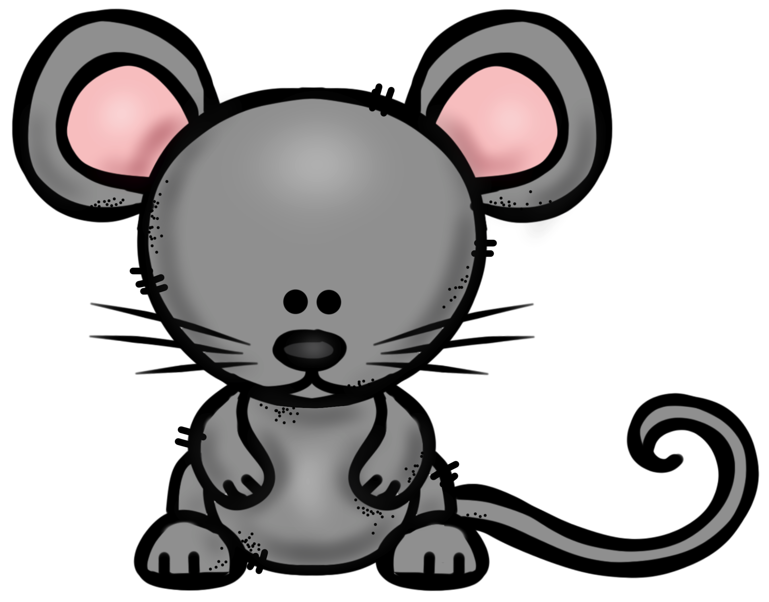
Desert
Deserts are the driest place on earth, getting just below 10 inches of rain a year. Some deserts are always hot, and some are always cold. They are full of life with plants and animals adapated to not needing a lot of water.

Slide 7
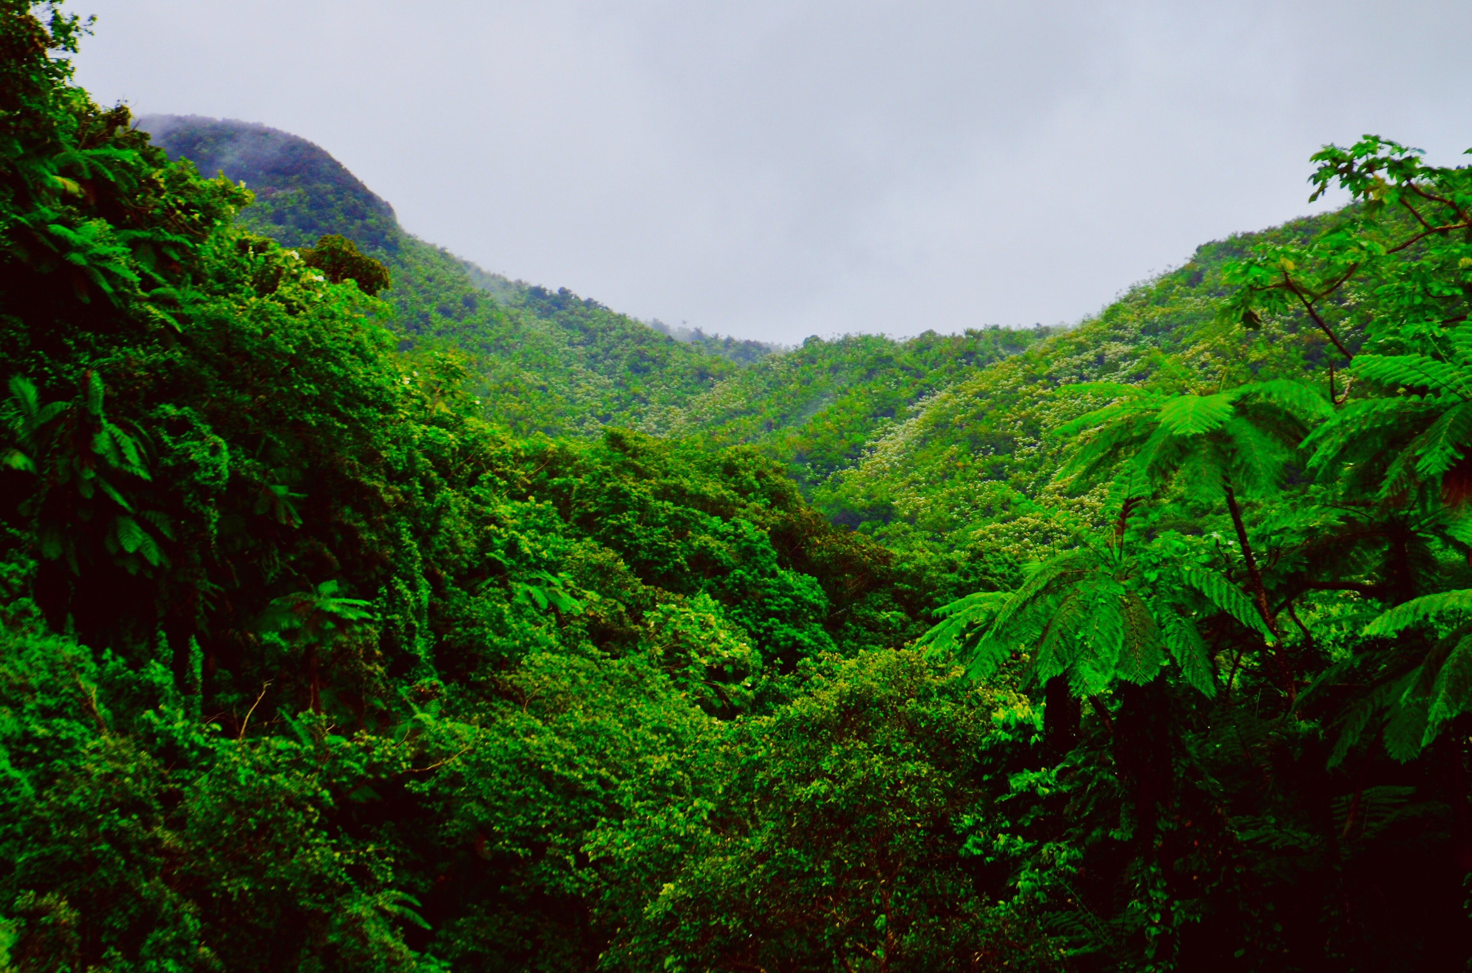
Tropical rainforest
Rainforests are warm, wet environments with very tall trees. The trees can release up to 200 gallons of water a year. The biggest rainforest is the Amazon, which is almost the size of the United States.

Slide 8
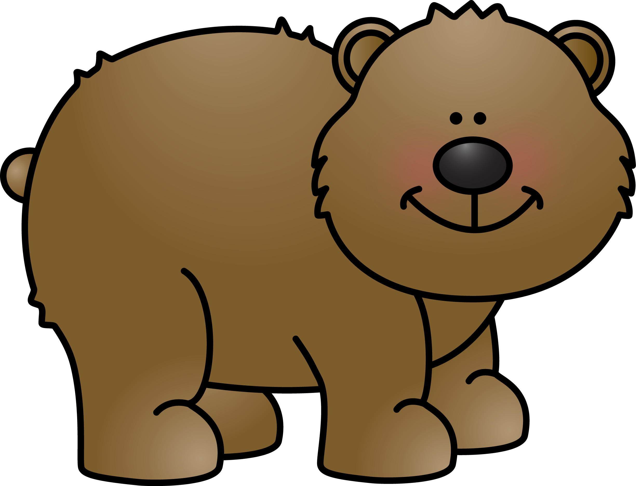
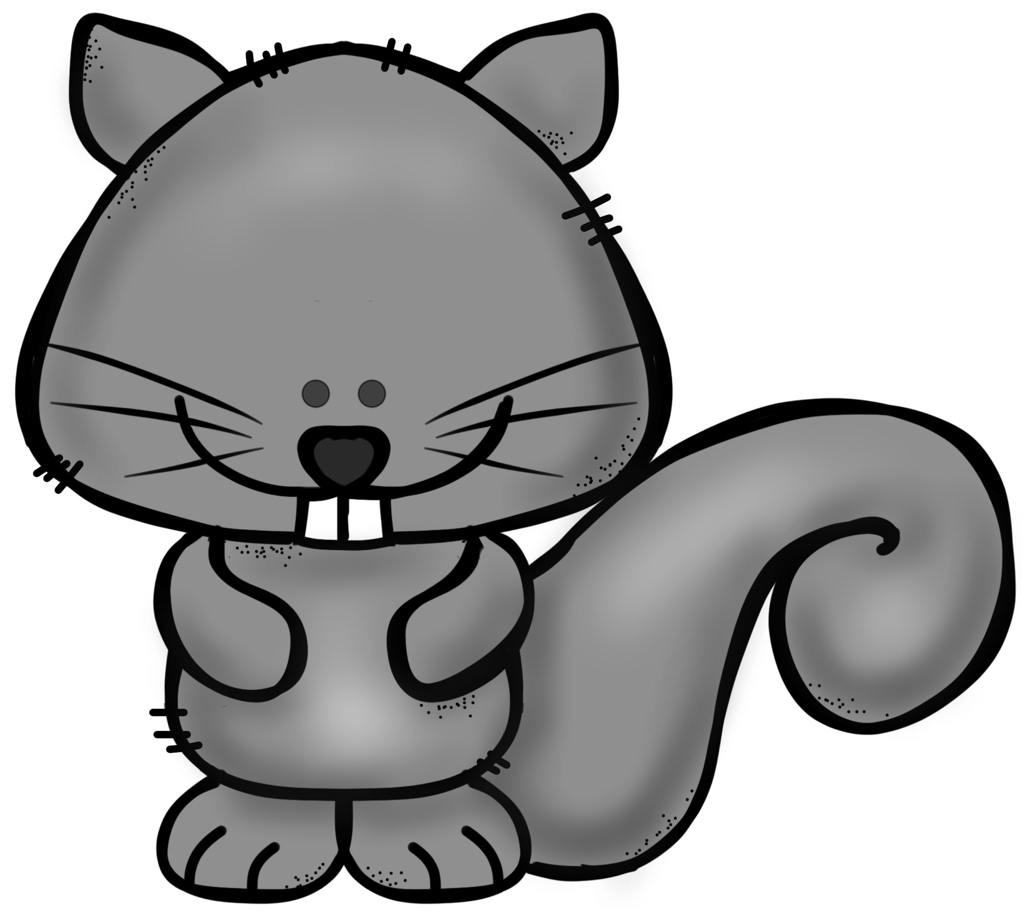
Temperate Forest
In parts of the world where it is not too hot or too cold, there are forests full of trees with thin leaves. This habitat goes through the four seasons of the year. They do not get enough rain a year to grow big trees.

Slide 9
The ocean
More than 70% of the earth’s surface is covered by the ocean. On average, it is a little over 2 miles deep. The four oceans are the Pacific, Atlantic, Indian, and Antarctic.

Slide 10
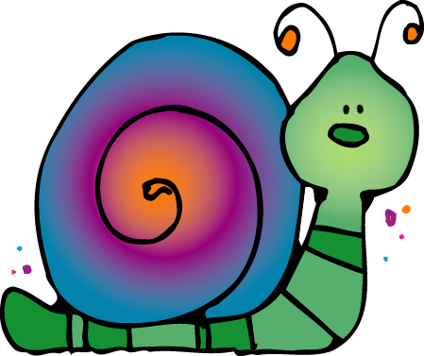
Freshwater
Freshwater habitats can be things like rivers, lakes, swamps, and streams. They account for only 3% of the world’s water. They have more than 100,000 animals though.

