Slide 1
Types Of Dogs
Syllable Count
By: Audrey Beggs

Slide 2
What is Your Favorite?

Slide 3
Siberian Husky
Medium sized working dog. Thick double coat, triangular ears. Originated in Northeast Asia. Used for sled-pulling.

Slide 4
Poodle
Second most intelligent dog breed. Used in dog shows. Originated in Germany.

Slide 5
German Shepard
Medium to large size working dog. Originated from Germany. Herding dog. Used for disability assistance, search and rescue, police and military.

Slide 6
Boxer
Medium- sized, Short haired. Developed in Germany. 8th most popular dog in the United States.

Slide 7
Pitbull
Descendant of bulldogs and terriers. Some considered dangerous and used for fighting. Others used for police dogs and some family pets.

Slide 8
Golden Retriever
Large size gun dog that “retrieves” ducks and birds.
Originally from Scotland. Popular for disability dog such as guide dog and hearing dog.

Slide 9
Shih tzu
Toy Dog Breed. Originally from China. Weighs from 8 to 15 pounds full grown.

Slide 10
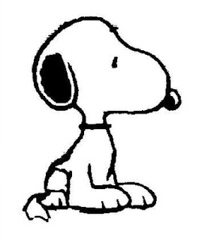
Beagle
Small hound. Used to hunt rabbit and squirrel. Developed in Great Britain. Cartoon Snoopy is considered a beagle.

Slide 11
Basset Hound
A short-legged breed of dog in the hound family. Originally bred for hunting.

Slide 12
Divide the Following Dog Types Into Syllables:
* Siberian Husky
* Poodle
* German Shephard
* Boxer
* Pitbull
* Golden Retriever
* Shih Tzu
* Beagle
* Basset Hound

