Slide 1
Beginning Diagraphs SH- words
By: Audrey Beggs

Slide 2
Question Board
1 | 2
3 | 4
5 | 6
7 | 8
9 | 10

Slide 3
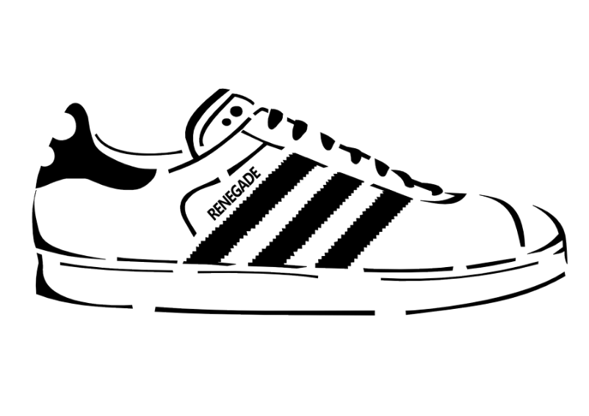
Question 1
What Picture begins with the sh- sounds?
Back to Questions

Slide 4
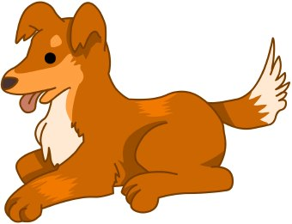
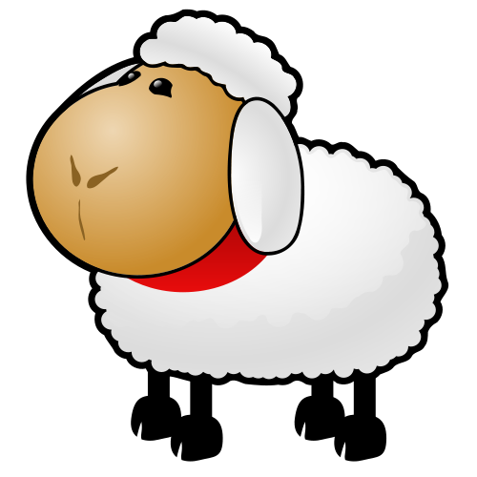
Question 2
Which picture begins with sh- sound?
Back to Questions

Slide 5
Question 3
What picture begins with sh- sound?
Back to Questions

Slide 6
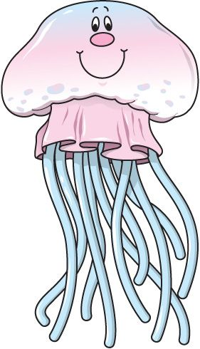
Question 4
Which picture begins with sh- sound?
Back to Questions

Slide 7
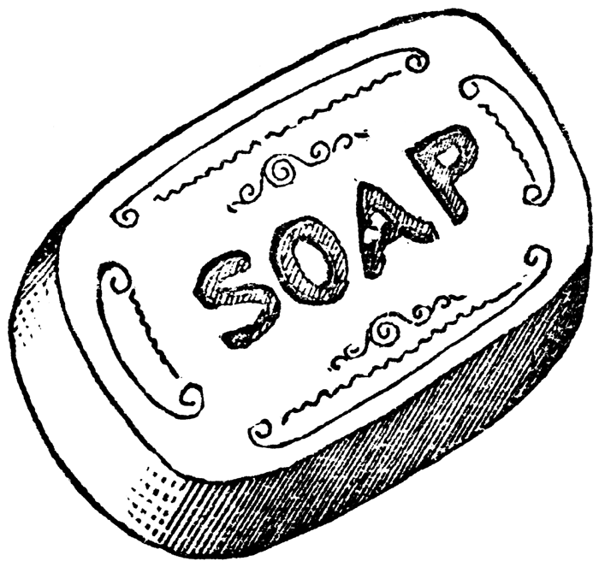
Question 5
Which picture begins with the sh- sound?
Back to Questions

Slide 8
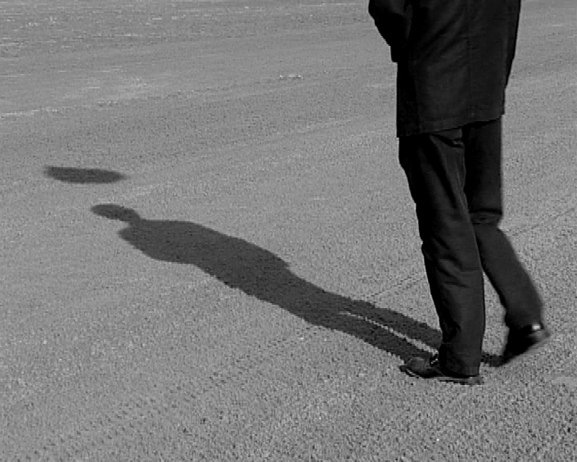
Question 6
Which picture begins with the sh- sound?
Back to Questions

Slide 9
Question 7
Which picture begins with the sh- sound?
Back to Questions

Slide 10
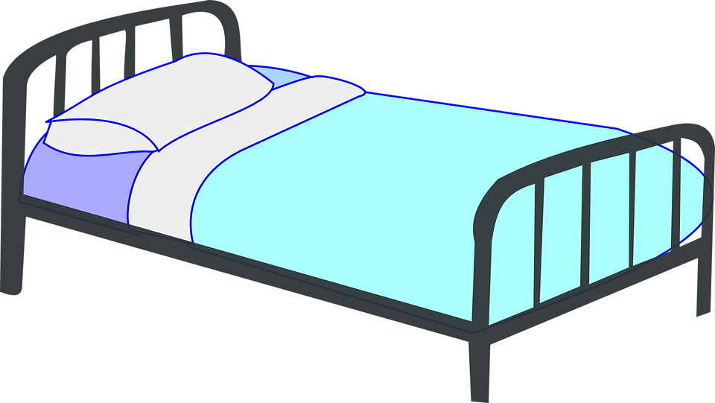
Question 8
Which picture begins with the sh- sound?
Back to Questions

Slide 11
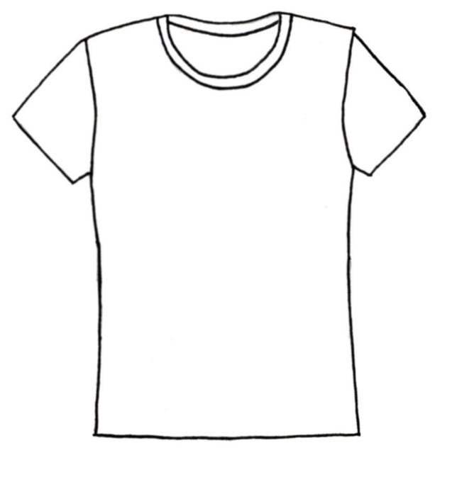
Question 9
Which picture begins with the sh- sound?
Back to Questions
This Photo by Unknown Author is licensed under CC BY-SA

Slide 12
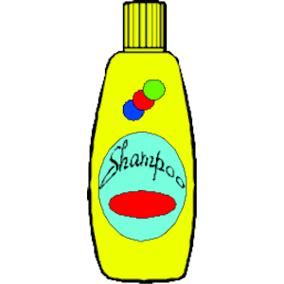
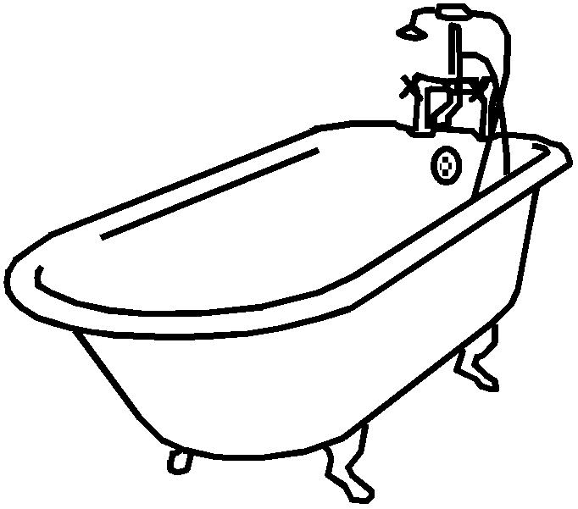
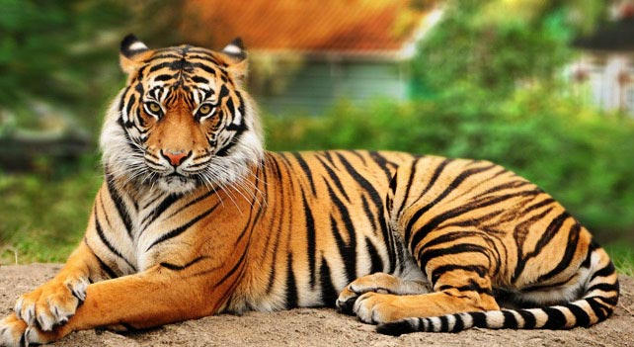
Question 10
Which picture begins with the sh- sound?
Back to Questions

