Slide 1
Bullying
By: Audrey Beggs

Slide 2
What is Bullying?
Bullying is defined to use superior strength or influence to intimidate, typically to force him or her to do what one wants.

Slide 3
to be considered bullying, two Things Must Happen:
An imbalance of Power.
Repetition.

Slide 4
Type of Bullying: Verbal
Teasing
Name calling
Taunting
Threatening to cause harm

Slide 5
Type of Bullying: Social
Leaving someone out on purpose
Telling other children not to be friends with someone
Spreading rumors about someone
Embarrassing someone in public

Slide 6
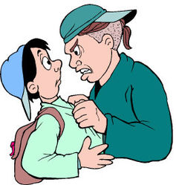
Type of Bullying: Physical
Hitting/Kicking
Pinching
Spitting
Tripping/Pushing

Slide 7
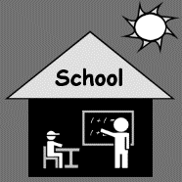
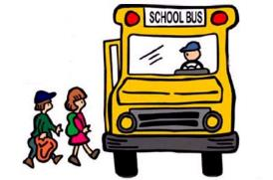
Where & When can bullying happen?
Bullying can happen anytime.
In School
After School

Slide 8
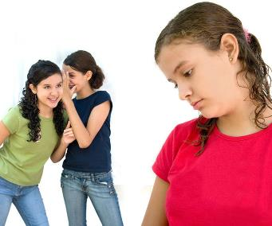
Signs a child is being bullied
Injuries
Not eating or overindulging
Grades dropping
No Friends
Low Self Esteem

Slide 9
Signs a child is bullying others
Physical or verbal fights
Aggressive
Blame others for their problems
No responsibility for their actions

Slide 10
what can Teachers Do?
Help kids comprehend bullying.
Keep the lines of communication open at all times.
Show others how to act.

Slide 11
How to Stop Bullying
Get involved
Isolate the kids
Make sure no one is harmed
Meet any immediate medical needs
Stay composed
Show proper behavior

Slide 12
Reference PAge
https://www.stopbullying.gov/what-is-bullying/index.html
https://www.apa.org/topics/bullying/

